Slide 1
ALGEBRA
REVISION
YEAR 10
KAUSAR KHAN

Slide 2
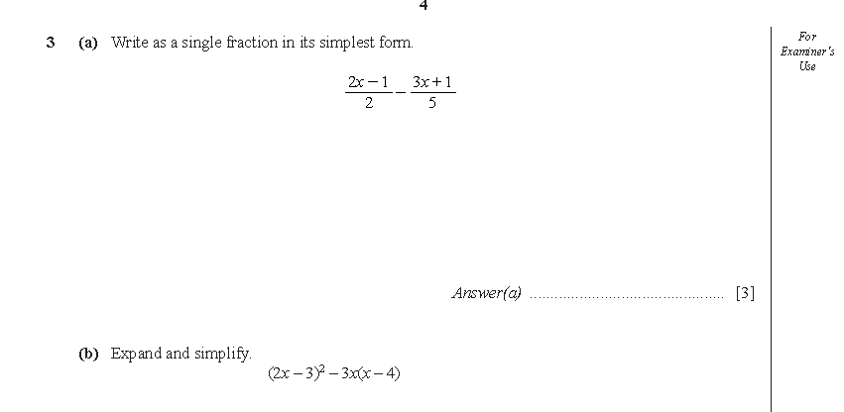

Slide 3


Slide 4
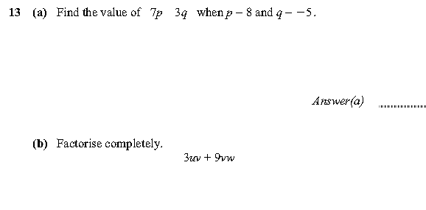

Slide 5


Slide 6


Slide 7


Slide 8



Slide 9
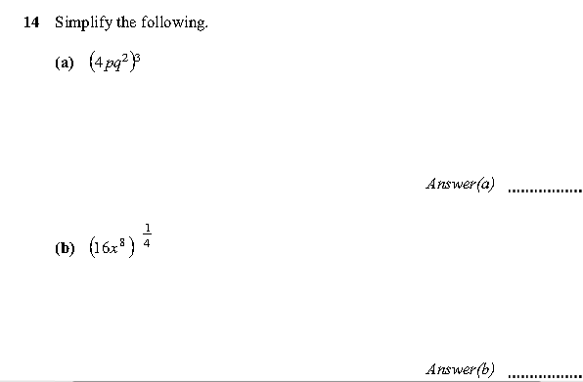

Slide 10


Slide 11


Slide 12


Slide 14


Slide 16


Slide 17
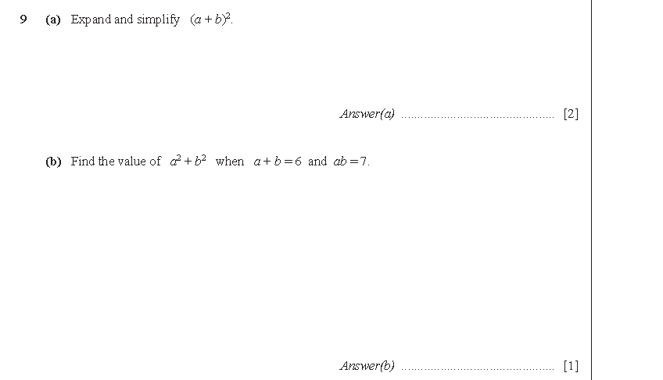

Slide 18
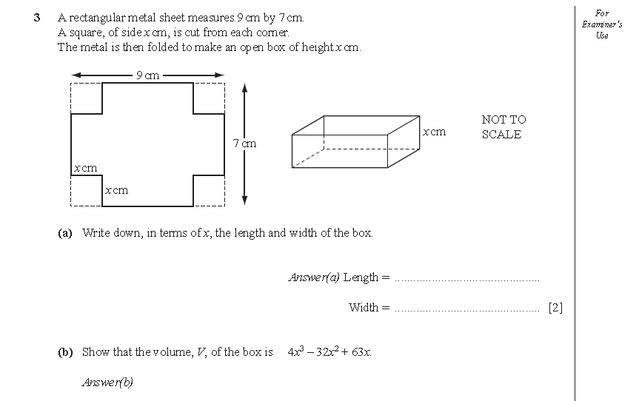

Slide 19
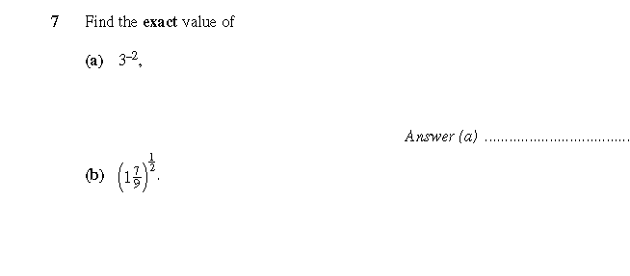


Slide 20
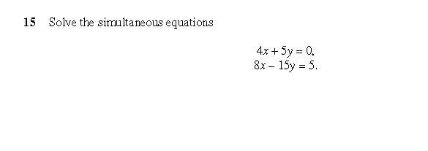


Slide 22



Slide 23


