Slide 1
Greek Gods

Slide 2
Hades
God of the Underworld
Lonely
Kidnapped Persephone
Brother of Zeus

Slide 3
Demeter
Goddess of Agriculture
Mother of Persephone
Searched for her kidnapped daughter
Gave the world seasons
*Link here*

Slide 4
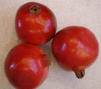
Persephone
Happy and kind
Kidnapped by Hades to be his queen
Goddess of the underworld
Must return to the underworld during wintertime because she ate the seed of a pomegranate.

Slide 5
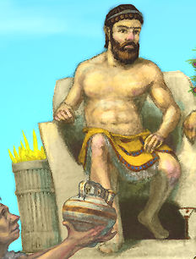
Zeus
Highest god
Had authority over sky, earth and Mount Olympus
As a child was hidden by his mother in a cave
*Link here*

Slide 6
Pandora
Woman made by the gods
Opened a box that released evil into the world
Shut the box before the evil of “foreboding” could escape into the world and take away hope.

Slide 7
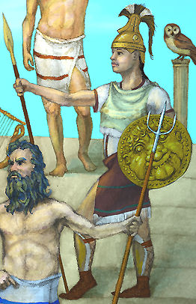
Athena
Goddess of crafts, domestic arts and war
Symbol is the owl
Patron deity of Athens
*Link here*

Slide 8
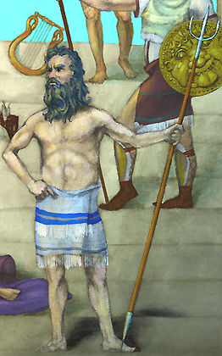
Poseidon
God of all water, earthquakes and horses
Brother of Zeus and Hades
Often turned himself into the shape of a horse
*Link here*

Slide 9
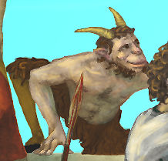
Pan
God of shepherds and flocks
Son of Hermes and a nymph
Was very lonely and responsible for the scared feeling people may get- “panic”
*Link here*

Slide 10
Writer’s Notebook Assignment
Now that we have looked at some different gods and goddesses in Greek Mythology, which one would you like to learn about the most? Why? Which ones have you heard about?

Slide 11
This powerpoint was kindly donated to www.worldofteaching.com
http://www.worldofteaching.com is home to over a thousand powerpoints submitted by teachers. This is a completely free site and requires no registration. Please visit and I hope it will help in your teaching.

