Slide 1
Evolutionary Concepts: Variation and Mutation
6 February 2003

Slide 2
Definitions and Terminology
Microevolution
  Changes within populations or species in gene frequencies and distributions of traits
Macroevolution
  Higher level changes, e.g. generation of new species or higher–level classification

Slide 3
Gene
Section of a chromosome that encodes the information to build a protein
Location is known as a “locus”

Slide 4
Allele
Varieties of the information at a particular locus
Every organism has two alleles (can be same or different)
No limit to the number of alleles in a population

Slide 5
Zygosity
Homozygous:
  Two copies of the same allele at one locus
Heterozygous:
  Two different alleles at one locus

Slide 6
Genotype
Genetic information contained at a locus
Which alleles are actually present at a locus
Example:
  Alleles available: R and W
  Possible genotypes:
    RR, RW, WW

Slide 7
Phenotype
Appearance of an organism
Results from the underlying genotype

Slide 8
Phenotype
Example 1:
  Alleles R (red) and W (white), codominance
  Genotypes: RR, RW, WW
  Phenotypes: Red, Pink, White

Slide 9
Phenotype
Example 2:
  Alleles R (red) and w (white), simple dominance
  Genotypes: RR, Rw, ww
  Phenotypes: Red, Red, white

Slide 10
Dominant and Recessive Alleles
Dominant alleles:
  “Dominate” over other alleles
  Will be expressed, while a recessive allele is suppressed
Recessive alleles:
  Alleles that are suppressed in the presence of a dominant allele

Slide 11
Gene Pool
The collection of available alleles in a population
The distribution of these alleles across the population is not taken into account!

Slide 12
Allele frequency
The frequency of an allele in a population
Example:
  50 individuals = 100 alleles
  25 R alleles = 25/100 = 25% R
  = 0.25 is the frequency of R
  75 W alleles = 75/100 W = 75% W
  = 0.75 is the frequency of W

Slide 13
Allele frequency
Note:
The sum of the frequencies for each allele in a population is always equal to 1.0!
Frequencies are percentages, and the total percentage must be 100
  100% = 1.00

Slide 14
Other important frequencies
Genotype frequency
  The percentage of each genotype present in a population
Phenotype frequency
  The percentage of each phenotype present in a population

Slide 15
Evolution
Now we can define evolution as the change in genotype frequencies over time

Slide 16
Genetic Variation
The very stuff of evolution!
Without genetic variation, there can be no evolution

Slide 17
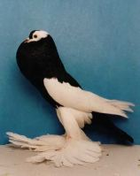
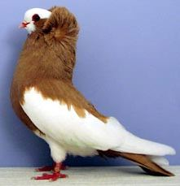
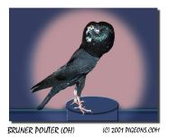
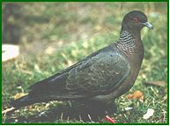
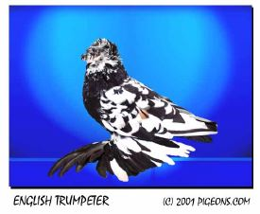
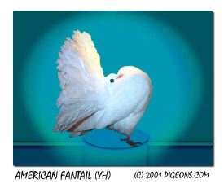
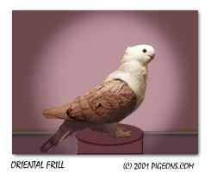
Pigeons

Slide 18
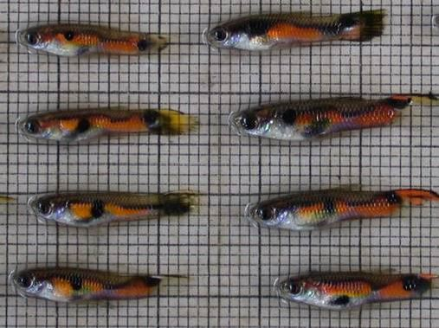
Guppies

Slide 19
Why is phenotypic variation not as important?
Phenotypic variation is the result of:
  Genotypic variation
  Environmental variation
  Other effects
    Such as maternal or paternal effects
Not completely heritable!

Slide 20
Hardy-Weinberg Equilibrium
Five conditions under which evolution cannot occur
All five must be met:
If any one is violated, the population will evolve!

Slide 21
HWE: Five conditions
No net change in allele frequencies due to mutation
Members of the population mate randomly
New alleles do not enter the population via immigrating individuals
The population is large
Natural selection does not occur

Slide 22
HWE: 5 violations
So, five ways in which populations CAN evolve!
Mutation
Nonrandom mating
Migration (Gene flow)
Small population sizes (Genetic drift)
Natural selection

Slide 23
Math of HWE
Because the total of all allele frequencies is equal to 1…
If the frequency of Allele 1 is p
And the frequency of Allele 2 is q
Then…
p + q = 1

Slide 24
Math of HWE
And, because with two alleles we have three genotypes:
pp, pq, and qq
The frequencies of these genotypes are equal to (p + q)² = 1²
Or, p² + 2pq + q² = 1

Slide 25
Example of HWE Math
Local population of butterflies has 50 individuals
How many alleles are in the population at one locus?
If the distribution of genotype frequencies is 10 AA, 20 Aa, 20 aa, what are the frequencies of the two alleles?

Slide 26
Example of HWE math
With 50 individuals, there are 100 alleles
Each AA individual has 2 A’s, for a total of 20. Each Aa individual has 1 A, for a total of 20. Total number of A = 40, out of 100,
p = 0.40
Each Aa has 1 a, = 20, plus 2 a’s for each aa (=40), = 60/100 a, q = 0.60
(Or , q = 1 - p = 1 - 0.40 = 0.60)

Slide 27
Example of HWE math
What are the expected genotype frequencies after one generation? (Assume no evolutionary agents are acting!)

Slide 28
Example of HWE math
What are the expected genotype frequencies after one generation? (Assume no evolutionary agents are acting!)
p² + 2pq + q² = 1 and p = 0.40 and q = 0.60

Slide 29
Example of HWE math
What are the expected genotype frequencies after one generation? (Assume no evolutionary agents are acting!)
p² + 2pq + q² = 1 and p = 0.40 and q = 0.60
AA = (0.40) X (0.40) = 0.16
Aa = 2 X (0.40) X (0.60) = 0.48
aa = (0.60) X (0.60) = 0.36

Slide 30
Mutation
Mutation is the source of genetic variation!
No other source for entirely new alleles

Slide 31
Rates of mutation
Vary widely across:
  Species
  Genes
  Loci (plural of locus)
  Environments

Slide 32
Rates of mutation
Measured by phenotypic effects in humans:
  Rate of 10⁻⁶ to 10⁻⁵ per gamete per generation
Total number of genes?
  Estimates range from about 30,000 to over 100,000!
  Nearly everyone is a mutant!

Slide 33
Rates of mutation
Mutation rate of the HIV–AIDS virus:
  One error every 10⁴ to 10⁵ base pairs
Size of the HIV–AIDS genome:
  About 10⁴ to 10⁵ base pairs
So, about one mutation per replication!

Slide 34
HIV-AIDS Video

Slide 35
Rates of mutation
Rates of mutation generally high
Leads to a high load of deleterious (harmful) mutations
Sex may be a way to eliminate or reduce the load of deleterious mutations!

Slide 36
Types of mutations
Point mutations
  Base-pair substitutions
  Caused by chance errors during synthesis or repair of DNA
  Leads to new alleles (may or may not change phenotypes)

Slide 37
Types of mutations
Gene duplication
  Result of unequal crossing over during meiosis
  Leads to redundant genes
    Which may mutate freely
    And may thus gain new functions

Slide 38
Types of mutations
Chromosome duplication
  Caused by errors in meiosis (mitosis in plants)
  Common in plants
    Leads to polyploidy
    Can lead to new species of plants
      Due to inability to interbreed

Slide 39
Effects of mutations
Relatively speaking…
Most mutations have little effect
Many are actually harmful
Few are beneficial

Slide 40
How can mutations lead to big changes?
Accumulation of many small mutations, each with a small effect
Accumulation of several small mutations, each with a large effect
One large mutation with a large effect
Mutation in a regulatory sequence (affects regulation of development)

Slide 41
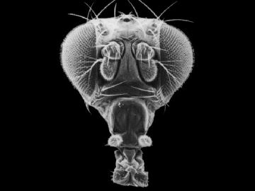
Normal fly head
Notes:
http://sdb.bio.purdue.edu/fly/aimain/images.htm

Slide 42
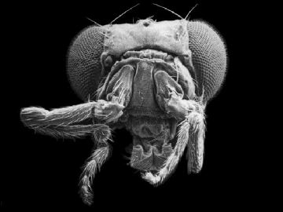
Antennapedia fly
Notes:
http://sdb.bio.purdue.edu/fly/aimain/images.htm

Slide 43
Random mating
Under random mating, the chance of any individual in a population mating is exactly the same as for any other individual in the population
Generally, hard to find in nature
But, can approximate in many large populations over short periods of time

Slide 44
Non-random mating
Violations of random mating lead to changes in genotypic frequencies, not allele frequencies
But, can lead to changes in effective population size…

Slide 45
Elephant seal video

Slide 46
Non-random mating
Reduction in the effective population size leaves a door open for the effects of…
Genetic Drift!

Slide 47
Genetic Drift Activity

Slide 48
This powerpoint was kindly donated to www.worldofteaching.com
http://www.worldofteaching.com is home to over a thousand powerpoints submitted by teachers. This is a completely free site and requires no registration. Please visit and I hope it will help in your teaching.

