Slide 1
Nature of the Genetic Material
Property 1 - it must contain, in a stable form, information encoding the organism’s structure, function, development and reproduction
Property 2 - it must replicate accurately so progeny cells have the same genetic makeup
Property 3 - it must be capable of some variation (mutation) to permit evolution

Slide 2
Historical Perspective
1928 - Griffith discovered a “transforming principle” in heat killed bacteria (Property 1)
1944 - Avery demonstrated that the transforming principle is sensitive to DNase
1952 - Hershey & Chase used ³²P and ³⁵S labelling, of bacteriophage T2 DNA and protein respectively, to show only the DNA enters the host cell and can be passed to progeny phage (consistent with Property 2)

Slide 3
Replication of DNA and Chromosomes
Speed of DNA replication: 3,000 nucleotides/min in human 30,000 nucleotides/min in E.coli
Accuracy of DNA replication: Very precise (1 error/1,000,000,000 nt)

Slide 4
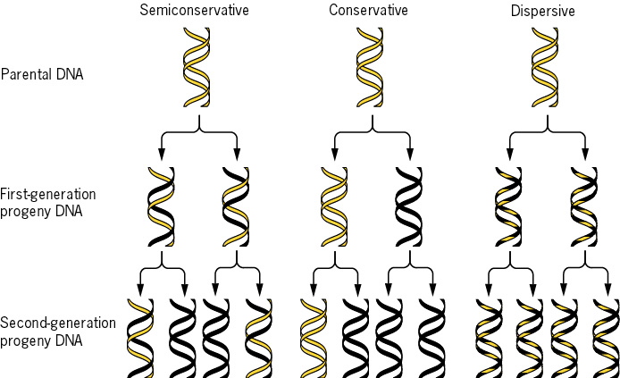
Meselson and Stahl (1958)

Slide 5
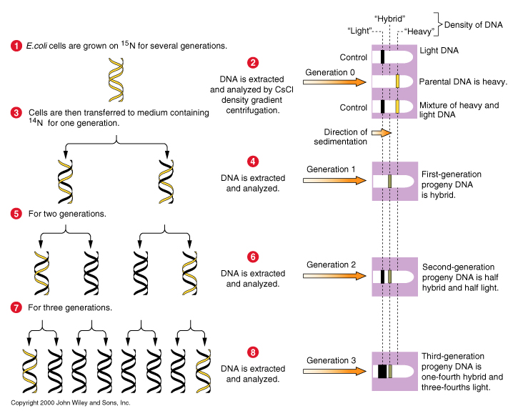

Slide 6
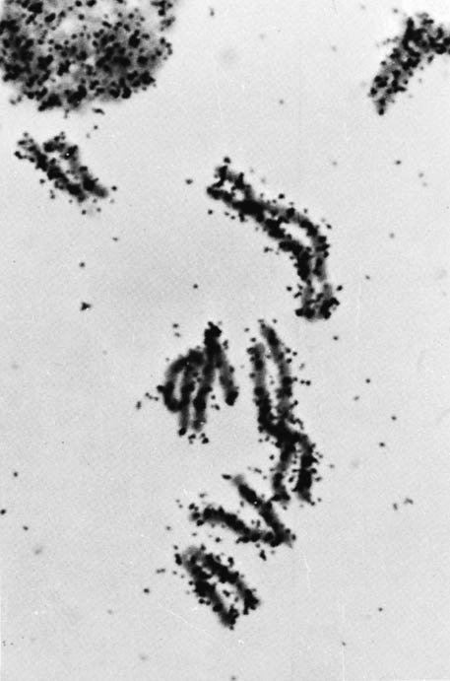
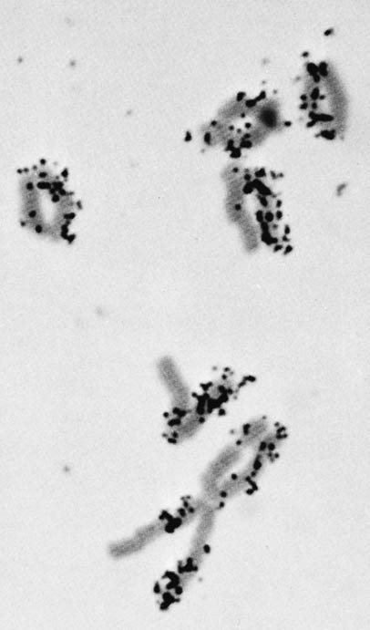
Taylor and co-workers (1957)
³H-labelled chromosomes
after one further replication
in unlabelled media

Slide 7
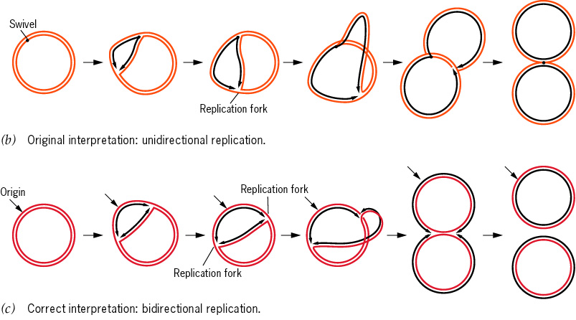
Bi-directional replication in E. coli

Slide 8
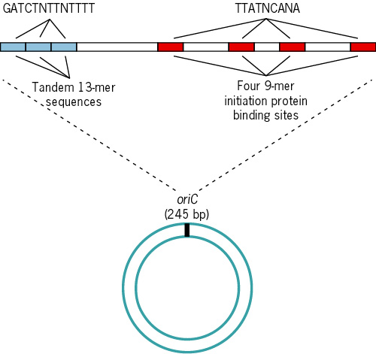
Only One Replication Origin in E. coli

Slide 9
Multiple Origins in Eukaryotes
Eukaryotes replicate their DNA only in S-phase
Eukaryotes have larger chromosomes
Replication speed 2,600 npm.
Largest Drosophila chromosome is 6.5 x 10⁷ nucl., but it can replicate in 3-4 min. From a single origin, bidirectional replication would take 8.5 days. ==> The chromosome must have some 7,000 origins of replication.

Slide 10
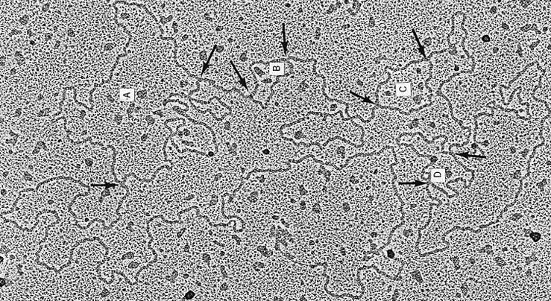
A replicating Drosophila chromosome

Slide 11
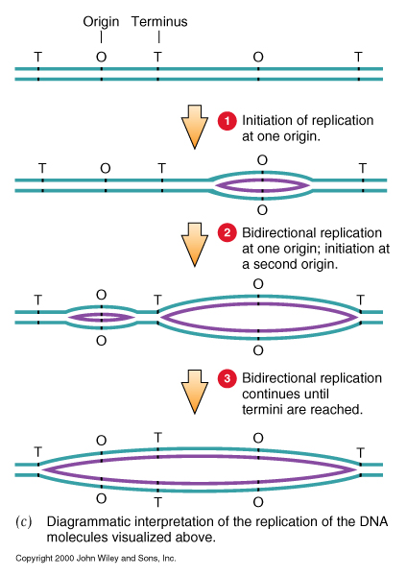
Origins initiate replication at different times.

Slide 12
Two DNA polymerases are involved in eukaryotic replication
DNA polymerase δ has no primase activity and is thought to be the polymerase that synthesizes the leading strand.
DNA polymerase α has associated primase activity and is thought to be the polymerase that synthesizes the lagging strand.

Slide 13
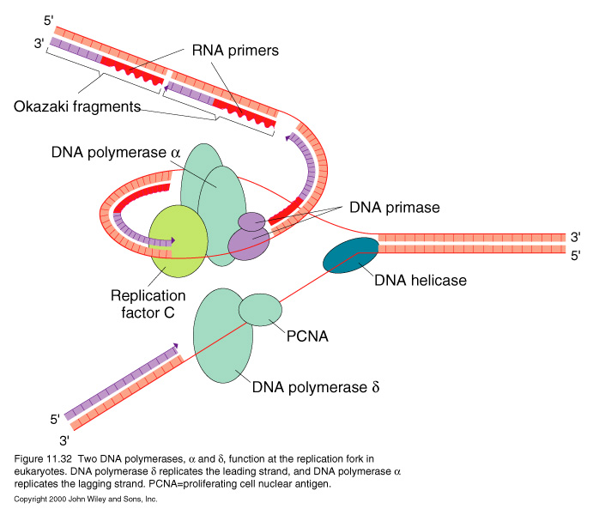
DNA Synthesis at the Origin
Additional factors:
PCNA (proliferating cell nuclear antigen)
DNA helicase
Replication factor C
OTHERS

Slide 14
Replication of Nucleosomes
Eukaryotic DNA is packaged with histones in structures called nucleosomes.
What happens to the nucleosome when the replication fork and the replication machinery pass by and open up the DNA double strand?
Nucleosomes are found properly spaced on both postreplicative DNA strands immediately after passage of replication fork.

Slide 15
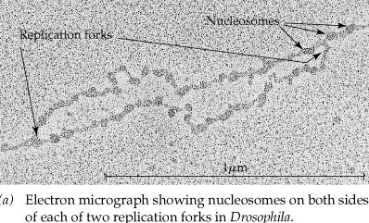

Slide 16
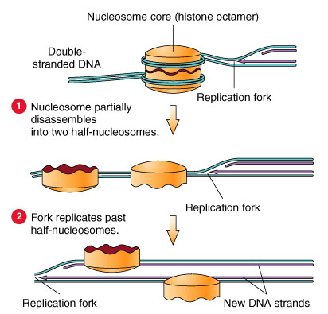
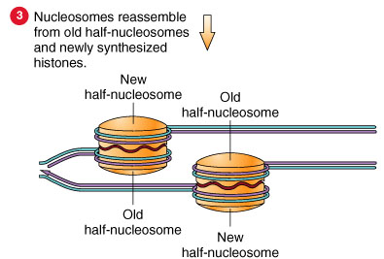
A model for nucleosome replication

Slide 17
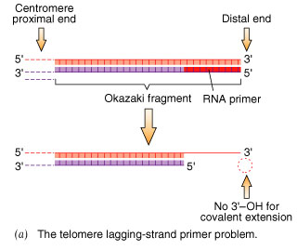
The lagging strand of telomeres cannot be replicated by the usual mechanism

Slide 18
Telomere and Telomerase
Solution:
special telomere sequence: tandem repeats of TTAGGG (human)
telomerase, a specific enzyme with integrated RNA template.

Slide 19
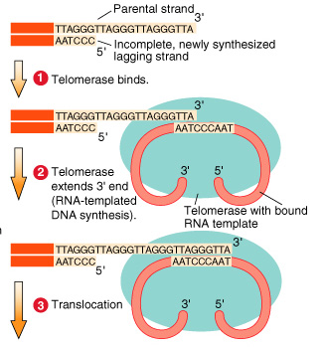
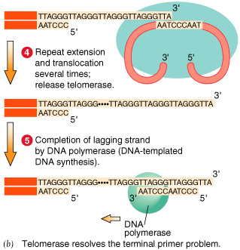
Telomere replication

Slide 20
This powerpoint was kindly donated to www.worldofteaching.com
http://www.worldofteaching.com is home to over a thousand powerpoints submitted by teachers. This is a completely free site and requires no registration. Please visit and I hope it will help in your teaching.

