Slide 1
Objectives
Outline the regulation of protein synthesis in bacteria. (Reference should be made to the lac operon in Escherichia coli).
http://www.sumanasinc.com/webcontent/anisamples/majorsbiology/lacoperon.html

Slide 2
Lac Operon
The Lac Operon is an example of an operon that is able to regulate itself depending on the environmental conditions it is subjected to.
It codes for 3 genes: Beta-galactosidase, lactose permease and Thiogalactosidase transacetylase. These genes are involved in lactose metabolism.
If lactose is absent, the system is turned off; if lactose is present, the operon is switched on.
The bacteria’s favoured source of food is glucose and if that is present the operon does not need to be switched on, as there is no need to metabolise lactose.

Slide 3
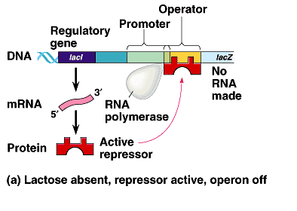

Slide 4
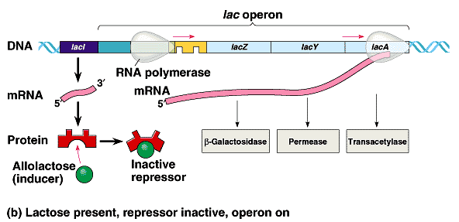

Slide 5
Element | Purpose
Operator (LacO) | Binding site for repressor
Promoter (LacP) | Binding site for RNA Polymerase
Repressor | Gene encoding the lac repressor protein. Binds to DNA at the operator & blocks binding of RNA Pol at the promoter.
LacI | Controls production of the repressor protein

Slide 6
Enzyme | Function
Beta galactosidase | This enzyme hydrolyzes the bond between the two sugars, glucose and galactose. It is coded for by the gene LacZ.
Lactose Permease | This enzyme spans the cell membrane and brings lactose into the cell from the outside environment. The membrane is otherwise essentially impermeable to lactose. It is coded for by the gene LacY
Thiogalactosidase transacetylase | The function of this enzyme is not known. It is coded for by the gene LacA.

Slide 7
This powerpoint was kindly donated to www.worldofteaching.com
http://www.worldofteaching.com is home to over a thousand powerpoints submitted by teachers. This is a completely free site and requires no registration. Please visit and I hope it will help in your teaching.

