Slide 1
Genetics and inheritance
Aim:
To recall the important terms that relate to genetics and inheritance (KS4)
Describe the basic structure of DNA

Slide 2
In your own words, explain the following terms
Chromosome
Gene
Features
Gametes
Zygote
Diploid
Allele
Homozygous
Heterozygous
Selective breeding
Genetic engineering
Meiosis
Mitosis
Sexual reproduction
Asexual reproduction
Mutations
Dominant
Recessive

Slide 3

chromosome
The instructions that tell cells what we look like are carried in these. There are 23 pairs of them in a normal human cell.

Slide 4
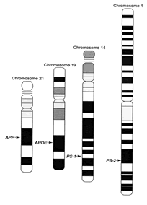
Genes
These are the units which make up chromosomes. Responsible for inheritance of specific characteristics

Slide 5
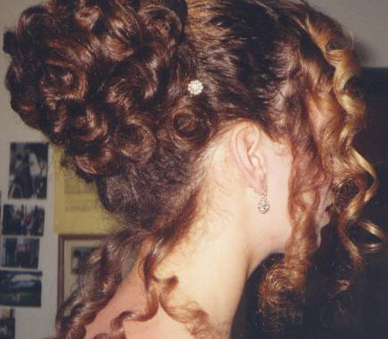
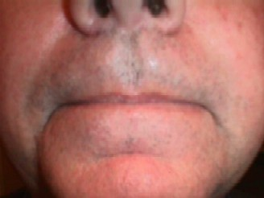
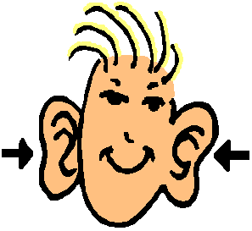
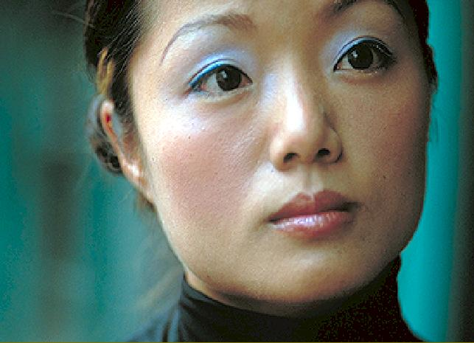
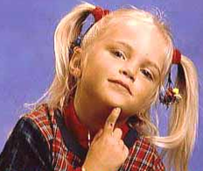

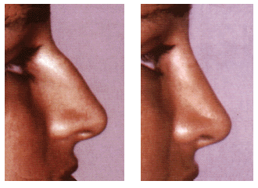
FEATURES
These are things like eye colour,
skin colour and hair colour.
They are controlled by genes.

Slide 6

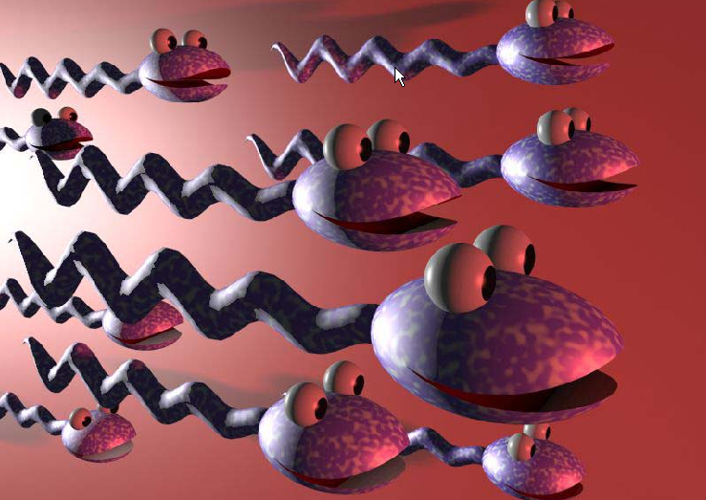
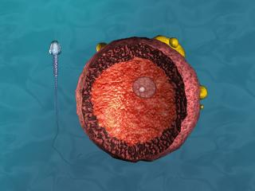
gametes
Sperm and egg cells are both this type of cell.
Contain half the amount of DNA of normal diploid cells

Slide 7
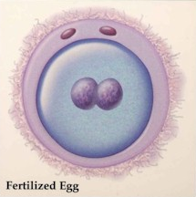
zygote
When a sperm and egg cell
fuse together,
they produce this.

Slide 8

diploid
We use this word to describe
cells which contain the full
complement of genetic
material. In humans this would be
46 chromosomes (23 pairs)

Slide 9



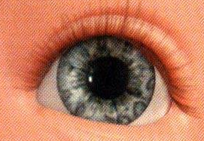

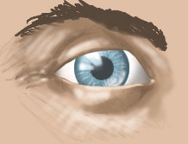
alleles
The different versions of genes
Notes:
How many genes are there for each characteristic?
Sometimes these genes can be slightly different. These different versions we call alleles.
Process check – if 15 mins or less, then go onto completion of the handout, otherwise go onto the white mouse example and then onto the handout

Slide 10

Homozygous
Alleles of a given gene are identical (can be either dominant or recessive

Slide 11
Heterozygous
Alleles of a given gene are not identical

Slide 12
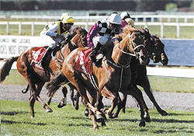
selective breeding
Where plants and animals with useful or desired traits
are bred together
to produce offspring with those desired traits

Slide 13
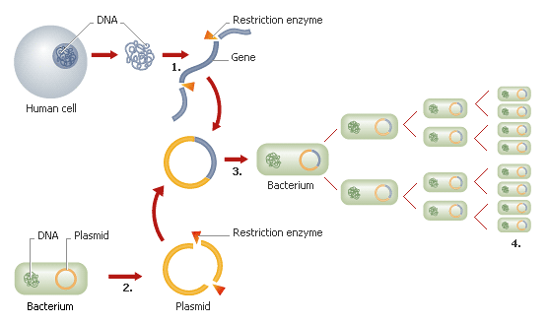
Genetic engineering
The altering of the character of an
organism by
inserting genes from another organism

Slide 14
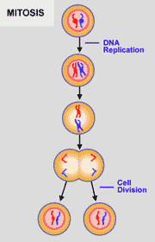
mitosis
Division of a cell to produce 2 daughter
cells which each has the same
number and kind of chromosomes as
the mother cell

Slide 15
sexual reproduction
Type of reproduction that involves
fusion of gametes
Notes:
How many genes are there for each characteristic?
Sometimes these genes can be slightly different. These different versions we call alleles.
Process check – if 15 mins or less, then go onto completion of the handout, otherwise go onto the white mouse example and then onto the handout

Slide 16
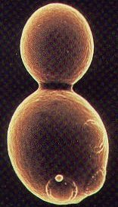
asexual reproduction
Reproduction whereby individuals are produced from a single parent

Slide 17
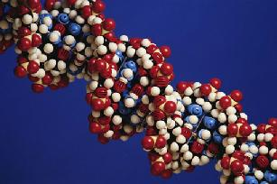
Mutation
Random change in the genetic material of the cell

Slide 18
dominant
The allele that is expressed where
an individual is heterozygous

Slide 19
recessive
The allele that is ‘hidden’ (not expressed)
when an individual is heterozygous
for a given gene

Slide 20
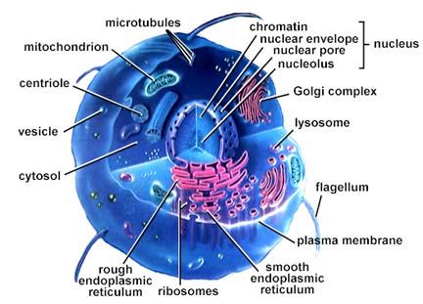
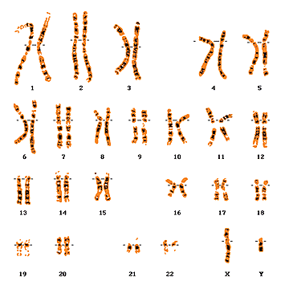

Where is it?
Notes:
If you unravel the chromosome – makes up an extremely long thread – thread is DNA

Slide 21
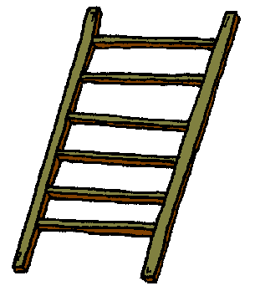
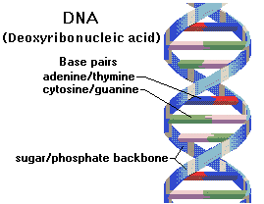
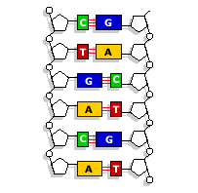
What does it look like?
Notes:
DNA made up thousands of units called nucleotides
Looks like a spiral staircase
The most important part of DNA is the base pairs which form the rungs. Made up of 4 base pairs only.
These are called adenine, thymine, guanine and cytosine.
40,000 genes in humans.
Telegraph and argus, Cheltenham and Gloucester. All DNA in all molecules is made up of these 4 base pairs only. So Whatever you try and look at – always have the same. Imagine all the genes in the world and all the different species in the world have the same DNA. It just depends on the way the DNA is put together.
In human genome there are 2.85 billion rungs which have all been sequenced by scientists as part of the Human Genome Mapping project.

Slide 22
This powerpoint was kindly donated to www.worldofteaching.com
http://www.worldofteaching.com is home to over a thousand powerpoints submitted by teachers. This is a completely free site and requires no registration. Please visit and I hope it will help in your teaching.

