Slide 1
Inheritance

Slide 2
Some features are in two forms
e.g.
Some people have ear lobes and others do not.

Slide 3
A gene controls how ear lobes develop.
There are two versions of the gene.
They are called alleles.
E
which produces ears with lobes.
and
e
which produces ears without lobes.

Slide 4
The genes are in our cells.
In the nucleus
Where are they kept?

Slide 5
The genes are on long, string-like things called
chromosomes

Slide 6
We have 46 of them in our cells.
What do you notice about them?

Slide 7
All our chromosomes are in pairs
and half came from dad
half came from mum
Where did we get each one from?

Slide 8
This means that genes are in pairs
Because…
E
E
Genes are on chromosomes.

Slide 9
2
So...
forgetting all those chromosomes
you might have
two lobe alleles
EE
two no lobe alleles
ee
or
one of each allele
Ee
but you definitely have

Slide 10
However!

Slide 11
Sex cells are special when it comes to chromosomes and genes.
They only have one of each, not the usual two.
Why is this?
Sex cells are designed to join together and so...
1 + 1 = 2

Slide 12
We can use these facts
to make predictions
about the features that
children will inherit from
their parents.

Slide 13
Lets pretend...
that a man without ear lobes
and a woman with lobes
will soon have their first baby
Will the baby have ear lobes?

Slide 14
mum
dad
Lobes
No lobes
parent’s
genotype
EE
ee
sex cell’s
alleles
E
e
e
Children’s
genotype
E
Ee
But… does the child have ear lobes?

Slide 15
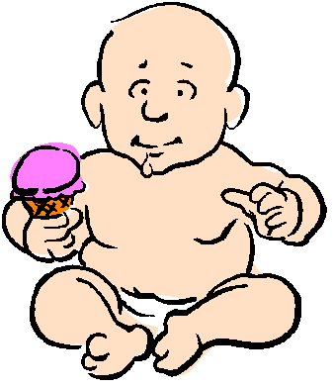
YES
If someone has
both versions of
the allele…
One version’s
effect can hide
the other’s.
dominant
The version is...

Slide 16
Lets see if you have got the idea!

Slide 17
mum
dad
Lobes
Lobes
parent’s
genotype
Ee
Ee
sex cell’s
alleles
E
e
E
e
E
e
Children’s
genotype
E
EE
Ee
e
Ee
ee
But… do the children have ear lobes?

Slide 18

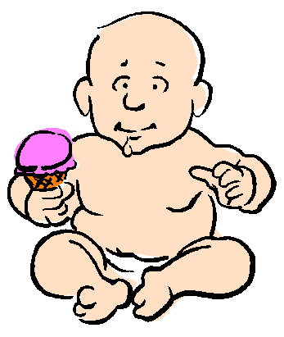
EE
Ee
Ee
ee

Slide 19
Click here to go back to the start.
Click here to finish

Slide 20
This powerpoint was kindly donated to www.worldofteaching.com
http://www.worldofteaching.com is home to over a thousand powerpoints submitted by teachers. This is a completely free site and requires no registration. Please visit and I hope it will help in your teaching.

