Slide 1
Genetics
The study of genes and the inheritance of traits

Slide 2
Characteristics
These are features you exhibit physically
( your looks)
Example: Eye color - green

Slide 3
Traits
The different versions of a characteristic
Example: blue, green, and brown eyes

Slide 4
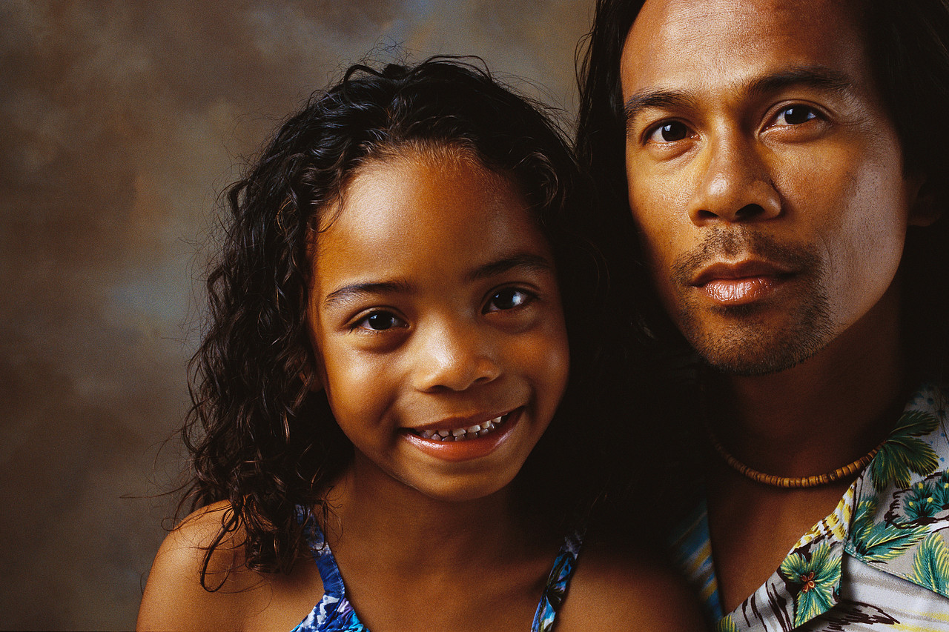
Inheritance
Occurs when traits are passed down from parent to child.

Slide 5
Genes
Bits of information passed down from parent to child.
Made of chemicals called DNA.

Slide 6
Genetic Diseases
Can be passed on through genes from a parent to the child.
Example : Marfan Syndrome
(Individual is tall, has long arms and legs)
Remember - JOE

Slide 7
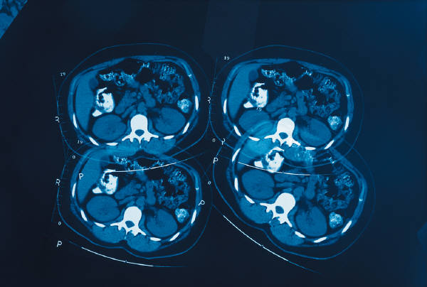
Reproduction
Sexual – Sperm fertilizes an egg to produce offspring
Asexual – occurs when 1 organism copies itself to produce offspring

Slide 8

Fertilization
Occurs when a sperm unites with an egg

Slide 9
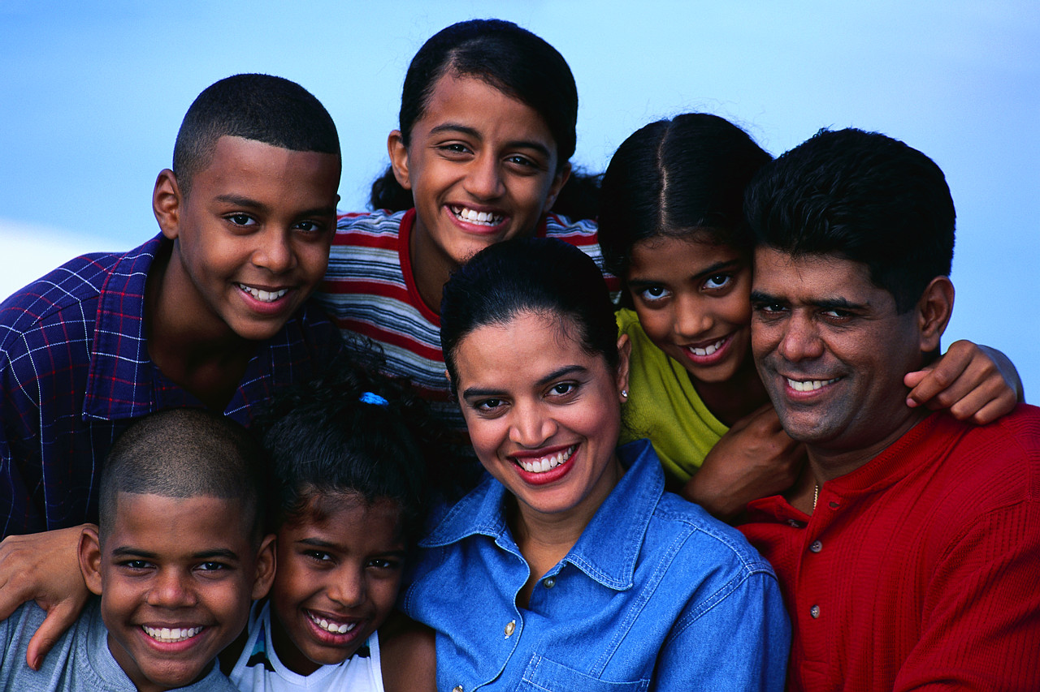
Offspring
Another name for the children of a male and female parent

Slide 10

Mutation
Occurs when genes make a mistake mixing and produce new or different traits in the offspring.

Slide 11
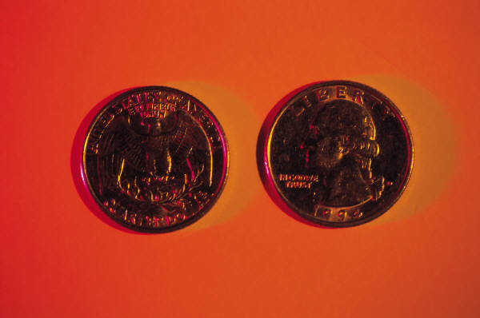
Genotype
A combination of alleles
Example: TT, Tt, or tt
*We flipped coins to determine the genotype of our critters and puppies.

Slide 12
Alleles
T – is considered a dominant allele
t – is considered a recessive allele
TT – is dominant
Tt or tT – is dominant
tt - is recessive

Slide 13
Punnett Square
Uses mom and dad’s genotypes to determine the possible traits of their offspring.
4 offspring

Slide 14
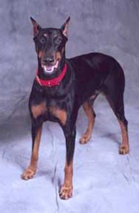
Phenotype
They are the traits determined by reading the genotype.
Example : FF = black fur
Black fur is the phenotype or trait

Slide 15
This powerpoint was kindly donated to www.worldofteaching.com
http://www.worldofteaching.com is home to over a thousand powerpoints submitted by teachers. This is a completely free site and requires no registration. Please visit and I hope it will help in your teaching.

