Slide 1
Principles of genetic engineering
L Mathias

Slide 2
What is genetic engineering
Genetic engineering, also known as recombinant DNA technology, means altering the genes in a living organism to produce a Genetically Modified Organism (GMO) with a new genotype.
Various kinds of genetic modification are possible: inserting a foreign gene from one species into another, forming a transgenic organism; altering an existing gene so that its product is changed; or changing gene expression so that it is translated more often or not at all.
Notes:
Gene technology – used in same way as genetic engineering, genetic fingerprinting – no manipulation of DNA

Slide 3
Basic steps in genetic engineering
Isolate the gene
Insert it in a host using a vector
Produce as many copies of the host as possible
Separate and purify the product of the gene
Notes:
Genetic engineering is a very young discipline, and is only possible due to the development of techniques from the 1960s onwards.
These techniques have been made possible from our greater understanding of DNA and how it functions following the discovery of its structure by Watson and Crick in 1953.
Although the final goal of genetic engineering is usually the expression of a gene in a host, in fact most of the techniques and time in genetic engineering are spent isolating a gene and then cloning it. This table lists the techniques that we'll look at in detail.
Need to explain some key terms first before we talk about how we would isolate the gene and clone it

Slide 4
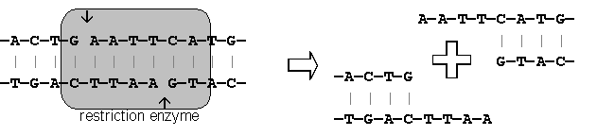
Step 1: Isolating the gene
Notes:
Gene is cut out using restriction endonucleases
Molecular scissors
Cut DNA at specific base sequence
Hundreds available
DNA cut at exactly the right place to isolate the gene
Make a staggered cut, forming sticky ends
The cut ends are "sticky" because they have short stretches of single-stranded DNA. These sticky ends will stick (or anneal) to another piece of DNA by complementary base pairing, but only if they have both been cut with the same restriction enzyme. Restriction enzymes are highly specific, and will only cut DNA at specific base sequences, 4-8 base pairs long.Restriction enzymes are produced naturally by bacteria as a defence against viruses (they "restrict" viral growth), but they are enormously useful in genetic engineering for cutting DNA at precise places ("molecular scissors"). Short lengths of DNA cut out by restriction enzymes are called restriction fragments. There are thousands of different restriction enzymes known, with over a hundred different recognition sequences. Restriction enzymes are named after the bacteria species they came from, so EcoR1 is from E. coli strain R.
There are also RE that produce blunt ends – see page 483
RE’s in bacteria, protect against viruses by cutting up DNA

Slide 5
Step 1: Alternative method (using reverse transcriptase)
Reverse transcriptase
mRNA converted into cDNA
Complementary strand produced using DNA polymerase
Advantage – more mRNA in cell than DNA
Notes:
Enzyme that does the reverse of transcription
mRNA for the gene is extracted and RT used to produce a single strand of DNA, catalysed by the enzyme RT
DNA produced called cDNA
DNA polymerase produces the complementary strand
This way has advantage that much more mRNA is present than DNA in a normal cell
Method 2 much more common as prokaryotic cells are unable to process introns which would be present in the first version, also regulatory genes are different in eukaryotic and prokaryotic cells. Both methods used with yeast as it is eukaryotic

Slide 6
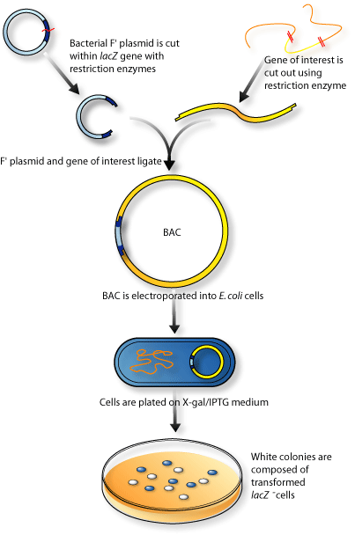
Step 2: Inserting gene into vector
Vector – molecule of DNA which is used to carry a foreign gene into a host cell
Notes:
Now you have the gene that you wish to have duplicated, you need to put it into something else to make it produce what you want
Most common vectors are bacterial plasmids and phage viruses
What are they – plasmids – circular DNA that present in bacteria, double stranded
A vector is needed because a length of DNA containing a gene on its own won’t actually do anything inside a host cell. Since it is not part of the cell’s normal genome it won’t be replicated when the cell divides, it won’t be expressed, and in fact it will probably be broken down pretty quickly. A vector gets round these problems by having these properties:
It is big enough to hold the gene we want
It is circular (or more accurately a closed loop), so that it is less likely to be broken down
It contains control sequences, such as a transcription promoter, so that the gene will be replicated or expressed.
It contain marker genes, so that cells containing the vector can be identified.
Duplicate like the normal cell when cell replicates, remember Asexual reproduction so the DNA is not altered
Good visual on page 486 of text book

Slide 7
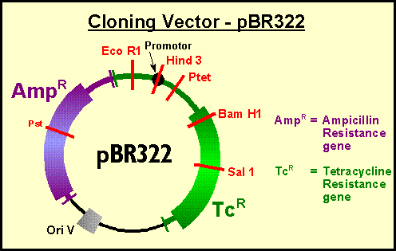
Notes:
Popular cloning vector – 2 genes for resistance, several restriction sites

Slide 8
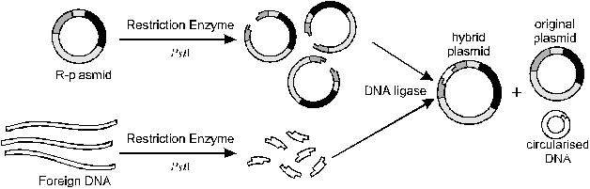
Notes:
The diagram below shows how DNA fragments can be incorporated into a plasmid using restriction and ligase enzymes. The restriction enzyme used here (PstI) cuts the plasmid in the middle of one of the marker genes (we’ll see why this is useful later). The foreign DNA anneals with the plasmid and is joined covalently by DNA ligase to form a hybrid vector (in other words a mixture or hybrid of bacterial and foreign DNA). Several other products are also formed: some plasmids will simply re-anneal with themselves to re-form the original plasmid, and some DNA fragments will join together to form chains or circles. Theses different products cannot easily be separated, but it doesn’t matter, as the marker genes can be used later to identify the correct hybrid vector

Slide 9
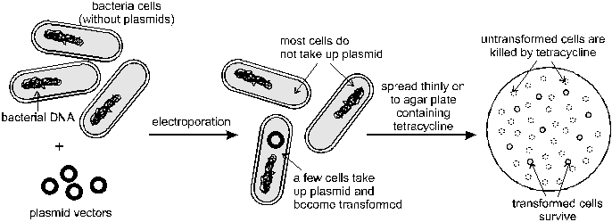
Step 3: inserting vector into host
See worksheet
Notes:
First of all, the host plasmids are removed for preparation for the hosts to receive recombinant plasmids
Possible treatments that can help the hosts to take up the vectors include; shocking, temperature shock, calcium ions – all help the cells to uptake the plasmids
Not all bacteria will take up recombinant plasmids so they need to be identified and isolated
These are needed to identify cells that have successfully taken up a vector and so become transformed. With most of the techniques above less than 1% of the cells actually take up the vector, so a marker is needed to distinguish these cells from all the others. A common marker, used in plasmids, is a gene for resistance to an antibiotic such as tetracycline. Bacterial cells taking up this plasmid are resistant to this antibiotic. So if the cells are grown on a medium containing tetracycline all the normal untransformed cells (99%) will die. Only the 1% transformed cells will survive, and these can then be grown and cloned on another plate.

Slide 10
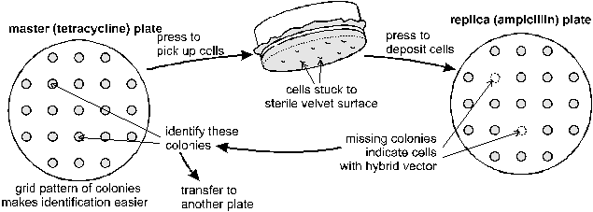
Replica plating
Notes:
Replica plating is a simple technique for making an exact copy of an agar plate. A pad of sterile cloth the same size as the plate is pressed on the surface of an agar plate with bacteria growing on it. Some cells from each colony will stick to the cloth. If the cloth is then pressed onto a new agar plate, some cells will be deposited and colonies will grow in exactly the same positions on the new plate. This technique has a number of uses, but the most common use in genetic engineering is to help solve another problem in identifying transformed cells. This problem is to distinguish those cells that have taken up a hybrid plasmid vector (with a foreign gene in it) from those cells that have taken up plasmids without the gene. This is where the second marker gene (for resistance to ampicillin) is used. If the foreign gene is inserted into the middle of this marker gene, the marker gene is disrupted and won't make its proper gene product. So cells with the hybrid plasmid will be killed by ampicillin, while cells with the normal plasmid will be immune to ampicillin. Since this method of identification involves killing the cells we want, we must first make a master agar plate and then make a replica plate of this to test for ampicillin resistance.
Once the colonies of cells containing the correct hybrid plasmid vector have been identified, the appropriate colonies on the master plate can be selected and grown on another plate.

Slide 11
Step 4: Multiplication of the host cells by cloning
Large scale fermenters by cloning
All genetically identical because of asexual reproduction

Slide 12
Step 5: Extraction of desired gene product

Slide 13
This powerpoint was kindly donated to www.worldofteaching.com
http://www.worldofteaching.com is home to over a thousand powerpoints submitted by teachers. This is a completely free site and requires no registration. Please visit and I hope it will help in your teaching.

