Slide 1
Genetic code
Lesson 1: The structure of DNA
Objectives: I can describe the structure of DNA, I can explain the difference between an allele, a gene and homologous chromosomes

Slide 2
Genes
Genes are sections of DNA that contain coded information that determines the nature and development of organisms

Slide 3
Allele
A different form of a particular gene, positioned in the same relative position (locus) on homologous chromosomes
Homologous chromosomes
Gene locus – position on the chromosome
Alleles (diff versions of the genes)

Slide 4
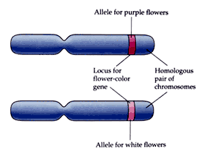
Homologous chromosomes
Two chromosomes which contain the same genes but may contain different alleles

Slide 5
DNA nucleotides
Phosphate group
Nitrogenous base
Pentose sugar

Slide 6
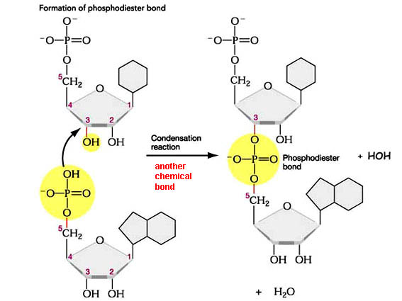
Phosphodiester bond
Notes:
Monomers are joined up by a phosphodiester bond – water given out in this reaction (condensation reaction) bases stick out to the side, bases can be in any order and this determines the gene sequence
Students do not need to be able to reproduce the structures. Basic structure is adequate

Slide 7
Nucleotide
Polynucleotide
chain
Sugar phosphate
backbone
Notes:
There are four different types of bases and they can be in any order on the DNA chain. It is this order that determines the genetic code and sequence

Slide 8
4 different bases
C
G
T
A
Notes:
Adenine, thymine, guanine, cytosine, adenine and guanine are larger called purines, other two are pyrimidines
Phosphate and deoxyribose sugar is the same for each base used

Slide 9

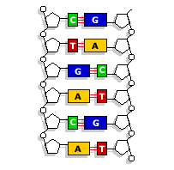
Notes:
DNA has two polynucleotide chains or strands linked by hydrogen bonds A- T, C-G. Cheltenham and Gloucester and Telegraph and argus.
Note the number of hydrogen bonds between each pair
The specific base pairing is essential for protein synthesis and DNA replication
Precise order determines the sequence in a gene and ultimately what an organism is and looks like

Slide 10
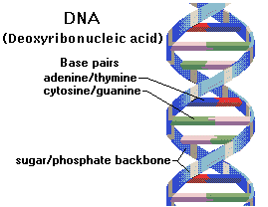
Double helix
5’end
3’end
3’end
5’end
Notes:
Two DNA strands form a double helix structure. The sugar and phosphate groups are inorganic and the nitrogen base is organic – what advantage does making a helical arrangement give to the DNA – protects against water (base are hydrophobic)
Two strands are antiparallel – strands run in opposite directions to each other
5’ end where the carbon 5 of the pentose sugar is nearest to the end and the 3’ end where the carbon 3 of the pentose sugar is nearest to the end.
Each species is genetically different with a unique sequence. Amount of A will always be the same as amount of T and C and G will also be the same. Species have relative differences in their percentages of bases.

Slide 11
This powerpoint was kindly donated to www.worldofteaching.com
http://www.worldofteaching.com is home to over a thousand powerpoints submitted by teachers. This is a completely free site and requires no registration. Please visit and I hope it will help in your teaching.

