Slide 1
What is a gene?

Slide 2
Definitions of the gene
The gene is to genetics what the atom is to chemistry.
The gene is the unit of genetic information that controls a specific aspect of the phenotype.
The gene is the unit of genetic information that specifies the synthesis of one polypeptide.

Slide 3
How has the concept of a gene developed in the minds of geneticists?

Slide 4
Mendel (1866)
Inheritance is governed by “characters” or “constant factors” that each controls a phenotypic trait such as flower colour.

Slide 5
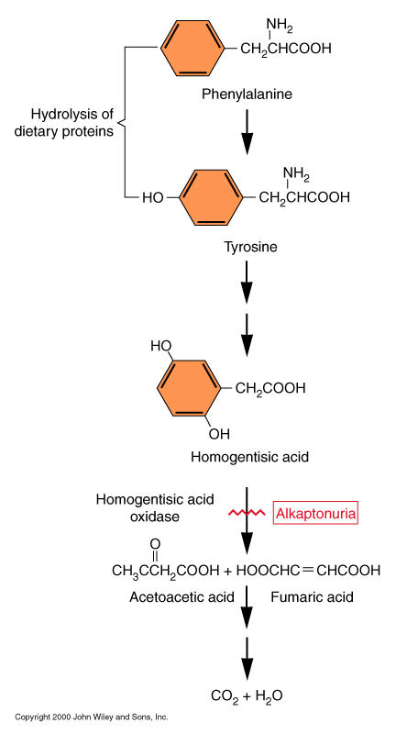
Garrod (1909) Inborn errors of Metabolism
Inherited human metabolic disorders such as alkaptonuria result from alternative metabolism.
Individual genes can mutate to cause a specific metabolic block. Concept later elaborated as “one gene-one enzyme”.
Over 4,000 inherited genetic disorders have now been described.

Slide 6
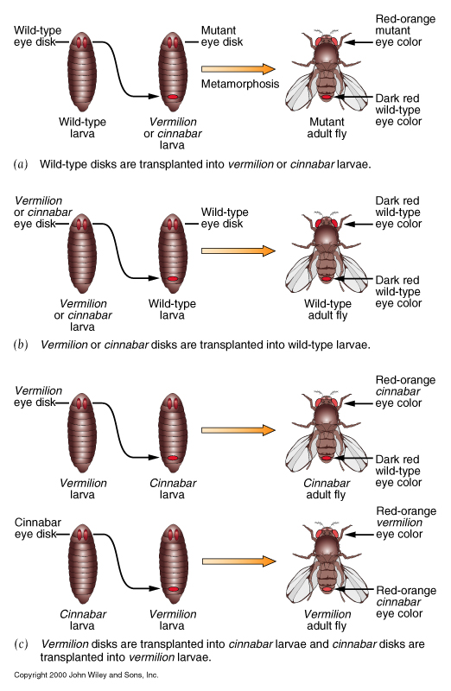
Metabolic mutations in Drosophila (Beadle and Ephrussi)
Fly eyes are normally dark red because of two pigments, one bright red and one brown.
Mutants in v or cn have bright red eyes because they lack brown pigment.
Disk transplantation experiments showed that wild-type hosts produce a diffusible substance than can allow v or cn disks to form dark red eyes.
v disks transplanted into cn hosts also develop normally, but cn disks transplanted into v hosts still develop bright red eyes!

Slide 7
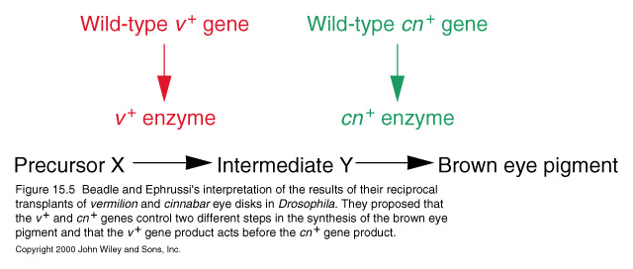
Explanation: v and cn affect different steps of the same metabolic pathway

Slide 8
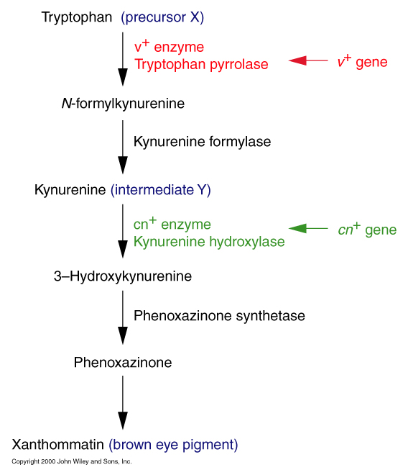
We now know the precise pathway.

Slide 9
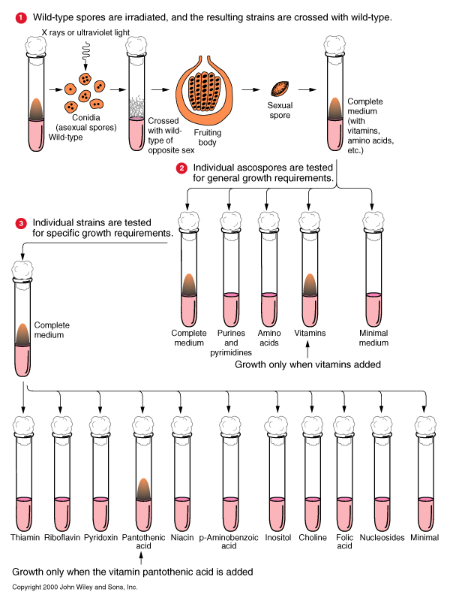
Beadle and Tatum (1942)--One Gene, One Enzyme
Bread mold Neurospora can normally grow on minimal media, because it can synthesize most essential metabolites.
If this biosynthesis is under genetic control, then mutants in those genes would require additional metabolites in their media.
This was tested by irradiating Neurospora spores and screening the cells they produced for additional nutritional requirements (auxotrophs).

Slide 10
Are genes both the basic functional unit and the smallest genetic structural unit?
Until 1940, the gene was considered as the basic unit of genetic information as defined by three criteria.
  The unit of function, controlling the inheritance of one “character” or phenotypic attribute.
  The unit of structure, operationally defined by recombination and by mutation.

Slide 11
Oliver (1940) - intergenic recombination at lozenge
Mutations in lozenge affect eye shape in Drosophila.
Two mutations, lz^{s} and lz^{g}, were considered alleles of the same gene because lz^{s}/lz^{g} heterozygotes have lozenge, not wild-type, eyes.
But when lz^{s}/lz^{g} females are crossed to lz^{s} or lz^{g} males, about 0.2% of the progeny are wild-type!
These must result from recombination between lz^{s} and lz^{g} , because the wild-type progeny always had recombinant flanking markers. Also, the frequency of 0.2% is much higher than the reversion rate of the mutations.

Slide 12
Further studies of intergenic recombination in bacteriophage and bacteria (where billions, instead of thousands, of progeny can be analyzed) showed that recombination occurs between adjacent nucleotide pairs.

Slide 13
So the nucleotide, not the gene, is the basic unit of genetic structure.

Slide 14
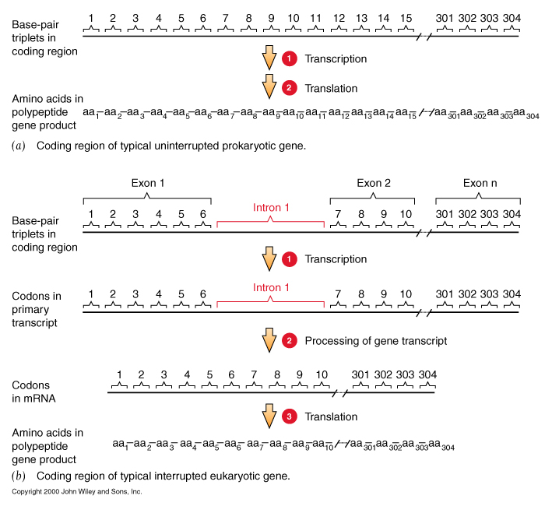
The coding sequence of a gene and its polypeptide product are colinear

Slide 15
Summary
Mendel’s work established the concept of the gene.
This concept has evolved from:
  the unit that can mutate to cause a specific block in metabolism…
  to the unit specifying one enzyme…
  to the sequence of nucleotide pairs in DNA encoding one polypeptide chain.

Slide 16
This powerpoint was kindly donated to www.worldofteaching.com
http://www.worldofteaching.com is home to over a thousand powerpoints submitted by teachers. This is a completely free site and requires no registration. Please visit and I hope it will help in your teaching.

