Slide 1
Gel electrophoresis
L Mathias

Slide 2
Definition
Separation of DNA fragments according to size, based on movement through a gel medium when an electric field is applied.

Slide 3
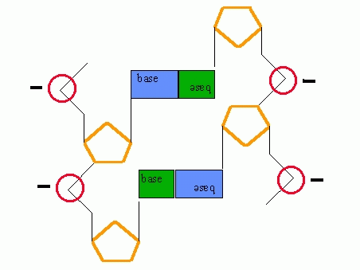
DNA negatively charged
Notes:
Organic molecules such as DNA are charged. DNA is negatively charged because the phosphates (red circles) that form the sugar-phosphate backbone of a DNA molecule have a negative charge

Slide 4
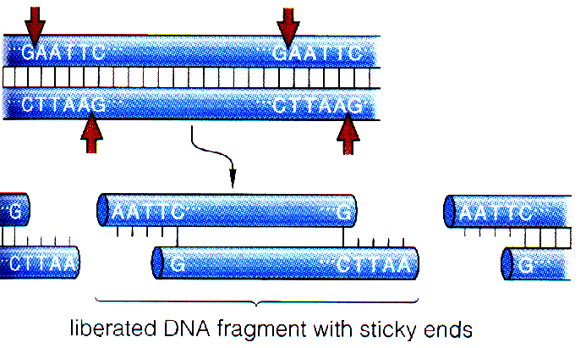
DNA cut up using restriction endonucleases
Notes:
Demonstrate on the board using diagrams
Students to complete exercise of cutting up a plasmid using restriction enzymes
Give them W/S and instruct to cut the plasmid using different enzymes and then look at the restriction fragments
Ask – Why do they cut in different places?
Reinforce that this can be applied to any DNA – example human DNA
Called restriction digestion
Different DNA will produce different fragment sizes
Can be PCR’d DNA or DNA produced by clones or ‘natural state’ DNA

Slide 5
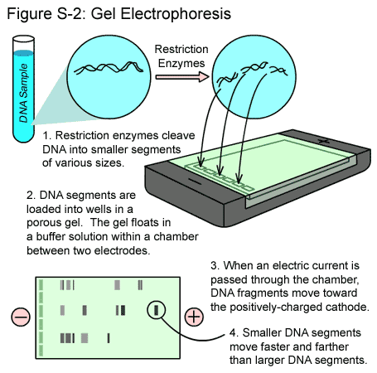
Notes:
A bit like electronic chromatography
The fragments are seperated according to size in process called gel electrophoresis

Slide 6
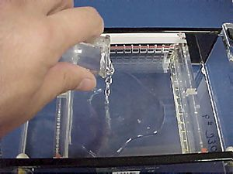
Make up the gel which the DNA will be put into
Notes:
Square tray
2-3 cm of agarose gel which is left to set, can also be made of starch or polyacrylamide, special comb put in so that there are small wells left in the gel

Slide 7
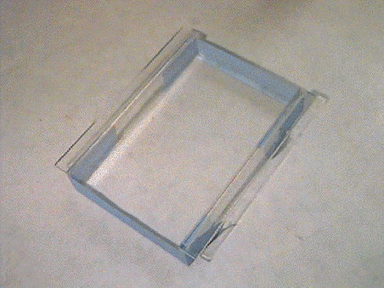

Slide 8
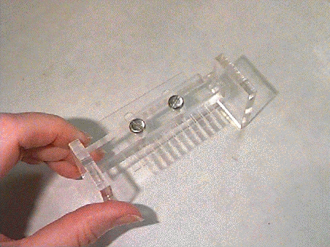
Notes:
A comb is put in the gel to create holes which we call wells

Slide 9
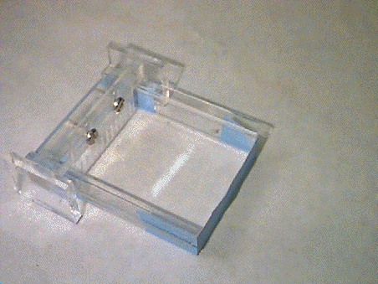

Slide 10
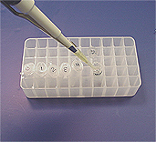
Dye added to the DNA
Notes:
Makes the sample visible when it is put into the agarose wells

Slide 11
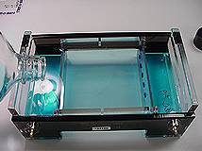
Buffer solution added to the tank
Notes:
This ensures that the electric current goes through the whole tank and that maintains that ions can move in the solution

Slide 12
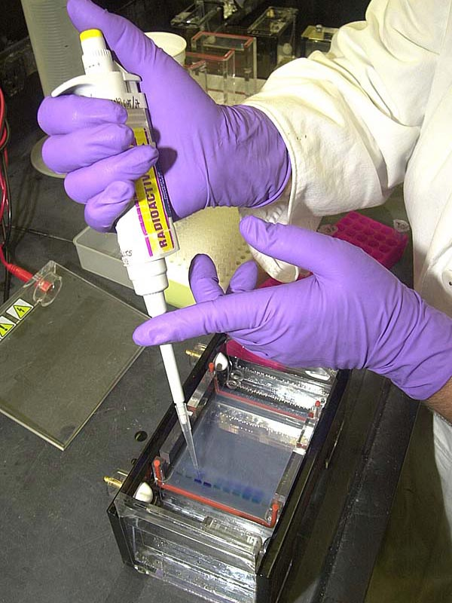
DNA samples loaded into wells
Notes:
Glycerol also in the loading dye

Slide 13
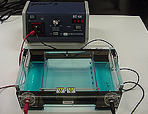
Electrical current applied to the chamber
Notes:
Safety cover is put over the top and the current is switched on
The dye will migrate through the gel toward the positive electrode, as will the DNA
Depending on how much voltage is applied and how warm the gel is and size and shape of molecules will depend on how fast the mols move through the gel
Smaller fragments will move easier so they will be closer to the positive electrode
Once the dye has moved through the gel to the buffer, the electrical current is switched off and gel is removed from the tray

Slide 14
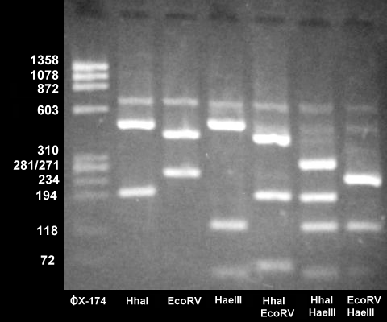
DNA is stained using ethidium bromide
Notes:
Gel is stained using ethidium bromide which binds to DNA it shows up as bands in UV light
Draw attention to the fact that small mols are at the bottom of the gel and large ones stay nearest to the wells

Slide 15
This powerpoint was kindly donated to www.worldofteaching.com
http://www.worldofteaching.com is home to over a thousand powerpoints submitted by teachers. This is a completely free site and requires no registration. Please visit and I hope it will help in your teaching.

