Slide 1
Aim: What is cloning?
Do Now: Review our test.

Slide 2
What is a clone?
Clone refers to genetically identical cells originating from one cell.
What are they talking about when they refer to “cloned animals”?
They take DNA from a cloned cell of another animal, and insert it into a zygote that had its DNA removed, and replace it with the cloned DNA.

Slide 3
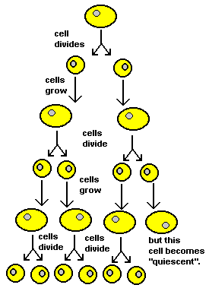
What cloning looks like on a cellular level…

Slide 4
Who did they clone?
In 1997, they successfully cloned the first animal- a lamb named Dolly.
The nucleus they used was from an adult of the same species.
Since then, they have successfully cloned sheep and pigs.

Slide 5
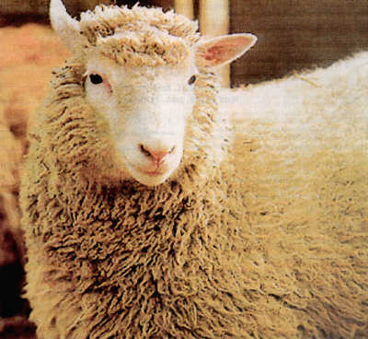

Slide 6
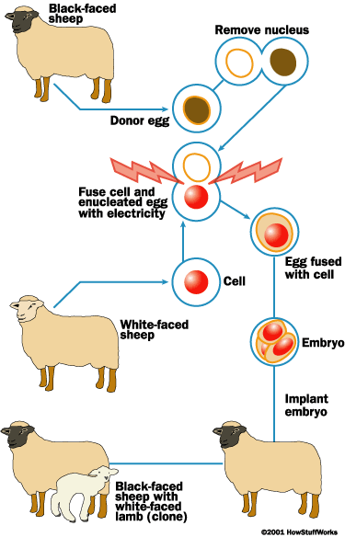

Slide 7
Why do they want to clone animals?
They do this to study genetic disorders and disease susceptibility.
It is done strictly for medical research.

Slide 8
In the blue Biology book…
Turn to page 331 and read up to 333.
Answer questions 1-4 on page 333. You need to read the previous pages in order to answer the questions.
Make sure your name is on the paper – it will be collected.

Slide 9
This powerpoint was kindly donated to www.worldofteaching.com
http://www.worldofteaching.com is home to over a thousand powerpoints submitted by teachers. This is a completely free site and requires no registration. Please visit and I hope it will help in your teaching.

