Slide 1
Cause and effect of mutation
L Mathias

Slide 2
What causes mutation
Spontaneous
Increases caused by environmental factors
UV light
X-rays
Benzene, formaldehyde, carbon tetrachloride

Slide 3
Gametic and somatic mutations
Gametic – testis of males, ovaries of females, inherited
Somatic – in normal body cells occuring beyond zygote formation, not inherited but may effect the person during their lifetime. Chimaeras
Notes:
Chimaeras – mixtures of cell types, some with the mutation and some without. May trigger the onset of cancer if the normal controls of gene regulation are disrupted

Slide 4
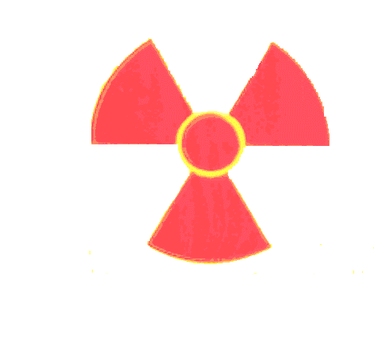
Mutagens and their effects
Ionising radiation – Nuc radiation, xrays, gamma rays (e.g. medical treatment) associated with development of cancers (e.g. leukaemia, thyroid cancer and skin cancer

Slide 5
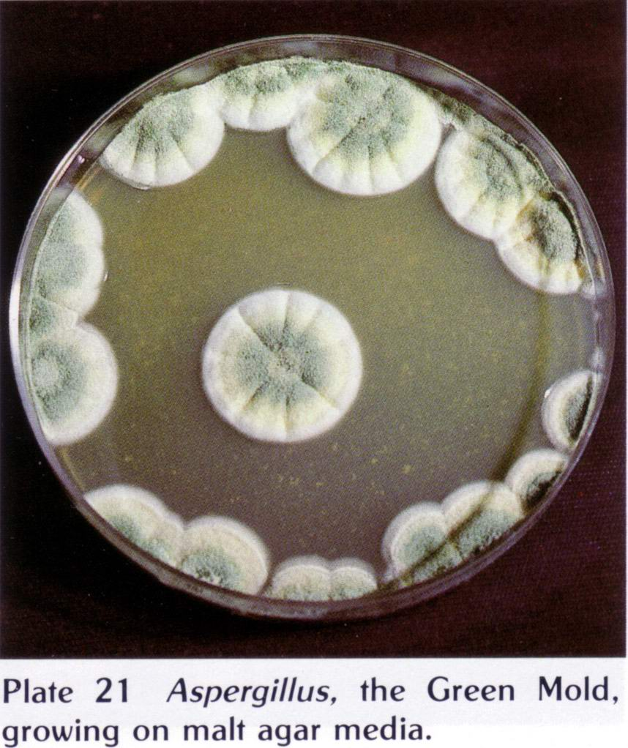
Mutagens and their effects
Viruses and microorganisms – integrate into human chromosome, upset genes and can trigger cancer
Notes:
Aspergillus fungus release toxins that induce liver cancer

Slide 6
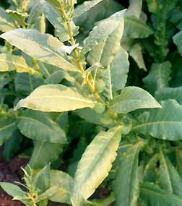
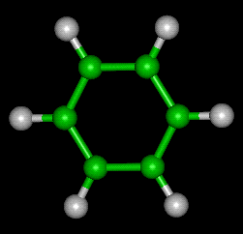
Mutagens and their effects
Environmental poisons – Organic solvents such as formaldehyde, tobacco, coal tars, benzene, asbestos, some dyes

Slide 7


Mutagens and their effects
Alcohol and diet – High alcohol intake increase the risk of some cancers. Diet high in fat and those containing burned or highly preserved meat
Notes:
These pass through the gut slowly and allow buildup of irritants/mutagens in the bowel
Test knowledge: In your own words, explain where a mutation must occur to be inherited and give a brief reason why. Explain why inherited mutations are important in an evolutionary sense.

Slide 8
The effect of muations
Not all are harmful
Survival advantage
Most common among bacteria and viruses but also seen in insects
If no selective pressure may remain in population
Notes:
Survival – most common among viruses and bacteria – MRSA, also occur in multicellular organisms
Sometimes neutral and no immediate effect. If no selective pressure against it, a mutation may be carried in the population and be of benefit (or harm) at a future time

Slide 9
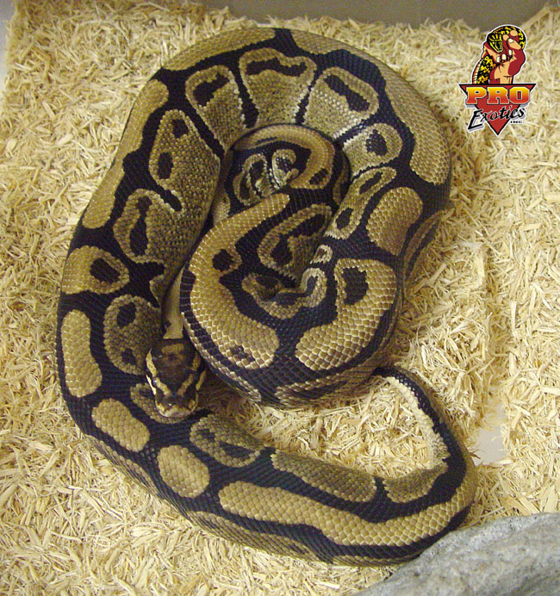
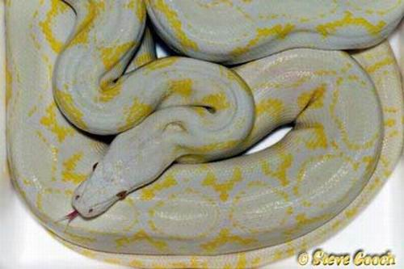
Harmful mutations
Cystic fibrosis and sickle cell anaemia
Disfunctional proteins
Albinism – caused by mutation in gene of enzyme pathway of melanin
Notes:
CF – loss of 3 nucleotides
Sickle cell anaemia – 1 base change
Albinism – not common in the wild because of predation

Slide 10
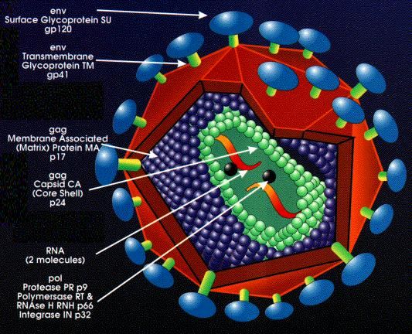
Beneficial mutations
Bacteria – antibiotic resistance through mutation, transfer between bacterial species
Superbugs such as MRSA have arisen this way
RNA viruses – such as HIV – mutates it’s protein coat so that the host human is unable to make antibodies quick enough against it

Slide 11
Neutral mutations
Neither harmful or beneficial to the organism but may be important in an evolutionary sense
Silent mutations
Virtually impossible to detect because no observable effect
Notes:
Double page 140 – 141 complete as homework

Slide 12
This powerpoint was kindly donated to www.worldofteaching.com
http://www.worldofteaching.com is home to over a thousand powerpoints submitted by teachers. This is a completely free site and requires no registration. Please visit and I hope it will help in your teaching.

