Slide 1
Variation and the Monohybrid Cross
Higher Biology

Slide 2
Significance of meiosis
Allele: different forms of the same gene
‘Meiosis provides the opportunity for new combinations of the existing alleles of genes to arise”

Slide 3
Independent assortment of chromosomes
Homologous pairs line up at equator during first meiotic division
Final position of any one pair is random relative to any other
Second meiotic division brings about independent assortment of chromosomes
This may lead to new phenotypes in the next generation

Slide 4
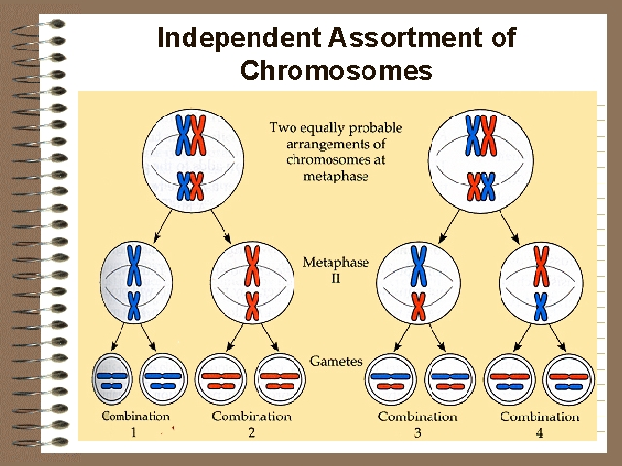

Slide 5
Crossing over and separation of linked genes
Chromosome is aligned with its homologous partner during first meiotic division
Portions of chromatid exchanged at points called chiasmata

Slide 6
Chiasmata
Chromatids become broken
Broken end of one joins with that of another
Alleles of linked genes can become separated
Formation of new allele combinations
Formation of new phenotypes

Slide 7
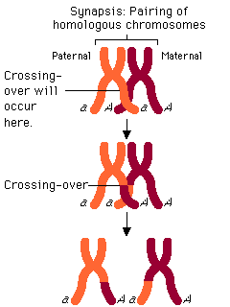

Slide 8
Importance of Variation
Helps species adapt to a changing environment
‘Survival of the fittest’ then occurs as a result of natural selection

Slide 9
Monohybrid Cross
Cross between true-breeding parents with different alleles of the same gene
Genotype: the alleles the individual possesses of a particular gene
Phenotype: physical appearance of an individual

Slide 10
Mendel’s First Law
The principle of segregation
alleles of a gene exist in pairs
when gametes form
members of each pair pass into different gametes
each gamete contains only one allele of each gene

Slide 11
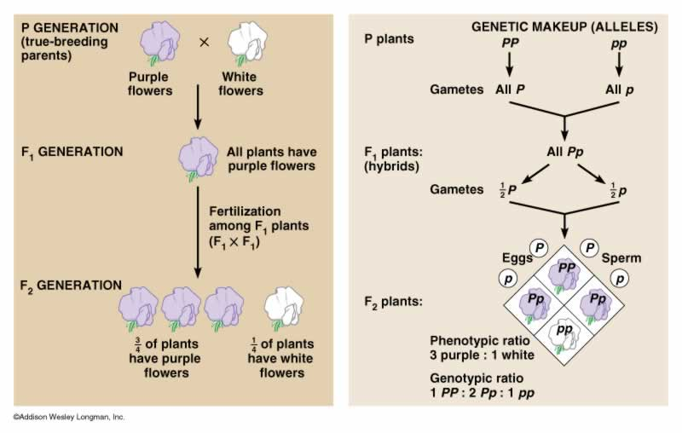

Slide 12
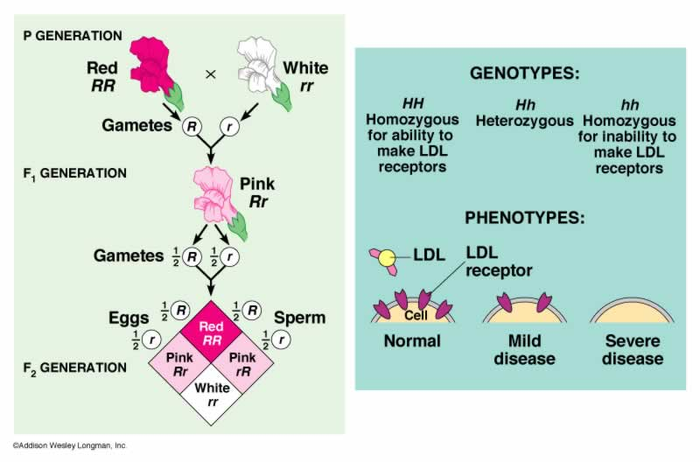
Incomplete dominance

Slide 13
This powerpoint was kindly donated to www.worldofteaching.com
http://www.worldofteaching.com is home to over a thousand powerpoints submitted by teachers. This is a completely free site and requires no registration. Please visit and I hope it will help in your teaching.

