Slide 1

The Human Genome Project

Slide 2
What is the Human Genome Project?
U.S. govt. project coordinated by the Department of Energy and the National Institutes of Health, launched in 1986 by Charles DeLisi.
Definition: GENOME – the whole hereditary information of an organism that is encoded in the DNA.
Aims of the project:
- to identify the approximate 100,000 genes in the human DNA.
- determine the sequences of the 3 billion bases that make up human DNA.
- store this information in databases.
- develop tools for data analysis.
- address the ethical, legal, and social issues that arise from genome research.

Slide 3
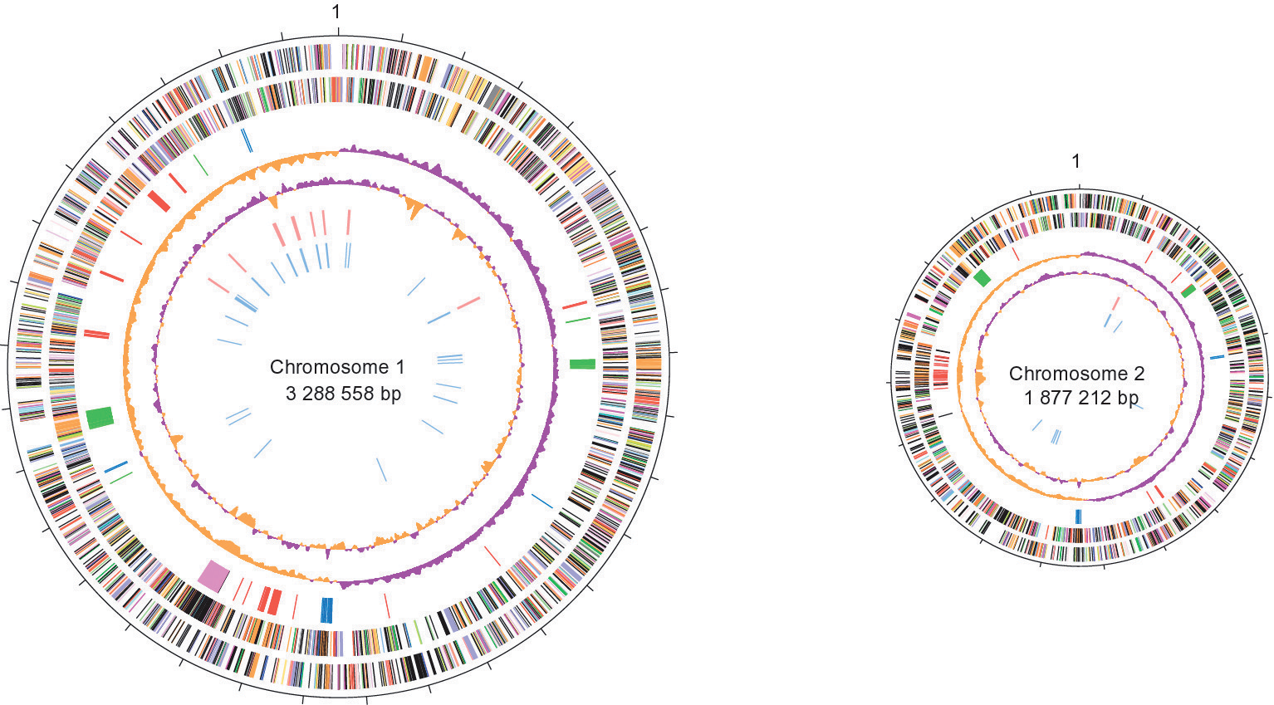
Whose genome is being sequenced?
the first reference genome is a composite genome from several different people.
generated from 10-20 primary samples taken from numerous anonymous donors across racial and ethnic groups.

Slide 4

Benefits of Human Genome Project research
- improvements in medicine.
- microbial genome research for fuel and environmental cleanup.
- DNA forensics.
- improved agriculture and livestock.
- better understanding of evolution and human migration.
- more accurate risk assessment.

Slide 5
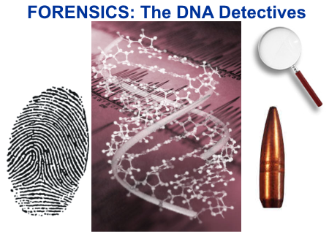
How is each area benefited specifically by the Human Genome Project?
Improvements in medicine: improved diagnosis of disease.
Microbial research: new energy sources, bio fuels.
DNA forensics: identifying potential suspects at a crime scene.
Agriculture: more nutritious produce.
Evolution and human migration: study migration of different population groups based on female genetic inheritance.
- Risk assessment: reduce the likelihood of heritable mutations.

Slide 6
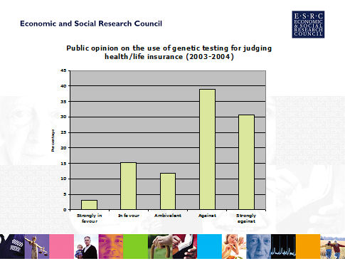
Ethical, legal and social implications of the Human Genome Project
fairness in the use of genetic information.
privacy and confidentiality.
psychological impact and stigmatization.
genetic testing.
reproductive issues.
education, standards, and quality control.
commercialization.
conceptual and philosophical implications.

Slide 7

What are the implications of the Human Genome Project specifically to each of these areas?
Some questions to consider:
Fairness and privacy: who should have access to your genetic information?
Psychological stigmatization: how does knowing your predisposition to disease affect an individual?
Genetic testing: should screening be done when there is no treatment available?
Some other issues:
Reproductive issues: use of genetic information in decision making.
Clinical issues: implementation of standards and quality control measures in testing procedures.

Slide 8
This powerpoint was kindly donated to www.worldofteaching.com
http://www.worldofteaching.com is home to over a thousand powerpoints submitted by teachers. This is a completely free site and requires no registration. Please visit and I hope it will help in your teaching.

