Slide 1
The History of DNA
The scientists who discovered Dna

Slide 2
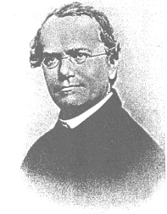
Gregor Mendel
Austrian monk
Born in 1822
In monastery known for
research and teaching
After his death (1884) acknowledgment of his
discoveries in 1900
Known as “The Father of Genetics“

Slide 3
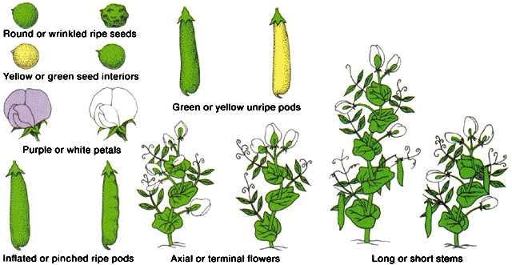
Mendel’s Pea Plants
First scientist to describe how traits are inherited
Looked at pea plants for 8 years
He studied 9 generations of plants

Slide 4
Mendel’s Observations
He noticed that peas are easy to breed for pure traits and he called the pure strains purebreds.
He developed pure strains of peas for seven different traits (i.e. tall or short, round or wrinkled, yellow or green, etc.)
He crossed these pure strains to produce hybrids.

Slide 5
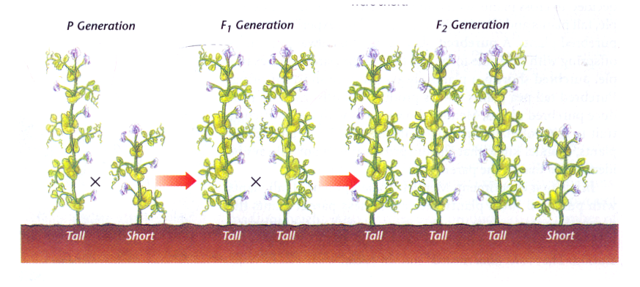
Mendel’s Results
Mendel crossed purebred tall plants with purebred short plants and the first generation plants were all tall.
When these tall offspring were crossed the result was a ratio of 3 tall to 1 short.

Slide 6
The Traits Mendel Looked At

Slide 7
Dominant Trait Rule
Strong Hereditary traits cover weak traits.
Mendel called stronger traits
DOMINANT – Represented by CAPITAL LETTER (T)
Mendel called weaker traits
Recessive – Represented by lower case letter (t)

Slide 8
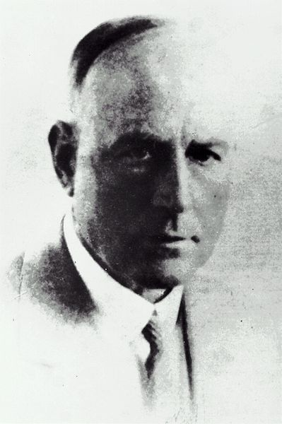
Fredrick Griffith
Worked in the 1920’s
Taxonomist – a scientist who classifies and names organisms – He specialized in pathogens (disease-causing organisms)
Used mice and bacterium (Streptococcus pneumonia) to see if inherited material is passed though DNA or protein.

Slide 9
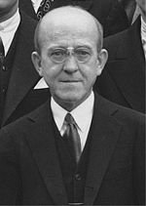
Oswald Avery
Continued Griffith’s work
Identified DNA as the material that passes on the inherited information.
He used large amounts of bacteria and a process of heating and mixing the liquids to extract the nitrogen bases away from the protein
Became world’s first genetic engineer

Slide 10
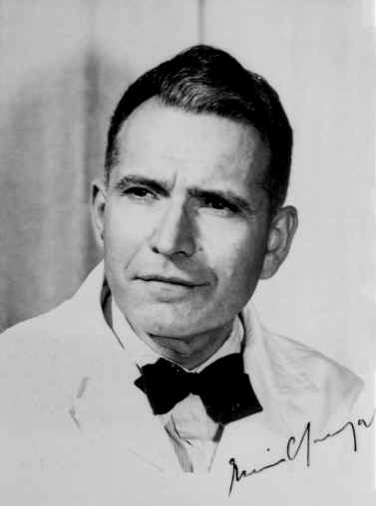
Erwin Chargaff and his rule
In 1950, biochemist Erwin Chargaff found that the arrangement of nitrogen bases in DNA varied widely,
The amount of certain bases always occurred in a one-to-one ratio.
Nitrogen bases always match up like this:
Adenine – Thymine and Cytosine -- Guanine

Slide 11
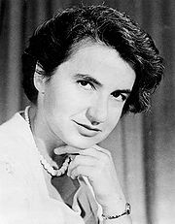
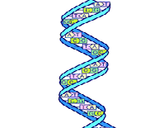
Rosalind Franklin (1920-1953)
Using X-ray techniques took pictures of DNA and discovered the double helix shape of DNA.
Died of cancer due to unknown harmful affects of X-ray

Slide 12
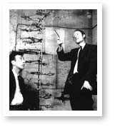
James Watson and Francis Crick
First scientists to create a model of DNA
It is still the model used today
Sides are made of sugar and phosphate molecules
Rungs of the ladder are made of nitrogen bases
Made of 5 elements: carbon, hydrogen, oxygen, nitrogen, and phosphorus

Slide 13
This powerpoint was kindly donated to
www.worldofteaching.com
http://www.worldofteaching.com
Is home to well over a thousand powerpoints submitted by teachers. This a free site. Please visit and I hope it will help in your teaching
Notes:
13

