Slide 1
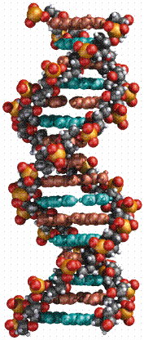
Genetic control of protein structure and function

Slide 2
The structure of DNA and RNA
Genetic material of living organisms is either DNA or RNA.
DNA – Deoxyribonucleic acid
RNA – Ribonucleic acid
Genes are lengths of DNA that code for particular proteins.

Slide 3
DNA and RNA are polynucleotides
Both DNA and RNA are polynucleotides.
They are made up of smaller molecules called nucleotides.
DNA is made of two polynucleotide strands:
RNA is made of a single polynucleotide strand:
Nucleotide
Nucleotide
Nucleotide
Nucleotide
Nucleotide
Nucleotide
Nucleotide
Nucleotide
Nucleotide
Nucleotide
Nucleotide
Nucleotide
Nucleotide
Nucleotide
Nucleotide
Nucleotide

Slide 4
Structure of a nucleotide
A nucleotide is made of 3 components:
A Pentose sugar
This is a 5 carbon sugar
The sugar in DNA is deoxyribose.
The sugar in RNA is ribose.

Slide 5
Structure of a nucleotide
A Phosphate group
Phosphate groups are important because they link the sugar on one nucleotide onto the phosphate of the next nucleotide to make a polynucleotide.

Slide 6
Structure of a nucleotide
A Nitogenous base
In DNA the four bases are:
  Thymine
  Adenine
  Cytosine
  Guanine
In RNA the four bases are:
  Uracil
  Adenine
  Cytosine
  Guanine

Slide 7
Nitrogenous bases – Two types
Pyramidines
Thymine - T
Cytosine - C
Uracil - U
Purines
Adenine - A
Guanine - G

Slide 8
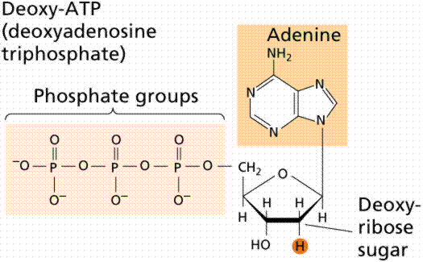
Adenine

Slide 9
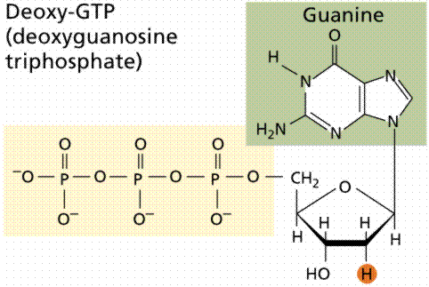
Guanine

Slide 10
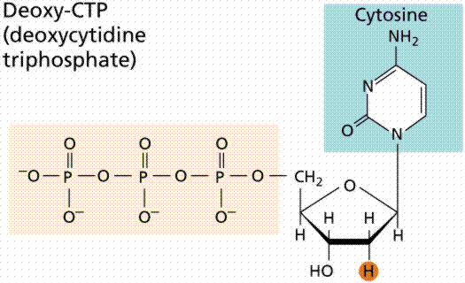

Slide 11
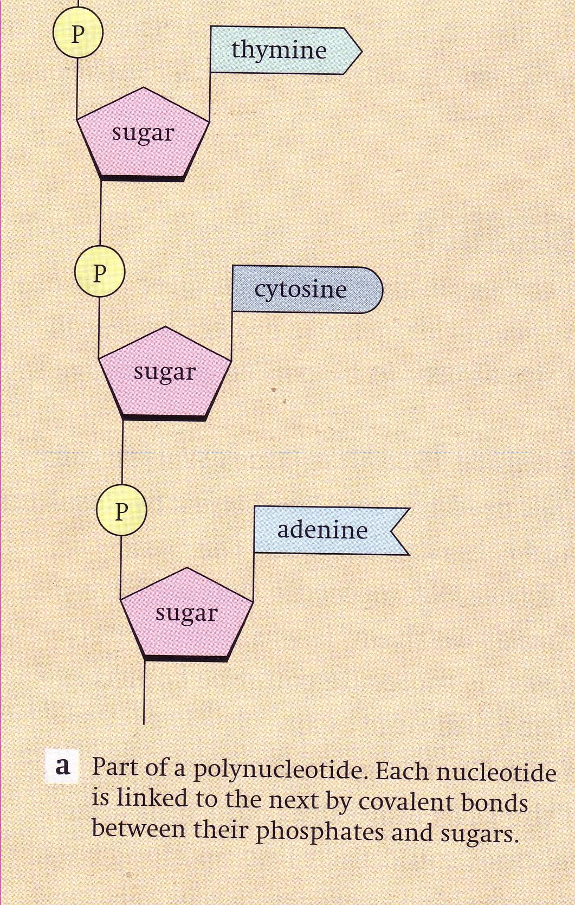
Sugar phosphate bonds (backbone of DNA)
Nucleotides are connected to each other via the phosphate on one nucleotide and the sugar on the next nucleotide
A Polynucleotide

Slide 12
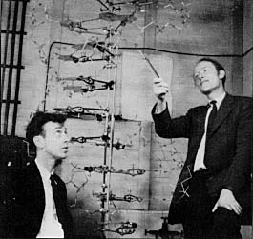
James Watson (L) and Francis Crick (R), and the model they built of the structure of DNA

Slide 13
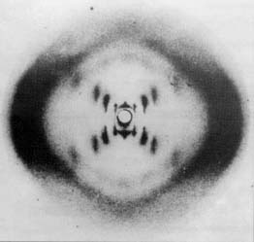
X-ray diffraction photograph of the DNA double helix

Slide 14
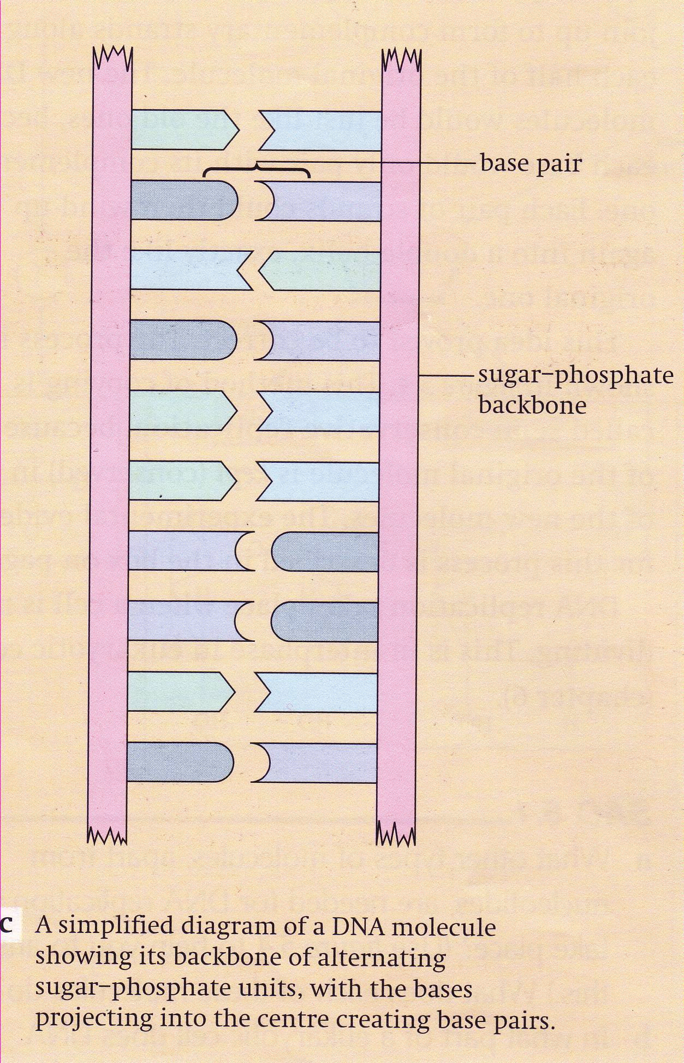
Base pairing
The Nitrogenous Bases pair up with other bases. For example the bases of one strand of DNA base pair with the bases on the opposite strand of the DNA.

Slide 15
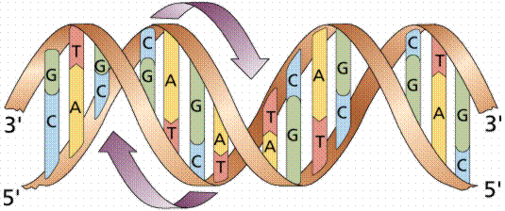

Slide 16
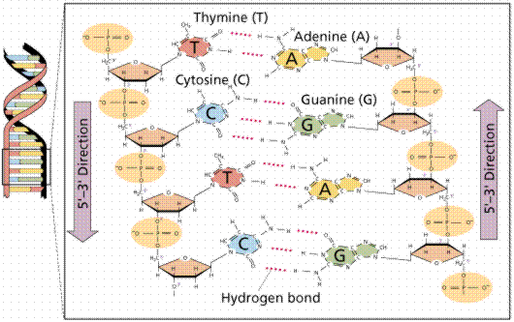

Slide 17
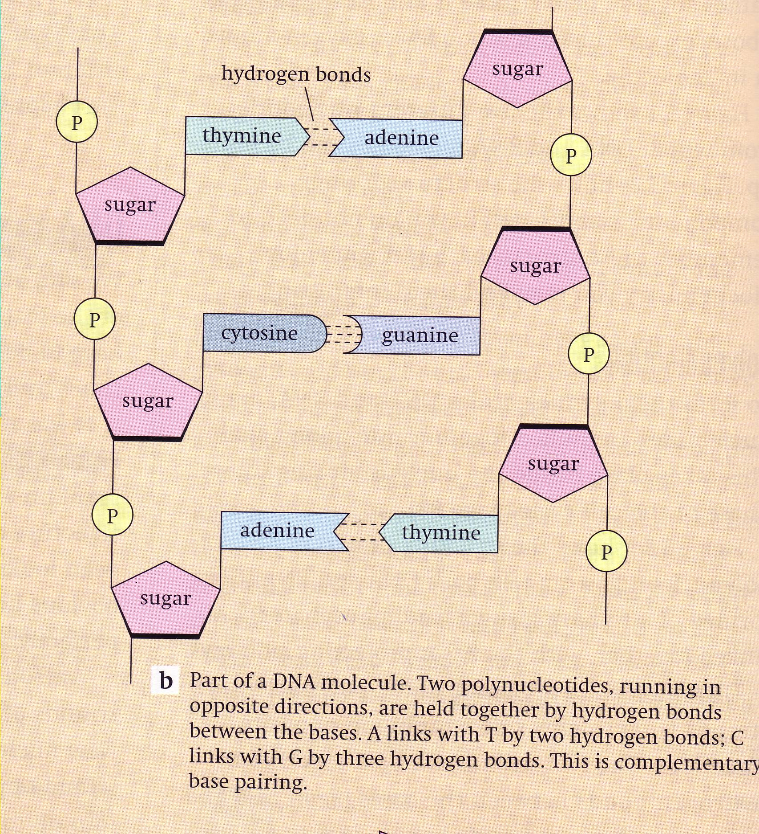

Slide 18
The Rule:
Adenine always base pairs with Thymine (or Uracil if RNA)
Cytosine always base pairs with Guanine.
This is beacuse there is exactly enough room for one purine and one pyramide base between the two polynucleotide strands of DNA.

Slide 19
Complementary base pairing
Purines Pyramidines
Adenine Thymine
Adenine Uracil
Guanine Cytosine

Slide 20
Nature of the Genetic Material
Property 1 - it must contain, in a stable form, information encoding the organism’s structure, function, development and reproduction
Property 2 - it must replicate accurately so progeny cells have the same genetic makeup
Property 3 - it must be capable of some variation (mutation) to permit evolution

Slide 21
Replication of DNA and Chromosomes
Speed of DNA replication:
3,000 nucleotides/min in human
30,000 nucleotides/min in E.coli
Accuracy of DNA replication:
Very precise (1 error/1,000,000,000 nt)

Slide 22
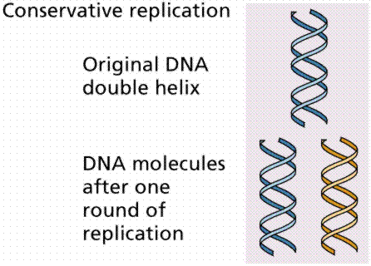

Slide 23
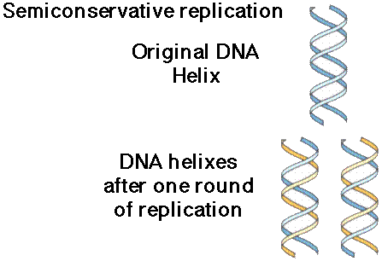

Slide 24
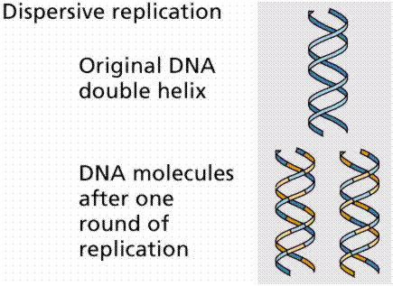

Slide 25
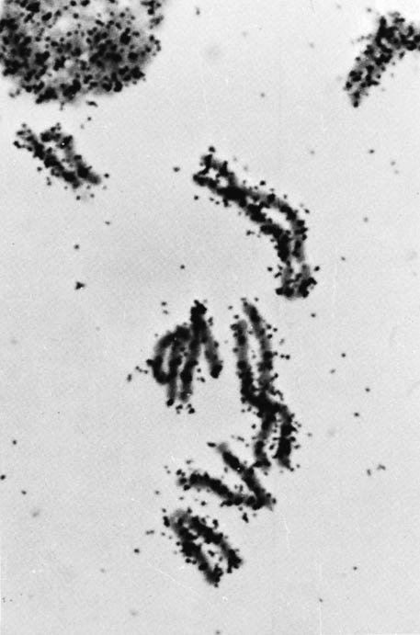
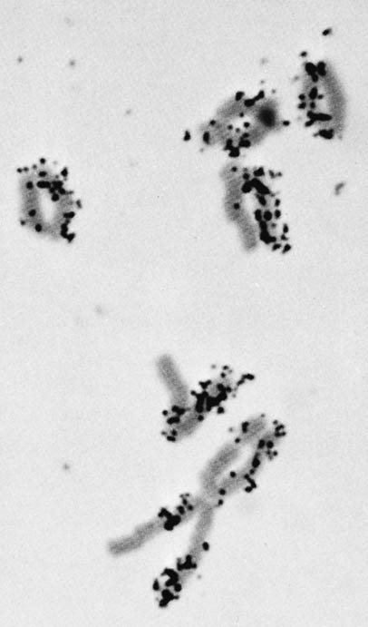
Taylor and co-workers (1957)
³H-labelled chromosomes
after one further replication
in unlabelled media

Slide 26
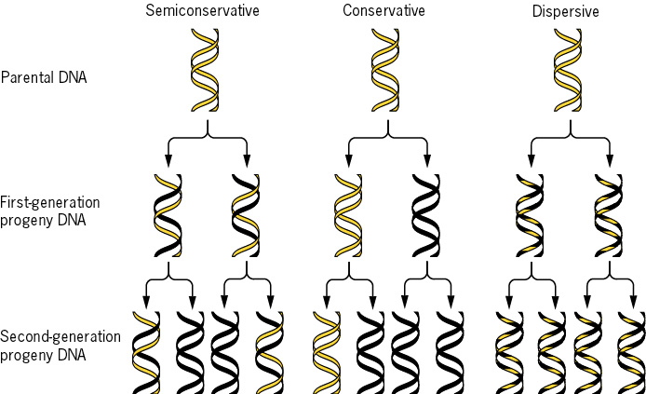
Meselson and Stahl (1958)

Slide 27
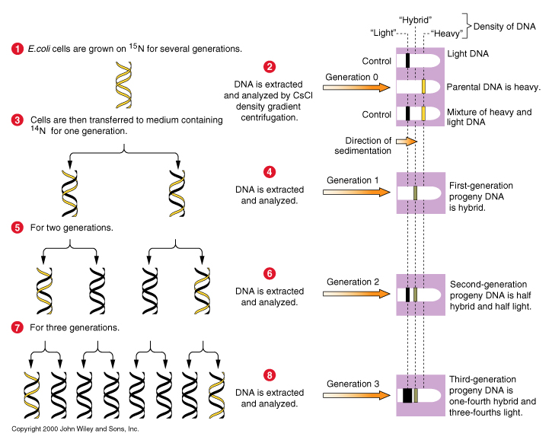

Slide 28
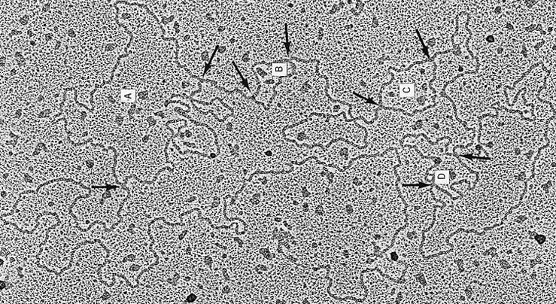
A replicating Drosophila chromosome

Slide 29
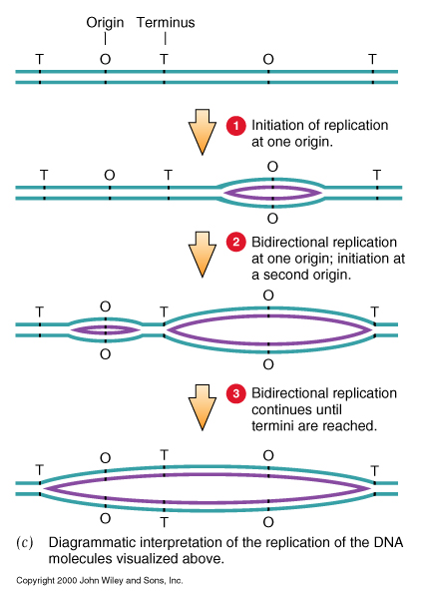
Origins initiate replication at different times.

Slide 30
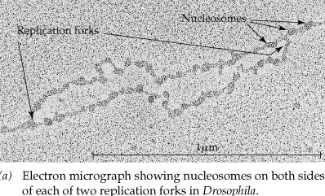

Slide 31
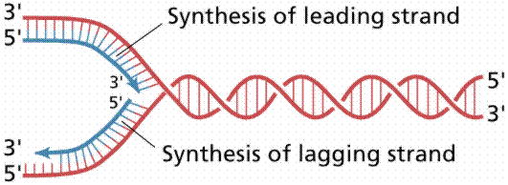

Slide 32
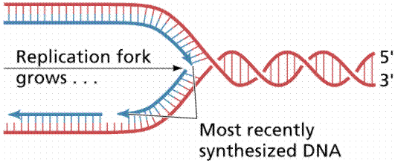

Slide 33
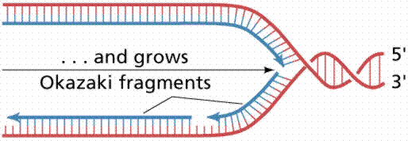

Slide 34
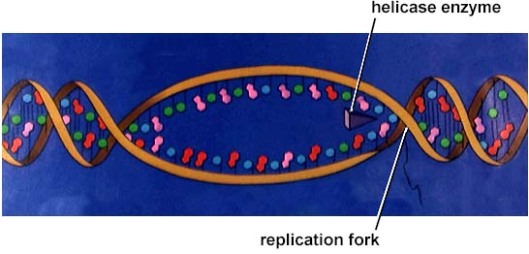

Slide 35
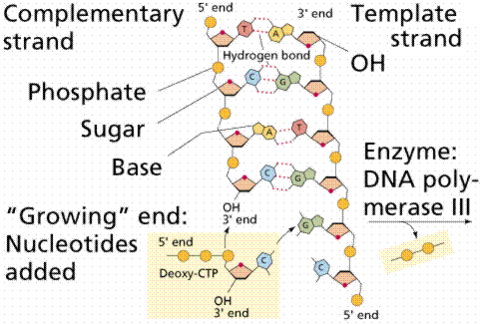

Slide 36
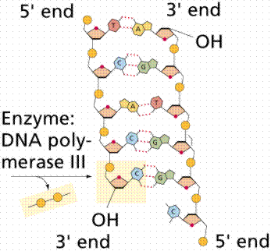

Slide 37
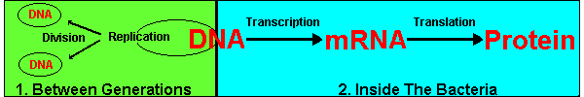

Slide 38
This powerpoint was kindly donated to www.worldofteaching.com
http://www.worldofteaching.com is home to over a thousand powerpoints submitted by teachers. This is a completely free site and requires no registration. Please visit and I hope it will help in your teaching.

