Slide 1
Last Week in….
Adventures in Biology...
We discussed the different forms of Reproduction
We discussed the costs/benefits of each form
This week we’ll discuss sexual
differentiation - how sexually reproducing organisms develop
into separate sexes. Specifically, as it applies to us humans

Slide 2
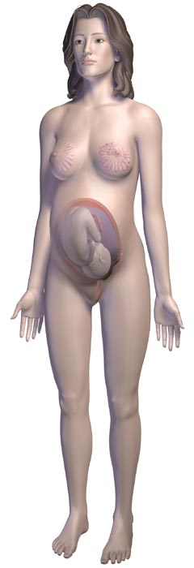
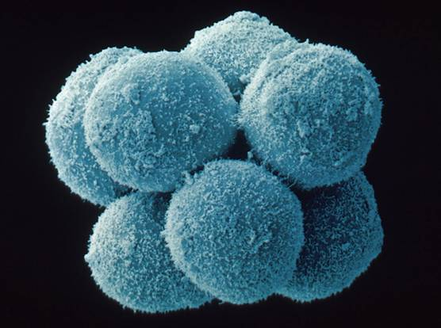
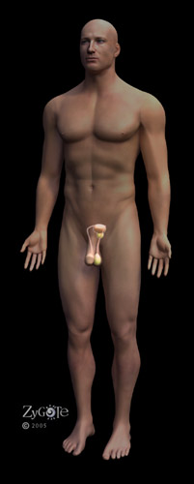
SO…How Do We Get From…
Here…
To here…
(fully developed adult female)
?
OR
To here…
(essentially a clump
of undifferentiated
cells)
(fully developed adult male)

Slide 3
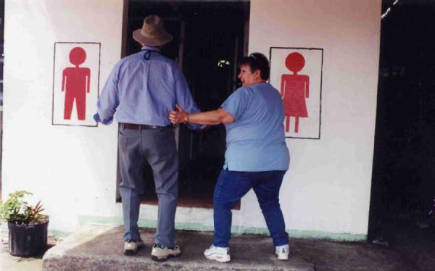
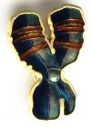
In other words, How do our bodies know if we are meant to use the little boys’ room or the little girls’ room?
It’s the factor!

Slide 4

The Y chromosome contains a gene known as the SRY (sex determining region on the Y chromosome) gene.
This gene is responsible for the development of testes
But what about the factor?

Slide 5
Everyone develops an area known as the urogenital ridge
Unless testes develop, this area will naturally develop into the female reproductive system
In other words, we are all female by default

Slide 6
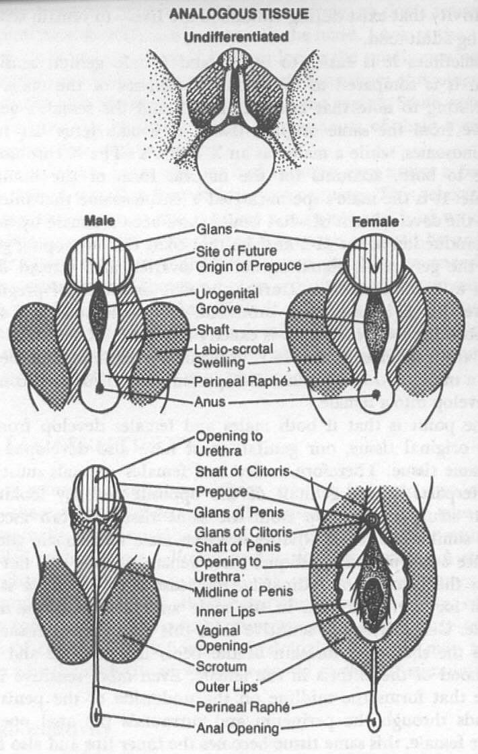

Slide 7
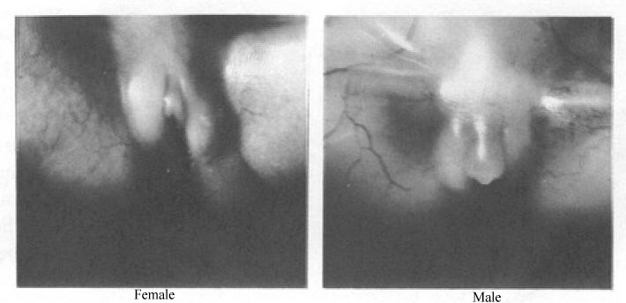

Slide 8
BUT…how does this happen??
When testes form they release 2 hormones - testosterone & MIS (mullerian inhibiting substance)
The testosterone causes the male reproductive system to develop
MIS causes the ducts of the female system to degenerate

Slide 9
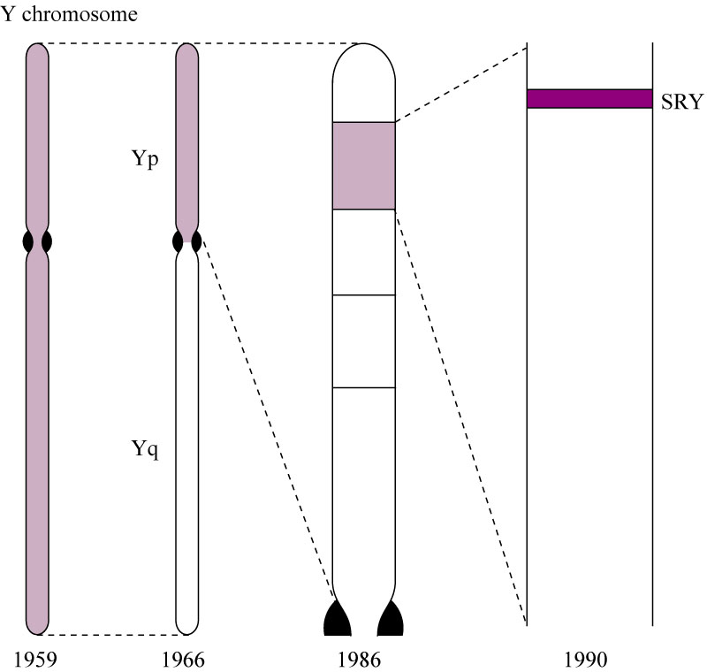
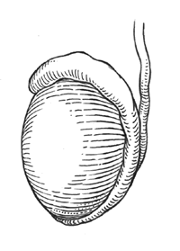
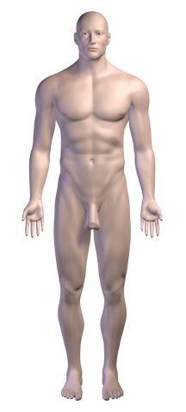
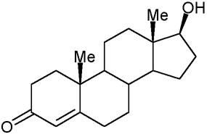
Codes for
formation of
produces
testes
SRY gene on the
Y Chromosome
Leads to
development
of mature male
reproductive
system
Testosterone
& MIS

Slide 10

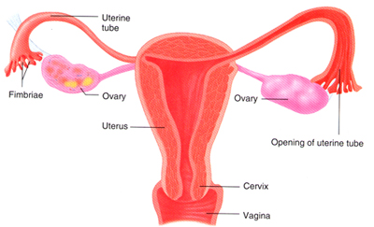
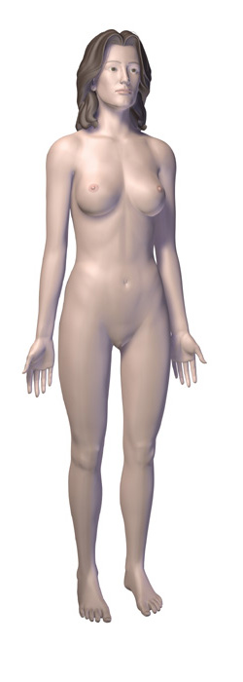
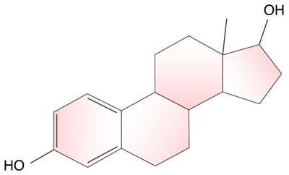
leads to the
natural
development
of the
produces
Female reproductive organs
leads to
development
of mature
female
reproductive
system
Estrogen
& Progesterone

Slide 11
This powerpoint was kindly donated to www.worldofteaching.com
http://www.worldofteaching.com is home to over a thousand powerpoints submitted by teachers. This is a completely free site and requires no registration. Please visit and I hope it will help in your teaching.

