Slide 1
Reverse Transcription

Slide 2
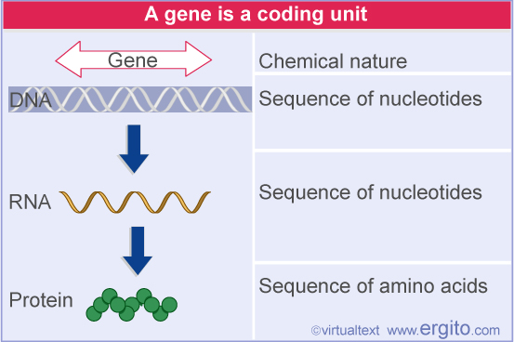
Central Dogma

Slide 3
Normal transcription involves synthesis of RNA from DNA.
Reverse transcription is the transcription of single stranded RNA into double stranded DNA
With the help of the enzyme Reverse Transcriptase.

Slide 4
Reverse Transcriptase also known as RNA directed DNA Polymerase
- DNA Nucleotidyl transferase (RNA directed)
- Revertase
Reverse Transcriptase was discovered by Howard Temin and Baltimore in 1970 independently
- shared Nobel Prize in Physiology or Medicine in 1975 for their discovery.

Slide 5
Reverse transcriptase common in Retrovirus.
- HIV
M-MLV (Moloney Murine Leukemia Virus)
AMV (Avian Myeloblastosis Virus)
Reverse Transcriptase enzyme includes two activity: DNA polymerase and RNase H

Slide 6
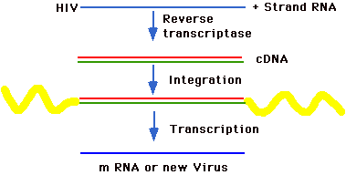
Retrovirus Replication Cycle
ds DNA
host DNA
Provirus
Packaging into virus ; budding

Slide 7
Antiviral drug
Zidovudine
Lamivudine
Tenfovir

Slide 8
Typical retrovirus has three or four genes.
Gag-pol- env
Retrovirus are called + strand because viral RNA itself code for protein products.
Reverse transcriptase enzyme code for proteins are called – strand
R : Redundant or repeating seq – 10-80
U5: 80 – 100
U3: 170-1350
Like DNA polymerase, Reverse transcriptase requires primers.
tRNA of the host is Primer

Slide 9
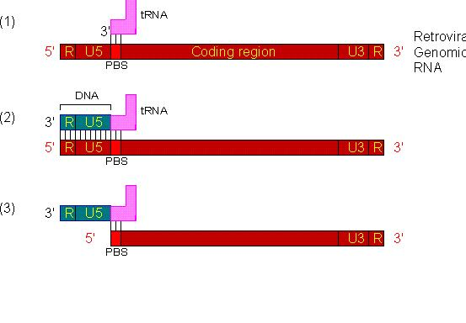
MECHANSIM OF RETROVIRUS REPLICATION
1. A Retrovirus specific cellular tRNA hybridizes with a complementary region called PBS (Primer Binding Sites)
2. Reverse Transcriptase (RT) starts at this binding site and copies RNA into a single strand of complementary DNA. A DNA segment is extended from tRNA based on the sequence of the retroviral genomic RNA
3. The viral R and U5 sequences are removed by RNase H.
LTR – Long Terminal Repeat
Left LTR - Redundant sequence [R]+ 5’ untranslated region (U5)
Right LTR - Redundant sequence [R]+ 3’ untranslated region (U3)

Slide 10
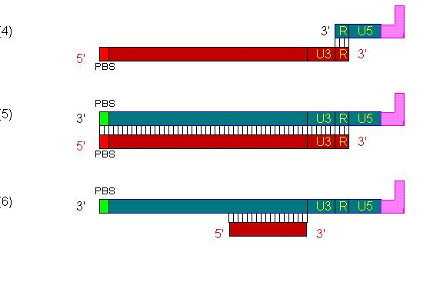
4. First jump: DNA hybridizes with the remaining R sequence at the 3' end.
5. A DNA strand is extended from the 3' end.
6. Most viral RNA is removed by RNase H

Slide 11
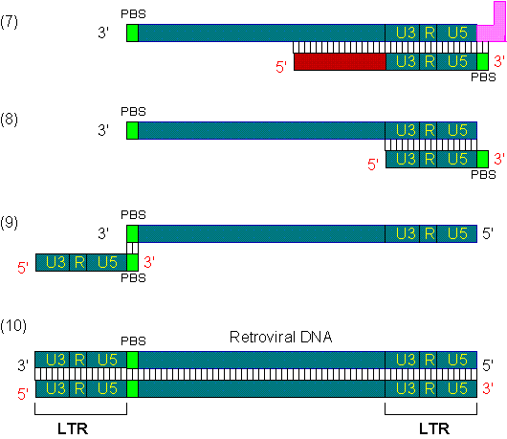
7. A second DNA strand is extended from the viral RNA.
8. Both tRNA and the remaining viral RNA are removed by RNase H.
9. Second jump: The PBS region of the second strand hybridizes with the PBS region of the first strand.
10. Extension on both DNA strands.

Slide 12
Reverse transcriptase has a high error rate when transcribing RNA into DNA as unlike DNA Polymerase, since it has no proof reading ability
This high error rate allows mutations to accumulate
The commercially available RT produced by Promega are quoted high error rates in range of one in 17,000 bp for AMV and one in 30,000 bases for M-MLV

Slide 13
cDNA
Reverse Transcriptase can use single stranded RNA into DS DNA – cDNA.
cDNA library: A set of clones representing as many as possible of the mRNAs in a given cell type at given time.
In the preparation cDNA library, mRNA is extracted, purified, and treated with the enzyme reverse transcriptase.
Complementary DNA (cDNA) analogs of the isolated mRNA are thereby obtained.
Since mature mRNA contains no introns or regulatory regions, a cDNA library composed of coding regions.

Slide 14
This powerpoint was kindly donated to
www.worldofteaching.com
http://www.worldofteaching.com
Is home to well over a thousand powerpoints submitted by teachers. This a free site. Please visit and I hope it will help in your teaching
Notes:
14

