Slide 1
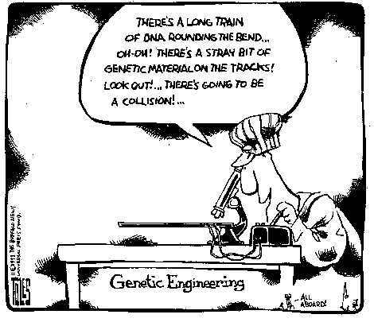
RECOMBINANT DNA AND POLYMERASE CHAIN REACTIONS

Slide 2
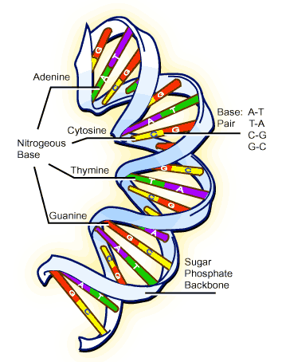
What do we already know
DNA – Double Helix Structure
Each spiral strand is composed of a sugar phosphate backbone and attached bases
4 Bases: Adenine (A), Guanine(G),
Cytosine (C), and Thymine (T).
Form Base Pairs; A with T and C with G in the complementary strand via
hydrogen bonding (non- covalent)
The strands can be cut by
restriction enzymes, e.g. ECOR1

Slide 3
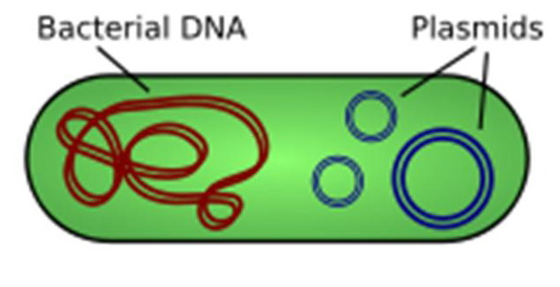
Bacterial Structure
Bacteria are often used in biotechnology as they have plasmids
A plasmid a circular piece of DNA that exists apart from the chromosome and replicates independently of it.

Slide 4
Fill in the blanks of the worksheet

Slide 5
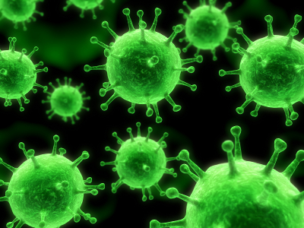
What is Recombinant DNA?
DNA that has been cut from one strand of DNA and then inserted into the gap of another piece of DNA that has been broken.
The host DNA is often a bacterial cell such as E coli.
The purpose of splicing the gene into the host DNA is to produce many copies of it.
As bacteria reproduce in a very short time it is possible to make millions of
copies of the gene fairly quickly.

Slide 6
How do we make it?
The required gene e.g. Insulin, is cut from the DNA using a restriction enzyme.
A circular piece of DNA, called a plasmid, is removed from the bacterial cell and is cut open using the same restriction enzyme.
The cut out human gene is then mixed with the bacterial plasmids in a test tube.
Because they have been cut with the same enzyme, the cut ends of the plasmid and the end of the human gene match. Often called ‘sticky ends’
The enzyme DNA ligase is used to stick the ends together.

Slide 7
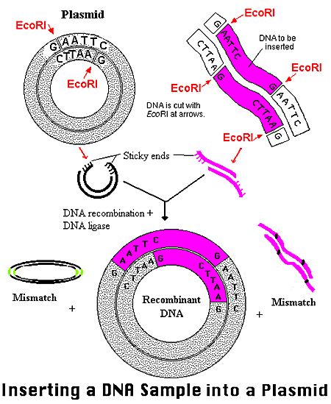

Slide 8
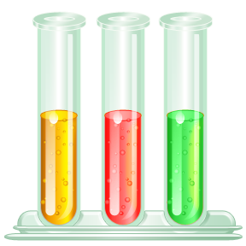
Re-Introducing the Plasmid Back - TRANSFORMATION
Now the plasmids that contains the introduced gene (recombinant DNA) need to be reintroduced into the bacteria so they can multiply and make more of the gene.
Can be done by combining them in a test tube with CaCl2. The high concentration of calcium ions makes the membranes of the bacteria more porous.
This then allows the plasmids to move into the bacterial cells.
Not all bacteria will take up a plasmid
and this is why the monitoring must
happen.

Slide 9
How do we know which bacteria have the gene?
It is necessary to isolate the host bacteria that contain the gene that has been spliced as only want the recombinant DNA
By having a gene on the same plasmid that gives resistance to an antibiotic, the other bacteria can be removed by culturing the bacteria in a medium that contains the antibiotic.
The bacteria containing the resistance to the antibiotic will survive and the others will be killed by the antibiotic.

Slide 10
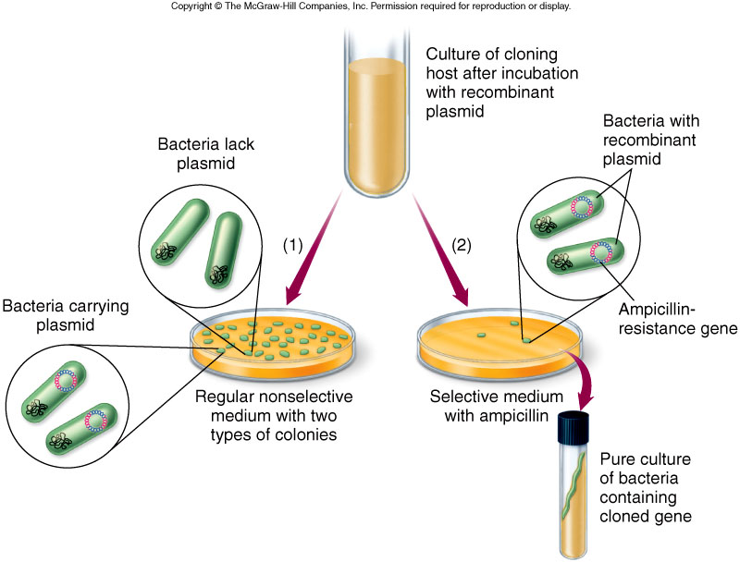
Selection of Altered Cells
Antibiotic resistance gene used to identify recombinant cells

Slide 11
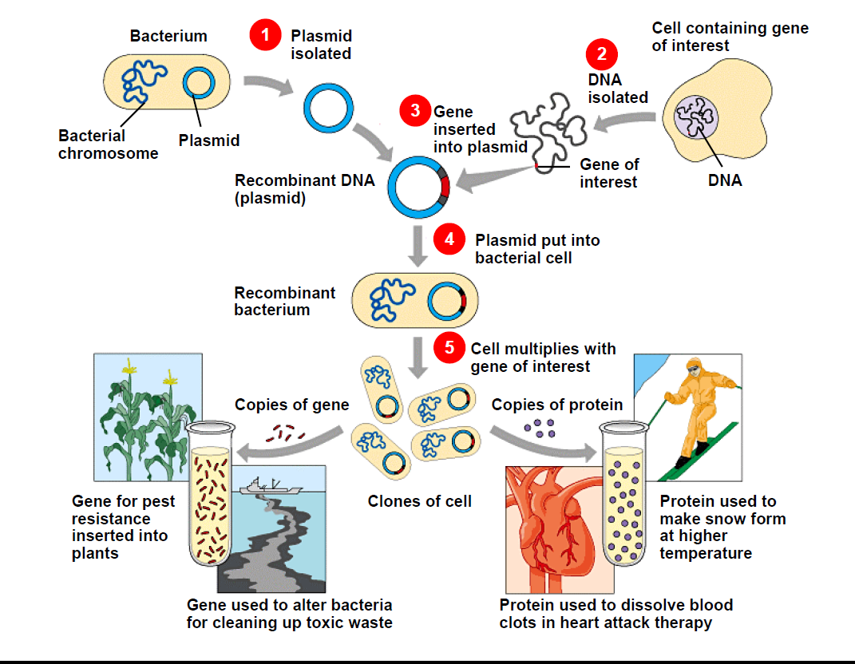
ANIMATION – RECOMBINANT DNA
http://www.sumanasinc.com/webcontent/animations/content/plasmidcloning.html

Slide 12
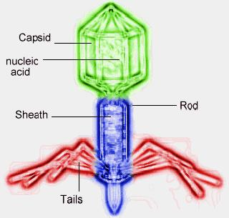
Can we use this technique on all cells?
Plasmids will not work as well in eukaryotic organisms like plants and animals
Other methods need to be used to insert the DNA
Viral vectors can be used for animal cells.
The virus can ‘inject’ their DNA into an animal host cell.

Slide 13
GENE GUN
Gene Gun can be used to insert genes into plant cells
http://www.hort.purdue.edu/hort/courses/HORT250/animations/Gene%20Gun%20Animation/Genegun1.html

Slide 14
Biotechnologists are Problem Solvers!
Diabetics having reactions to porcine/animal insulin
Wheat crops being attacked by insects
People sick with cystic fibrosis
All these can be fixed by recombinant DNA!!!
On a Flow Chart show the steps involved in making recombinant DNA for a desired gene. From cutting of the gene to the final product (this may involve the delivery method)

Slide 15
Now we have made the gene – how do we get lots of copies??

Slide 16
E.Coli Plasmid is cut with the same restriction enzyme used to cut the insulin gene
Insulin gene is cut from a pancreatic cell DNA using a specific restriction enzyme
The insulin gene and E.coli plasmid are mixed with DNA ligase enzyme so that they can join their sticky ends
The plasmid containing the insulin gene is reinserted into the E.coli (TRANSFORMATION/TRANSFECTION)
The plasmid reproduces itself inside the E.coli.
The bacterial cells reproduce, cloning the required gene – can be monitored by using antibiotic resistance.
Only recombinant Plasmids containing gene and antiobiotic resistance gene will grow
The desired genes can then be selected
insulin - Bacterial cells when supplied with required polypeptides or proteins, the colonies will produce insulin
E.g Vaccines- The plamids are isolated from the e.coli cells, the genes are then amplifyed via PCR and used to create inactivated viruses for vaccines

Slide 17
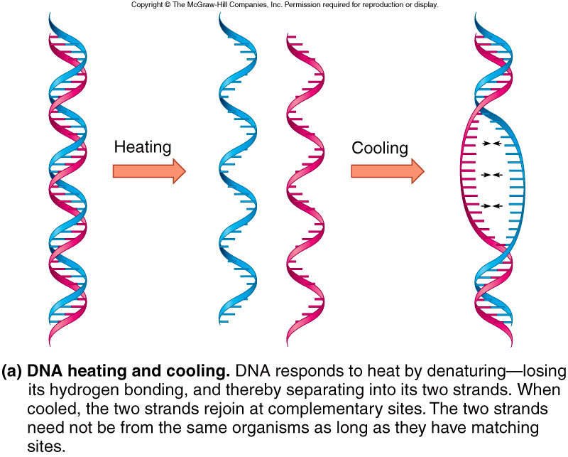
Useful Properties of DNA
The complementary strands of DNA can be separated and re-associated by heating and cooling
One strand of DNA specifies the sequence of the other strand

Slide 18
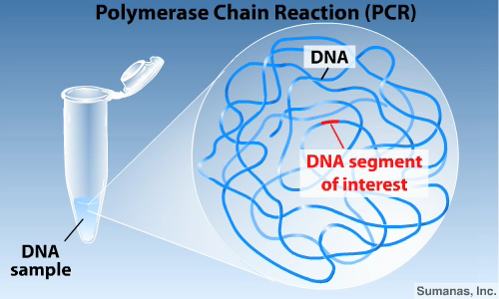
Polymerase Chain Reaction
Used to make more copies of DNA from a tiny DNA sample
http://www.sumanasinc.com/webcontent/animations/content/pcr.html

Slide 19
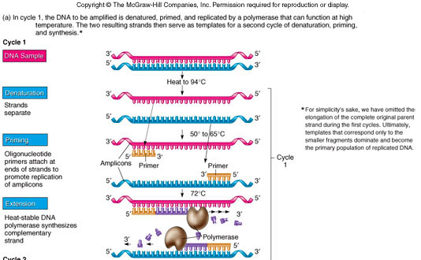
Polymerase Chain Reaction (PCR) Amplifies DNA
Primers specify what DNA is copied

Slide 20
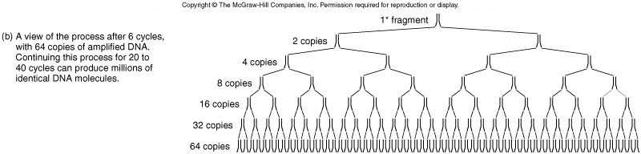
PCR Amplifies DNA
Diagnosis
Epidemiology
Genetic engineering

Slide 21
Flow Chart of PCR

Slide 22

Real World Applications
Production of Insulin
Making recombinant vaccinations
Making food crops with immunity to insects
Forensic Crime scene analysis –
DNA profiling

Slide 23
Other Issues
Ethical issues related to “cloning” of human genes
How will genetically engineered organisms affect environment?
Spread of genes to other organisms?
Who will decide?

Slide 24
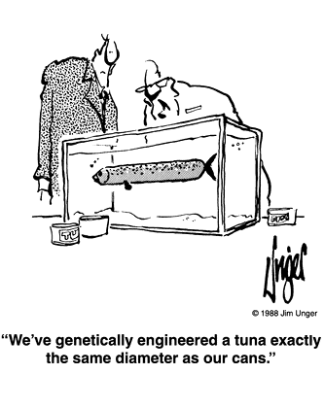

Slide 25
This powerpoint was kindly donated to
www.worldofteaching.com
http://www.worldofteaching.com
Is home to well over a thousand powerpoints submitted by teachers. This a free site. Please visit and I hope it will help in your teaching
Notes:
25

