Slide 1

REAL TIME PCR & IT’S FUNCTIONS IN DIAGNOSIS
By: A . Qorani

Slide 2


1:Introduction to PCR 2:Advantages & disadvantages 3:Real Time PCR 4:Detection of products 5:Function in medicine 6:Conclusion 7:Reference
Outline
Introduction
Advantage disadvantages
Real Time PCR
Product Detection
in medicine
Conclusion
Reference
3/14/2023
REAL TIME PCR & IT’S FUNCTIONS IN DIAGNOSIS

Slide 3
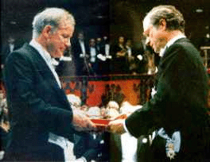
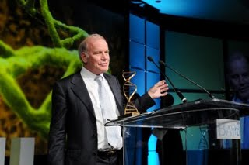
Introduction to PCR
PCR was invented in 1984 by ( Kary mullis ) & he received the Nobel Prize in chemistry in 1993, for his invention.(1)
Introduction
It revolutionized biological methods specially in molecular cloning in a way that it has
became an inseparable & irreplaceable part of molecular investigations.
Advantage disadvantages
Real Time PCR
Product Detection
in medicine
Conclusion
Reference
REAL TIME PCR & IT’S FUNCTIONS IN DIAGNOSIS

Slide 4
more…
There is three basic steps which are in common with all type of PCR
Thermal denaturation :
In this step DNAs are denatured mostly by temprature about 94˚c & single stranded DNAs are made.
( in some cases It’s done by helicase )
Primer annealing :
In this step Primers are attached to ssDNA by their complementary regions.
Extension or polymerization :
This is done by a temprature resistance polymerase named Taq polymerase which is extracted from Thermus aquaticus.
Introduction
Advantage disadvantages
Real Time PCR
Product Detection
in medicine
Conclusion
Reference
REAL TIME PCR & IT’S FUNCTIONS IN DIAGNOSIS

Slide 5
more…
PCR phases
Exponential
If 100% efficiency – exact doubling of products. Specific and precise
Linear
High variability. Reaction components are being consumed and PCR products are starting to degrade.
Plateau
End-point analysis. The reaction has stopped and if left for long – degradation of PCR products.
Introduction
Advantage disadvantages
Plateau
Real Time PCR
Linear
Product Detection
Exponential
in medicine
Conclusion
Reference
REAL TIME PCR & IT’S FUNCTIONS IN DIAGNOSIS

Slide 6
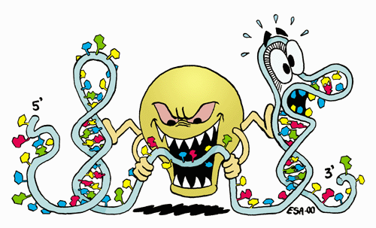
more…
Things which are needed for PCR(1)
Template DNA that is going to be amplified.this DNA must be pure & all other contaminations like RNAs must be removed by RNase.
Primers (forward & reverse )which are attached to their complementary sequence in 3´ of each strand.
Taq or any other polymerase which must have
activity in high temprature.
dNTPs which are the main substances in DNA composition.
Buffer which makes a perfect condition to process.
Cations that are essential for polymerase activity.
Contaminations like RNAs must be removed by RNase.
Introduction
Advantage disadvantages
Real Time PCR
Product Detection
in medicine
Conclusion
Reference
REAL TIME PCR & IT’S FUNCTIONS IN DIAGNOSIS

Slide 7
Advantages & disadvantages
* The most accurate & feasible technique to determine the amount & concentration of products.
* Rapid cycling (30 minutes to 2 hours).
* Specific & sensitive.
* Not much more expensive.
* * * * *
* Pollution.
* Poor precision.
* Hard to get quantitative data.
Introduction
Advantage disadvantages
Real Time PCR
Product Detection
in medicine
Conclusion
Reference
REAL TIME PCR & IT’S FUNCTIONS IN DIAGNOSIS

Slide 8
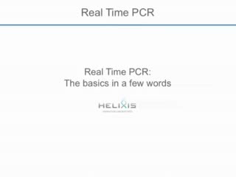
Real Time PCR
The perfect standard does not exist.
Quantitative Real-Time PCR is an important technique for quantifying messenger RNA levels (gene expression) and DNA gene levels (copy number) in biological samples.(1)
Introduction
Advantage disadvantages
Real Time PCR
Product Detection
Additional benefits of Real-Time quantitative PCR include sensitivity and a wide dynamic range. As few as 10 copies of an RNA/DNA target can be detected with linearity of detection greater than six orders of magnitude.
in medicine
Conclusion
Considered to be the most sensitive method for the detection and quantification of gene expression
Reference
REAL TIME PCR & IT’S FUNCTIONS IN DIAGNOSIS

Slide 9
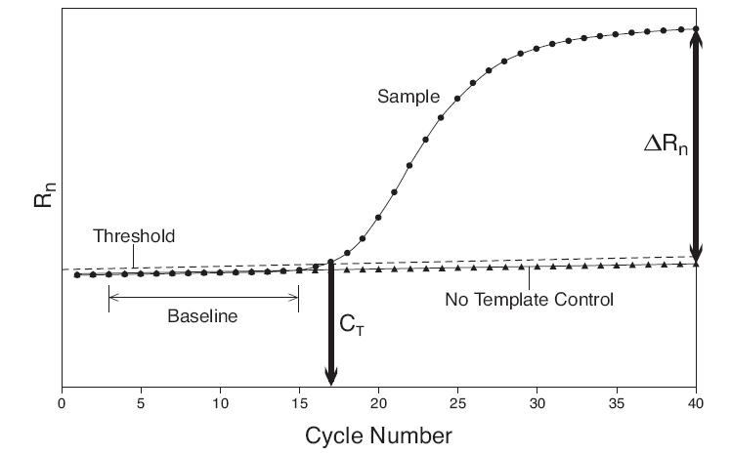
The Basic of Real time PCR
Introduction
Log fluorescence (Rn)
Advantage disadvantages
Real Time PCR
Product Detection
in medicine
Baseline – The baseline phase contains all the amplification that is below the level of detection of the real time instrument.
Threshold – where the threshold and the amplification plot intersect defines C_{T}. Can be set manually/automatically
C_{T} – (cycle threshold) the cycle number where the fluorescence passes the threshold
ΔR_{n} – (R_{n}-baseline)
NTC – no template control
ΔRn is plotted against cycle numbers to produce the amplification curves and gives the C_{T} value.
Conclusion
Reference
REAL TIME PCR & IT’S FUNCTIONS IN DIAGNOSIS

Slide 10
Using the PCR Equation
X_{n}
X_{n} = X₀(1 + E)^{n}
A
Introduction
X_{n} =PCR product after cycle n
X₀ =initial copy number
E =amplification efficiency
n =cycle number
Advantage disadvantages
Real Time PCR
X₀
cycle number
Product Detection
A difference of 0.1 in amplification efficiency create a five-fold difference in the final ratio of PCR products after 30 cycles.
in medicine
X_{n} = X₀(1+E)^{n}
Conclusion
Case 1: E = 0.9 Case 2: E = 0.8
Reference
X_{n} = 100 (1+0.9)³⁰
X_{n} = 100 (1+0.8)³⁰
X_{n} = 2.3 x 10¹⁰
X_{n} = 4.6 x 10⁹
REAL TIME PCR & IT’S FUNCTIONS IN DIAGNOSIS

Slide 11
Instruments, Accessories and Software
1 ) Light Cycler® Relative Quantification Software
The first commercially available software was the Light Cycler® Relative Quantification Software (2001).
2 ) REST
In 2002, the relative expression software tool (REST ) was established as a new tool.
3 ) Q-Gene
Recently a second software tool, Q-Gene, was developed, which is able to perform a statistical test of the real-time data.Q-Gene manages and expedites the planning, performance and evaluation of quantitative real-time PCR experiments.
4 ) qBASE
QBASE is an Excel®-based tool for the management and automatic analysis of real-time quantitative PCR data.
Introduction
Advantage disadvantages
Real Time PCR
Product Detection
in medicine
Conclusion
Reference
REAL TIME PCR & IT’S FUNCTIONS IN DIAGNOSIS

Slide 12
more…
5 ) SoFAR
The algorithms implemented in SoFAR (distributed by Metralabs) allow fully automatic analysis of real-time PCR data obtained with a Roch LightCycler® (Roche Diagnostics) instrument. The software yields results with considerably increased precision and accuracy of real-time quantification.
6 ) DART-PCR
DART-PCR (Data Analysis for Real-Time PCR) provides a simple means of analyzing real-time PCR data from raw fluorescence data.This allows an automatic calculation of amplification kinetics, as well as performing the subsequent calculations for the relative quantification and calculation of assay variability.
Introduction
Advantage disadvantages
Real Time PCR
Product Detection
in medicine
Conclusion
Reference
REAL TIME PCR & IT’S FUNCTIONS IN DIAGNOSIS

Slide 13
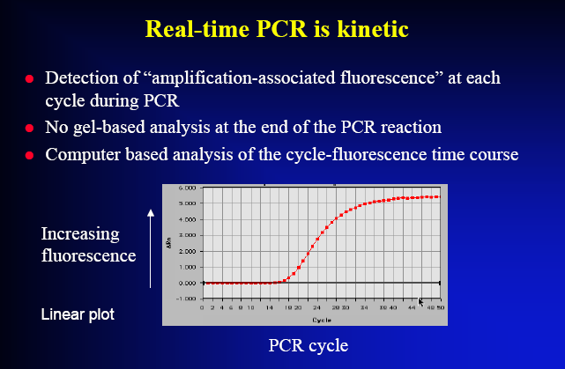
Real time PCR in comparison with other technical methods
Less time to getting results
Introduction
Advantage disadvantages
Real Time PCR
Product Detection
in medicine
Conclusion
Reference
REAL TIME PCR & IT’S FUNCTIONS IN DIAGNOSIS

Slide 14
Real time PCR is the most accurate method to detect(2) :
Copy number of each gene
Amount of gene expression
Efficiency of drugs
Virus infection
Different type of Pathogens
( CMV, streptococcus, mycobacterium,HIV & … )
Methylation of DNA
Different type of mutations
Adverse effect of organ transplantation
& …
Introduction
Advantage disadvantages
Real Time PCR
Product Detection
in medicine
Conclusion
Reference
REAL TIME PCR & IT’S FUNCTIONS IN DIAGNOSIS

Slide 15
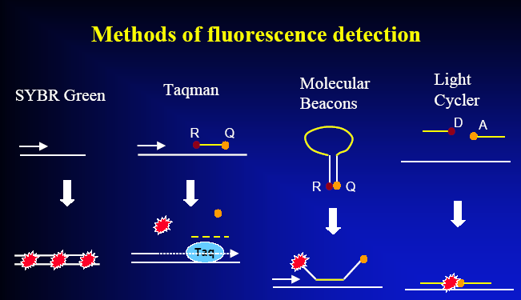
Detection in real time PCR
Uses fluorescence as a reporter by Three general methods :
1. Hydrolysis probes
(TaqMan, Beacons, Scorpions)
2. Hybridization probes
(Light Cycler) most accurate & specific.
3. DNA-binding agents
(SYBR Green)less accuracy.
Introduction
Advantage disadvantages
Real Time PCR
Product Detection
in medicine
Conclusion
Reference
REAL TIME PCR & IT’S FUNCTIONS IN DIAGNOSIS

Slide 16
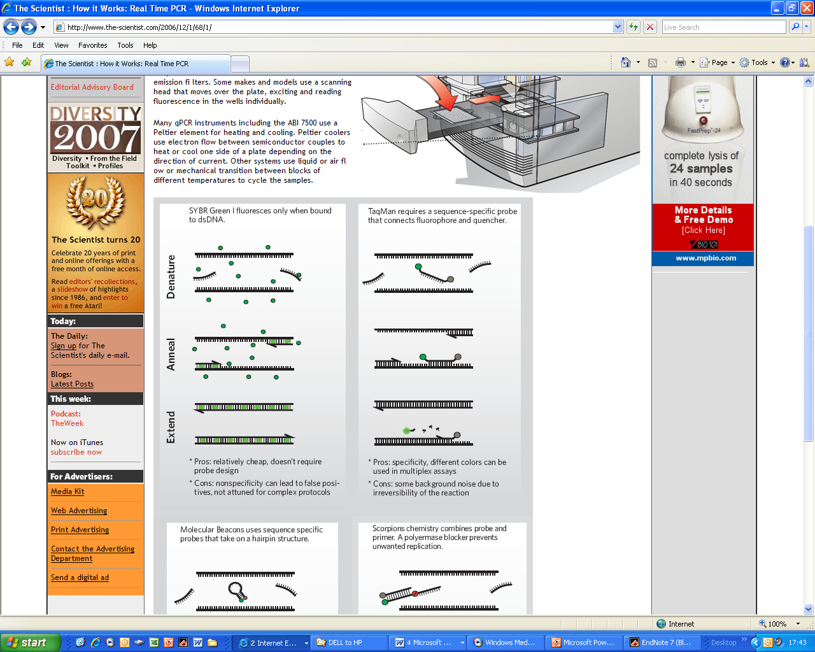
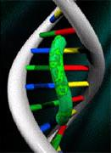
SYBR® green
* DNA binding dye
* Binds to minor groove (dsDNA)
* Emits light when bound
More double stranded DNA = more binding = more fluorescence
* Forensically, can be used to calculate how much DNA was present before reaction.
* Unspecific
* Dissociation curve
Introduction
Advantage disadvantages
Real Time PCR
Product Detection
in medicine
Conclusion
Reference
REAL TIME PCR & IT’S FUNCTIONS IN DIAGNOSIS

Slide 17
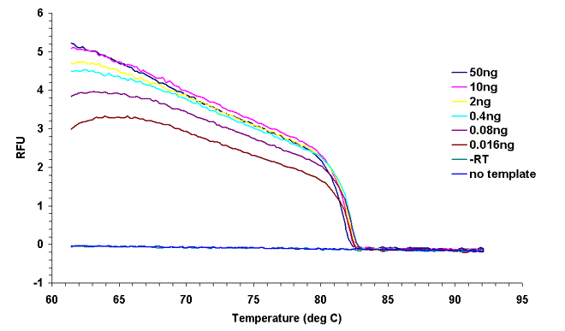
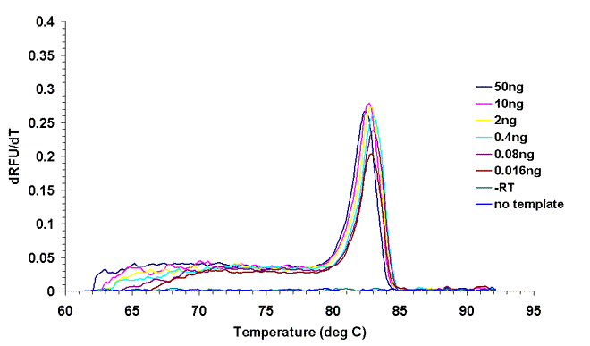
Dissociation curve
Fluorescence decrease as the temperature increase:
DNA strands start to separate
SYBR green looses its binding to the DNA
Fluorescence decreases
The melting temperature of the amplicon can easily be detected
Contaminating DNA, primer dimer or false priming is seen as an additional peak.
This curve lets us to detect non-specific products.
Introduction
Advantage disadvantages
Real Time PCR
Product Detection
in medicine
Conclusion
Reference
REAL TIME PCR & IT’S FUNCTIONS IN DIAGNOSIS

Slide 18
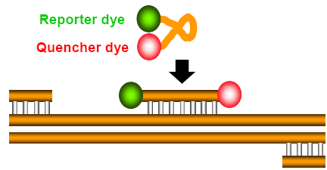
Taqman
1)
1) Denaturation and hybridization of probe.
2) Extension of primer and strand displacement of probe.
3) Cleavage of probe and fluorescence from the reporter dye.
Introduction
Advantage disadvantages
2)
Real Time PCR
Product Detection
in medicine
Conclusion
3)
Fluorescence from reporter dye is directly proportional to the number of amplicons generated
Reference
REAL TIME PCR & IT’S FUNCTIONS IN DIAGNOSIS

Slide 19
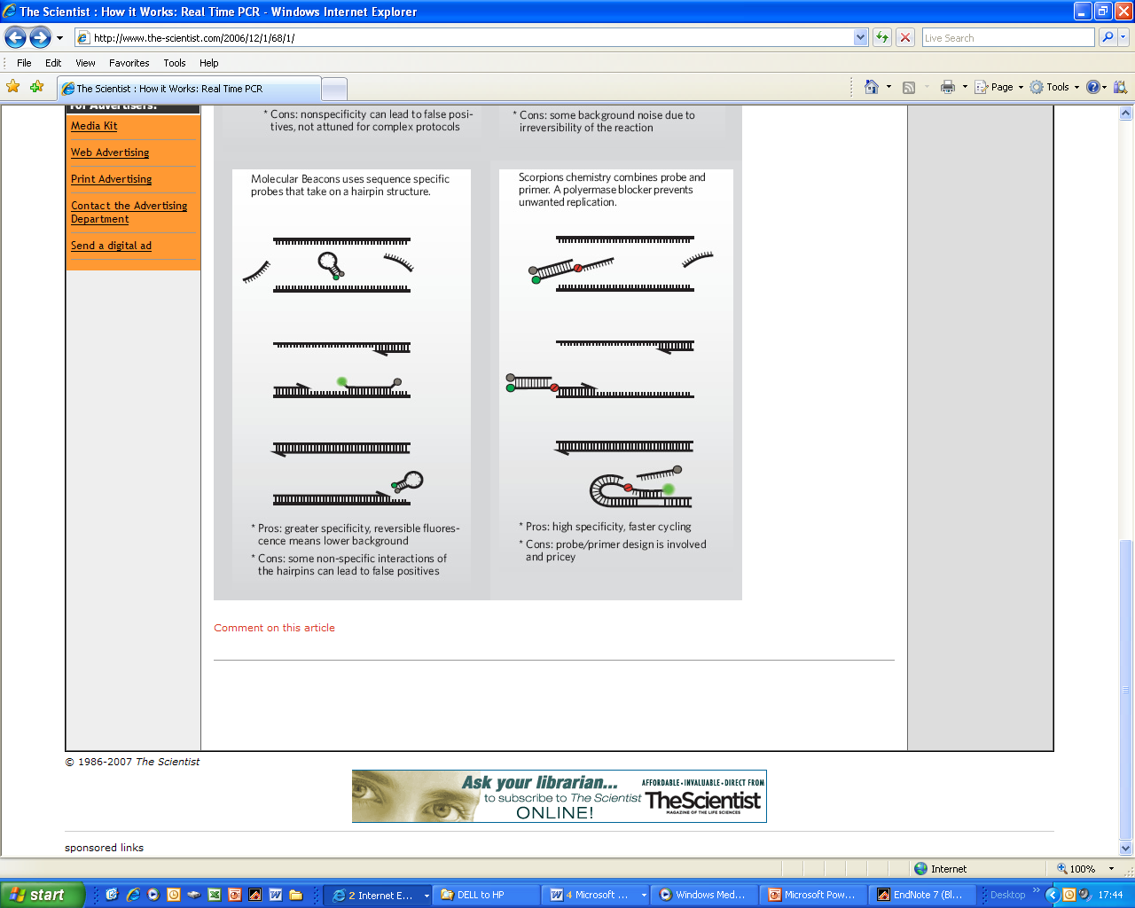
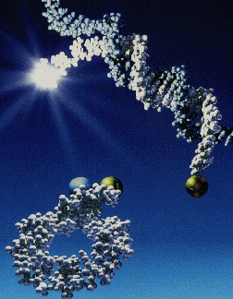
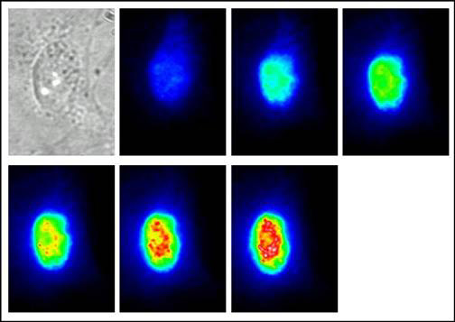
Molecular Beacons
MIDLAND is licensed by The Public Health Research Institute of New York, Inc. to manufacture and sell Molecular Beacon Probes. These probes, first described by Dr. Fred Russell Kramer and his colleagues, make possible the in situ visual detection of target DNA, and they also enable real-time PCR quantitation. Use of different fluorophores coupled with careful design of the probes permits distinguishing between sequences differing by as little as one base.
Introduction
Advantage disadvantages
Real Time PCR
Product Detection
in medicine
Conclusion
Reference
A transmission and then the fluorescent images of a PtK2 cell inject with a ß-1 andrenergic mRNA MB at 3-minute intervals for 18 minutes.
REAL TIME PCR & IT’S FUNCTIONS IN DIAGNOSIS

Slide 20
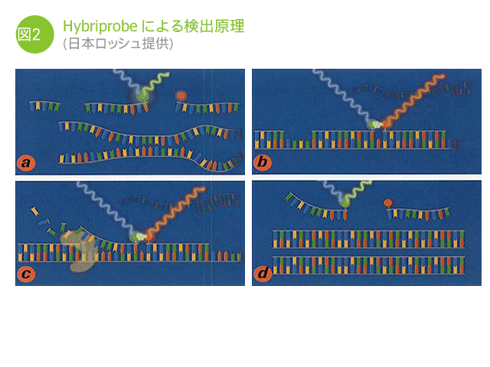
Hybridization probes technique
Two oligo probes bearing a single dye each, one with a fluorescein dye at the 3’ end and the other with a rhodamine dye at the 5’ end. When the
two oligos anneal to a complementary template, the fluorescein dye is excited by the light source in the instrument and transfers its energy to the rhodamine
dye via FRET. FRET can only occur when the two dyes are in close proximity.The instrument is set to detect the rhodamime signal.
This results in the emission of fluorescence, which subsequently can be detected during the annealing phase and first part of the extension phase of the PCR reaction. After each subsequent PCR cycle more hybridization probes can anneal, resulting in higher fluorescence signals.
Introduction
Advantage disadvantages
Real Time PCR
Product Detection
in medicine
Conclusion
Reference
REAL TIME PCR & IT’S FUNCTIONS IN DIAGNOSIS

Slide 21
Real Time PCR in Diagnosis
*Quantitatively measurment of Human Immunodeficiency Virus (HIV).
*Detection of Thalassemia, hemophilia,Sickle cell anemia & favism by real time PCR.
*Cystic fibrosis.
*Phenyl ketonuria.
*Use in forensic medicine.
*Noninvasive Prenatal Diagnosis by Analysis of Fetal DNA in Maternal Plasma.
*Detection and Quantitation of Circulating Plasmodium falciparum DNA.
*Effect of antimicrobial peptides on host cells
& …
Introduction
Advantage disadvantages
Real Time PCR
Product Detection
in medicine
Conclusion
Reference
REAL TIME PCR & IT’S FUNCTIONS IN DIAGNOSIS

Slide 22
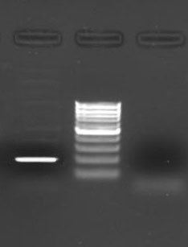
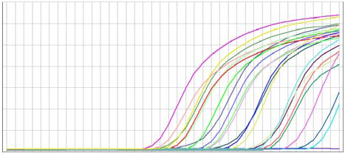
Quantitatively measurment of Human Immunodeficiency Virus (HIV).
180 bp
Nowadays HIV is strikingly spreading out whole the world. so in order to diminish its distribution , it is necessary to detect it as soon as possible & for this purpose, Real time PCR is recommended by scientist.
In this method ,’ pol’’ gen of the virus, is amplified in thermocycler.
26 patient have been studied. infection in these patients was confirmed by ELISA & western blot.
Then what was done?
Sampling & RNA extracting from patients.
Cloning of target segment by using Xba I & Hind III. And 180 bp primers.
Standard virus mRNA was extracted.
Quantitative analysis of HIV virus by SYBR-green Real Time RT-PCR.(3,4,5)
0.34
o.29
0.24
0.19
0.14
0.09
0.04
-0.01
product
marker
- control
Introduction
Advantage disadvantages
Real Time PCR
Product Detection
in medicine
Conclusion
0 10 20 30 40
Reference
Flu
cycle
REAL TIME PCR & IT’S FUNCTIONS IN DIAGNOSIS

Slide 23
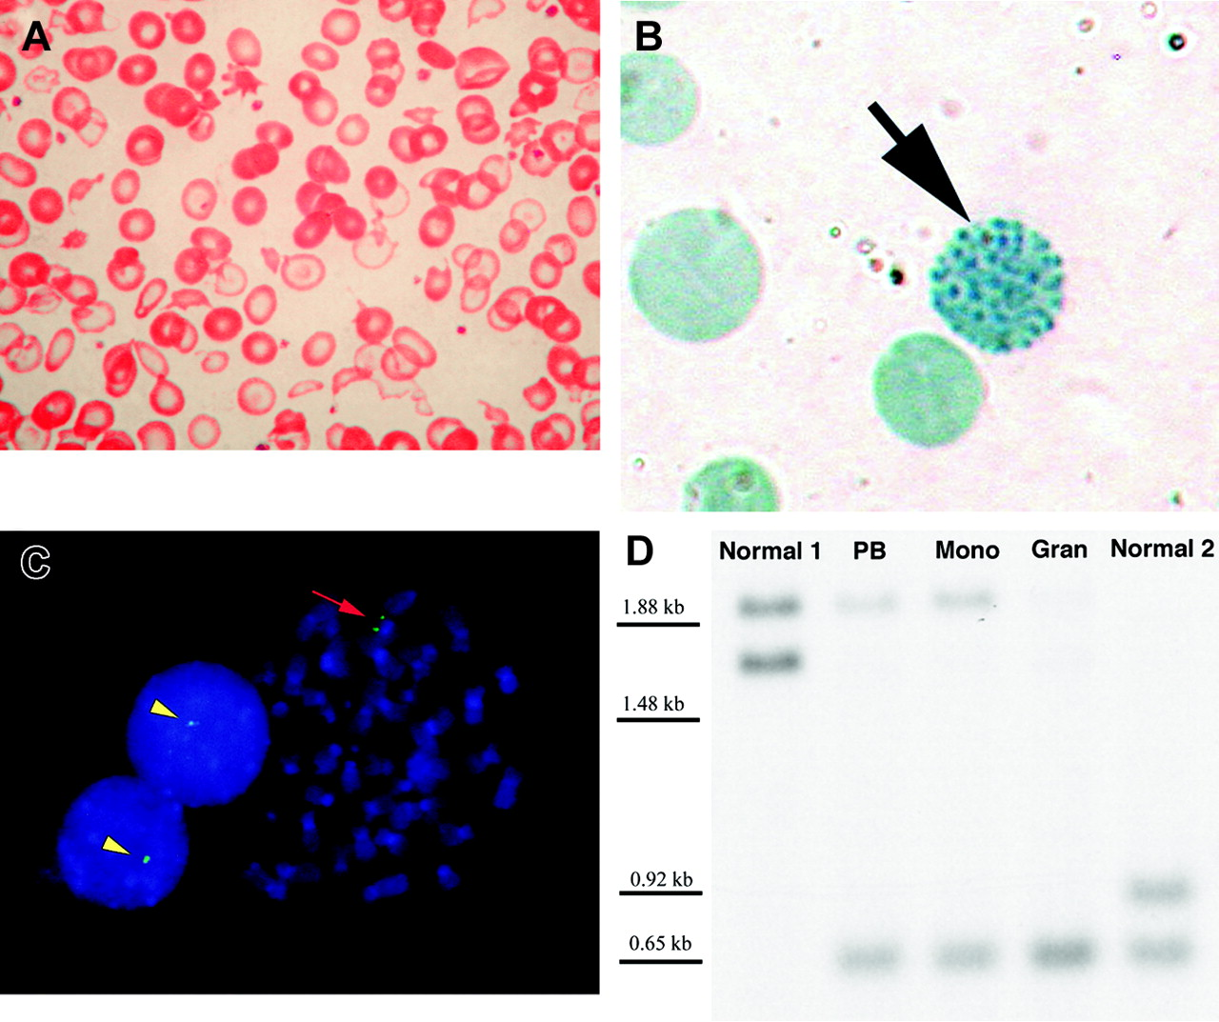
Detection of unknown deleted genes in
Thalassemia
Thalassemia is the most commonplace hemoglobin disorder which is caused by deletion of one or both globin genes.
By the way deletion or any other change can be detected quantitatively by real time PCR in a real time, we can determine the sort of deletion.
Alpha thalassemia is caused mostly by whole gene deletion but beta is by piont mutation.
60 patients were under study.(6,7,8)
Primer for deleted genes were designed using Primer Express soft ware & its sequence confirmed in NCBI/BLAST data bank. after PCR any changes was detected.
Introduction
Advantage disadvantages
Real Time PCR
Product Detection
in medicine
Conclusion
Peripheral blood findings and molecular evidence for loss of the telomeric region of chromosome 16p in a patient with acquired hemoglobin H and myelodysplastic syndrome.
Wright-Giemsa–stained peripheral blood smear demonstrates severe anisopoikilocytosis.
(B) Brilliant cresyl blue stain reveals with classical HbH inclusions .
(C) Metaphase spread and 2 interphase nuclei.
(D) Southern blot of the 3 hypervariable region in the alpha-globin cluster
Reference
REAL TIME PCR & IT’S FUNCTIONS IN DIAGNOSIS

Slide 24
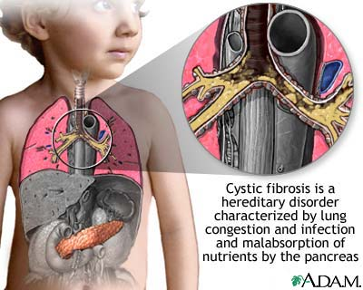
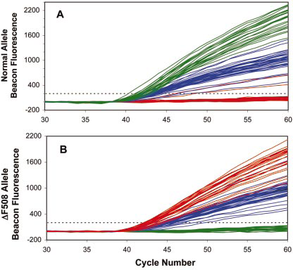
Cystic fibrosis
Cystic fibrosis (CF) is the most common inherited disease among Caucasian populations with an incidence of ~1 in 2500 births.(9)
Couples in which both individuals carry a mutant copy of the CF gene have a one in four chance of having an affected child.The conditions caused by these mutations range from mild to lifethreatening.
A3 base pair (bp) deletion, designated DF508, accounts for nearly 70% of CF cases and causes severe manifestations of the disease. It results in the absence of phenylalanine at position 508 of the cystic fibrosis transmembrane conductance regulator (CFTR) protein and this error prevents normal processing and translocation of the polypeptide chain to apical membranes of epithelial cells.This deletion can be detected by molecular beacons in real time PCR.
Introduction
Advantage disadvantages
Real Time PCR
Product Detection
in medicine
Conclusion
Figure 1. Examples of specific molecular beacon fluorescence increase during real-time PCR in samples containing single lymphoblasts homozygous normal for CF (green), heterozygous DF508 (blue), or homozygous DF508 (red). (A) Fluorescent signal from the molecular beacon detecting the normal allele. (B) Fluorescent signal from the molecular beacon detecting the DF508 allele. Dashed lines indicate the threshold of 200 units (~10 SD above baseline readings) used for determining CT values.
Reference
REAL TIME PCR & IT’S FUNCTIONS IN DIAGNOSIS

Slide 25
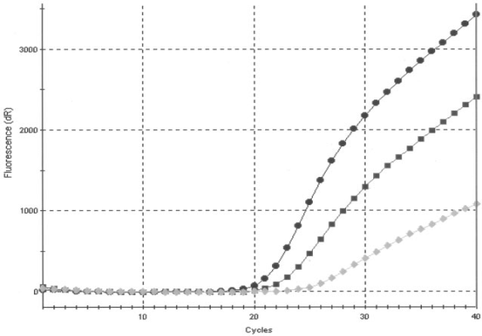
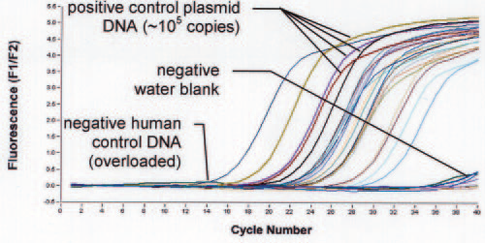
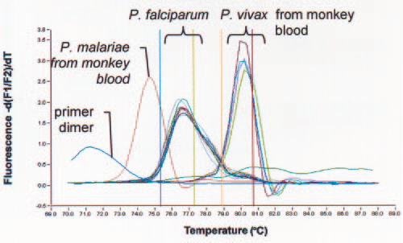
Plasmodium falciparum
Improving our understanding of the biology of the Plasmodium falciparum parasite is of extreme importance if we are to combat human malaria.This parasite uses the process of antigenic variation to expose the human immune system to continually changing antigens on the surface of infected red blood cells.
Real-time PCR assays have the potential to detect low levels of parasitemia, identify mixed infections, and allow for precise differentiation of species via melting curve analysis.(10,11)
Plasmodium detection was performed by using real-time PCR in the Light Cycler. The 18S rRNA gene was chosen as the target since it contains both highly conserved and variable regions, and at least five copies of the gene are dispersed on separate chromosomes of the Plasmodium genome. Consensus primers were designed after comparing several partial 18S rRNA gene sequences for each of four Plasmodium species.
Introduction
Advantage disadvantages
Real Time PCR
Product Detection
in medicine
Conclusion
FIG. Real-time amplification with SYBR Green fluorescence detection. The plasmid controls for four species, water blank, and negative human control DNA are indicated. The remaining curves are patient specimens with various parasitemia levels.
Reference
FIG. Melting curve analysis: DNA isolated from blood of monkeys infected with either P. malariae or P. vivax (ATCC) and purified P. falciparum genomic DNA .
FIG. Representative singleplex 18S rRNA gene (Plasmodium genus-specific) PCR fluorescence-versus-cycle curves for three clinical samples with various parasitemias as determined by microscopy.
REAL TIME PCR & IT’S FUNCTIONS IN DIAGNOSIS

Slide 26
Detection of Anti-inflammatory effects of peptides
The epithelium lining the airways is the first tissue to
encounter pathogens and their products; it is therefore, critical to the innate immune system and is the front line of the host defence against invading microorganisms.
Some peptides which are classified in an antimicrobial group , can have an effect on immune system ,for example Intercellular adhesion molecule-1(ICAM-1) is expressed at a low level in a subpopulation of haematopoietic cells, vascular endothelium, fibroblasts and epithelial cells. However, its expression is dramatically increased at sites of inflammation, providing an important means of regulating cell–cell interaction and thereby inflammatory responses.
Increase in Expression of 1(ICAM-1) will be lowered due to the effect of antimicrobial peptide & this can be detected by Real time PCR using SYBR Green.(12)
Introduction
Advantage disadvantages
Real Time PCR
Product Detection
in medicine
Conclusion
Reference
REAL TIME PCR & IT’S FUNCTIONS IN DIAGNOSIS

Slide 27
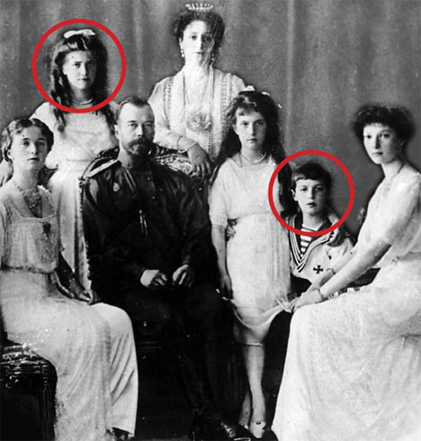
Real time PCR in forensic medicine
The main task in The Forensic Medicine is to investigate deaths from unnatural causes.
Forensic science has embraced the use of DNA molecular biology tools for diagnostic purposes more than any other scientific field.
The process of routine forensic human identification involves sensitive PCR and can be performed successfully on most evidence materials found at a crime scene.
This real-time technology monitors the accumulation
of PCR product with each cycle and allows assessment of each sample individually during the exponential growth phase.quantification assay has proven to be highly sensitive,specific,rapid, cost-effective and flexible assay for analysis of forensic casework samples.
Introduction
Advantage disadvantages
Real Time PCR
Product Detection
in medicine
Conclusion
Reference
DNA tests performed by a U.S. laboratory have proved that bone fragments exhumed in the Ural Mountains in 2007 belong to two children of Russia's last czar.
REAL TIME PCR & IT’S FUNCTIONS IN DIAGNOSIS

Slide 28
Some kites to detection of pathogens by Real Time PCR
Adenoviruses different type
Bordetella pertussis
Herpsvirus (Bovine & Human all type )
Leukemia virus
Klebsiella pneumoniae
Influenza A virus
Helicobacter pylori
Hepatitis virus ( A,B,C,Delta )
HIV ( type1&2 )
Leishmania
Neisseria meningitidis
Respiratory Syncytial virus
Shigella
Streptococcus
& …
Introduction
Advantage disadvantages
Real Time PCR
Product Detection
in medicine
Conclusion
Reference
REAL TIME PCR & IT’S FUNCTIONS IN DIAGNOSIS

Slide 29
Conclusion
PCR has proved to be a useful tool in research and diagnosis. However, its use has also brought new challenges to research. The sensitivity found in PCR technology and the availability of quantitative results will bring new problems to the interpretation of these results. A great deal of work is needed to generate a basis of knowledge for correct interpretation of these tests. In medicine, PCR-based diagnostics are just becoming widely used and because of the increased cost-effectiveness of the newer assays, knowledge for their interpretation will soon become available.
Introduction
Advantage disadvantages
Real Time PCR
Product Detection
in medicine
Conclusion
Reference
REAL TIME PCR & IT’S FUNCTIONS IN DIAGNOSIS

Slide 30
Reference
1) Real time PCR By M. Tevfik Dorak (Ed.). ISBN 0–203–96731–3 Master e-book
2) Clinical Applications of PCRSEECOND EDIITIION Edited by :Y. M. Dennis Lo, Rossa W. K. Chiu & K. C. Allen Chan
3) JOURNAL OF CLINICAL MICROBIOLOGY, May 2005, p. 2435–2440
4) Am. J. Trop. Med. Hyg., 75(2), 2006, pp. 212–218
Copyright © 2006 by The American Society of Tropical Medicine and Hygiene
5) Using Real Time RT-PCR in quantitatively measurment of HIV-1
6) [Cooley's Anemia, Mediterranean Anemia. Includes: Thalassemia Major (Beta-Thalassemia Major), Thalassemia Intermedia,Thalassemia Minor (Beta-Thalassemia Minor, Heterozygous Beta-Thalassemia)]
7) Quantitative Real-Time PCR Assay for Rapid Identification of Deletion
Carriers in Hemophilia.
8) Detection of unknown deleted genes in alpha-Thalassemia by real time pcr. (Pasteur Institute of Iran)
9) Detection of cystic ®brosis alleles from single cells using molecular beacons and a novel method of asymmetric real-time PCR
10) Development of a Real-Time PCR Assay for Detection of Plasmodium
Falciparum
11) Real-Time PCR for Detection and Identification of Plasmodium spp
Introduction
Advantage disadvantages
Real Time PCR
Product Detection
in medicine
Conclusion
http://www.oligos.com/MolecularBeaconProbes.htm
Reference
REAL TIME PCR & IT’S FUNCTIONS IN DIAGNOSIS

Slide 31


Slide 32
This powerpoint was kindly donated to
www.worldofteaching.com
http://www.worldofteaching.com
Is home to well over a thousand powerpoints submitted by teachers. This a free site. Please visit and I hope it will help in your teaching
Notes:
32

