Slide 1
Polymerase Chain Reaction
14 March 2023
Aims
To understand the process of PCR and its uses.
Starter - Match each term with its correct description (work in pairs)

Slide 2
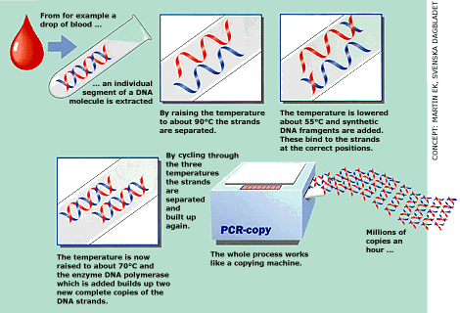
What is it?

Slide 3
Animations
http://www.dnalc.org/ddnalc/resources/pcr.html
http://www.maxanim.com/genetics/PCR/pcr.swf

Slide 4
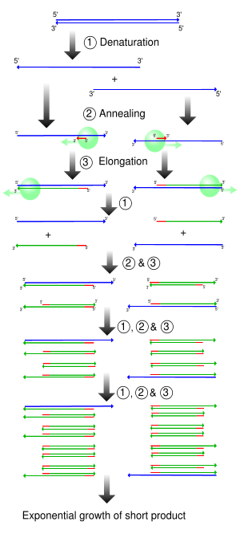

Slide 5
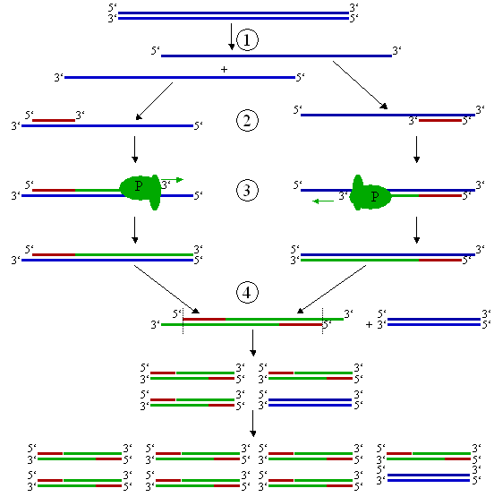

Slide 6
Information
Polymerase chain reaction enables large amounts of DNA to be produced from very small samples (0.1ml)
There is a repeating cycle of:
separation of double DNA strands
synthesis of a complementary strand for each

Slide 7
What happens?
Sample DNA , nucleotides, DNA primers & thermostable DNA polymerase placed in PCR machine.
Strands of sample DNA separated by heating to 95ºC
Mixture cooled to 37ºC to allow primers to bind.
Mixture heated to 72ºC for replication (optimum temp of DNA polymerase)
Cycle repeats many times (~8mins /cycle)

Slide 8
Problems
Separation achieved by heating to 95ºC – no suitable helicase
DNA polymerase can’t work on completely single stranded DNA – double stranded regions needed at the start of sequence to be copied:
primers (short sequences DNA) complementary to bases at start of region to be copied used
To synthesize primers , base sequence at start must be known

Slide 9
TTAACGGGGCCCTTTAAA.....…TTTAAACCCGGGTTT
AATTGCCCCGGGAAATTT.....…AAATTTGGGCCCAAA
the sequence of bases which ONLY flank a particular region of a particular organism's DNA, and NO OTHER ORGANISM'S DNA. This region would be a target sequence for PCR.

Slide 10
The first step for PCR would be to synthesize "primers" of about 20 letters-long
ONE primer exactly like the lower left-hand sequence, and ONE primer exactly like the upper right-hand sequence:
TTAACGGGGCCCTTTAAA.....…TTTAAACCCGGGTT
AATTGCCCCGGGAAATTT.......................>
and:
<........................................TTTAAACCCGGGTTT
AATTGCCCCGGGAAATTT........AAATTTGGGCCCAAA

Slide 11
DNA polymerase must be thermostable (37ºC – 95ºC used) to avoid fresh enzyme being added.

Slide 12
Remember….
Nucleotides used must be very pure.
DNA must not be contaminated - any foreign DNA would also be copied….PCR in legal cases in UK suspended at present

Slide 13
Uses of PCR
http://nobelprize.org/nobel_prizes/chemistry/laureates/1993/illpres/already.html

Slide 14
This powerpoint was kindly donated to www.worldofteaching.com
http://www.worldofteaching.com is home to over a thousand powerpoints submitted by teachers. This is a completely free site and requires no registration. Please visit and I hope it will help in your teaching.

