Slide 1
Aim: What are the stages of Mitosis?
Do Now: What is an example of asexual reproduction? Homework #3 due tomorrow.
Notes are boxed in.

Slide 2
Some vocabulary we’ll need…
Cell division - process by which cells reproduce
Chromosomes - cell parts that determine what traits a living thing will have
Chromatid - one strand of DNA; after replication, a chromosome is made up of two identical chromatids
Daughter cells - new cells produced by cell division
Cytokinesis – a division of the cytoplasm of one parent cell into 2 daughter cells

Slide 3
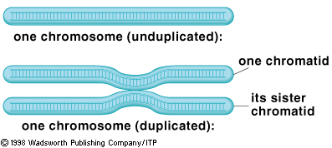

Slide 4
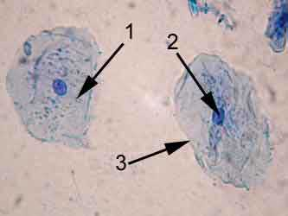
Interphase
Stages of Mitosis
This is the phase of mitosis where the cell performs its normal activities for life. (MRS. GONE without the R)
DNA is in the chromatin state (kind of like spaghetti)

Slide 5
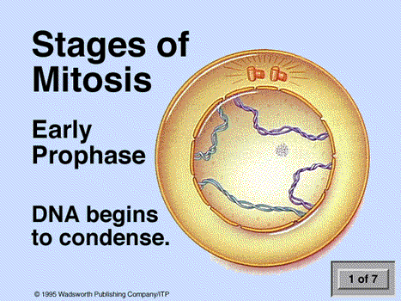
Centrioles appear

Slide 6
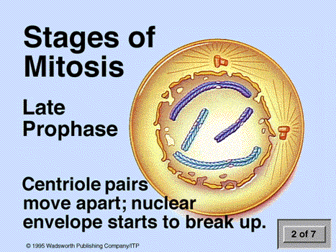
Centrioles move

Slide 7
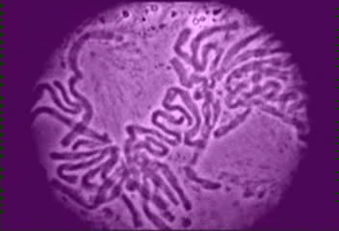
Prophase
Prophase- the nuclear membrane breaks down. The double stranded chromosomes are able to move feely around the cytoplasm

Slide 8
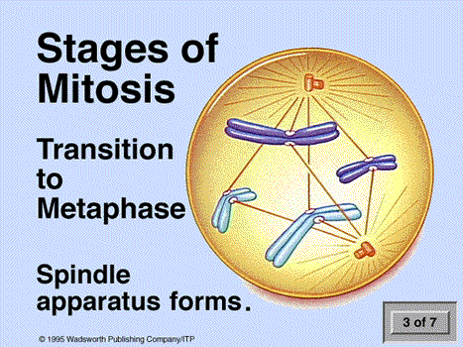

Slide 9
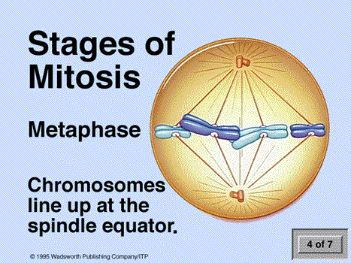
METAphase = MIDDLE
Spindle fibers
form from
The centrioles

Slide 10
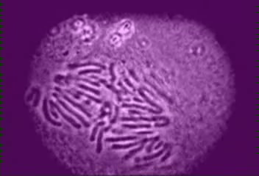

Slide 11
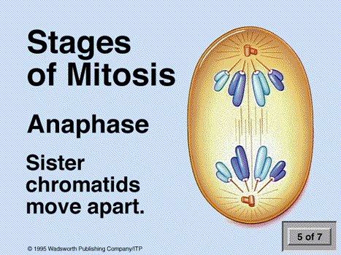
ANAphase = AWAY
(DNA)

Slide 12
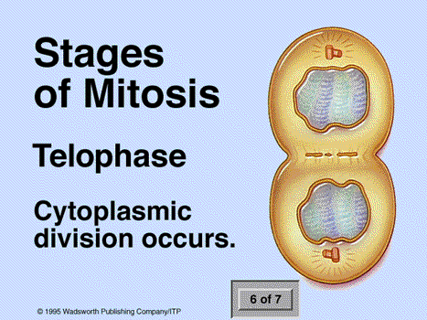

Slide 13
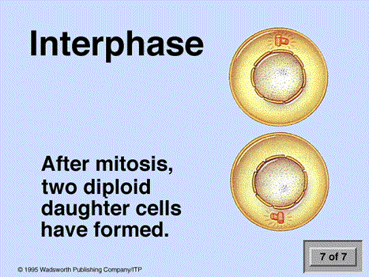
CYTOKINESIS

Slide 14
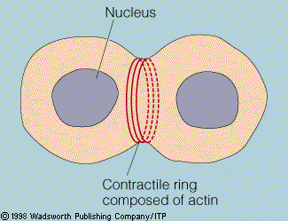

Slide 15
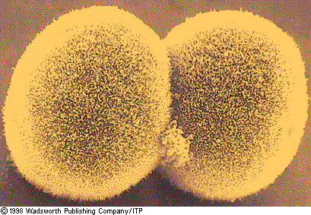

Slide 16
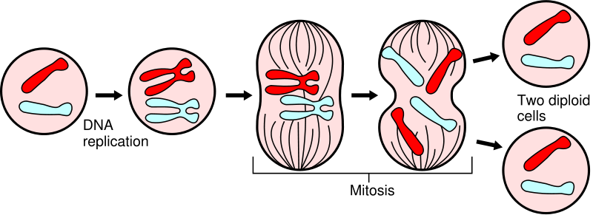
I
P
M
A
T

Slide 17
How can we remember the stages of mitosis?
Interphase
Prophase
Metaphase
Anaphase
Telophase
IPMAT

Slide 18
How is mitosis different in plant cells?
The only difference is during telophase, where instead of the cell membrane pinching in for cytokinesis, the cell wall forms between the two daughter cells,

Slide 19
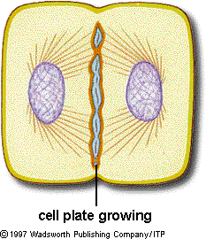
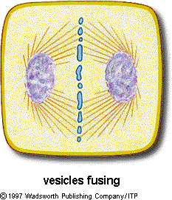
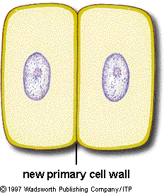
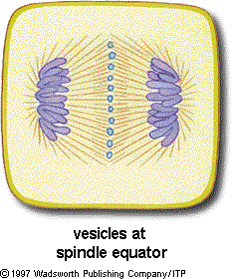
plant
cytokinesis

Slide 20
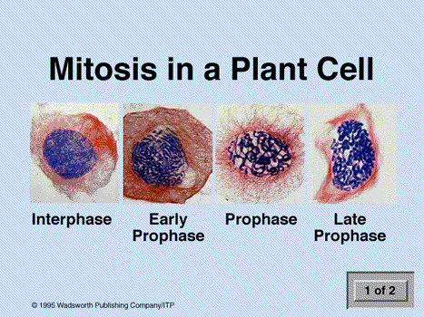

Slide 21
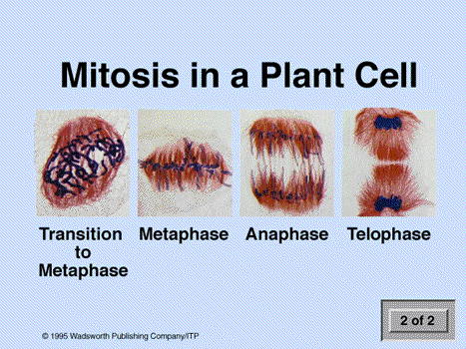

Slide 22
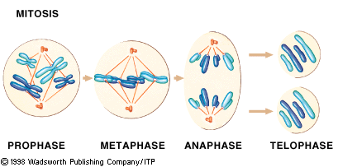
Mitosis produces identical offspring (2N---2N)

Slide 23
This powerpoint was kindly donated to www.worldofteaching.com
http://www.worldofteaching.com is home to over a thousand powerpoints submitted by teachers. This is a completely free site and requires no registration. Please visit and I hope it will help in your teaching.

