Slide 1
Mitosis and Meiosis
Higher Biology

Slide 2
Mitosis and Meiosis
Mitosis:
-division of somatic (body) cells
Meiosis
-division of gametes (sex cells)

Slide 3
Mitosis
Interphase
Prophase
Metaphase
Anaphase
Telophase

Slide 4
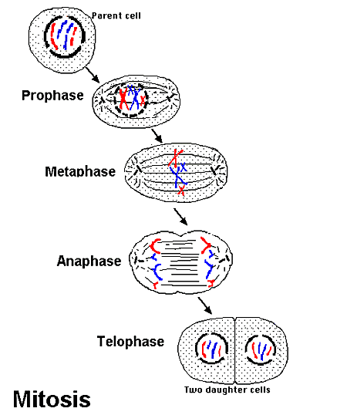
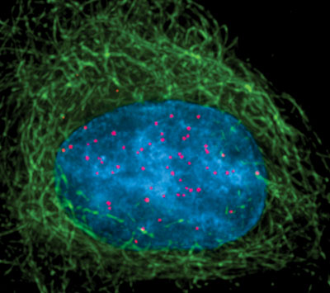
Interphase
Interesting things happen!
Cell preparing to divide
Genetic material doubles

Slide 5
Prophase
Chromosome pair up!
Chromosomes thicken and shorten
-become visible
-2 chromatids joined by a centromere
Centrioles move to the opposite sides of the nucleus
Nucleolus disappears
Nuclear membrane disintegrate

Slide 6
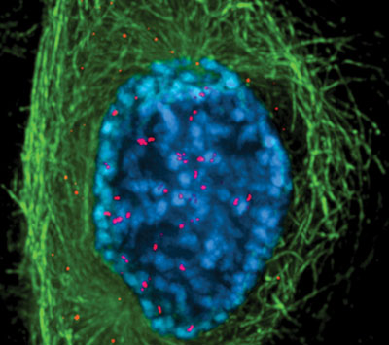

Slide 7
Metaphase
Chromosomes meet in the middle!
Chromosomes arrange at equator of cell
Become attached to spindle fibres by centromeres
Homologous chromosomes do not associate

Slide 8
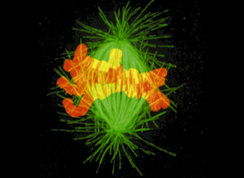

Slide 9
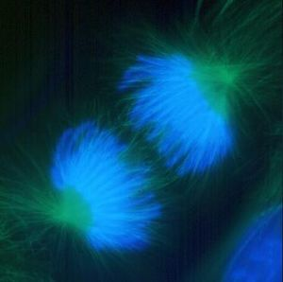
Anaphase
Chromosomes get pulled apart
Spindle fibres contract pulling chromatids to the opposite poles of the cell

Slide 10
Telophase
Now there are two!
Chromosomes uncoil
Spindle fibres disintegrate
Centrioles replicate
Nucleur membrane forms
Cell divides

Slide 11
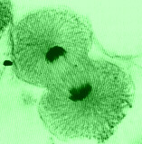

Slide 13
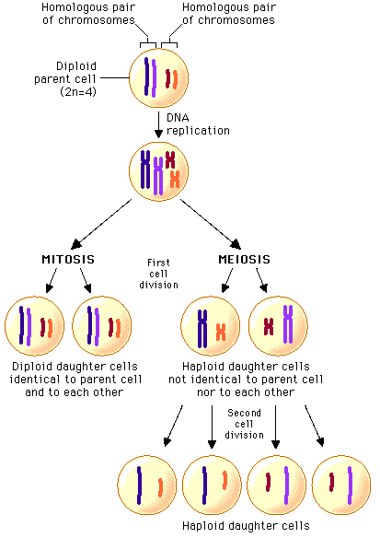

Slide 14
Meiosis
4 daughter cells produced
Each daughter cell has half the chromosomes of the parent
2 sets of cell division involved

Slide 15
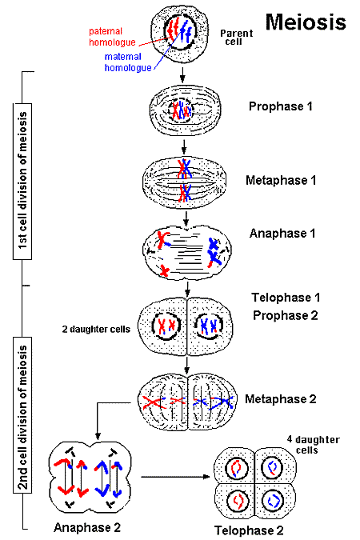

Slide 16
This powerpoint was kindly donated to www.worldofteaching.com
http://www.worldofteaching.com is home to over a thousand powerpoints submitted by teachers. This is a completely free site and requires no registration. Please visit and I hope it will help in your teaching.

