Slide 1
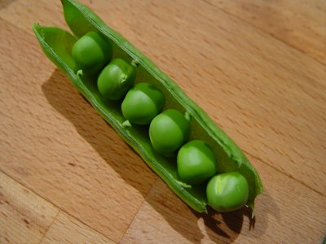
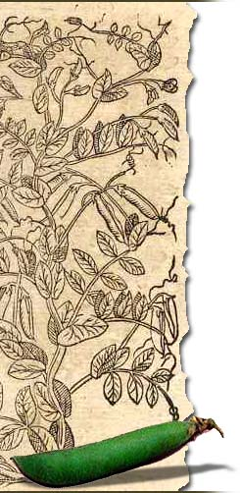
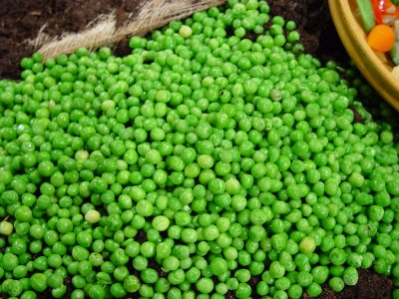
Mendel‘s Law of
Segregation
Visit www.worldofteaching.com
For 100’s of free powerpoints
by Alexandra Schedat-Spotzl

Slide 2
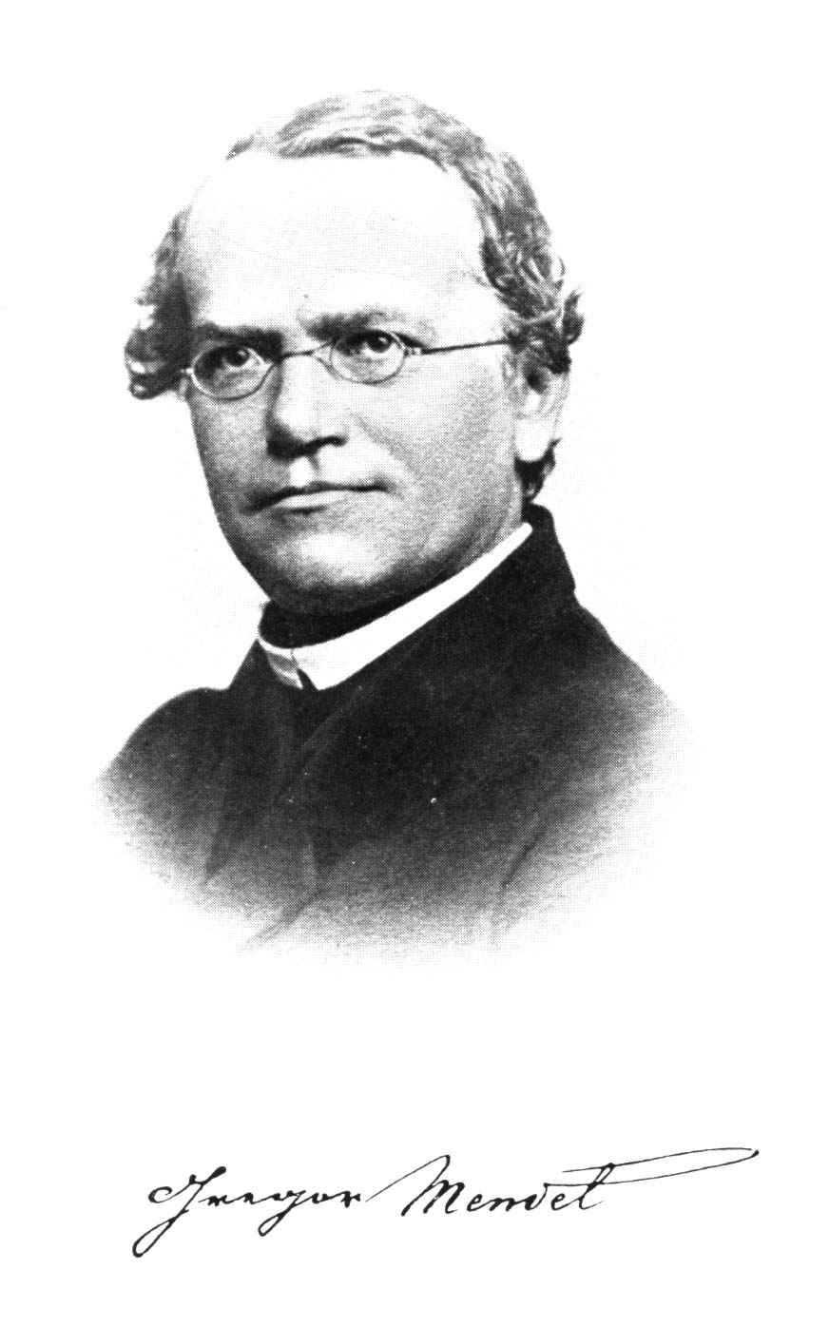
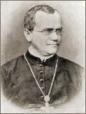
Georg Mendel
Austrian monk
born in 1822
in monastery known for
research and teaching
after his death (1884)
acknowledgment of his discoveries in 1900

Slide 3
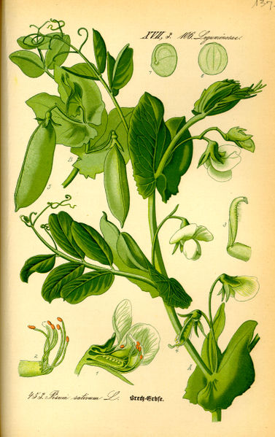

Experiments with Pea Plants
- Seed coat colour (gray or white)
- Seed shape (round or wrinkled)
- Seed colour (yellow or green)
- Pod colour (green or yellow)
- Flower position (axial or terminal)
- Pod shape (inflated or constricted)
- Stem length (tall or dwarf)

Slide 4
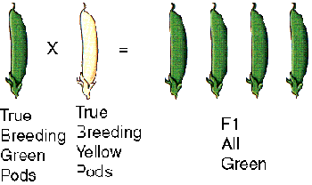
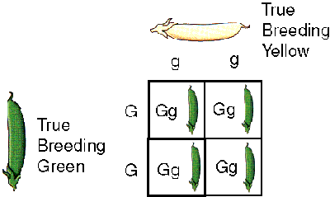
Cross-Pollination of Purebread Plants
- cross-pollination between true breeding green and yellow pods
- all F1 green
F1 Generation
Gg = heterozygous

Slide 5
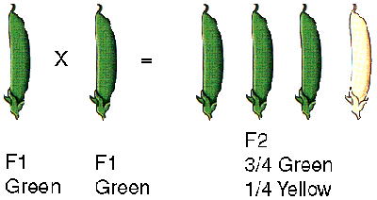
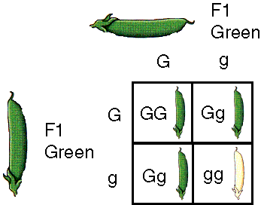
F2 Generation
- self-pollination of green F1 plants
- ¾ in F2 green,
        ¼ yellow
- 3 : 1 ratio in pod colour in F2
G = dominant = green
g = recessive = yellow
GG, gg = homozygous

Slide 6
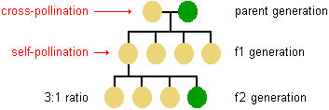
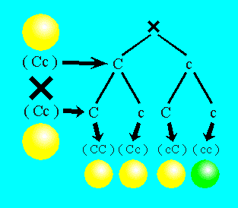
Seed Colour
C = dominant = yellow
c = recessive = green

Slide 7
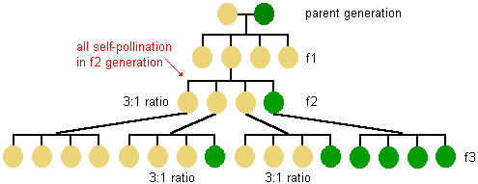
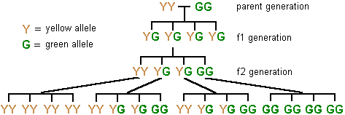
Inheritance of Pea Colour
phenotype:
genotype:

Slide 8
Results from Mendel's Experiments
Parental Cross
F₁ Phenotype
F₂ Phenotypic Ratio
F₂ Ratio
Round x Wrinkled Seed
Round
5474 Round :
1850 Wrinkled
2.96:1
Yellow x Green Seeds
Yellow
6022 Yellow :
2001 Green
3.01:1
Axial x Terminal
Flower Position
Axial
705 Axial :
224 Terminal
3.15:1
Tall x Dwarf Plants
Tall
l787 Tall :
227 Dwarf
2.84:1

Slide 9
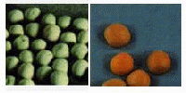
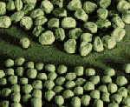
Mendel‘s Generalization
Alternative versions of genes account for variations in inherited characters
- concept of alleles (G=green, g=yellow)
2. For each character, an organism inherits two genes, one from each parent
- two gametes form somatic cells
- one allele comes from the mother,
one from the father

Slide 10
Mendel‘s Generalization
3. If the two alleles differ, then:
- dominant allele is fully expressed in the organism's appearance (phenotype)
- recessive allele has no noticeable effect on the organism's appearance (genotype)
4. The two genes for each character segregate during gamete production
- ensures variation

Slide 11
Law of Segregation
the pair of alleles of each parent separate and only one allele passes from each parent on to an offspring
which allele in a parent's pair of alleles is inherited is a matter of chance
segregation of alleles occurs during the process of gamete formation (meiosis)
randomly unite at fertilization

Slide 12
This powerpoint was kindly donated to www.worldofteaching.com
http://www.worldofteaching.com is home to over a thousand powerpoints submitted by teachers. This is a completely free site and requires no registration. Please visit and I hope it will help in your teaching.

