Slide 1
Meiosis
Cell division – ‘reduction division’
Production of sex cells – gametes
Meiosis errors

Slide 2
Why do we need meiosis?
Meiosis is necessary to halve the number of chromosomes going into the sex cells
Why halve the chromosomes in gametes?
At fertilisation the male and female sex cells will provide ½ of the chromosomes each – so the offspring has genes from both parents

Slide 4
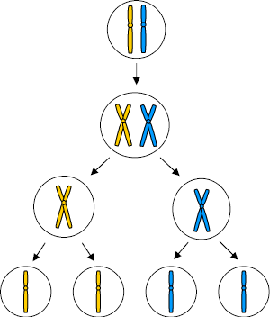
Meiosis
Parent cell – chromosome pair
Chromosomes copied
1st division - pairs split
2nd division – produces 4 gamete cells with ½ the original no. of chromosomes

Slide 5
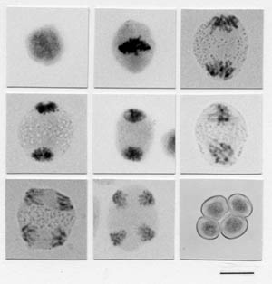
Meiosis – mouse testes
Parent cell
1st division
2nd division
4 gametes

Slide 6
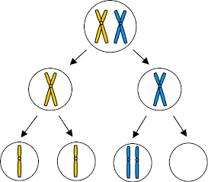
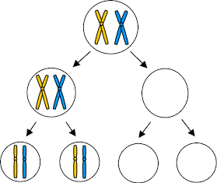
Meiosis – division error
Chromosome pair

Slide 7
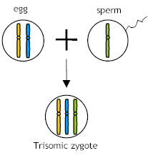
Meiosis error - fertilisation
Should the gamete with the chromosome pair be fertilised then the offspring will not be ‘normal’.
In humans this often occurs with the 21st pair – producing a child with Downs Syndrome

Slide 8
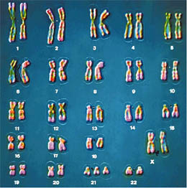
21 trisomy – Downs Syndrome
Can you see the extra 21st chromosome?
Is this person male or female?

Slide 9
This powerpoint was kindly donated to www.worldofteaching.com
http://www.worldofteaching.com is home to over a thousand powerpoints submitted by teachers. This is a completely free site and requires no registration. Please visit and I hope it will help in your teaching.

