Slide 1
Gregor Mendel
Group 1
Kristen Enriquez
Cassandra Rojas
William Zuniga
Melissa Medrano

Slide 2
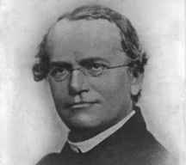
Father of Modern Genetics
The first person to trace the characteristics of successive generations of a living thing
He was not a world-renowned scientist of his day.
Rather, he was an Augustinian monk who taught natural science to high school students.

Slide 3
Family
Second child of Anton and Rosine Mendel
They were farmers in Brunn
They couldn’t afford for him to attend college
Gregor Mendel then attended the Augustinian Monastery and became a monk

Slide 4

Where Mendel Studied
He was later sent to the University of Vienna to study. By both his professors at University and his colleagues at the monastery, Mendel was inspired to study variance in plants

Slide 5
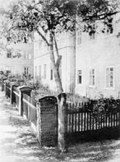
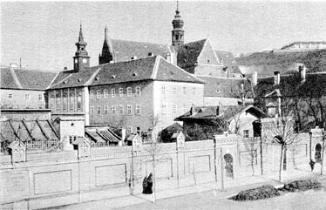
The Monastery Garden with the greenhouse which Gregor J. Mendel, O.S.A., had built in 1870. Its appearance before 1902.Courtesy of Villanova University Archives.
Gregor J. Mendel, O.S.A., experimental garden (35x7 meters) in the grounds of the Augustinian Monastery in Old Brno.Its appearance before 1922. Courtesy of Villanova University Archives.

Slide 6
How Mendel Got Started
Mendel's attraction to research was based on his love of nature.
He was not only interested in plants, but also in meteorology and theories of evolution.
Mendel often wondered how plants obtained atypical characteristics.

Slide 7
The Birth of the idea: Heredity
On a walk around the monastery, he found an atypical variety of an ornamental plant.
He took it and planted it next to the typical variety.
He grew their progeny side by side to see if there would be any approximation of the traits passed on to the next generation.
This experiment was "designed to support or to illustrate Lamarck's views concerning the influence of environment upon plants.“
He found that the plants' respective offspring retained the essential traits of the parents, and therefore were not influenced by the environment.

Slide 8
Mendel's research reflected his personality.
Once he crossed peas and mice of different varieties "for the fun of the thing," and the phenomena of dominance and segregation "forced themselves upon notice."
He saw that the traits were inherited in certain numerical ratios.
He then came up with the idea of dominance and segregation of genes and set out to test it in peas.
It took seven years to cross and score the plants to the thousand to prove the laws of inheritance!

Slide 9

Pictures of atypical plant

Slide 10
Mendel’s laws of heredity
From his studies, Mendel derived certain basic laws of heredity:
Hereditary factors do not combine, but are passed intact;
Each member of the parental generation transmits only half of its hereditary factors to each offspring (with certain factors "dominant" over others);
Different offspring of the same parents receive different sets of hereditary factors.

Slide 11
YY
GG
Y= Yellow allele
G= Green allele
F1 Generation
YG
YG
YG
YG
F2 Generation
YY
YG
YG
GG
YY
YY
YY
YY
YY
YG
YG
GG
GG
GG
GG
GG
YY
YG
YG
GG

Slide 12
Parent Generation
F1 Generation
F2 Generation, 3:1 ratio

Slide 13
Mendel's work became the foundation for modern genetics.
The impact of genetic theory is no longer questioned in anyone's mind.
Many diseases are known to be inherited
and pedigrees are typically traced to determine the probability of passing along an hereditary disease.
Plants are now designed in laboratories to exhibit desired characteristics.
The practical results of Mendel's research has not only changed the way we perceive the world, but also the way we live in it.

Slide 14
Interesting Facts
Took seven years to prove laws of inheritance
-Basic Laws-
Heredity Factors do not combine
Each member of a parental generation transfers only one half of its heredity factors to each offspring

Slide 15
More Interesting Facts
Mendel’s works became the foundation of modern genetics
Later crossed mice and pea plants
Noticed traits were inherited in certain numerical ratios
Came up with idea of dominance and segregation of genes and set out to test it in peas
Love of nature encouraged his interest in research
Also interested in meteorology and theories of evolution

Slide 16
References
http://205.180.85.40/w/pc.cgi?mid=10866&sid=7271
http://www.accessexcellence.org/AB/BC/Gregor_Mendel.html
http://www.netspace.org/MendelWeb/MWpaptoc.html
101 Key Ideas: Genetics
http://www.library.villanova.edu/html2/lib/mendel/mendexhib.htm

Slide 17
This powerpoint was kindly donated to www.worldofteaching.com
http://www.worldofteaching.com is home to over a thousand powerpoints submitted by teachers. This is a completely free site and requires no registration. Please visit and I hope it will help in your teaching.

