Slide 1
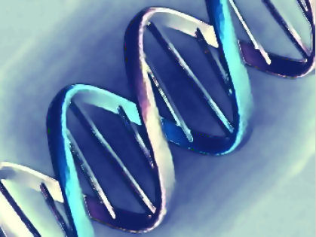
Year 12 Biology
Module 3: The Species
Outcomes covered:
  3.8, 3.9, 3.10, 3.11

Slide 2
Autosomal Dominant Inheritance
Dominant gene located on 1 of the autosomes
Letters used are upper case ie BB or Bb
Affected individuals have to carry at least 1 dominant gene (heterozygous or homozygous)
Passed onto males and females
Every person affected must have at least 1 parent with the trait
Does not skip generations
E.g. Huntington’s disease, Marfan syndrome

Slide 3
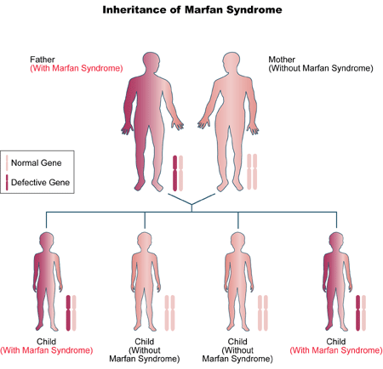
Autosomal Dominant- Marfan syndrome

Slide 4
Autosomal Recessive Inheritance
The recessive gene is located on 1 of the autosomes
Letters used are lower case ie bb
Unaffected parents (heterozygous) can produce affected offspring (if they get both recessive genes ie homozygous)
Inherited by both males and females
Can skip generations
If both parents have the trait then all offspring will also have the trait. The parents are both homozygous.
E.g. cystic fibrosis, sickle cell anaemia, thalassemia

Slide 5
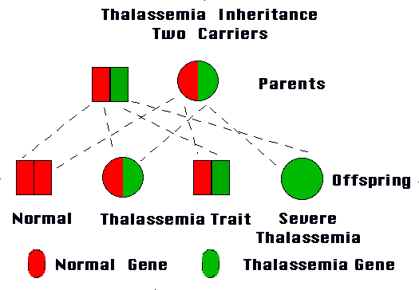
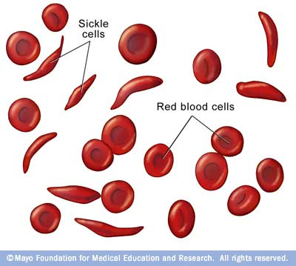

Slide 6
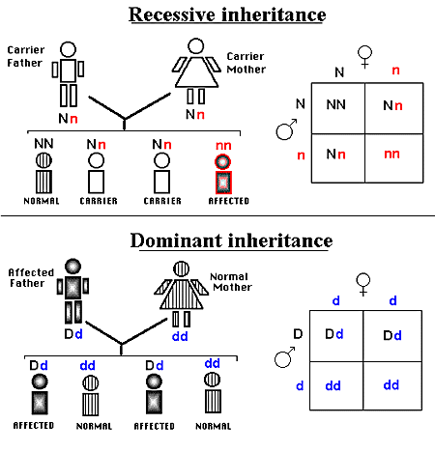

Slide 7
Autosomal Dominant/ Recessive Problems
Cross a pure breeding, black coated guinea pig with a pure breeding, white coated guinea pig. Given that, in guinea pigs, black coat colour is dominant to white coat colour, determine the genotypes and phenotypes of the first and second generation offspring.

Slide 8
Incomplete dominance
In a heterozygous organism, neither gene is dominant, both genes are expressed equally
Capital letters used for both alleles
  Snap dragons- red = RR, white= WW, pink = RW
  Cows- brown = BB, white= WW, roan=BW

Slide 9
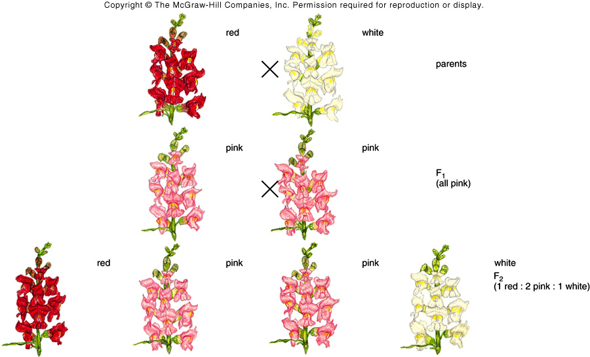
Incomplete dominance

Slide 10
Incomplete dominance problems
In Andalusian chickens, the black Andalusian character is incompletely dominant to the white-splashed Andalusian character. The heterozygous condition produces blue Andalusian chickens. Determine the genotypes and phenotypes of the F1 and F2 generations if a pure breeding, black Andalusian is crossed with a pure breeding, white-splashed Andalusian.

Slide 11
Co- dominance
Occurs when alternative alleles are present in the genotype and fully observed in the phenotype
E.g. ABO blood grouping system, where a single gene locus features multiple alleles- IA, IB, and i. Individuals carrying alleles for both A and B express both in the phenotype AB.

Slide 12
Co- dominance
Genotype | Phenotype (blood group)
I^{A} I^{A} or I^{A}i | A
I^{B} I^{B}, or I^{B}i | B
I^{A}I^{B} | AB
ii | O

Slide 13
Sex linked inheritance
Genes are carried on the sex chromosomes (X or Y)
Sex-linked notation
  X^{B}X^{B} normal female
  X^{B}X^{b} carrier female
  X^{b}X^{b} affected female
  X^{B}Y normal male
  X^{b}Y affected male

Slide 14
Sex linked inheritance Dominant
Dominant gene on X chromosome
Affected males pass to all daughters and none of their sons
  Genotype= X^{A}Y
If the mother has an X- linked dominant trait and is homozygous (X^{A}X^{A}) all children will be affected
If Mother heterozygous (X^{A}Xª) 50% chance of each child being affected
E.g. dwarfism, rickets, brown teeth enamel.

Slide 15
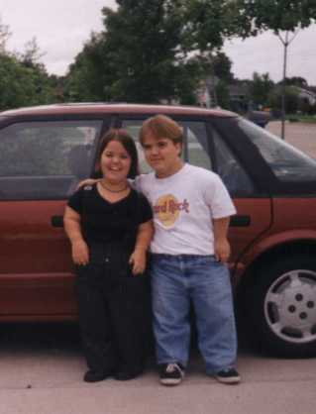
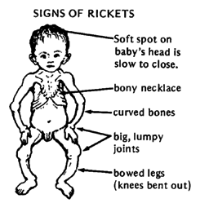
Sex linked dominant disorders

Slide 16
Sex linked dominant problems
The barred pattern of chicken feathers is inherited by a pair of sex linked genes, B for barred, b for no bars. If a non-barred female is mated to a barred male,
a) What will the proportion and appearance of the offspring?
What will be the appearance and proportion of the progeny produced by mating an Fl male with an Fl female?

Slide 17
Sex linked Inheritance Recessive
Gene located on the X chromosome
More males than females affected (males inherit X from mother)
Females can only inherit if the father is affected and mother is a carrier (hetero) or affected (homo)
An affected female will pass the trait to all her sons
  Daughters will be carriers if father is not affected
Males cannot be carriers (only have 1 X so either affected or not)
Can skip generations
E.g. colour blindness, haemophilia, Duchene muscular dystrophy

Slide 18
Sex linked recessive problem
Red-green colour blindness in men is caused by the presence of a sex-linked recessive gene c, whose normal allele is C.
a) Can two colour blind parents produce a normal son?
b) Can they produce a normal daughter?
c) Can two normal parents produce a colourblind son or daughter?
d) Can a normal daughter have a colourblind father or mother?
e) Can a colourblind daughter have a normal father or mother?

Slide 19
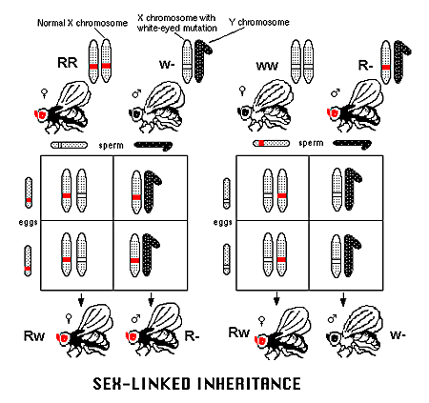
Sex linked Inheritance in Drosophila

Slide 20
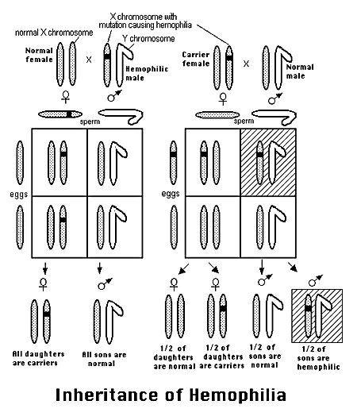

Slide 21
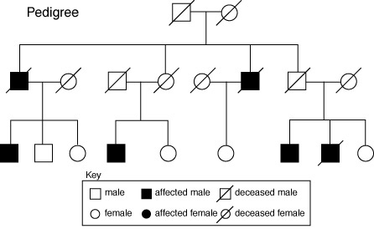
General Pedigree refer to NOB2 (new ed) pages 328-332

Slide 22
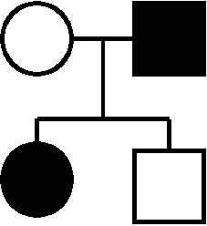
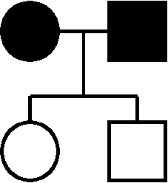
Autosomal Dominant Pedigree
Look for:
Trait in every generation
  Once leaves the pedigree does not return
Every person with the trait must have a parent with the trait
Males and females equally affected

Slide 23
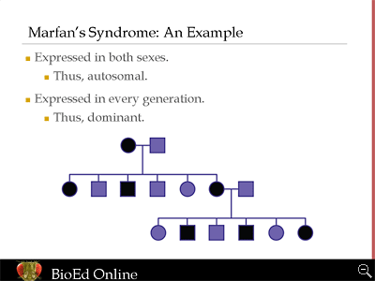
Autosomal dominant pedigree

Slide 24
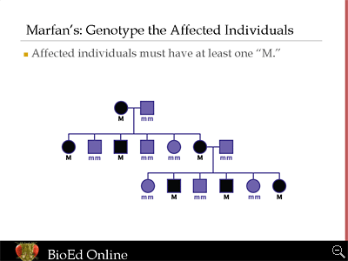

Slide 25
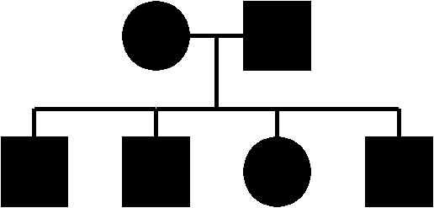
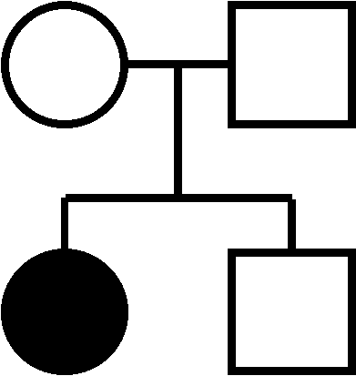
Autosomal Recessive Pedigree
Look for:
Skips in generation
Unaffected parents can have affected children
Affected person must be homozygous
Males and females affected equally

Slide 26
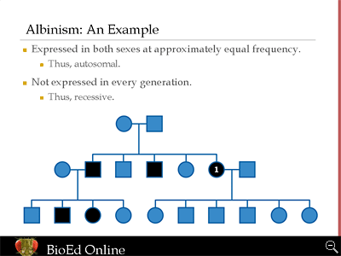
Autosomal recessive

Slide 27
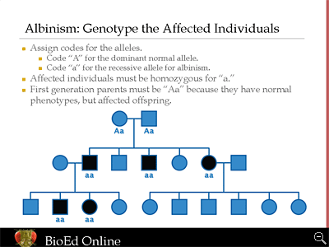

Slide 28
Sex linked Dominant pedigrees
Look for:
More males being affected
Affected males passing onto all daughter (dominant) and none of his sons
Every affected person must have an affected parent

Slide 29
Sex linked recessive pedigrees
More ales being affected
Affected female will pass onto all her sons
Affected male will pass to daughters who will be a carrier (unless mother also affected)
Unaffected father and carrier mother can produce affected sons

Slide 30
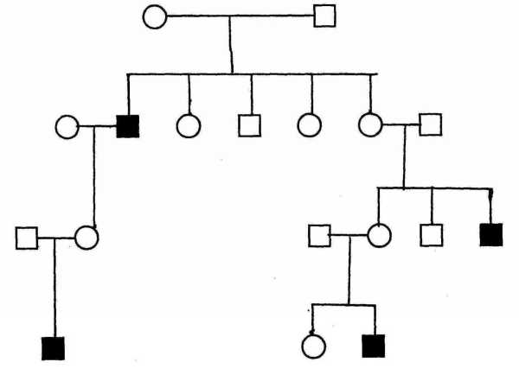

Slide 31
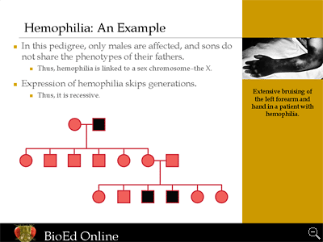
Sex linked recessive

Slide 32
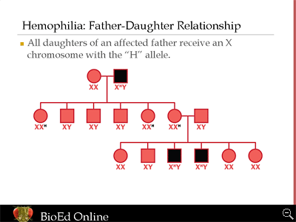

Slide 33
Questions to complete
Complete the following:
Biochallenge pg 334, ques 2
Review ques pgs 335-338
  Ques 6,7,8, 9, 10, 11, 12, 13, 14,

Slide 34
This powerpoint was kindly donated to www.worldofteaching.com
http://www.worldofteaching.com is home to over a thousand powerpoints submitted by teachers. This is a completely free site and requires no registration. Please visit and I hope it will help in your teaching.

