Slide 1


Genetic Traits

Slide 2
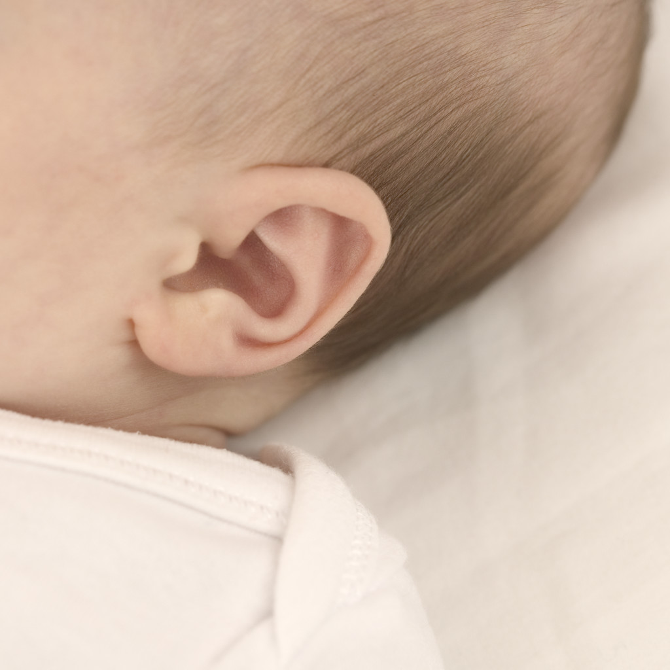
Earlobe
Attachment

Slide 3
Some scientists have reported that this trait is due to a single gene for which unattached earlobes is dominant and an attached earlobe is recessive. Other scientists have reported that this trait is probably due to several genes.

Slide 4


Thumb Extension

Slide 5
This trait is reportedly due to a single gene; strait thumb is dominant and hitchhiker's thumb is recessive.

Slide 6


Tongue Rolling

Slide 7
Tongue rolling ability may be due to a single gene with the ability to roll the tongue a dominant trait and the lack of tongue rolling ability a recessive trait.However, many twins do not share the trait, so it may not be inherited.

Slide 8

Dimples

Slide 9
Dimples are reportedly due to a single gene with dimples dominant (people may exibit a dimple on only one side of the face) and a lack of dimples is recessive.

Slide 10


Handedness

Slide 11
Some scientists have reported that handedness is due to a single gene with right handedness dominant and left handedness recessive. However, other scientists have reported that the interaction of two genes is responsible for this trait.

Slide 12

Freckles

Slide 13
This trait is reportedly due to a single gene’ the presence of freckles is dominant, the absence of freckles is recessive.

Slide 14

Hair curl

Slide 15
Early geneticists reported that curly hair was dominant and strait hair was recessive. More recent scientists believe that more than one gene may be involved.

Slide 16




Allergies

Slide 17
While allergic reactions are induced by things a person comes in contact with, such as dust, particular foods, and pollen, the tendency to have allergies is inherited. If a parent has allergies, there is a one in four (25%) chance that their child will also have allergy problems. The risk increases if both parents have allergies.

Slide 18
Hand Clasping

Slide 19
Some scientists report that there may be a genetic component to this trait while others have found no evidence to support this.

Slide 20
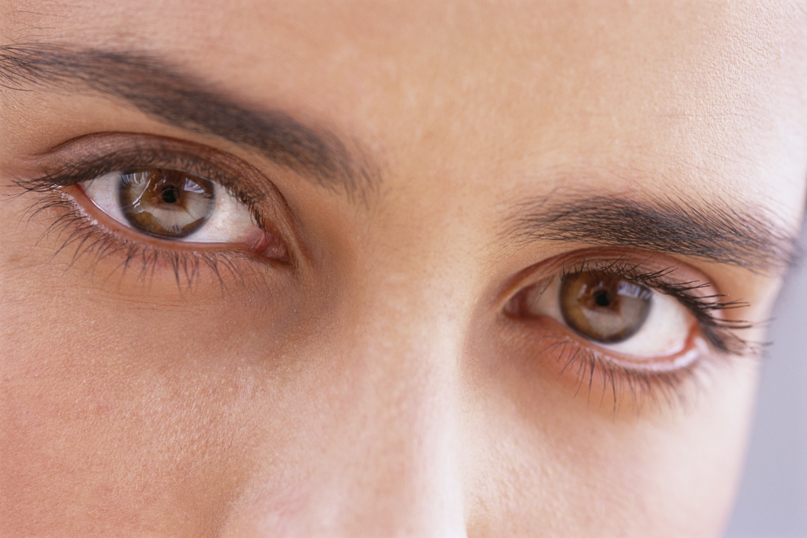
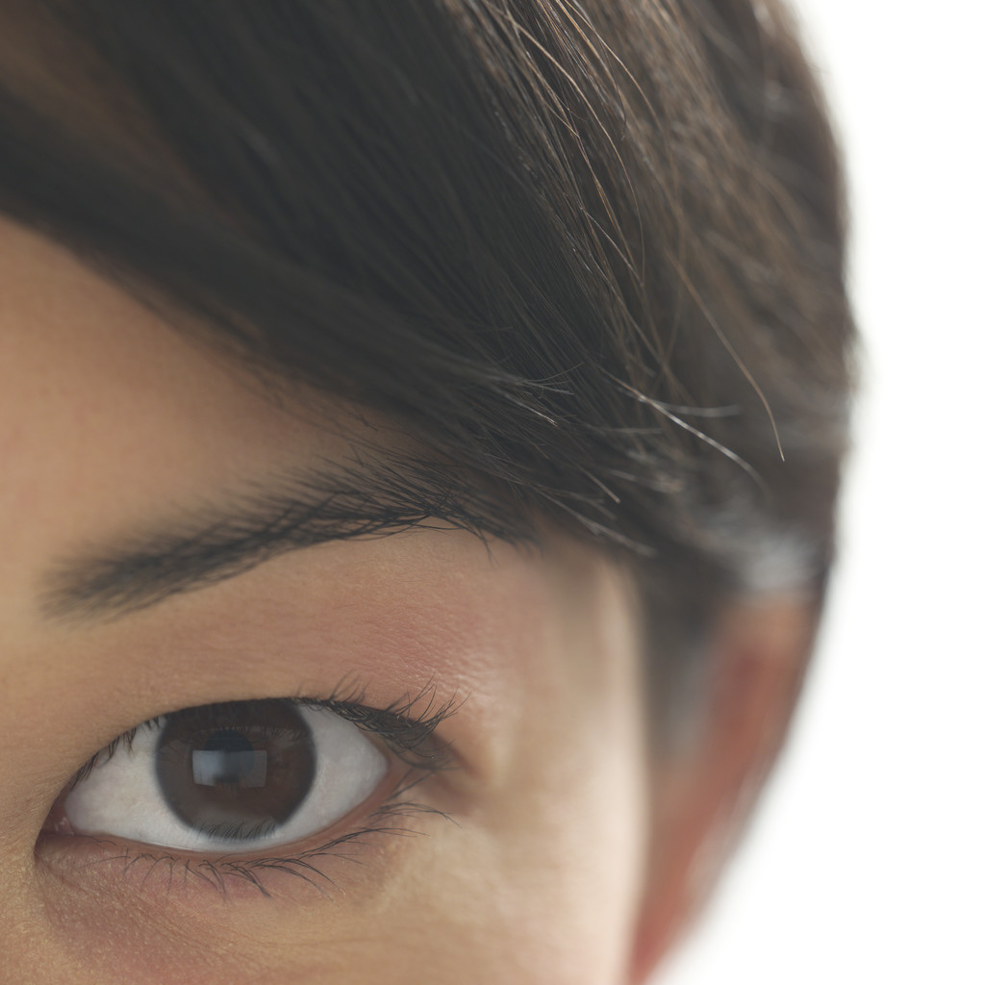
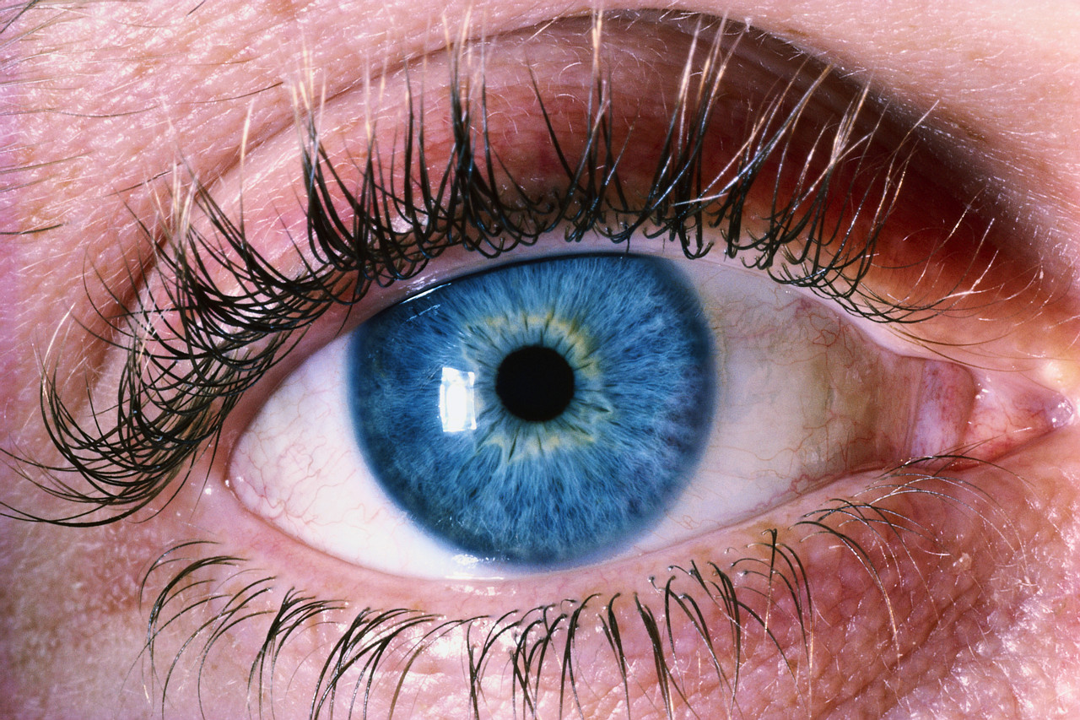
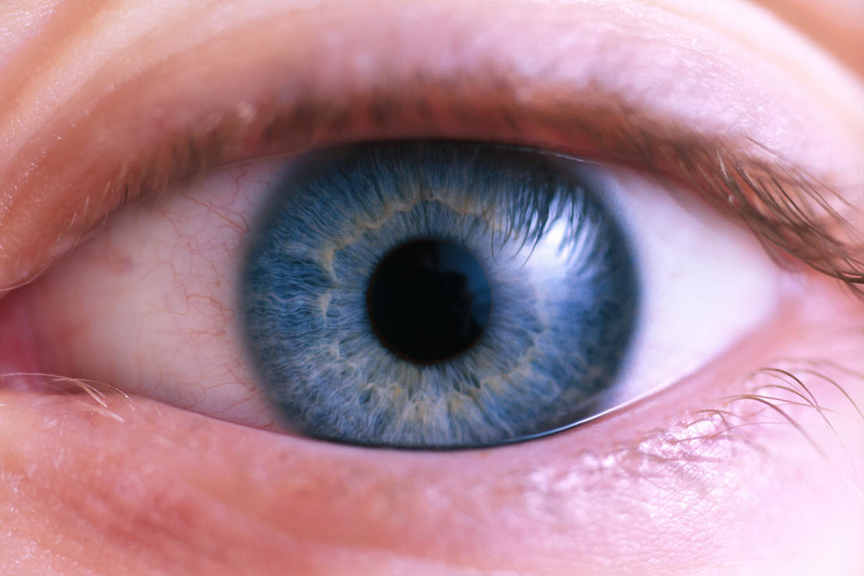
Colorblindness

Slide 21
Colorblindness is due to a recessive allele located on the X chromosome. Women have two X chromosomes, one of which usually carries the allele for normal color vision. Therefore, few women are colorblind. Men only have one X chromosome, so if they carry the allele for colorblindness, they will exhibit this trait. Thus, colorblindness is seen more frequently in men than in women.

Slide 22
End of show…

Slide 23
This powerpoint was kindly donated to www.worldofteaching.com
http://www.worldofteaching.com is home to over a thousand powerpoints submitted by teachers. This is a completely free site and requires no registration. Please visit and I hope it will help in your teaching.

