Slide 1
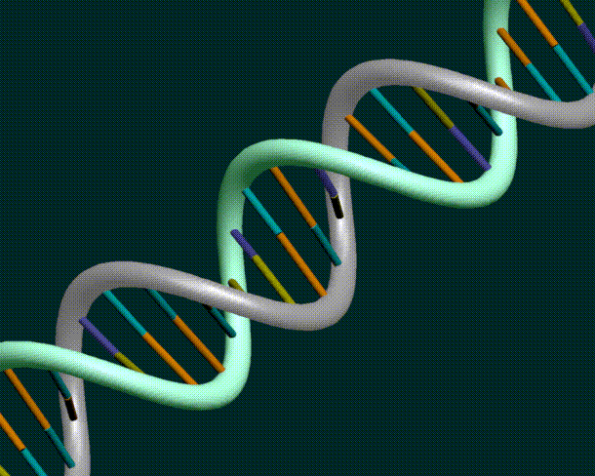
Genetic Engineering
Genetic Engineers can alter the DNA code of living organisms.
Selective Breeding
Recombinant DNA
PCR
Gel Electrophoresis
Transgenic Organisms

Slide 2
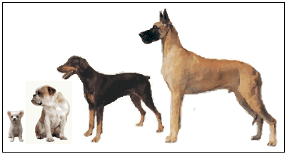

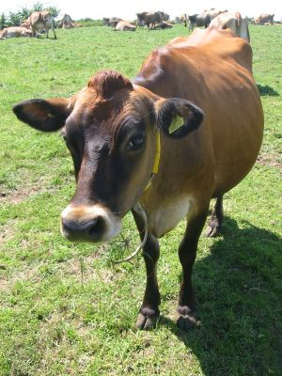
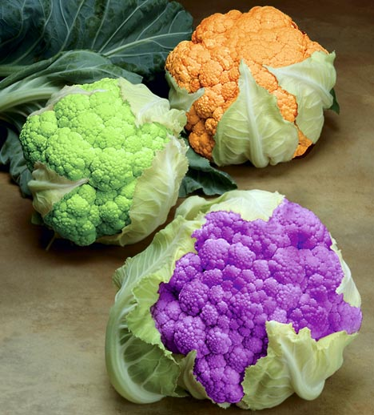
Selective Breeding
Breed only those plants or animals with desirable traits
People have been using selective breeding for 1000’s of years with farm crops and domesticated animals.

Slide 3
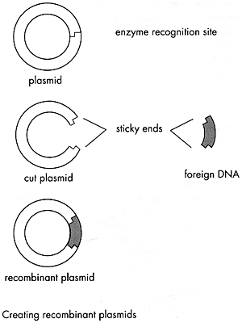
Recombinant DNA
The ability to combine the DNA of one organism with the DNA of another organism.
Recombinant DNA technology was first used in the 1970’s with bacteria.

Slide 4
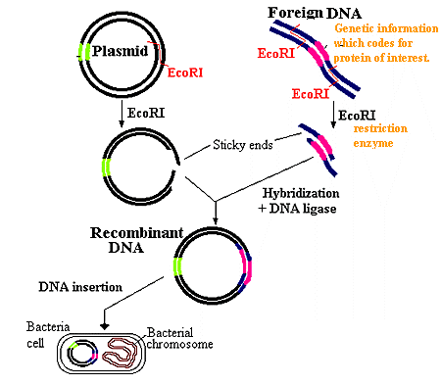
Recombinant Bacteria
Remove bacterial DNA (plasmid).
Cut the Bacterial DNA with “restriction enzymes”.
Cut the DNA from another organism with “restriction enzymes”.
Combine the cut pieces of DNA together with another enzyme and insert them into bacteria.
Reproduce the recombinant bacteria.
The foreign genes will be expressed in the bacteria.

Slide 5
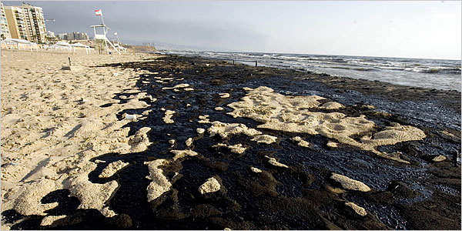
Benefits of Recombinant Bacteria
Bacteria can make human insulin or human growth hormone.
Bacteria can be engineered to “eat” oil spills.

Slide 6
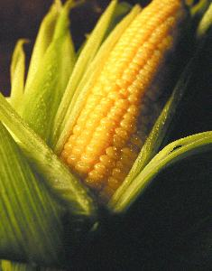

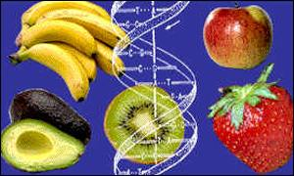
The DNA of plants and animals can also be altered.
PLANTS
disease-resistant and insect-resistant crops
2. Hardier fruit
3. 70-75% of food in supermarket is genetically modified.

Slide 7
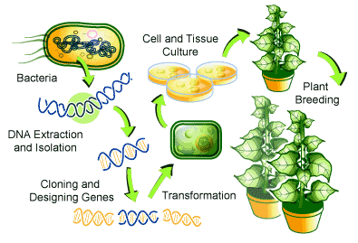
How to Create a Genetically Modified Plant
1.Create recombinant bacteria with desired gene.
2. Allow the bacteria to “infect" the plant cells.
3. Desired gene is inserted into plant chromosomes.

Slide 8
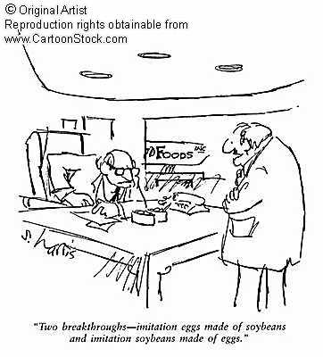
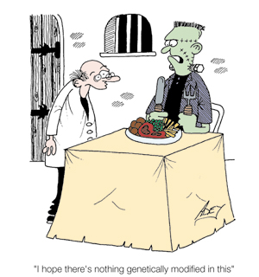
What do you think about eating genetically modified foods?

Slide 9
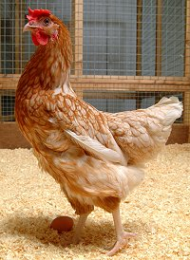
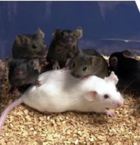
Genetically modified organisms are called transgenic organisms.
TRANSGENIC ANIMALS
Mice – used to study human immune system
Chickens – more resistant to infections
Cows – increase milk supply and leaner meat
4. Goats, sheep and pigs – produce human proteins in their milk

Slide 10
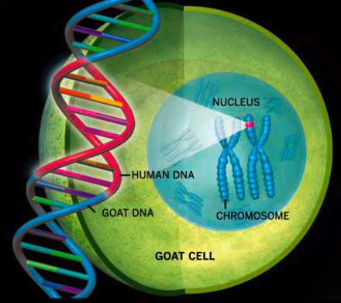
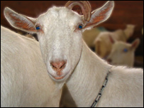
Transgenic Goat
.
This goat contains a human gene that codes for a blood clotting agent. The blood clotting agent can be harvested in the goat’s milk.
Human DNA in a Goat Cell

Slide 11
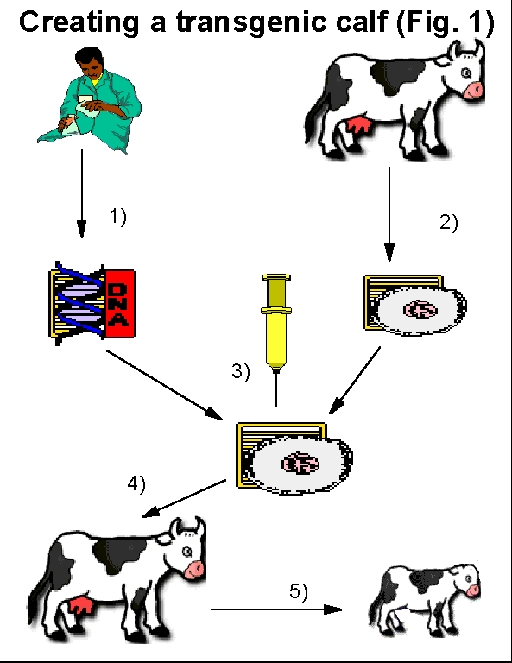
How to Create a Transgenic Animal
Desired DNA is
added to an egg cell.

Slide 12
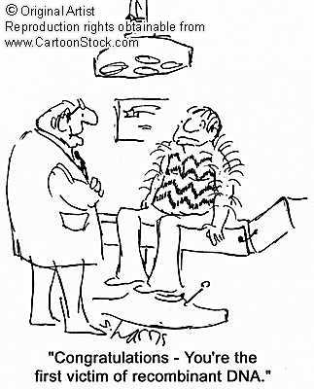
Ha Ha Ha!

Slide 13
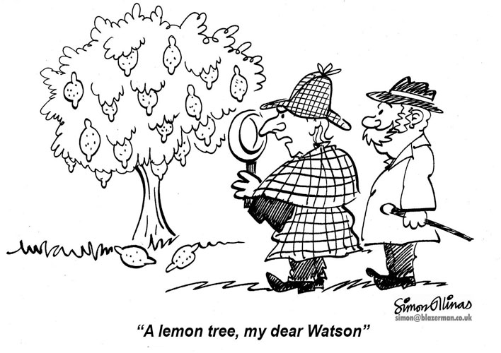
Genetic Engineering and Crime Scenes……

Slide 14
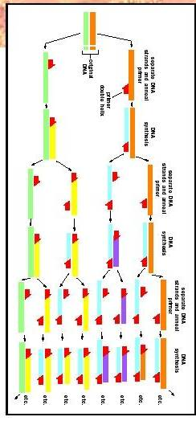
Polymerase Chain Reaction PCR
PCR allows scientists to make many copies of a piece of DNA.
Heat the DNA so it “unzips”.
2. Add the complementary nitrogenous bases.
3. Allow DNA to cool so the complementary strands can “zip” together.

Slide 15
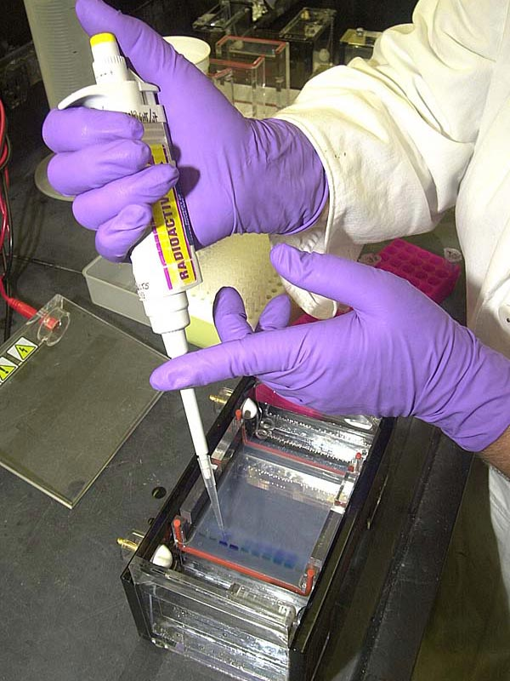
Gel Electrophoresis
This technology allows scientists to identify someone’s DNA!

Slide 16
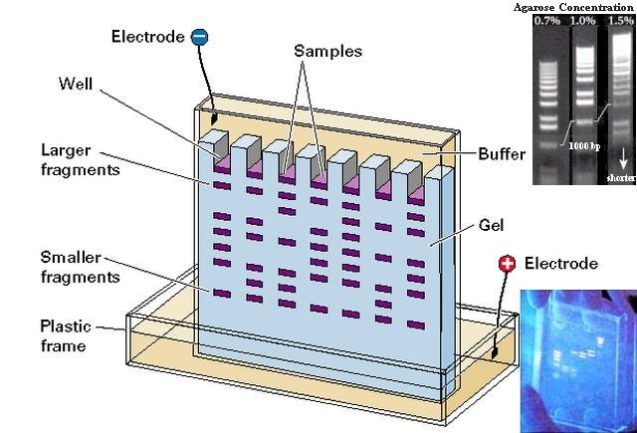
Steps Involved in Gel Electrophoresis
1. “Cut” DNA sample with restriction enzymes.
2. Run the DNA fragments through a gel.
3. Bands will form in the gel.
4. Everyone’s DNA bands are unique and can be used to identify a person.
5. DNA bands are like “genetic fingerprints”.

Slide 17
This powerpoint was kindly donated to www.worldofteaching.com
http://www.worldofteaching.com is home to over a thousand powerpoints submitted by teachers. This is a completely free site and requires no registration. Please visit and I hope it will help in your teaching.

