Slide 1
Genetic Crosses
Show possible outcomes of genes the new generation will have
We use:
Gene diagrams
Punnett Squares

Slide 2
Terminology
Genotype Phenotype Parent Gamete Offspring
dominant recessive allele

Slide 3
Gene control of characteristics
All characteristics are controlled by a minimum of 2 genes.
These genes give the characteristic a different of presenting itself.
Different genes that control the same feature are called ALLELES

Slide 4

EYE COLOUR
Possible alleles – blue , brown, green, hazel etc (each colour needs its own gene)
It is possible to have pairs of different alleles, alleles are usually given a letter

Slide 5
Genotype and phenotype
Genotype is the letter or term used to describe the allele of an individual gene or pair of genes
Phenotype – is how the gene (or pair) shows itself, how it appears.

Slide 6
Dominance and recessiveness
Some alleles for a feature are able to mask the influence of other (weaker) gene when they are paired
Stronger gene is DOMINANT and is represented by a capital letter e.g. H
The masked gene is RESSESIVE shown as lower case of the same letter e.g. h

Slide 7

Gene diagram – Flower colour
Genotype of alleles- R = red flower r = yellow flower
All genes occur in pairs – so 2 alleles affect a characteristic – possible combinations are;
genotype RR Rr rr
Phenotype RED RED YELLOW

Slide 8
Gene diagram – Flower colour
parent
Male female
RR
rr
gamete
R R r r
Offspring genotype
Rr
Rr
Rr
Rr
All red
Phenotype

Slide 9
Gene diagram – Flower colour
parent
Male female
Rr
Rr
gamete
R r R r
Offspring genotype
Rr
RR
rr
Rr
Phenotype
Red yellow red red
3 red : 1 yellow

Slide 10
Gene diagram – Flower colour
parent
Male female
Rr
rr
gamete
R r r r
Offspring genotype
Rr
rr
rr
Rr
Red yellow yellow red
Phenotype
Red 50% yellow 50%

Slide 11
Punnett Square
Another method of showing crosses

Slide 12
Parent genotypes are inserted B=black b=white
Gamete genotypes are inserted
What are the crosses
Bb male black
B
b
bb
2 white and 2 black offspring
50:50 chance with these parents
Bb
b
bb white female
b
Bb
bb

Slide 13
Question
Rats have 2 coat colours – black B, white b.
2 black rats are mated, they have 13 offspring. All of which are black, what are the genotypes of the parents
The male is re-mated with a white female, the offspring are
6 black and 7 white
What were the genotypes of the original parents
Both BB BB
BUT
one could be Bb
Female BB Male Bb

Slide 14
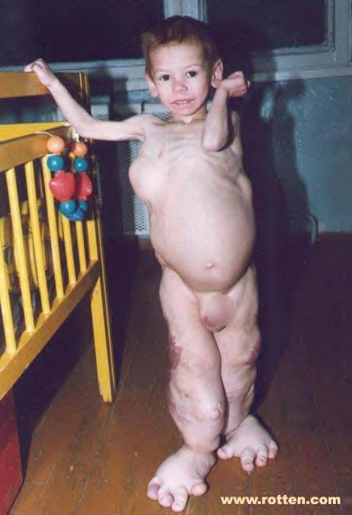
Remember think how lucky you are!

Slide 15
This powerpoint was kindly donated to www.worldofteaching.com
http://www.worldofteaching.com is home to over a thousand powerpoints submitted by teachers. This is a completely free site and requires no registration. Please visit and I hope it will help in your teaching.

