Slide 1
Evolution in present times

Slide 2
Evolutionary principals have become relevant & used in e.g.
Resolving legal issues by ‘DNA fingerprinting’
Tracing evolutionary origins of disease & developing treatments
Selective breeding of plants & animals
Understanding resistance of insect pests to insecticides
Modern warfare by use of biological pathogens & mutation-inducing chemicals

Slide 3
Is evolution happening now?
It is always happening!
But occurs extremely slowly for most species
So makes it difficult to observe
But it can be demonstrated:
In a lab using rapidly reproducing life forms
TB bacterium resisting TB drugs
Insects resisting insecticides
HIV adaption
New species of plants by polyploidy & hybridisation

Slide 4
Why can the use of antibiotic and insecticides be risky?
Populations of pathogenic organisms e.g. bacteria & insects can evolves quickly because:
- they have natural variation
- mutations occur often because individuals breed very rapidly

Slide 5
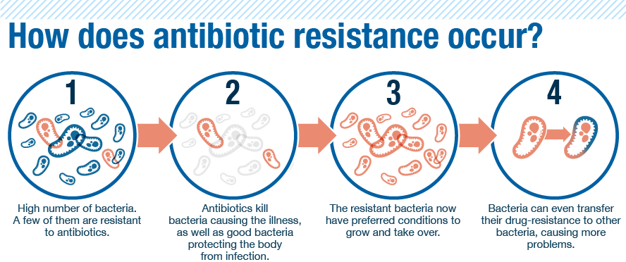
1. Resistance to antibiotics in bacteria
Antibiotic resistance is the ability of bacterium to survive the effects of antibiotics and to continue living and reproducing

Slide 6
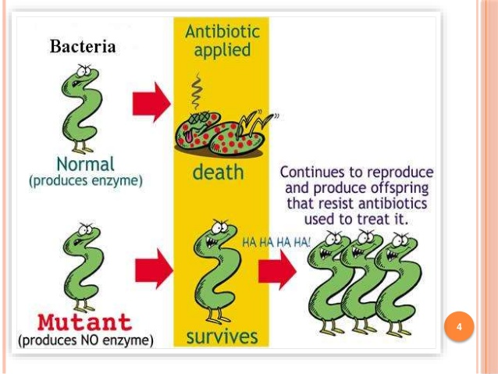
Superbugs!! (multi-drug resistant)

Slide 7
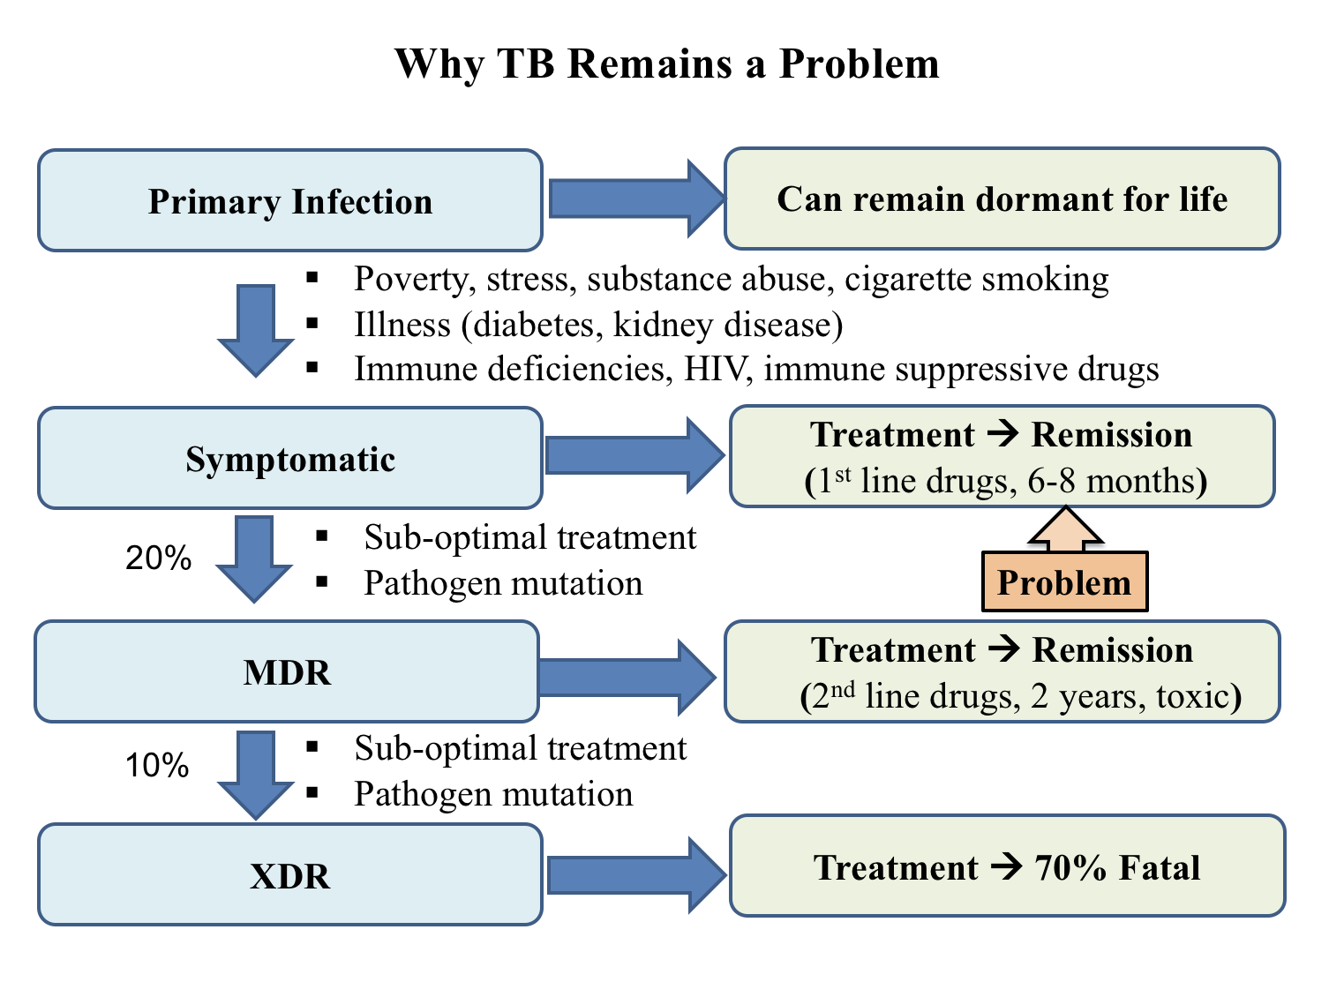
How have resistant strains of TB developed?
XDR-TB: extensively drug-resistant TB
MDR-TB: multidrug-resistant TB

Slide 8
How have resistant strains of TB developed?
The emergence of MDR-TB and XDR-TB is a direct consequence of incomplete treatments and evolutionary processes.
Lack of human discipline created an environment that selected for the survival of drug-resistant mutant TB bacteria.

Slide 9
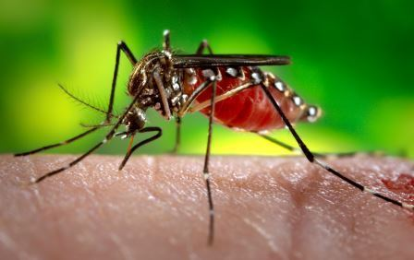
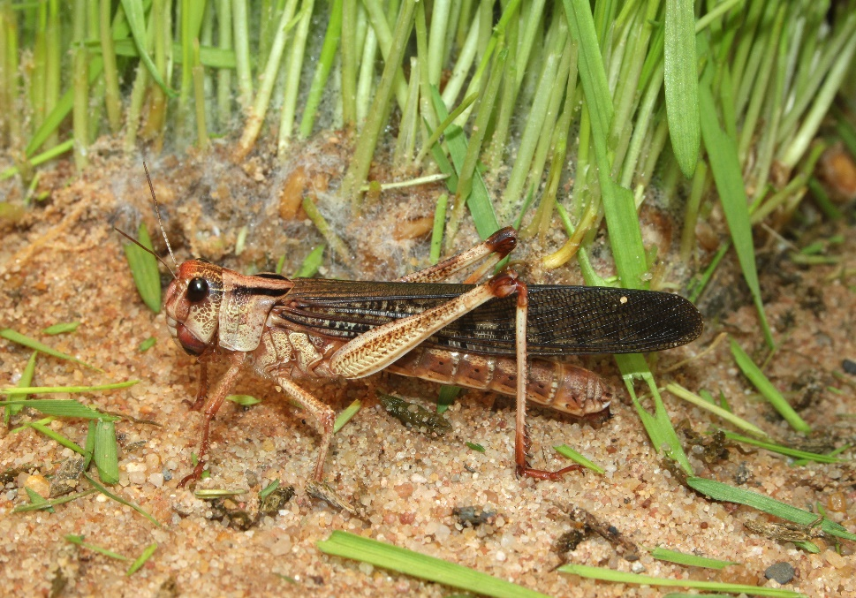
2. Resistance to insecticides in pest insects
Pest insects cause huge problems to humans
- destroy food crops e.g. locusts
- act as vectors of disease causing pathogens, e.g. mosquitoes
So scientists developed insecticides to destroy the insects

Slide 10
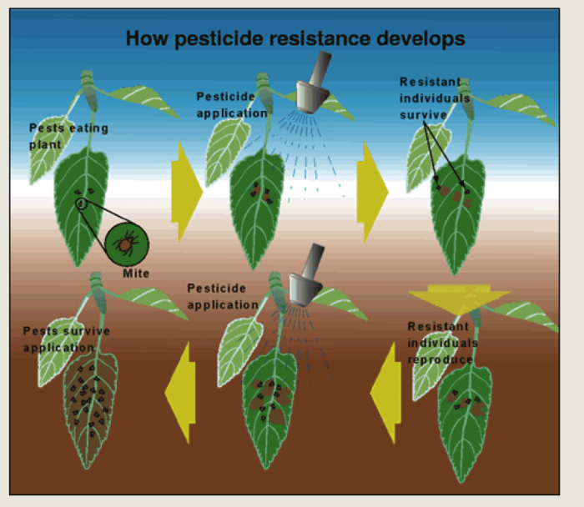
How did resistance to the insecticide DDT develop in insects?

Slide 11
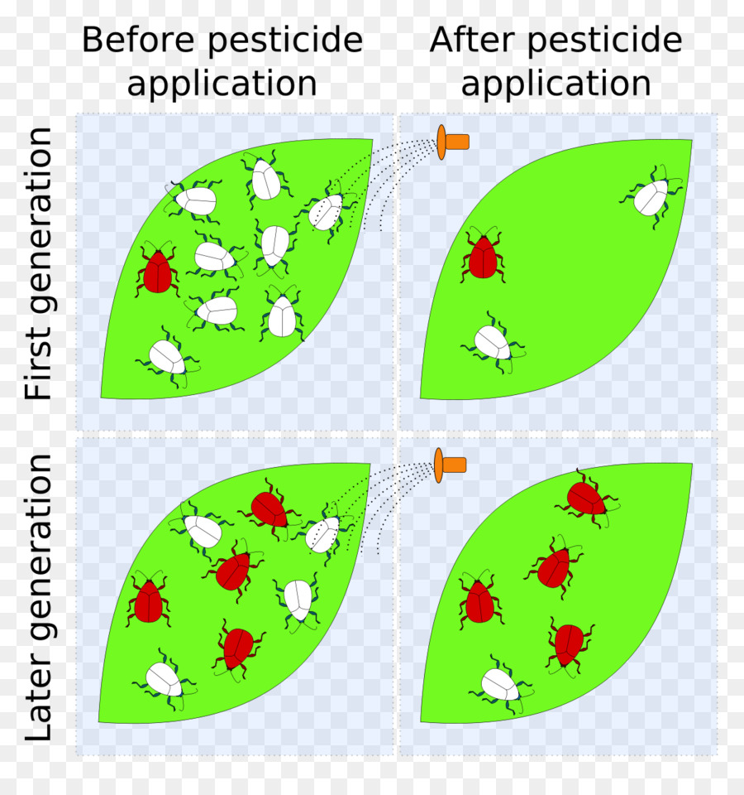
Most industrialised countries banned the use of DDT in the early 1970’s
But South Africa renewed spraying of low-dosage DDT again after populations of not resistant to DDT re-appeared

Slide 12
