Slide 1
DNA or no DNA
Notes:
All living things or things which have been living contain DNA.
What might contain DNA that is dead but made out of once living material:
Wooden objects such as chairs, dead leaves, meat etc.

Slide 2

1.

Slide 3

2.

Slide 4
DNA or no DNA

Slide 5
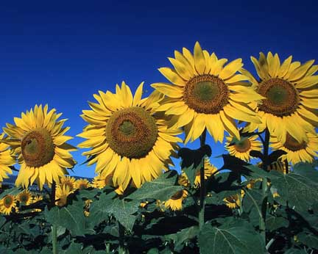
3.

Slide 6
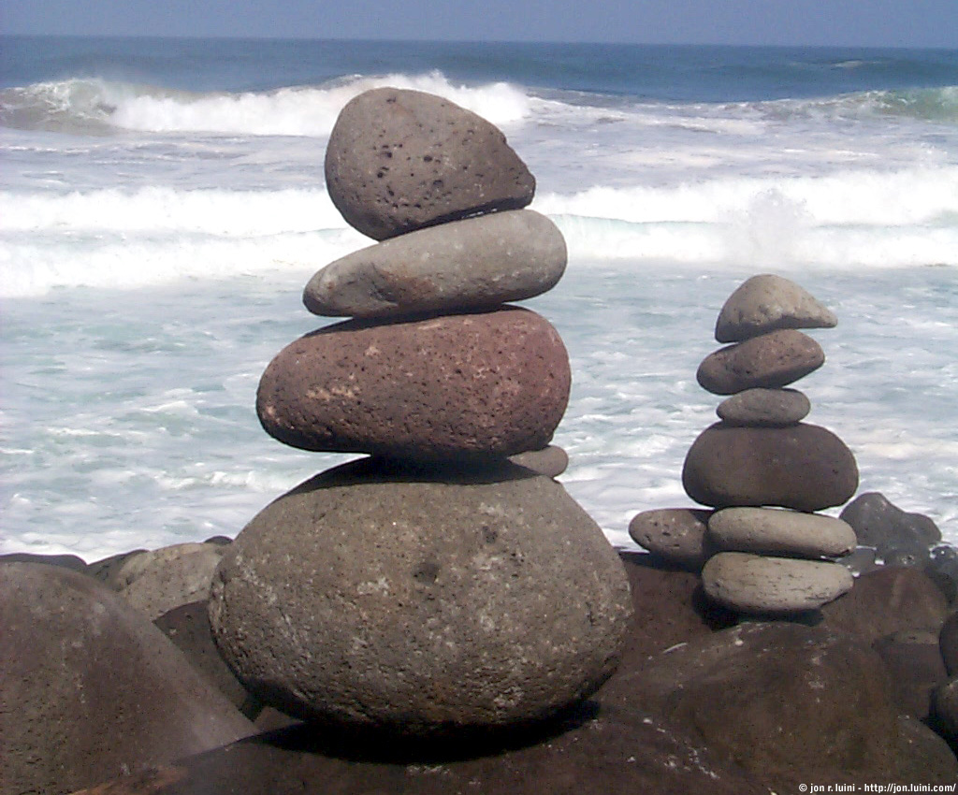
4.

Slide 7
DNA or no DNA

Slide 8
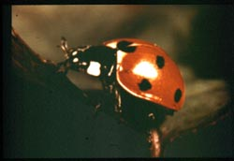
5.

Slide 9
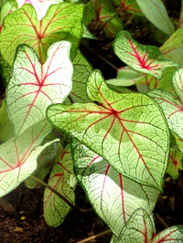
6.

Slide 10
DNA or no DNA

Slide 11
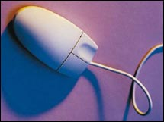
7.

Slide 12
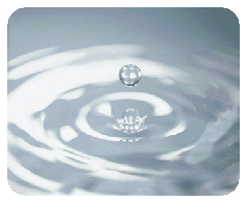
8.

Slide 13
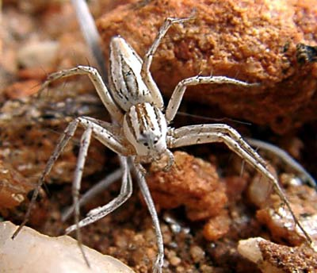
9.

Slide 14
DNA or no DNA

Slide 15
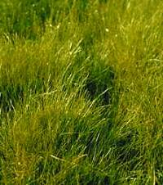
10.

Slide 16
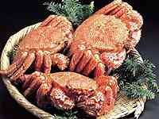
11.

Slide 17
DNA or no DNA

Slide 18
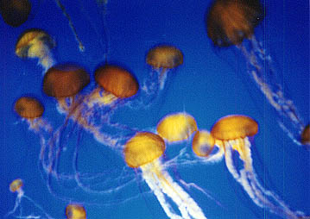
12.

Slide 19
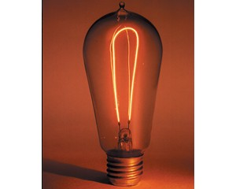
13.

Slide 20
DNA or no DNA

Slide 21

14.

Slide 22
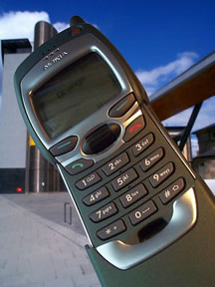
15.

Slide 23
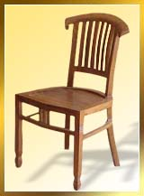
16.

Slide 24
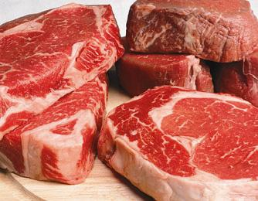
17.

Slide 25
This powerpoint was kindly donated to www.worldofteaching.com
http://www.worldofteaching.com is home to over a thousand powerpoints submitted by teachers. This is a completely free site and requires no registration. Please visit and I hope it will help in your teaching.

