Slide 1
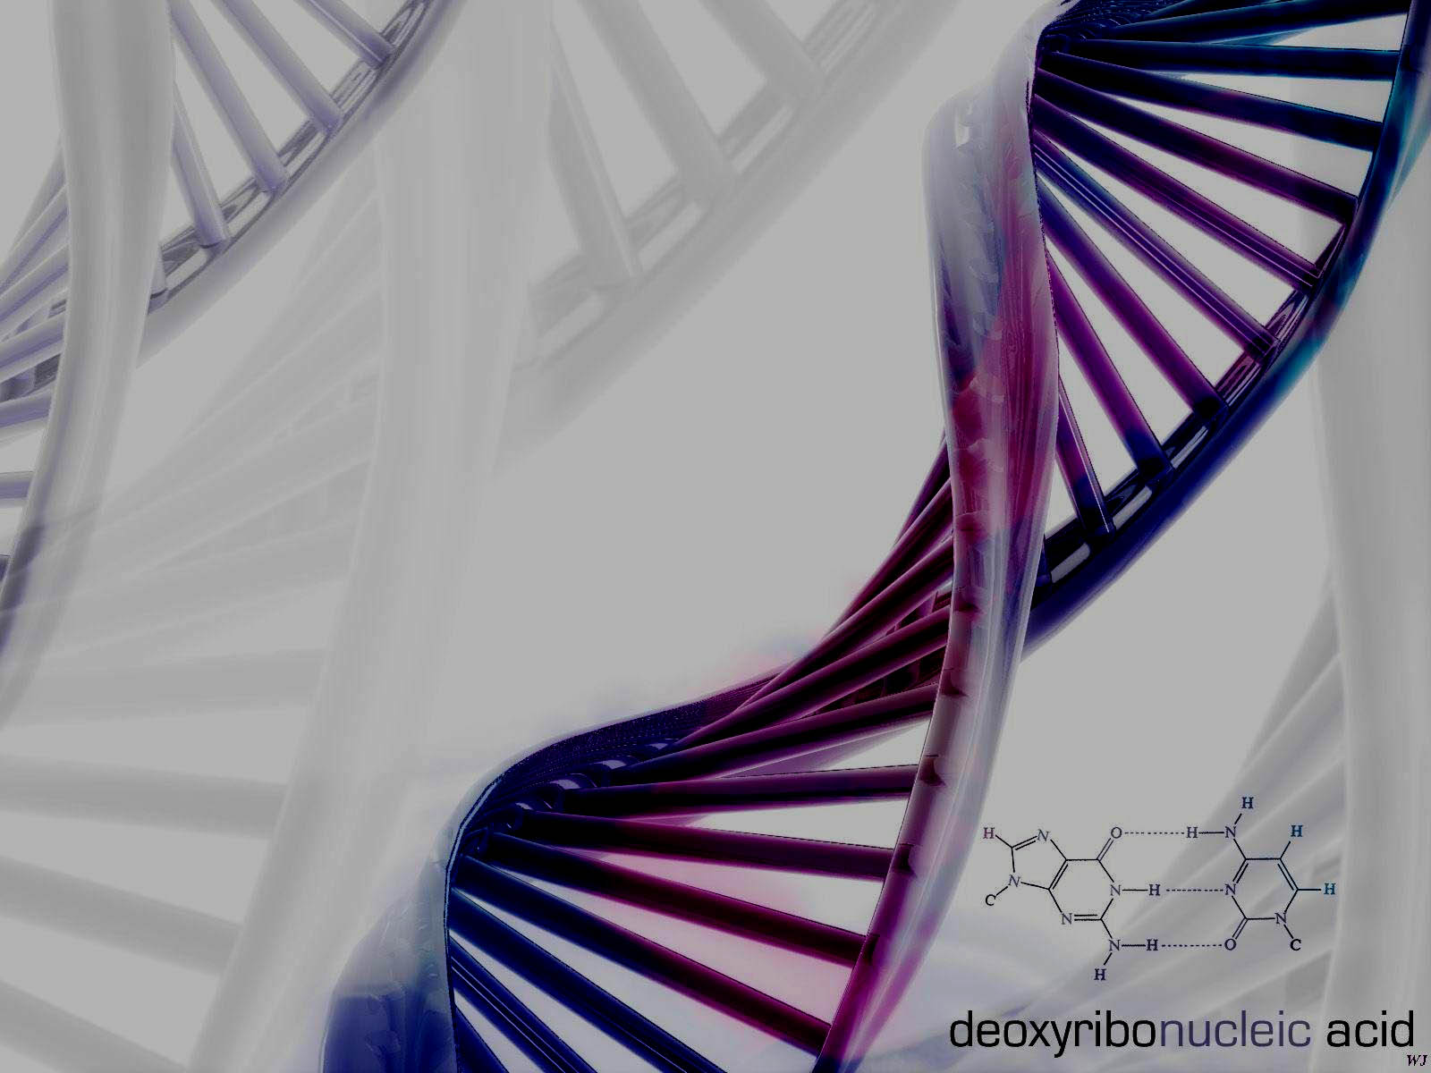
DNA
Structure

Slide 2
DNA Structure
DNA consists of two molecules that are arranged into a ladder-like structure called a Double Helix.
A molecule of DNA is made up of millions of tiny subunits called Nucleotides.
Each nucleotide consists of:
Phosphate group
Pentose sugar
Nitrogenous base

Slide 3
Nucleotides
Phosphate
Nitrogenous
Base
Pentose
Sugar

Slide 4
Nucleotides
The phosphate and sugar form the backbone of the DNA molecule, whereas the bases form the “rungs”.
There are four types of nitrogenous bases.

Slide 5
Nucleotides
A
T
Adenine
Thymine
C
G
Cytosine
Guanine

Slide 6
Nucleotides
Each base will only bond with one other specific base.
Adenine (A)
Thymine (T)
Cytosine (C)
Guanine (G)
Form a base pair.
Form a base pair.

Slide 7
DNA Structure
Because of this complementary base pairing, the order of the bases in one strand determines the order of the bases in the other strand.

Slide 8
A
T
C
G
T
A
C
G
A
T
G
C
T
A

Slide 9
DNA Structure
To crack the genetic code found in DNA we need to look at the sequence of bases.
The bases are arranged in triplets called codons.
A G G - C T C - A A G - T C C - T A G
T C C - G A G - T T C - A G G - A T C

Slide 10
DNA Structure
A gene is a section of DNA that codes for a protein.
Each unique gene has a unique sequence of bases.
This unique sequence of bases will code for the production of a unique protein.
It is these proteins and combination of proteins that give us a unique phenotype.

Slide 11


DNA
Gene
Protein
Trait

Slide 12
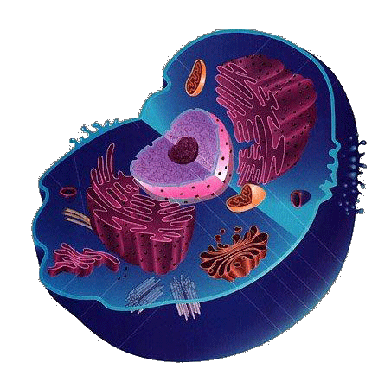
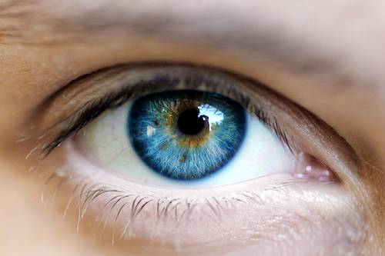
Your Task
Draw a flow chart to show how to get from:

Slide 13
This powerpoint was kindly donated to www.worldofteaching.com
http://www.worldofteaching.com is home to over a thousand powerpoints submitted by teachers. This is a completely free site and requires no registration. Please visit and I hope it will help in your teaching.

