Slide 1
DNA Profiling
(DNA fingerprinting)

Slide 2
What is DNA Profiling?
A technique used by scientists to distinguish between individuals of the same species using only samples of their DNA

Slide 3

Who Invented it?
The process of DNA fingerprinting was invented by Alec Jeffreys at the University of Leicester in 1985.
He was knighted in 1994.

Slide 4

Stages of DNA Profiling
Stage 1:
Cells are broken down
to release DNA
If only a small amount of DNA is available it can be amplified using the polymerase chain reaction (PCR)

Slide 5

Stages of DNA Profiling
Step 2:
The DNA is cut into fragments using restriction enzymes.
Each restriction enzyme cuts DNA at a specific base sequence.

Slide 6
Stages of DNA Profiling
The sections of DNA that are cut out are called restriction fragments.
This yields thousands of restriction fragments of all different sizes because the base sequences being cut may be far apart (long fragment) or close together (short fragment).

Slide 7
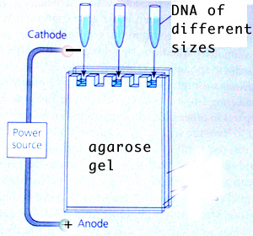
Stages of DNA Profiling
Stage 3:
Fragments are separated on the basis of size using a process called gel electrophoresis.
DNA fragments are injected into wells and an electric current is applied along the gel.

Slide 8
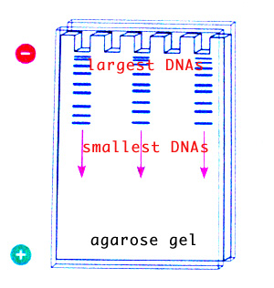
Stages of DNA Profiling
DNA is negatively charged so it is attracted to the positive end of the gel.
The shorter DNA fragments move faster than the longer fragments.
DNA is separated on basis of size.

Slide 9

Stages of DNA Profiling
A radioactive material is added which combines with the DNA fragments to produce a fluorescent image.
A photographic copy of the DNA bands is obtained.

Slide 10
Stages of DNA Profiling
Stage 4:
The pattern of fragment distribution is then analysed.

Slide 11
Uses of DNA Profiling
DNA profiling is used to solve crimes and medical problems

Slide 12
Crime
Forensic science is the use of scientific knowledge in legal situations.
The DNA profile of each individual is highly specific.
The chances of two people having exactly the same DNA profile is 30,000 million to 1 (except for identical twins).

Slide 13


Biological materials used for DNA profiling
Blood
Hair
Saliva
Semen
Body tissue cells
DNA samples have been obtained from vaginal cells transferred to the outside of a condom during sexual intercourse.

Slide 14
DNA Profiling can solve crimes
The pattern of the DNA profile is then compared with those of the victim and the suspect.
If the profile matches the suspect it provides strong evidence that the suspect was present at the crime scene (NB:it does not prove they committed the crime).
If the profile doesn’t match the suspect then that suspect may be eliminated from the enquiry.

Slide 15
Example
A violent murder occurred.
The forensics team retrieved a blood sample from the crime scene.
They prepared DNA profiles of the blood sample, the victim and a suspect as follows:

Slide 16
Was the suspect at the crime scene?
Suspects Profile
Blood sample from crime scene
Victims profile

Slide 17
Solving Medical Problems
DNA profiles can be used to determine whether a particular person is the parent of a child.
A childs paternity (father) and maternity(mother) can be determined.
This information can be used in
Paternity suits
Inheritance cases
Immigration cases

Slide 18
Example: A Paternity Test
By comparing the DNA profile of a
mother and her child it is possible to
identify DNA fragments in the child
which are absent from the mother and
must therefore have been inherited
from the biological father.

Slide 19
Is this man the father of the child?
Mother
Child
Man

Slide 20

Famous cases
In 2002 Elizabeth Hurley used DNA profiling to prove that Steve Bing was the father
of her child Damien

Slide 21
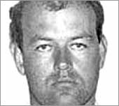
Famous Cases
Colin Pitchfork was the first criminal caught based on DNA fingerprinting evidence.
He was arrested in 1986 for the rape and murder of two girls and was sentenced in 1988.

Slide 22
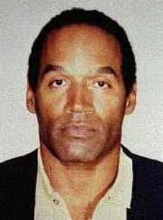
Famous Cases
O.J. Simpson was cleared of a double murder charge in 1994 which relied heavily on DNA evidence.
This case highlighted lab difficulties.

Slide 23
This powerpoint was kindly donated to www.worldofteaching.com
http://www.worldofteaching.com is home to over a thousand powerpoints submitted by teachers. This is a completely free site and requires no registration. Please visit and I hope it will help in your teaching.

