Slide 1
DNA – An overview
Dr. Siva Ramamoorthy
School of Biosciences and Technology
VIT University
India
email: rsiva77in@rediffmail.com

Slide 2
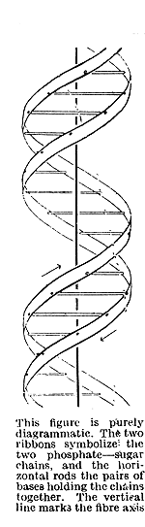
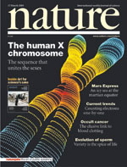
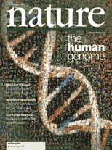
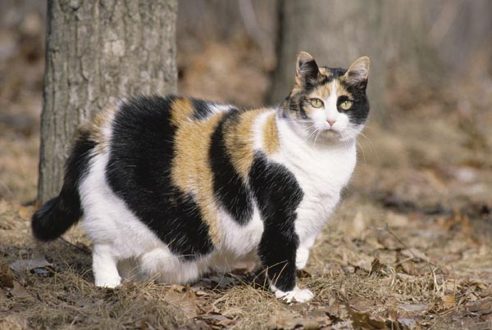
WHAT IS GENE?
2005
2003
DNA Double Helix,
Watson & Crick
Nature, 1953
Human genome Project
Inactivation of different X genes

Slide 3
The physical and functional unit of heredity that carries information from one generation to the next
DNA sequence necessary for the synthesis of a functional protein or RNA molecule.

Slide 4
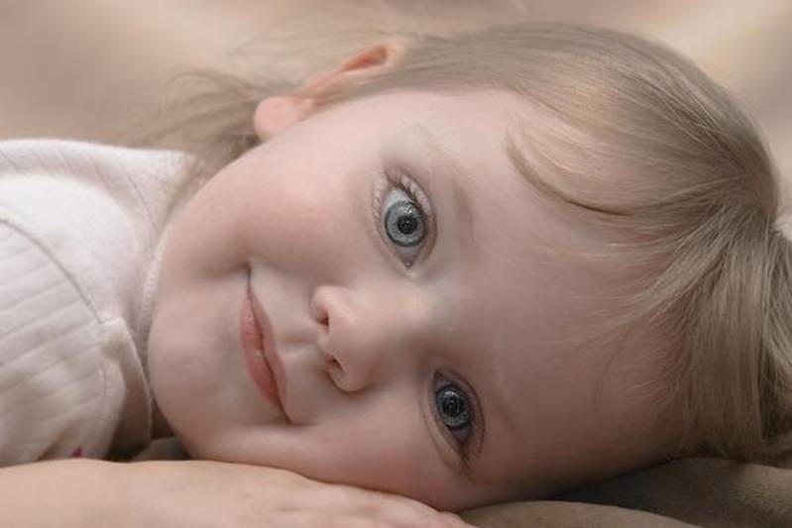

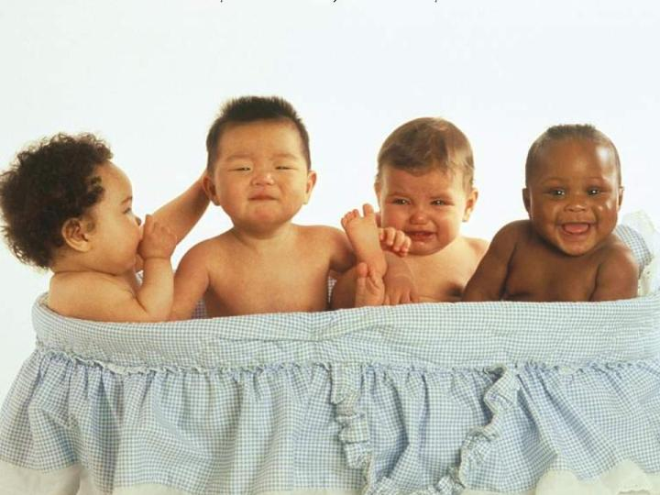

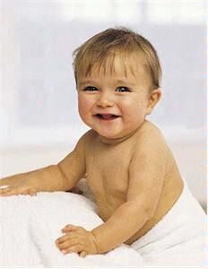

Slide 5
GENE
Gene were first detected and analyzed by Mendel and subsequently by many other scientist (Mendel stated that physical traits are inherited as “particles”)
Mendel did not know that the “particles” were actually Chromosomes & DNA
Subsequent studies shows the correlation between transmission of genes from one generation to generation (Segregation and independent assortment) and the behavior of chromosomes during sexual reproduction, specifically the reduction division of meiosis and fertilization.
These and related expt. provided a strong early evidence that genes are usually located on chromosomes.

Slide 6
What are the requirements to fulfill as a genetic material?
1. The genotype function or replication:
    The genetic material must be capable of storing genetic information and transmitting this information faithfully from parents to progeny, generation after generation.
2. The phenotype function or gene expression
    The genetic material must control the development of phenotype of the organism, be it a virus, a bacterium, a plant or animal.
    That is, the genetic material must dictate the growth and differentiation of the organism from single celled zygote to the mature adult.

Slide 7
Chromosomes are composed of two types of large organic molecules (macromolecules) called proteins and nucleic acids.
The NA are of two types: DNA and RNA
For many years there was considerable disagreement among scientists as to which of these macromolecules carries genetic information.
During the 1940s and early 1950s, several elegant experiments were carried out that clearly shows that NA is genetic material rather than protein.
More specifically these expt. shows that DNA is genetic material for all living organism except for RNA viruses.

Slide 8
DNA , The Genetic material
The first direct evidence showing that the genetic material is DNA rather than RNA or protein was published by O.T. Avery, Macleod and C.M. Mccarty in 1944.
They demonstrated that the component of the cell responsible for the phenomenon of transformation in the bacterium Diplococcus pneumoniae is DNA.

Slide 9
Griffith experiment
The phenomenon of transformation was first discovered by Frederick Griffith in 1928.
Pneumococci, like all other living organisms, exhibit genetic variability that can be exhibit with different phenotype
The two phenotypic characteristic of importance in Griffith experiment were:
1. presence or absence of a surrounding polysaccharide capsule, and
2. the type of capsule, that is, the specific molecular composition of the polysaccharide present in the capsules.

Slide 10
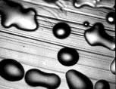
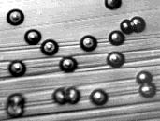
When grown in appropriate media in petri dishes, pneumococci with capsule form large, smooth colonies and thus designated as Type S.
Such encapsulated pneumococci are quite pathogenic to mammals, so they are virulent
The other type is nonpathogenic (nonvirulent) has no polysaccharide capsule.
Such a non-encapsulated, nonvirulent pneumococci form small, rough-surfaced colonies when grown on medium and are thus designated as Type R.
Smooth
Rough

Slide 11
Colony morphology Reaction with Antiserum
prepared against
Type Appearance Size Capsule Virulence Type IIS Type IIIS
IIR Rough Small Absent Non-virulent none none
IIS Smooth Large Present Virulent Agglutination none
IIIR Rough Small Absent Non-virulent none none
IIIS Smooth Large Present Virulent none Agglutina

Slide 12
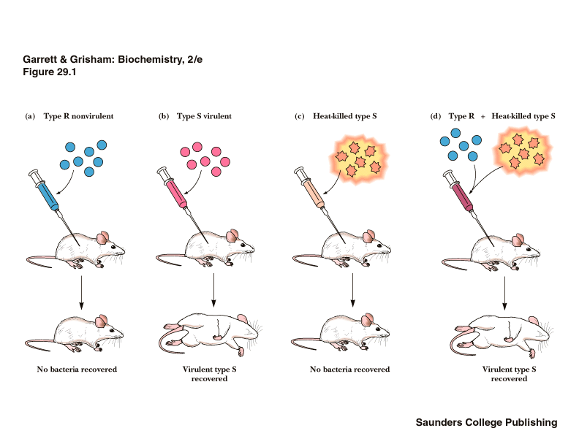

Slide 13
Griffith unexpected discovery was that if he injected heat-killed Type IIIS pneumococci (Virulent when alive) plus live Type IIR pneumococci (nonvirulent) into mice, many of the mice died.
But when mice were injected with heat-killed Type IIIS pneumococci alone none of the mice died.
Thus, the “transformation” of nonvirulent Type IIR cells to virulent Type IIIS cells cannot be explained by mutation, rather some component of dead Type IIIS cells (the “transforming principle”) must convert living Type IIR to Type IIIS.
Subsequent expt. Showed the phenomenon described by Griffith now called “transformation”.

Slide 14
Proof That the “Transforming Principle” is DNA
In 1944, Avery, Macleod, and McCarty published the results of extensive and laborious expt.
They confirmed through the experiments that “transforming particle is DNA”.
In a highly purified DNA from Type IIIS cells was treated with:
1. Deoxyribonuclease (DNase)
2. Ribonuclease (RNase)
3. Protease.

Slide 15
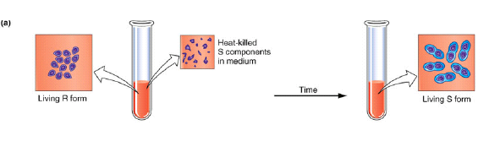
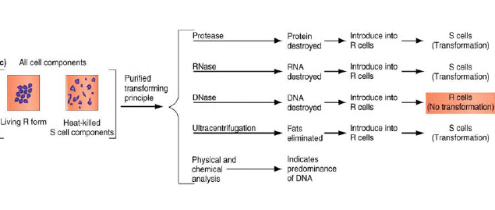

Slide 16
The Hershey – Chase Experiment
Additional direct evidence indicating that DNA is the genetic material was published in 1952 by A.D. Hershey (1969 Nobel Prize winner) and M.Chase.
These experiments showed that the genetic information of a particular bacterial virus (bacteriophage T₂) was present in DNA.
T₂ Phages infects the E.coli bacterium

Slide 17
Bacteriophage T_{2 is} composed of 50% protein and about 50% DNA.
Experiments prior to 1952 had shown that all bacteriophage T₂ reproduction takes within E.coli cell.
Therefore, when Hershey and Chase showed that the DNA of the virus particle entered the cell, where as most of the protein of the virus remained absorbed to the outside cell.
This is strongly implied that the genetic information necessary for viral reproduction was present in DNA.

Slide 18
The basis of the Hershey –Chase experiment is that DNA contains Phosphorous but no sulfur, where as Proteins contain sulfur but not phosphorous.
Thus, they were able to specifically label either
(1) the phage DNA by growth in a medium containing the radioactive isotope of Phosphorous, P³² , in the place of normal isotope P³¹
Or (2) the phage protein coats by growth in a medium containing radioactive sulfur S³⁵, in the place of normal S³²

Slide 19
T₂ phages labeled with S³⁵ were mixed with E.coli cells for few minutes.
It was then subjected to shearing forces by placing infected cells in a Waring blender
It was found that most of the radioactivity could be removed from the cells without affecting progeny production.
When T₂ phages labeled with P³², radioactivity was found inside the cells, that is, it was not subject to removal by shearing in a blender.

Slide 20
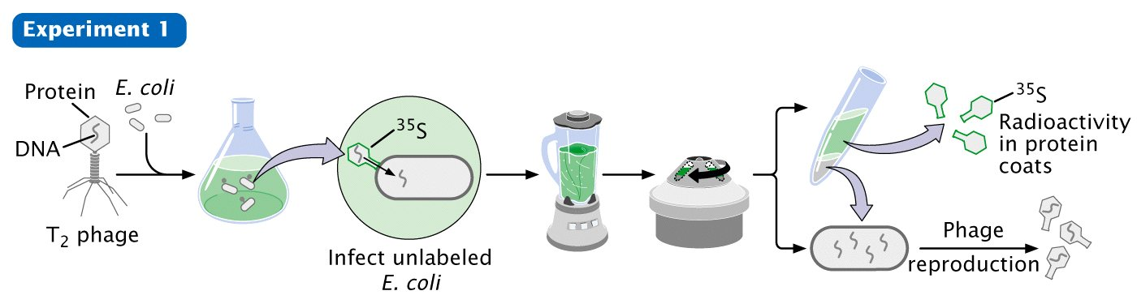
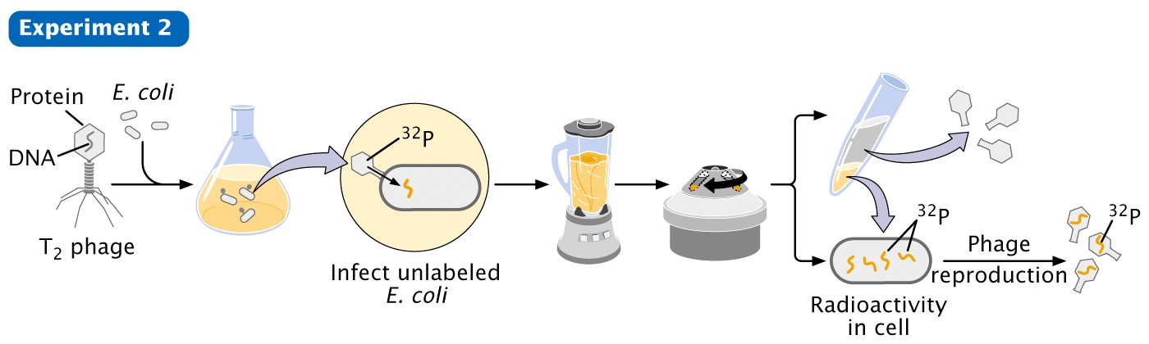
Hershey-Chase, 1952 Warring Blender Experiment

Slide 21
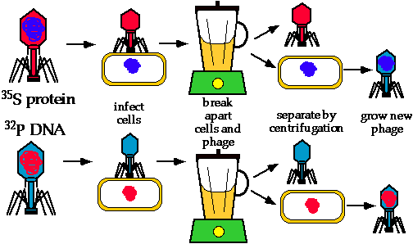
What was their conclusion regarding the source of genetic material in phages?

Slide 22
RNA as genetic material in small viruses
H.Fraenkel- Conrat and B.Singer in 1957 conduct experiment on TMV.
By using the appropriate chemical treatment one can separate the protein coats of TMV from the RNA.
Moreover, this process is reversible; by mixing the proteins and the RNA under appropriate conditions, “reconstitution” will occur.
They took two different strains of TMV, separated the RNAs from the protein coat.
Reconstituted “mixed” viruses by mixing the proteins of one strain with the RNA of the second strain, and vice versa.
When these mixed viruses were infected with tobacco leaves, the progeny was phenotypically and genotypically identical like parent from where RNA had been obtained.

Slide 23
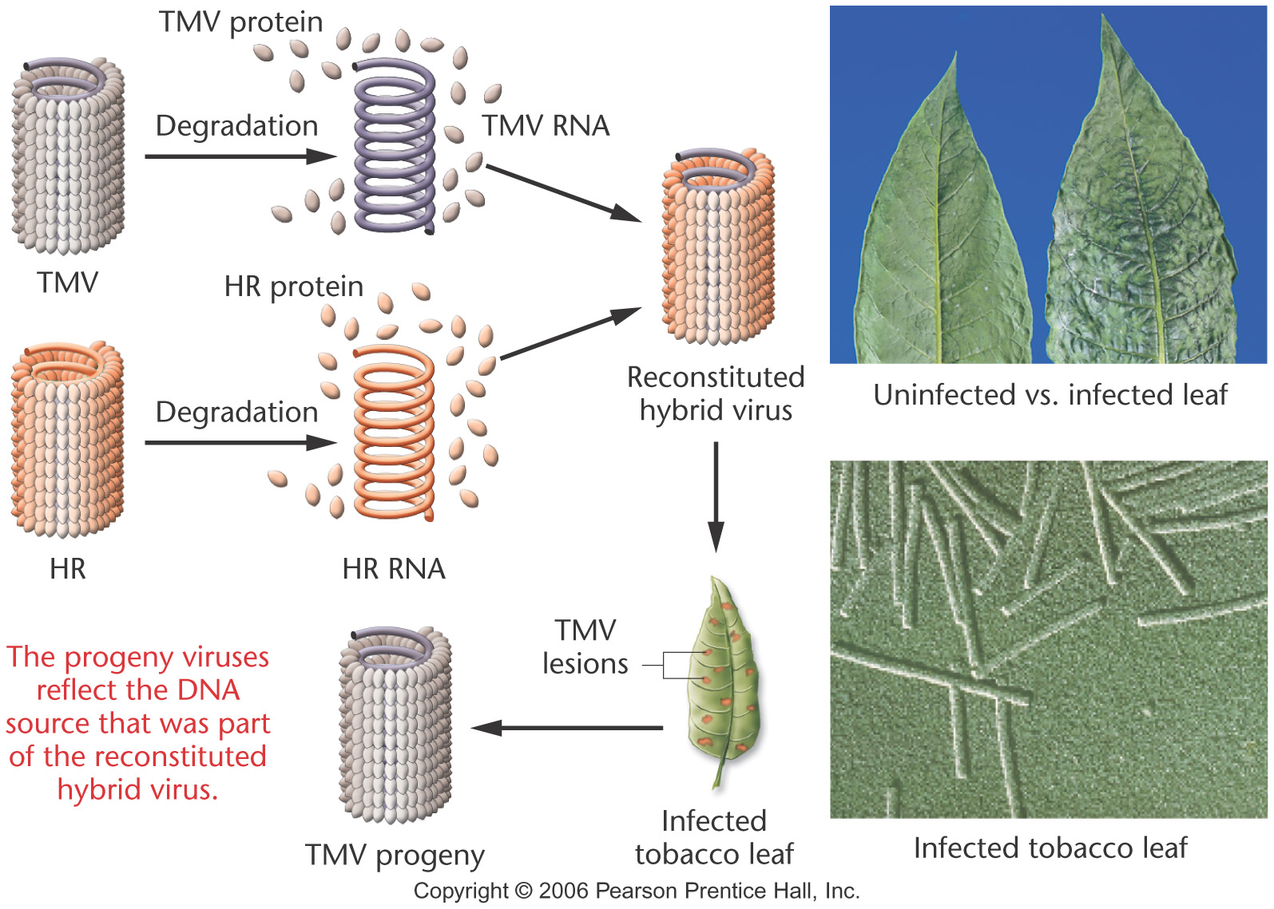

Slide 24
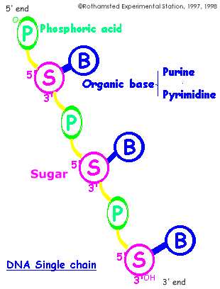

DNA STRUCTURE
Nucleic acids first called “nuclein” because they were isolated from cell nuclei by F. Miescher in 1869
Each nucleotide is composed of
  (1) a Phosphate group
  (2) a five – carbon sugar (or Pentose), and
  (3) a cyclic nitrogen containing compound called a base.

Slide 25
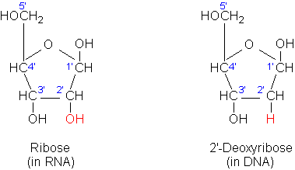
  In DNA, the sugar is 2-deoxyribose (thus the name deoxyribonucleic acid)
  In RNA, the sugar is ribose (thus ribonucleic acid).

Slide 26
There are four different bases commonly found in DNA:
Adenine
Guanine
Thymine and
Cytosine.
RNA also contains adenine, guanine and cytosine, but has different base, uracil in the place of thymine.

Slide 27
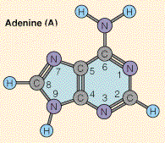
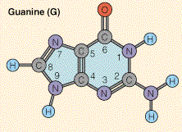
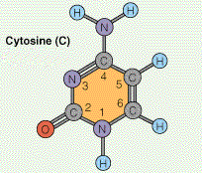
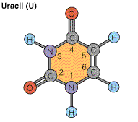
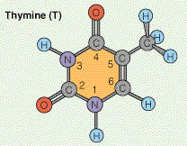
Adenine and Guanine are double ring base called Purines
6-aminopurine
2-amino-6-oxypurine
Cytosine, thymine, and uracil are single-ring base called Pyrimidines.
4-amino-2-oxypyrimidine
2,4-oxypyrimidine
2,4-oxy-5-pyrimidine

Slide 28
The Watson and Crick DNA Double helix
The correct structure of DNA was first deduced by J.D. Watson and F.H.C.Crick in 1953.
Their double helix model of DNA structure was based on two major kind of evidence.
1. Chargaff’s rule
2. X – ray diffraction patterns.

Slide 29
Chargaff’s rule
The composition of DNA from many different organisms was analyzed by E.Chargaff and his colleagues.
It was observed that concentration of thymine was always equal to the concentration of adenine (A = T)
And the concentration of cytosine was equal to the concentration of guanine (G = C).
This strongly suggest that thymine and adenine as well as cytosine and guanine were present in DNA with fixed interrelationship.
Also the total concentration of purines (A +G) always equal to the total concentration of pyrimidine (T +C). However, the (T+ A)/ (G+C) ratio was found to vary widely in DNAs of different species.

Slide 30
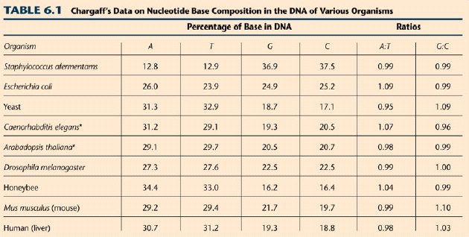

Slide 31
X ray diffraction
When X rays are focused through isolated macromolecules or crystals of purified molecules, the X ray are deflected by the atom of the molecules in specific patterns called diffraction patterns.
It provides the information about the organization of the components of the molecules.
Watson and Crick had X ray crystallographic data on DNA structure from the studies of Wilkins and Franklin and their coworkers.
These data indicated that DNA was a highly ordered, multiple stranded structure with repeating sub structures spaced every 3.4 Aº (1 Angstrom = 10⁻¹⁰ m )

Slide 32
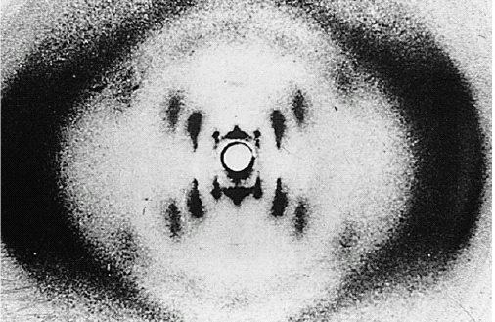
X-ray diffraction patterns of DNA
– Rosalind Franklin and Maurice Wilkins
The central cross shaped pattern as indicative of a helical structure. The heavy dark patterns (top and bottom) indicate that the bases are stacked perpendicular to the axis of the molecule.

Slide 33
Double Helix
Watson and Crick proposed that DNA exists as a double helix in which two polynucleotide chains are coiled above one another in a spiral.
Each polynucleotide chain consists of a sequence of nucleotide linked together by Phosphodiester bonds.
The two polynucleotide strands are held together in their helical configurations by hydrogen bonding.
The base pairing is specific
That is, adenine is always paired with thymine and guanine is always paired with cytosine
Thus, all base-pairs consists of one purine and one pyrimidine.
Once the sequence of bases in one strand of DNA double helix is known, it is possible to know the other strand sequence of base because of specific base pairing.

Slide 34
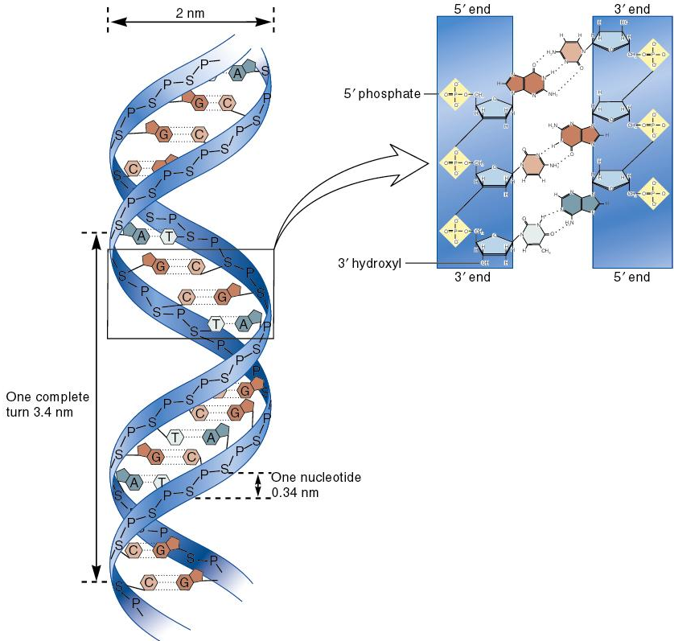
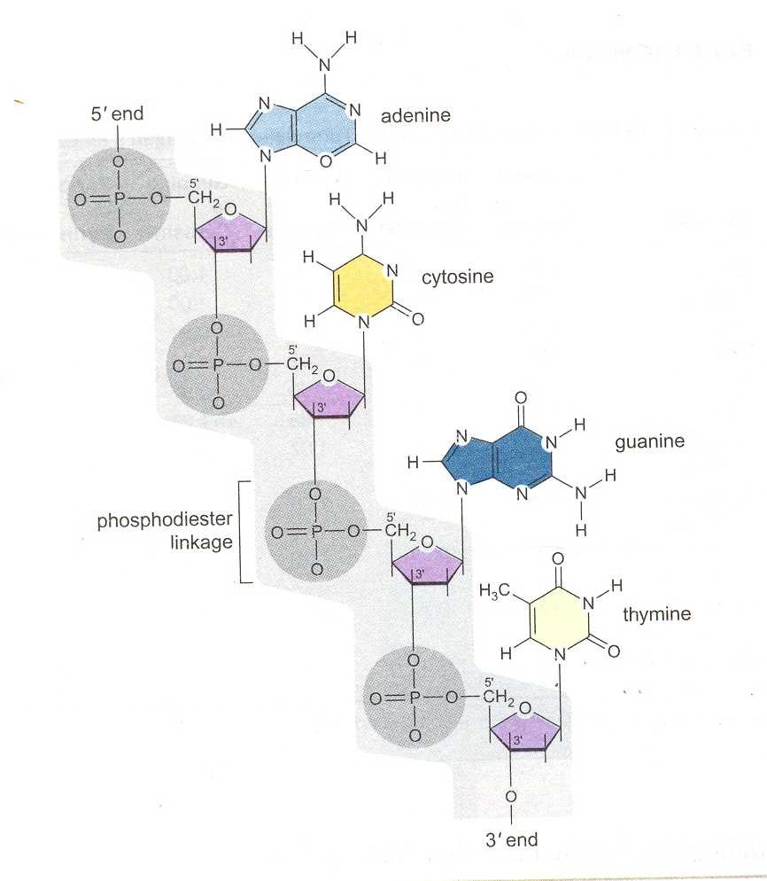

Slide 35
In their most structural configuration, adenine and thymine form two hydrogen bonds, where as guanine and cytosine form three hydrogen bonds.
The two strands of a DNA are complementary (not identical) to each other. It is this property, that makes DNA uniquely suited to store and transmitting the genetic information.
The base-pairs in DNA are stacked 34Aº apart with 10 base-pairs per turn (360⁰) of the double helix
The sugar – phosphate backbones of the two complementary strands are antiparallel, that is they have opposite chemical polority.

Slide 36
As one move unidirectionally along a DNA double helix, the phosophodiester bonds in one bonds in one strand go from a 3’Carbon of one nucleotide to a 5’Carbon of the adjacent nucleotide.
Where as those in complementary strand go from 5’Carbon to a 3’carbon.
This opposite polarity of the complementary strands is very important in considering the mechanism of replication of DNA.
The high degree of stability of DNA double helices results in part from the large number of hydrogen bonds between base pairs.

Slide 37
Although each hydrogen bond by itself quite weak, since no. of hydrogen bonds are more, it can withstand.
The planar sides of the base pair are relatively non polar and thus tend to be water insoluble (hydrophobic).
The hydrophobic core stacked base-pairs contributes considerable stability to DNA molecules present in the aqueous protoplasms of living cells.

Slide 38
Conformational Flexibility of DNA Molecule
The vast majority of the DNA molecules present in the aqueous protoplasms of living cells almost certainly exists in the Watson – Crick double helix from just described.
  This is the B form of DNA
B form represent the 92% relative humidity.
In fact, intracellular B-form DNA appears to have an average of 10.4 nucleotide-pairs per turn, rather than 10.

Slide 39
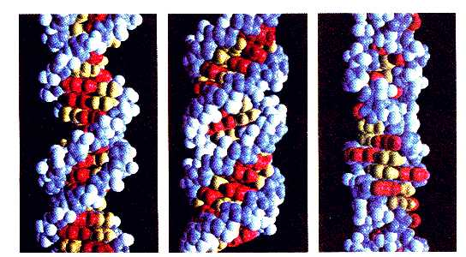
In high concentration of salts or in a dehydrated state, (75% humidity) DNA exists in the A- form, which has 11 nucleotide-pairs per turn.
Recently, certain DNA sequences have been shown to exist in a unique left handed, double helical form called Z-DNA.
The helices of A and B form DNA are wound in a right handed manner.
B-DNA
A-DNA
Z-DNA
Form Residues Pitch
Per Turn A⁰
A 11 24.6
B 10 33.2
Z 12 45.6

Slide 40
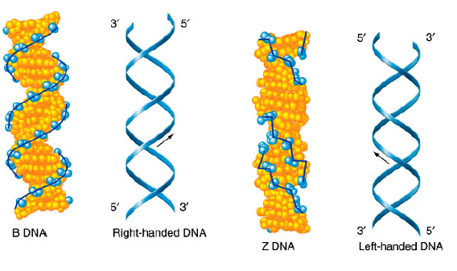

Slide 41
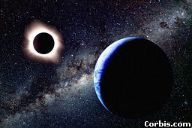
Did you know?
Each cell has about 2 m of DNA.
The average human has 75 trillion cells.
The average human has enough DNA to go from the earth to the sun more than 400 times.
DNA has a diameter of only 0.000000002 m.
The earth is 150 billion m
or 93 million miles from
the sun.

Slide 42
Semiconservative Replication of DNA
Living organism perpetuate their kind reproduction.
This may simple fission as in bacteria or complex mode of reproduction as in higher plants or animals.
In all cases, however reproduction entails the faithful transmission of genetic information of the progeny.
Since the genetic information is stored in DNA, the replication of DNA is central to all biology

Slide 43
Semiconservative Replication of DNA
When Watson and Crick proposed the double helical structure of DNA with its complementary base pairing, they immediately recognized that base pairing specificity could provide the basis for duplication.
If the two complementary strands of a double helix separated, (by breaking the H₂ bond) each parental strand could direct the synthesis of a new complementary strand.
That is each parental strand could serve as a template for a new complementary strand.
Adenine for e.g., in the parent strand synthesis of Thymine in complementary strand.
This mechanism of DNA replication is called semiconservative replication

Slide 44
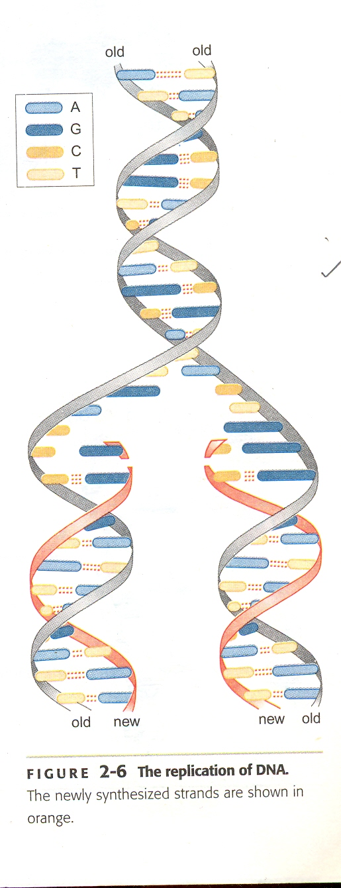
In considering possible mechanism of DNA replication, three different hypothetical modes are apparent.
1. Semiconservative
2. Conservative
3. Dispersive

Slide 45
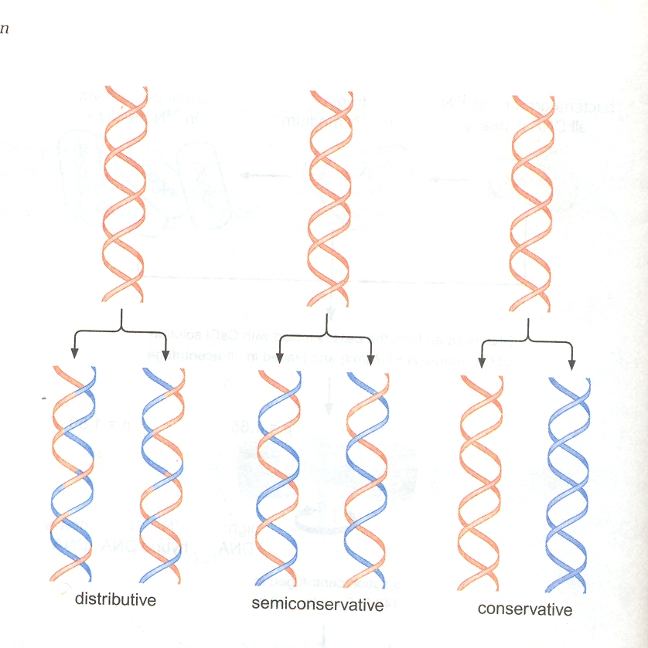
Conservative: parental double helix remain intact (is totally conserved) and somehow directs the synthesis of a “progeny” double helix composed of two newly synthesized strand.
Dispersive: Here, parental strand and progeny strand become interspersed through some kind of a fragmentation, synthesis, and rejoining process.

Slide 46
The Meselson – Stahl Experiment
They proved that DNA replicates semiconservatively in 1958 by the common bacteium E.coli.
Meselson and Stahl grew E.coli cells for many generations in a medium in which the heavy isotope of nitrogen N¹⁵ had been substituted for the normal, light isotope, N¹⁴.
The purine and pyrimidines bases in DNA contain nitrogen.
Thus the DNA grown on N¹⁵ will have a greater density (Wt. per vol.) than cells grown in N^{14.}
Since molecules of different densities can be separated by equilibrium density gradient centrifugation, they proved .

Slide 47
The density of most DNAs is about same as that of heavy salts such as CsCl.
For e.g., the density of 6M CsCl is about 1.7g/cm³
E.coli DNA containing N¹⁴ has density about 1.710 g/cm³
Where as E.coli DNA containing N¹⁵ has density about 1.724 g/cm³
When a heavy salt solution such as 6M CsCl centrifuged at very high speed (30,000-50,000 rpm) for 48-72 hrs, an equilibrium density gradient is formed.

Slide 48
Meselson and Stahl took cells that had been growing in medium containing N¹⁵ for several generation (thus contained “heavy” DNA).
They transferred them to medium containing N^{14.}
After allowing cells to grow in the presence of N¹⁴ for varying periods of time, the DNA was extracted and analyzed in CsCl equilibrium density gradient.
The results of their expt. are only consistent with semiconservative model.

Slide 49
All the DNA isolated from cells after one generation of growth in medium containing N¹⁴ had a density halfway between the densities of ‘heavy’ and ‘light’ DNA.
This intermediate referred to as ‘hybrid’
After 2 generations of growth in medium containing N¹⁴ , half of the DNA was of “hybrid” and half was “light”
This prove Semiconservative

Slide 50
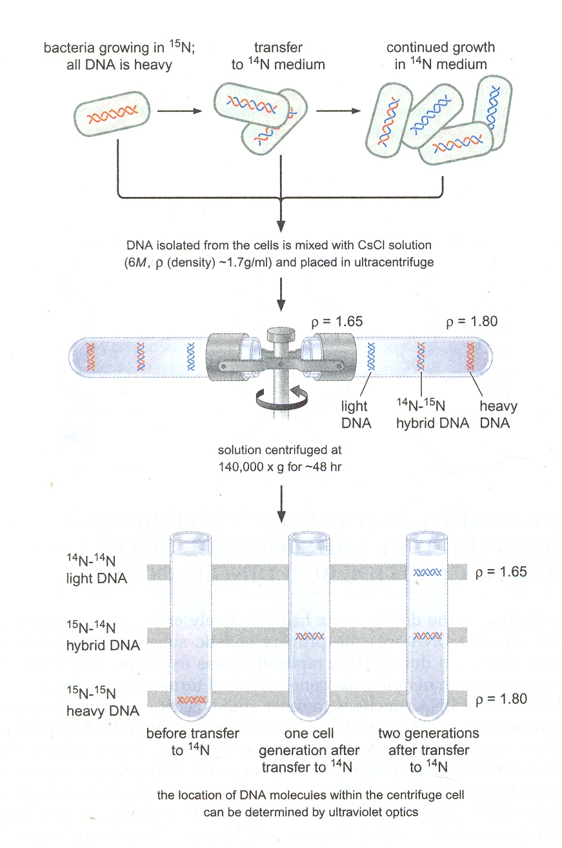

Slide 51
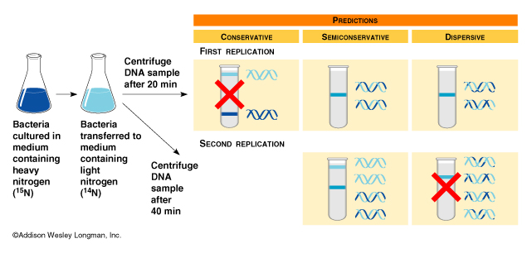

Slide 52
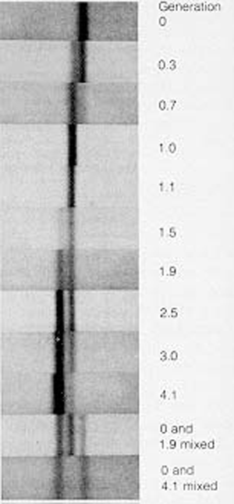

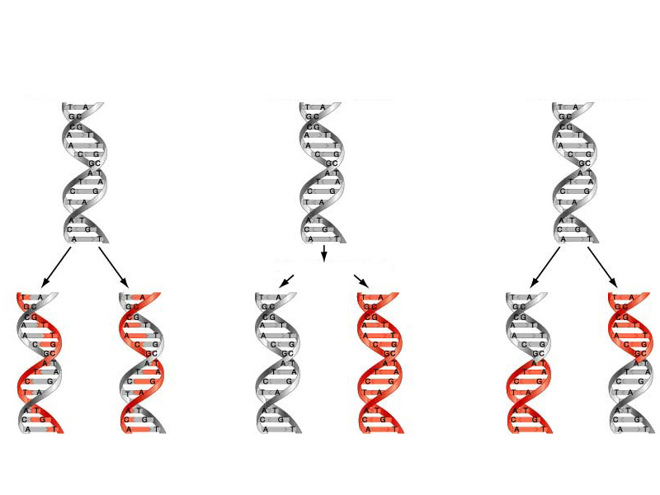
MESELSON AND STAHL EXPT.
MODELS OF DNA REPLICATION

Slide 53
Cairn’s Experiment
The visualization of replicating chromosome was first accomplished by J. Cairns in 1963 using the technique called autoradiography.
Autoradiography is a method of detecting and localizing radioactive isotopes in macromolecules by exposure to photographic emulsion that is sensitive to low energy radiation.
Autoradiography is particularly useful in studying DNA metabolism because DNA can be specifically labeled by growing cells on [H³]thymidine, the tritiated deoxyribonucleoside of thymidine.
Thymidine is incorporated exclusively into DNA; it is not present in any other major component of the cell.

Slide 54
Cairns grew E.coli cells in medium containing [H³]thymidine for varying period of time.
He lysed the cell very gently so as not to break the chromosomes and he carefully collected the chromsomes on membrane filter.
These filters are affixed to glass slides, coated with emulsion sensitive to β – particles (the low energy electrons emitted during decay of tritium) and store in dark for radioactive decays.
The autoradiograph observed when the films were developed.
It showed that the chromosomes of E.coli are circular structures that exist as θ shaped intermediates during replication.

Slide 55
John Cairns
Bacterial
culture
*T
*T
*T
*T
in media with low
concentration of
³H- thymidine
Grow cells for several generations
Small amounts of ³H thymidine
are incorporated into new DNA
*T
*T
*T
All DNA is lightly
labeled with radioactivity
Add a high
concentration
of ³H- thymidine
Grow for brief period of time
*T
*T
*T
*T
*T
*T
*T
*T
*T
*T
*T
*T
*T
*T
*T
*T
*T
*T
*T
*T
*T
*T
*T
*T
*T
*T
*T
Dense label at the replication fork
where new DNA is being made
Cairns then isolated the chromosomes by lysing the cells very very gently and placed them on an electron micrograph (EM) grid which he exposed to X-ray film for two months.

Slide 56
These autoradiograph further indicated that the unwinding of the complementary strands and their semiconservative replication occurs simultaneously or closely coupled.
Cairns interpretation of the autoradiographs was the semiconservative replication started at a site on the chromosome, which he called the, “origin” and proceeded unidirectionally around circular structure.
Subsequent evidence has shown his interpretation is incorrect on one point: replication actually proceeds bidirectionally , not unidirectionally.

Slide 57
Unique origin and Bidirectional replication
Cairn’s result provided no information as to whether the origin (the site at which replication is initiated) of replication is unique or occurs at random on the chromosome.
Moreover his results did not allow him to differentiate between uni - and bidirectional replication.
We now have direct evidence showing that replication in E.coli and several other organisms proceeds bidirectionally from a unique origin.
These features of DNA replication can be illustrated most simply and convincingly by experiments with some of the small bacterial virus.

Slide 58
Unique origin and Bidirectional replication
Bacteriophage lambda is like T₂ a virus that grows in E.coli.
It has a small chromosome consisting of a single linear molecule of DNA only 17.5 µm long.
The phage λ chromosome has 12 nucleotides long at 5’end of each complementary strand.
These single stranded ends called, “cohesive” or “sticky” ends, are complementary to each other.
3’ 5’
G
GGGCGGCGACCTC
5’ 3’

Slide 59
UNIDIRECTIONAL REPLICATION
Origin
BIDIRECTIONAL REPLICATION
5’
3’
Origin
3’
5’
5’
3’
3’
5’

Slide 60
The cohesive ends of a λ chromosome can thus base-pair to form a hydrogen bonded circular structure.
This conversion from the H₂ bonded circular form to the covalently closed circular form is catalyzed by polynucleotide ligase, a very important enzyme that seals ss breaks in DNA double helices.
λ chromosome when replicates to circular form via θ - shaped intermediates.
Bidirectional replication was shows different at different segments like the region rich in AT and CG.
Schnos and Inman conducted an experiment on it using a technique called “denaturation mapping”.

Slide 61
When the DNA molecules are exposed to 100⁰ C or high pH (11.4), the hydrogen and hydrophobic bonds that hold the complementary strands are broken and two strands are separate.
This process is called denaturation.
Since, A-T region contains only 2 Hydrogen bonds it denature more easily than C-G
It denature to form “denaturation bubbles” which are detectable by electron microscopy, while C-G remain in the duplex state.
These denaturation bubbles uses as a physical markers whether the lambda chromosome is in its mature linear form or circular form or its θ -shaped intermediate .

Slide 62
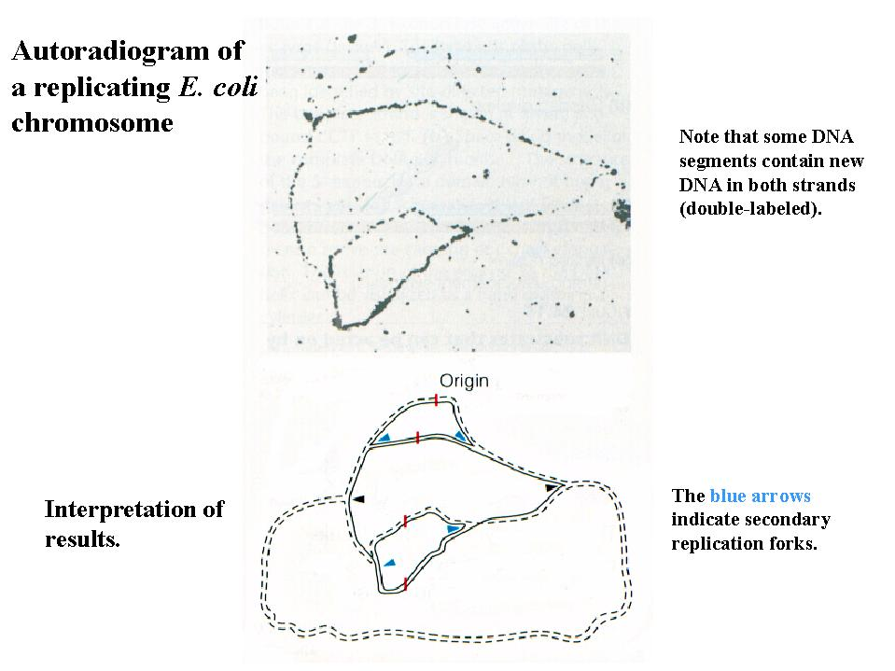
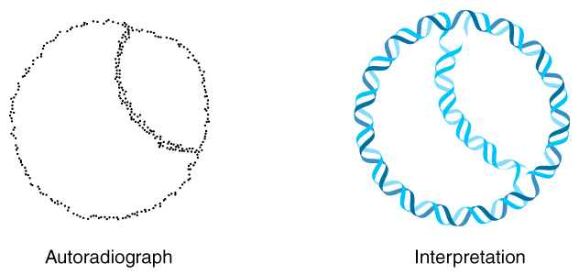

Slide 63
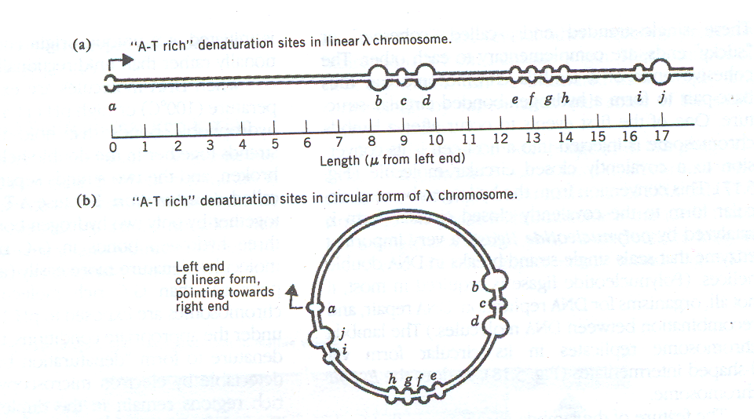
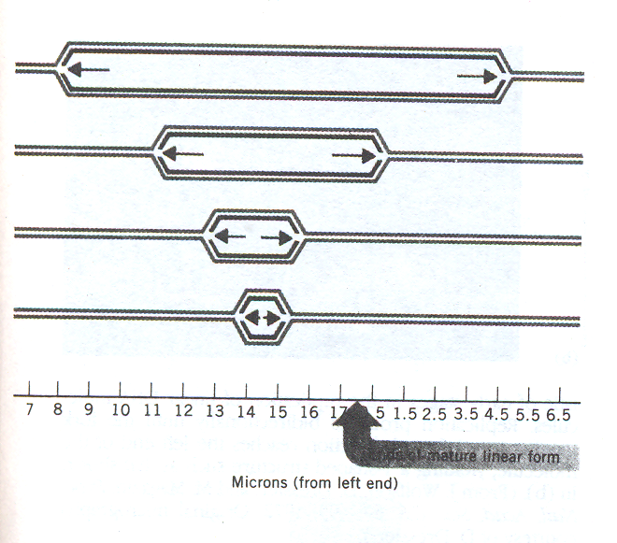
The origin of replication is located at 14.3 µm from the left end of the chromosome.
Four chromosomes are shown at different stage of replication

Slide 64
The Replication of DNA
The in vitro synthesis of DNA was first accomplished by Arthur Kornberg and his coworkers in 1957.
Kornberg received the Nobel prize in 1959 for this work.
He isolated an enzyme from E.coli that catalyzes the covalent addition of nucleotides to preexisting DNA chains.
Initially this enzyme is called DNA Polymerase or Kornberg enzyme, now known as DNA Polymerase I.

Slide 65
DNA POLYMERASES
After Kornberg’s discovery and extensive work with DNA polymerase I of E.coli, a large number of DNA polymerases have been isolated.
Three different Polymerases (I,II, and III) have been identified and studied in E.coli and B.subtilis.
The precise functions of some of the polymerases are still not clear.
Early it was believed that Polymerase I was considered as the major replicative enzyme.
But while study with the mutant Pol A ( where the Polymerase enzyme cannot synthesis) shows, replication same as that of Normal rates.

Slide 66
However these mutants are defective in their capacity to repair damage to DNA (e.g., caused from UV radiation)
This and other evidence suggest that major function of polymerase I is DNA repair.
Still other evidence indicates that DNA polymerase I responsible for the excision (removal) of RNA primers used in the initiation of DNA synthesis.
DNA Polymerase II function is uncertain, but it expect involve in DNA repair in the absence of DNA Polymerase I and III.
DNA Polymerase III, plays an essential role in DNA replication, because mutant growing under conditions where no functional polymerase III is synthesized, DNA synthesis stops.

Slide 67
Most of the prokaryotic DNA polymerases studied so far not only exhibit 5’ to 3’ polymerase activity , but also 3’ to 5’ exonuclease activity.
An exonuclease is an enzyme that degrades nucleic acid.
Both activities are present in the same macromolecule.
The 3’ to 5’exonuclease activity catalyzes the removal of nucleotides, one by one, from 3’ends of polynucleotide chains.
Some polymerases, such as DNA polymerase I of E.coli also have 5’ to 3’ exonuclease activity.
In fact, the 3’ to 5’ exonuclease activity of DNA polymerases carries out a critical “Proof reading” or “editing” function that is necessary for DNA replication.

Slide 68
When an unpaired or incorrectly paired base are clip off by exonucleases.
When an appropriate base-paired terminus results, polymerase begins resynthesis by adding nucleotides to the 3’ end.
The 5’ to 3’ exonuclease activity of many prokaryotic DNA polymerases is also very important.
It functions in the removal of segments of DNA damaged by UV and other agents.

Slide 69
Analogous to RNA, DNA is synthesized from deoxynucleoside 5-triphosphate precursors (dNTPs).
The enzyme requires the 5’triphosphates of each of the four deoxyribonucleosides:
dATP : deoxyadenosine triphosphate
dTTP: deoxythymidine triphosphate (TTP)
dGTP: deoxyguanosine triphosphate
dCTP: deoxycytidine triphosphate

Slide 70
This enzyme is active only in the presence of Mg⁺ ions and preexisting DNA.
This DNA must provide two essential components, one serving a primer function and other a template function.
1. Primer DNA: DNA polymerase I cannot initiate the synthesis of de novo. It has an absolute requirement for a free 3’hydroxyl on preexisting DNA chain.
DNA Polymerase I catalyzes the formation of a phosphodiester bridge between the 3’OH at the end of the primer DNA chain and 5’phosphate of the incoming deoxyribonucelotide.
The direction of synthesis is always 5’ to 3’
2. Template provides ssDNA that will direct the addition of each complementary deoxynuceotide

Slide 71
“Replicating Apparatus” is complex
DNA replication is complex.
It is carried out by multienzyme complex, often called, replication apparatus or the replisome.
In eukaryotes, the components of replication machinery are just beginning to be identified.
Even in prokaryotes, DNA replication requires many different proteins

Slide 72
Replication fork: The junction between the newly separated strands and unreplicated double stranded DNA
Leading and Lagging strand: Due to the anti-parallel nature of DNA, one strand will synthesis continuously towards replication fork and other strand will synthesis discontinuously away from the replication fork.
The continuously synthesizing strand is called leading strand and discontinuously synthesizing strand is called lagging strand.
Okazaki fragment: A short fragment of DNA formed on the lagging strand during replication is called Okazagi fragment. It will be around 100 – 1000 bp in length. In eukaryotes it identified about 100-200 nucleotides length.
Processivity: The ability of an enzyme to catalyze many reactions before releasing its substrate is called processsivity

Slide 73
To prepare DNA for replication, many proteins are involved in replication
These proteins are required because DNA must be single-stranded before replication can proceed.
The following are important Protein and enzyme required for DNA replication:
1. DNA helicases
2. Single stranded DNA binding proteins (SSB)
3. Topoisomerases / DNA gyrase
4.Primase
5. DNA Polymerases 6. Sliding DNA clamps
7. RNAse H 8. DNA ligase

Slide 74
DNA Helicases - These proteins bind to the double stranded DNA and stimulate the separation of the two strands.
DNA single-stranded binding proteins - These proteins bind to the ssDNA as a tetramer and stabilize the single-stranded structure that is generated by the action of the helicases.
Their binding exhibits cooperativity (the binding of one tetramer stimulates the biding of additional tetramers)
Replication is 100 times faster when these proteins are attached to the single-stranded DNA.

Slide 75
DNA Gyrase - This enzyme catalyzes the formation of negative supercoils that is thought to aid with the unwinding process.
It catalyzes the removal of Positively supercoils in DNA, which considered to be essential for replication and are believed to play a key role in unwinding process .
Primase – DNA replication require RNA primers to begin.
Primase is a specialized RNA polymerase which make short RNA primers using ssDNA as a template
Primase activity requires the formation of complex of primase and at least six other proteins.
This complex is called Primosome

Slide 76
DNA Polymerase: The synthesis of DNA is catalyzed by DNA Polymerase.
It can add only dNTPs to the 3’ and form polynucleotide.
Sliding DNA Clamps: It is to increase the degree of processivity of the DNA Polymerase sliding DNA clamps surrounds the DNA and binds to the DNA polymerase and holding them together.
RNAse H: To complete the DNA replication, RNA primers must be removed.
RNAse H Specifically degrade RNA that base paired with DNA. (H stands for Hybrid as RNA – DNA Hybrid)

Slide 77
DNA Ligase - Nicks occur in the developing molecule because the RNA primer is removed and synthesis proceeds in a discontinuous manner on the lagging strand.

Slide 78
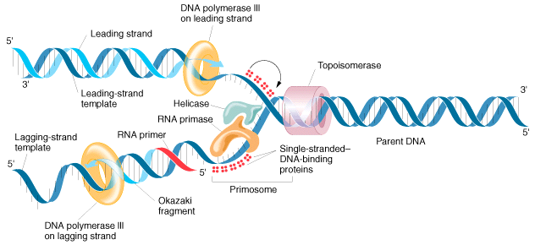

Slide 79
This powerpoint was kindly donated to
www.worldofteaching.com
http://www.worldofteaching.com
Is home to well over a thousand powerpoints submitted by teachers. This a free site. Please visit and I hope it will help in your teaching
Notes:
79

