Slide 1
Cloning – Science Fiction or Science Fact?

Slide 2
What we will do today……
Extend knowledge on asexual reproduction and sexual reproduction
Learn how can animals be cloned
Look at problems with cloning

Slide 3
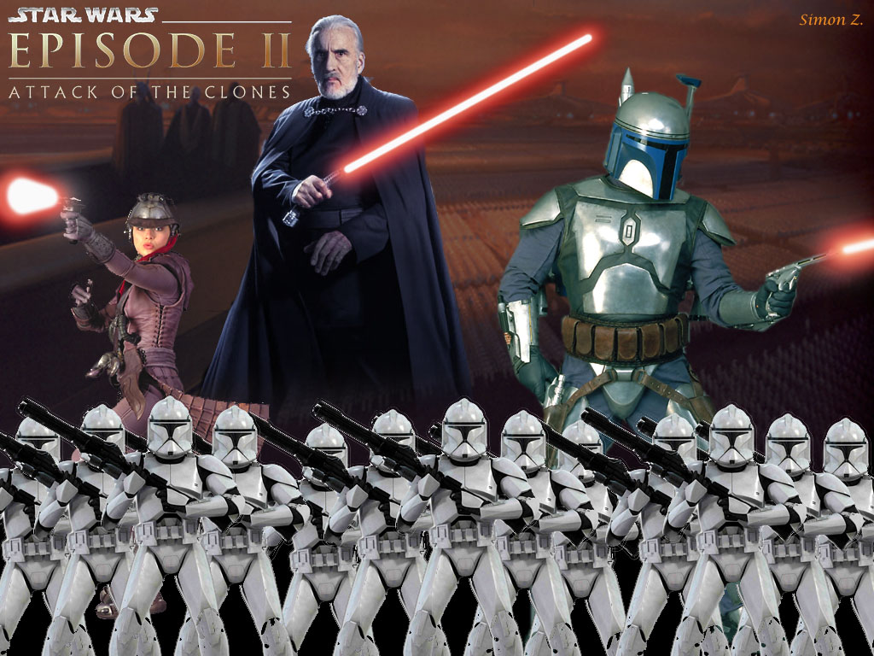
What are clones?
Genetically
Identical
copies

Slide 4
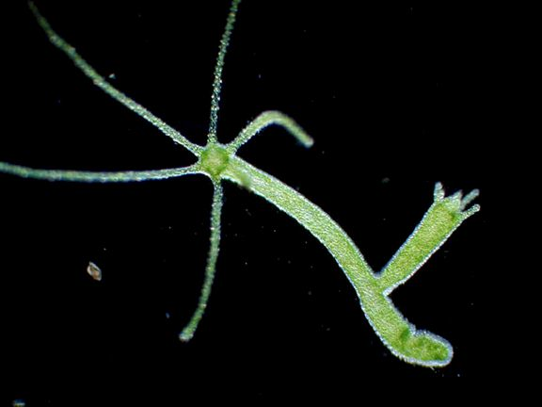
Hydra budding to make a clone

Slide 5
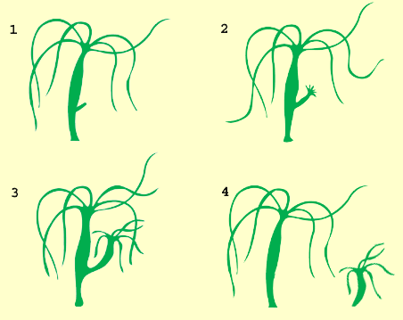
Asexual Reproduction
Tiny 'buds' grow out from the hydra's side, develop mouth tentacles, and finally nip off at the base to form a separate individual.

Slide 6
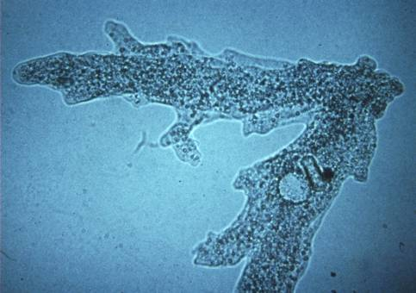
Amoeba dividing asexually

Slide 7
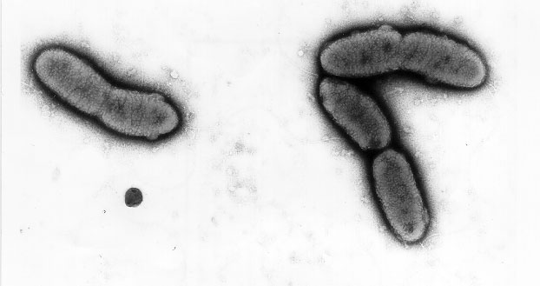
Bacteria dividing asexually
These are CLONES as only have information from 1 parent

Slide 8
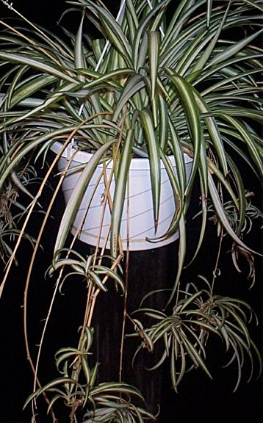
Spider plant making asexual clones
Plants retain some
unspecialized cells
These cells have the
potential to grow
into a whole new
plant

Slide 9
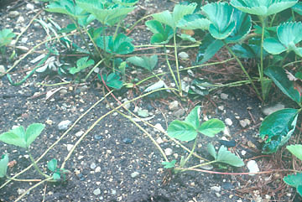
Strawberry plants making asexual clones
Whole new
plants grow
at the end
of the runners
How is this
Possible?

Slide 10
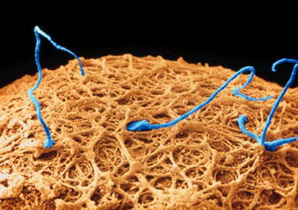
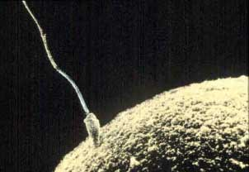
Sexual reproduction
Information (genes) from 2 parents in the sperm and egg

Slide 11
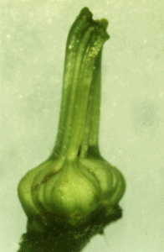
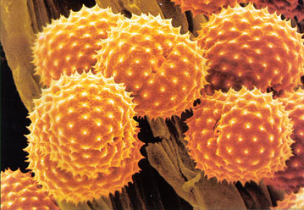
Sexual Reproduction in Plants
Pollen carries genes from the male part of plants this fertilizes the ovule (female sex cell)
POLLEN ovary
containing
OVULE

Slide 12
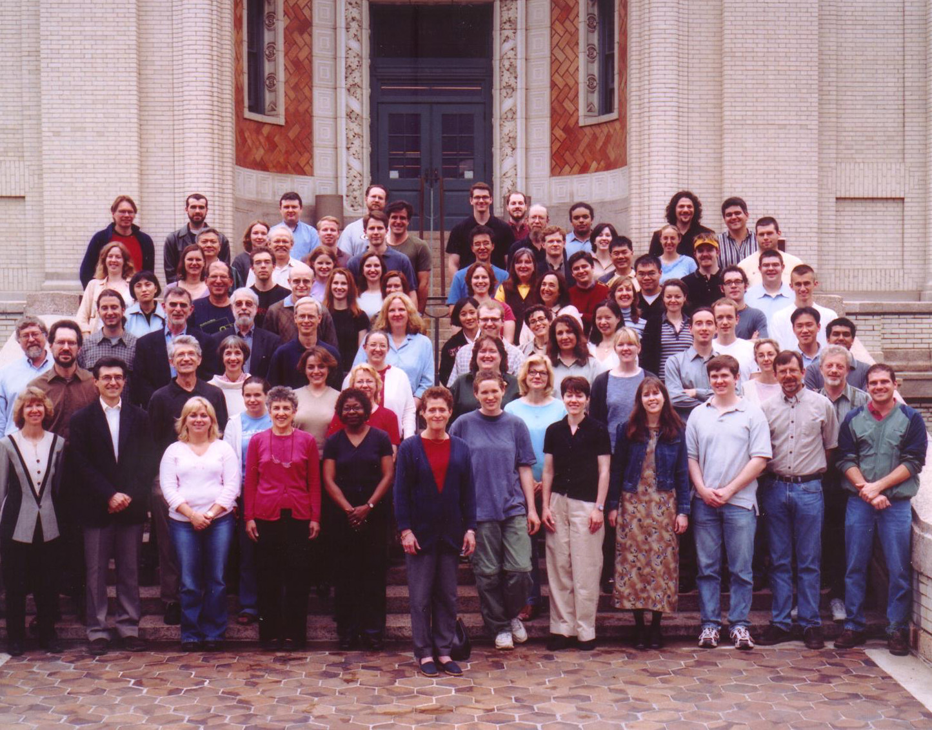
Sexual reproduction gives variation

Slide 13
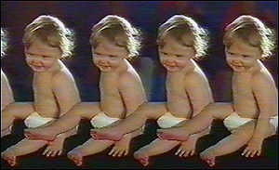
Cloning mammals
Sexual reproduction produces variation not clones. Why?

Slide 14
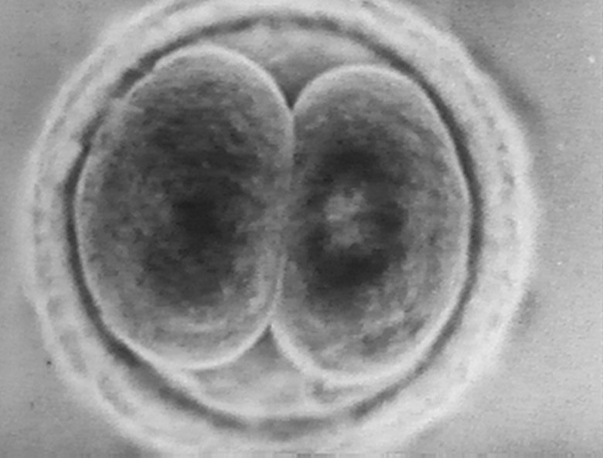
Identical Twins
Sperm fertilizes egg
Fertilized egg starts to divide into a embryo, but the cells separate and each cell becomes a baby

Slide 15

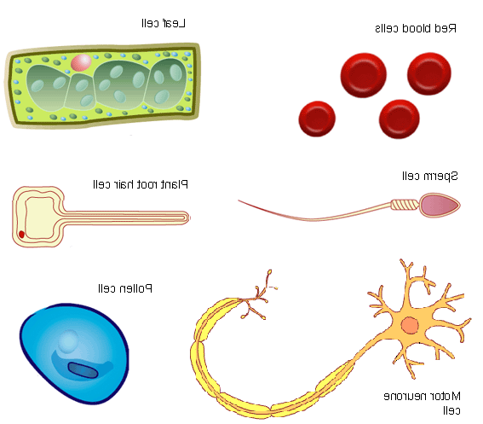
Clones can be made naturally…
Identical twins are clones of each other
Sperm cell
Baby
fertilisation
splits
Fertilised egg cell
Baby
Egg cell

Slide 16
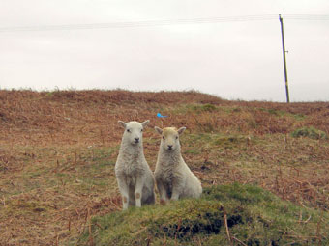
Twin Welsh Lambs
Clones of each other but not of their parents

Slide 17
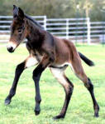
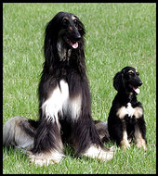
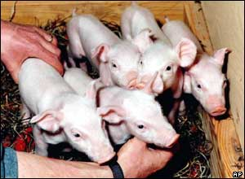
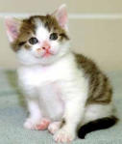
Recently cloned animals

Slide 18
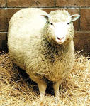
Dolly The Sheep
Hello Dolly Dolly was the first mammal cloned from an adult cell.
She was born in 1996 and died in 2003.
She was 6 when she died, about half the usual age for a sheep

Slide 19
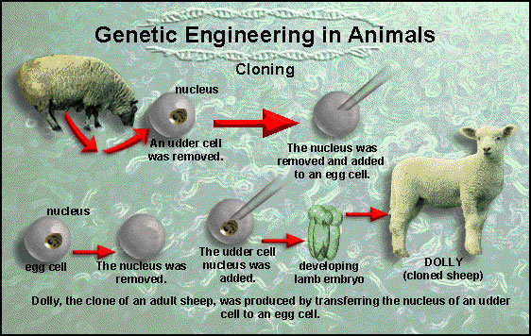
Making Dolly the sheep

Slide 20
Problems with cloning mammals
Dolly developed premature arthritis and showed signs of aging too quickly
She died 6 years old which is half the natural age of a sheep
She is now owned by the National Museum in Scotland

Slide 21
Reproduction and Cloning Recap
1. Are Sonny and Cher clones? Explain your answer.
2. If I wanted to clone Sonny how would I do it?
3. What problems may I encounter if I try to clone Sonny.

Slide 22
Next lesson
Uses of cloning
Should we clone mammals?
Will we clone humans? What would this mean?

Slide 23
This powerpoint was kindly donated to www.worldofteaching.com
http://www.worldofteaching.com is home to over a thousand powerpoints submitted by teachers. This is a completely free site and requires no registration. Please visit and I hope it will help in your teaching.

