Slide 1
Chromosomes
Dr. R. Siva
VIT University, INDIA
rsiva77in@rediffmail.com

Slide 2
What Exactly is a chromosome?
Chromosomes are the rod-shaped, filamentous bodies present in the nucleus, which become visible during cell division.
They are the carriers of the gene or unit of heredity.
Chromosome are not visible in active nucleus due to their high water content, but are clearly seen during cell division.

Slide 3
Chromosomes were first described by Strausberger in 1875.
The term “Chromosome”, however was first used by Waldeyer in 1888.
They were given the name chromosome (Chromo = colour; Soma = body) due to their marked affinity for basic dyes.
Their number can be counted easily only during mitotic metaphase.

Slide 4
Chromosomes are composed of thin chromatin threads called Chromatin fibers.
These fibers undergo folding, coiling and supercoiling during prophase so that the chromosomes become progressively thicker and smaller.
Therefore, chromosomes become readily observable under light microscope.
At the end of cell division, on the other hand, the fibers uncoil and extend as fine chromatin threads, which are not visible at light microscope

Slide 5
Number of chromosomes
Normally, all the individuals of a species have the same number of chromosomes.
Closely related species usually have similar chromosome numbers.
Presence of a whole sets of chromosomes is called euploidy.
It includes haploids, diploids, triploids, tetraploids etc.
Gametes normally contain only one set of chromosome – this number is called Haploid
Somatic cells usually contain two sets of chromosome - 2n : Diploid

Slide 6
3n – triploid
4n – tetraploid
The condition in which the chromosomes sets are present in a multiples of “n” is Polyploidy
When a change in the chromosome number does not involve entire sets of chromosomes, but only a few of the chromosomes - is Aneuploidy.
Monosomics (2n-1)
Trisomics (2n+1)
Nullisomics (2n-2)
Tetrasomics (2n+2)

Slide 7
Organism No. chromosomes
Human 46
Chimpanzee 48
Dog 78
Horse 64
Chicken 78
Goldfish 94
Fruit fly 8
Mosquito 6
Nematode 11(m), 12(f)
Horsetail 216
Sequoia 22
Round worm 2

Slide 8
Organism No. chromosomes
Onion 16
Mold 16
Carrot 20
Tomato 24
Tobacco 48
Rice 24
Maize 20
Haploppus gracilis 4
Crepis capillaris 6

Slide 9
On the extreme, round worm shows only two chromosomes, while the other extreme is represented by Protozoa having 300 or more chromosomes.
However, most organisms have numbers between 12 to 50.
3-8 in fungi
From 8 – 16 in Angiosperms (Most common number being 12).

Slide 10
Chromosome Size
In contrast to other cell organelles, the size of chromosomes shows a remarkable variation depending upon the stages of cell division.
Interphase: chromosome are longest & thinnest
Prophase: there is a progressive decrease in their length accompanied with an increase in thickness
Anaphase: chromosomes are smallest.
Metaphase: Chromosomes are the most easily observed and studied during metaphase when they are very thick, quite short and well spread in the cell.
Therefore, chromosomes measurements are generally taken during mitotic metaphase.

Slide 11
The size of the chromosomes in mitotic phase of animal and plants sp generally varies between 0.5 µ and 32 µ in length, and between 0.2 µ and 3.0 µ in diameter.
The longest metaphase chromosomes found in Trillium - 32 µ.
The giant chromosomes found in diptera and they may be as long as 300 µ and up to 10 µ in diameter.
In general, plants have longer chromosomes than animal and species having lower chromosome numbers have long chromosomes than those having higher chromosome numbers
Among plants, dicots in general, have a higher number of chromosome than monocots.
Chromosomes are longer in monocot than dicots.

Slide 12
In order to understand chromosomes and their function, we need to be able to discriminate among different chromosomes.
First, chromosomes differ greatly in size
Between organisms the size difference can be over 100-fold, while within a sp, some chromosomes are often 10 times as large as others.
In a species Karyotype, a pictorial or photographic representation of all the different chromosomes in a cell of an individual, chromosomes are usually ordered by size and numbered from largest to smallest.

Slide 13
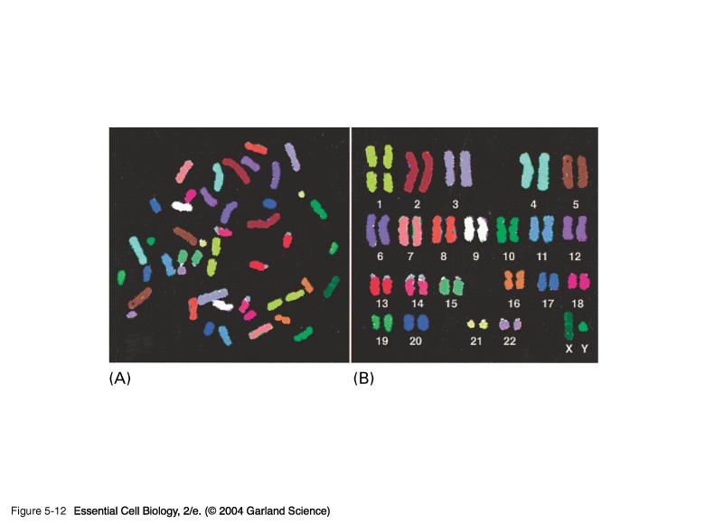
Can distinguish chromosomes by “painting” – using DNA hybridization + fluorescent probes – during mitosis

Slide 14
Karyotype: is the general morphology of the somatic chromosome. Generally, karyotypes represent by arranging in the descending order of size keeping their centromeres in a straight line.
Idiotype: the karyotype of a species may be represented diagrammatically, showing all the morphological features of the chromosome; such a diagram is known as Idiotype.

Slide 15
Chromosomes may differ in the position of the Centromere, the place on the chromosome where spindle fibers are attached during cell division.
In general, if the centromere is near the middle, the chromosome is metacentric
If the centromere is toward one end, the chromosome is acrocentric or submetacentric
If the centromere is very near the end, the chromosome is telocentric.

Slide 16
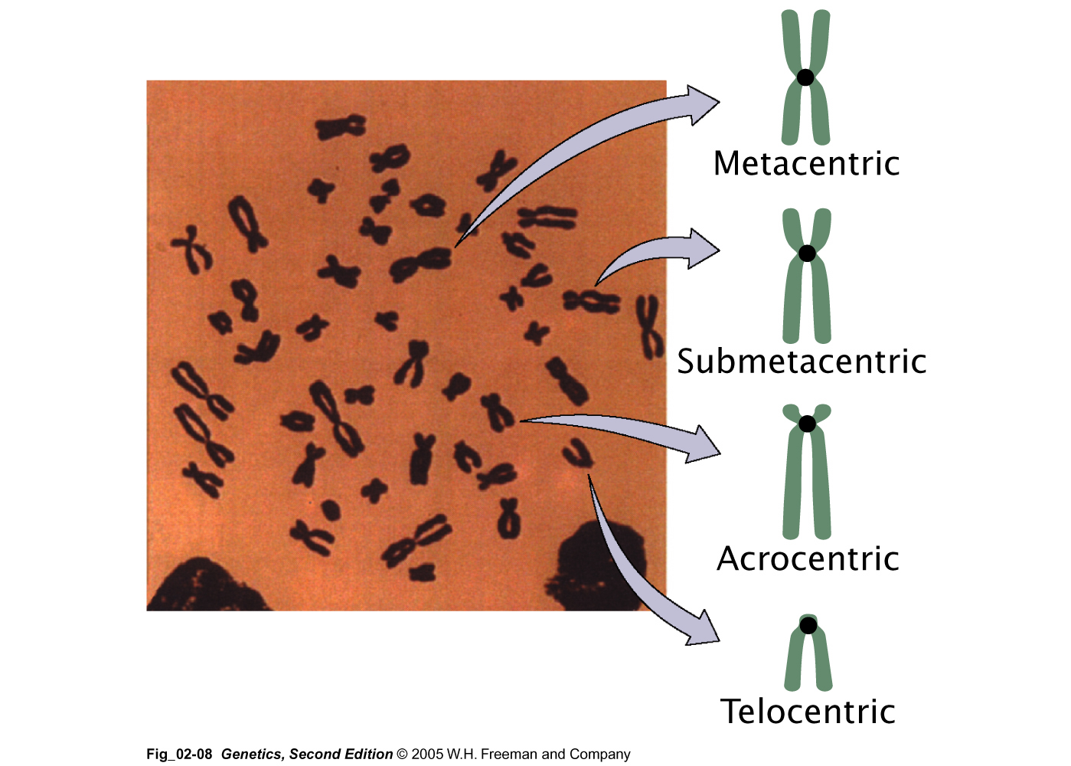

Slide 17
The centromere divides the chromosome into two arms, so that, for example, an acrocentric chromosome has one short and one long arm,
While, a metacentric chromosome has arms of equal length.
All house mouse chromosomes are telocentric, while human chromosomes include both metacentric and acrocentric, but no telocentric.

Slide 18
Autosomal pair Sex chromosome
Diploid No. of No. of X Y
(2n) metacentrics acrocentric or telocentric
Cat 38 16 2 M M
Dog 78 0 38 M A
Pig 38 12 6 M M
Goat 60 0 29 A M
Sheep 54 3 23 A M
Cow 60 0 29 M M
Horse 64 13 18 M A
M – Metacentric; A – Acrocentric

Slide 19
Euchromatin and Heterochromatin
Chromosomes may be identified by regions that stain in a particular manner when treated with various chemicals.
Several different chemical techniques are used to identify certain chromosomal regions by staining then so that they form chromosomal bands.
For example, darker bands are generally found near the centromeres or on the ends (telomeres) of the chromosome, while other regions do not stain as strongly.
The position of the dark-staining are heterochromatic region or heterochromatin.
Light staining are euchromatic region or euchromatin.

Slide 20
Heterochromatin is classified into two groups: (i) Constitutive and (ii) Facultative.
Constitutive heterochromatin remains permanently in the heterochromatic stage, i.e., it does not revert to the euchromatic stage.
In contrast, facultative heterochromatin consists of euchromatin that takes on the staining and compactness characteristics of heterochromatin during some phase of development.

Slide 21
Satellite DNAs
When the DNA of a prokaryote, such as E.coli, is isolated, fragmented and centrifuged to equilibrium in a Cesium chloride (CsCl) density gradient, the DNA usually forms a single band in the gradient.
On the other hand, CsCl density-gradient analysis of DNA from eukaryotes usually reveals the presence of one large band of DNA (usually called “Mainband” DNA) and one to several small bands.
These small bands are referred to as “Satellite DNAs”.
For e.g., in Drosophila virilis, contain three distinct satellite DNAs.

Slide 22
Prokaryotic and Eukaryotic Chromosomes

Slide 23
Not only the genomes of eukaryotes are more complex than prokaryotes, but the DNA of eukaryotic cell is also organized differently from that of prokaryotic cells.
The genomes of prokaryotes are contained in single chromosomes, which are usually circular DNA molecules.
In contrast, the genomes of eukaryotes are composed of multiple chromosomes, each containing a linear molecular of DNA.

Slide 24
Although the numbers and sizes of chromosomes vary considerably between different species, their basic structure is the same in all eukaryotes
Organism Genome Chromosome
Size (Mb)ª numberª
Arabidopsis thaliana 70 5
Corn 5000 10
Onion 15,000 8
Lily 50,000 12
Fruit fly 165 4
Chicken 50,000 39
Mouse 1,200 20
Cow 3000 30
Human 3000 23
a – both genome size and chromosome numbers are for haploid cells

Slide 25
The DNA of eukaryotic cell is tightly bound to small basic proteins (histones) that package the DNA in an orderly way in the cell nucleus.
This task is substantial (necessary), given the DNA content of most eukaryotes
For e.g., the total extended length of DNA in a human cell is nearly 2 m, but this must be fit into a nucleus with a diameter of only 5 to 10µm.
Although DNA packaging is also a problem in bacteria, the mechanism by which prokaryotic DNA are packaged in the cell appears distinct from that eukaryotes and is not well understood.

Slide 26
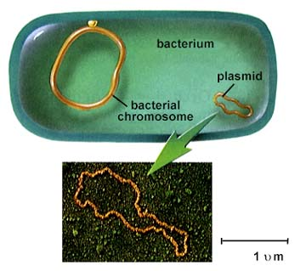
Prokaryotic chromosome
The prokaryotes usually have only one chromosome, and it bears little morphological resemblance to eukaryotic chromosomes.
Among prokaryotes there is considerable variation in genome length bearing genes.
The genome length is smallest in RNA viruses
In this case, the organism is provided with only a few genes in its chromosome.
The number of gene may be as high as 150 in some larger bacteriophage genome.

Slide 27
In E.coli, about 3000 to 4000 genes are organized into its one circular chromosome.
The chromosome exists as a highly folded and coiled structure dispersed throughout the cell.
The folded nature of chromosome is due to the incorporation of RNA with DNA.
There are about 50 loops in the chromosome of E.coli.
These loops are highly twisted or supercoiled structure with about four million nucleotide pairs.
Its molecular weight is about 2.8 X10⁹
During replication of DNA, the coiling must be relaxed.
DNA gyrase is necessary for the unwinding the coils.

Slide 28
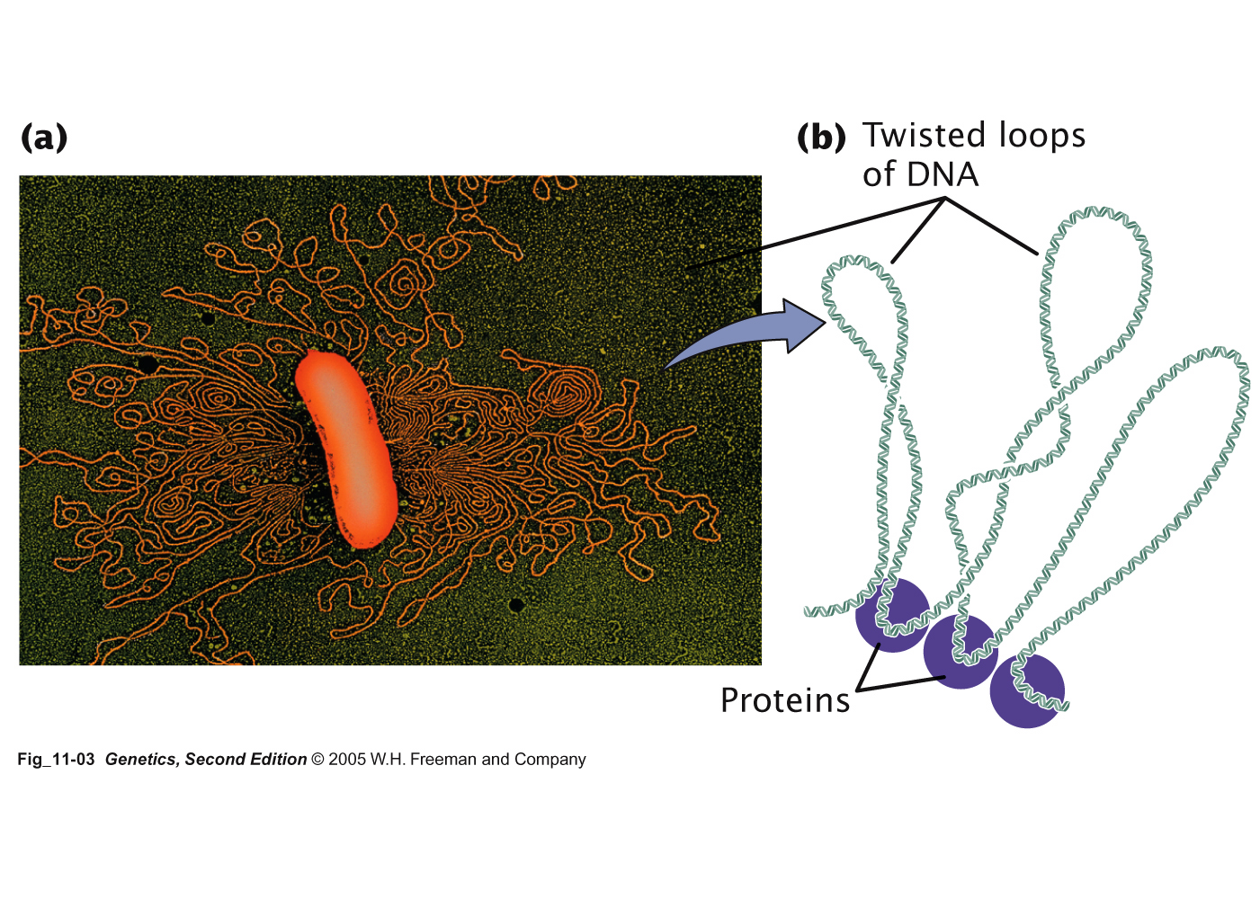
Bacterial Chromosome
Single, circular DNA molecule located in the nucleoid region of cell

Slide 29
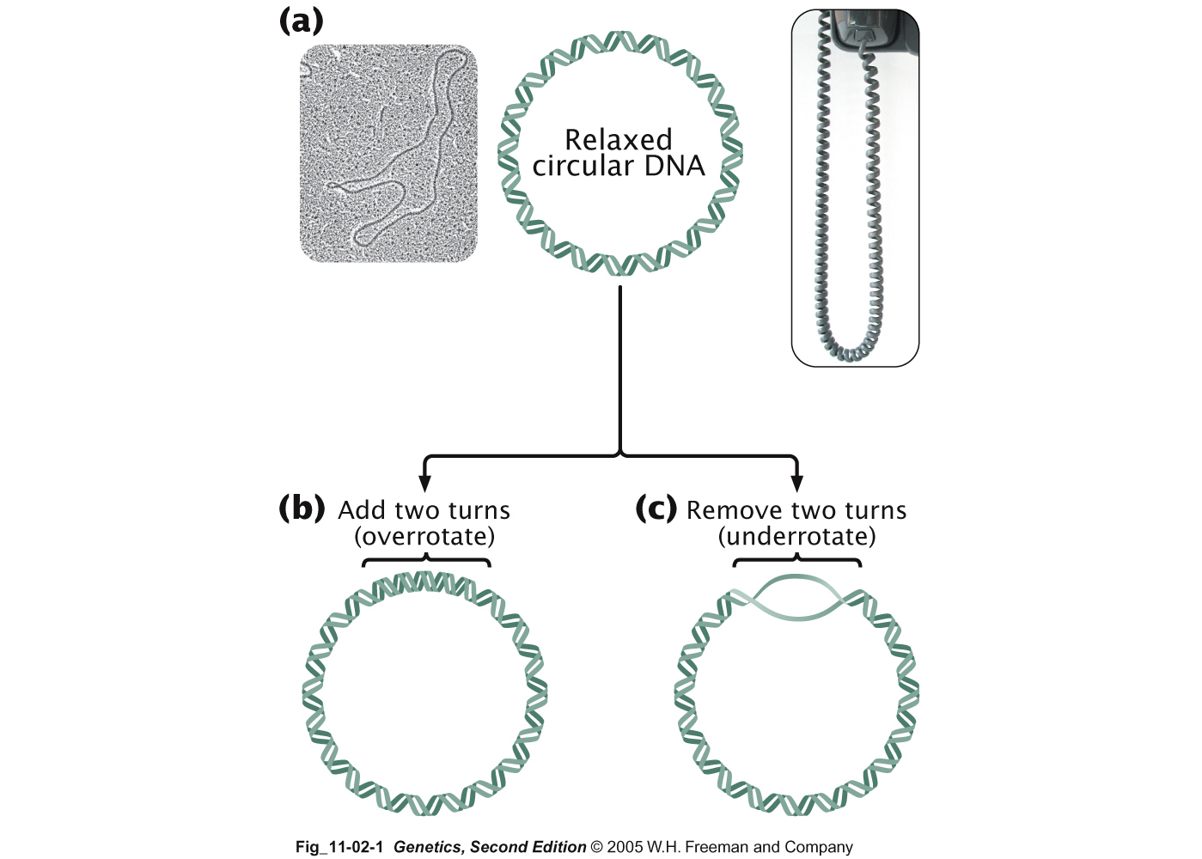
Supercoiling

Slide 30
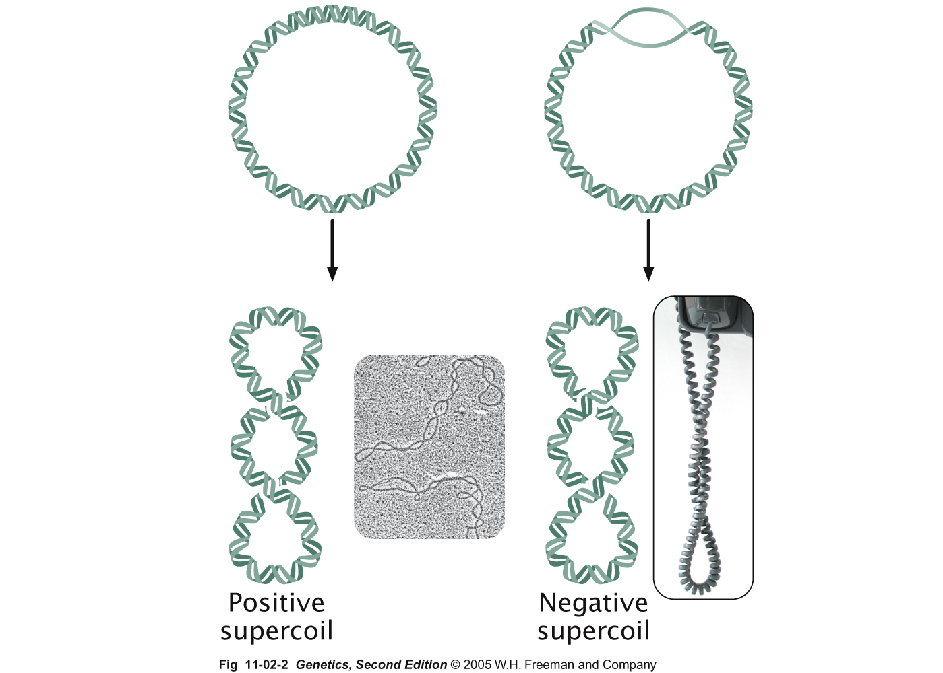
Supercoiling
Most common type
of supercoiling
The helix twists on itself; twists to the right
Helix twists on
itself in the opposite
direction; twists to
the left

Slide 31
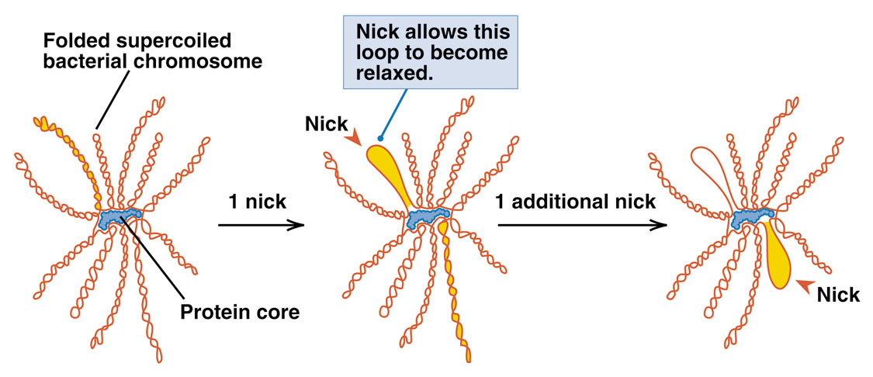
Mechanism of folding of a bacterial chromosome
There are many supercoiled loops (~100 in E. coli) attached to a central core. Each loop can be independently relaxed or condensed.
Topoisomerase enzyme – (Type I and II) that introduce or remove supercoiling.

Slide 32
Chromatin
The complexes between eukaryotic DNA and proteins are called Chromatin, which typically contains about twice as much protein as DNA.
The major proteins of chromatin are the histones – small proteins containing a high proportion of basic aminoacids (arginine and lysine) that facilitate binding negatively charged DNA molecule .
There are 5 major types of histones: H1, H2A, H2B, H3, and H4 – which are very similar among different sp of eukaryotes.
The histones are extremely abundant proteins in eukaryotic cells.
Their mass is approximately equal to that of the cell’s DNA

Slide 33
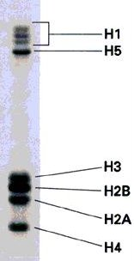
The major histone proteins:
Histone Mol. Wt No. of Percentage
Amino acid Lys + Arg
H1 22,500 244 30.8
H2A 13,960 129 20.2
H2B 13,774 125 22.4
H3 15,273 135 22.9
H4 11,236 102 24.5
The DNA double helix is bound to proteins called histones. The histones have positively charged (basic) amino acids to bind the negatively charged (acidic) DNA. Here is an SDS gel of histone proteins, separated by size

Slide 34
In addition, chromatin contains an approximately equal mass of a wide variety of non-histone chromosomal proteins.
There are more than a thousand different types of these proteins, which are involved in a range of activities, including DNA replication and gene expression.
The DNA of prokaryotes is similarly associated with proteins, some of which presumably function as histones do, packing the DNA within the bacterial cell.
Histones, however are unique feature of eukaryotic cells and are responsible for distinct structural organization of eukaryotic chromatin

Slide 35
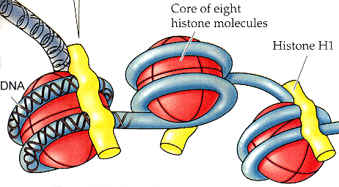
The basic structural unit of chromatin, the nucleosome, was described by Roger Kornberg in 1974.
Two types of experiments led to Kornberg’s proposal of the nucleosome model.
First, partial digestion of chromatin with micrococcal nuclease (an enzyme that degrades DNA) was found to yield DNA fragments approximately 200 base pairs long.
In contrast, a similar digestion of naked DNA (not associated with protein) yielded a continuous smear randomly sized fragments.
These results suggest that the binding of proteins to DNA in chromatin protects the regions of DNA from
nuclease digestion, so that enzyme can
attack DNA only at sites separated by
approximately 200 base pairs.

Slide 36
Electron microscopy revealed that chromatin fibers have a beaded appearance, with the beads spaced at intervals of approximately 200 base pairs.
Thus, both nuclease digestion and the electron microscopic studies suggest that chromatin is composed of repeating 200 base pair unit, which were called nucleosome.

Slide 37
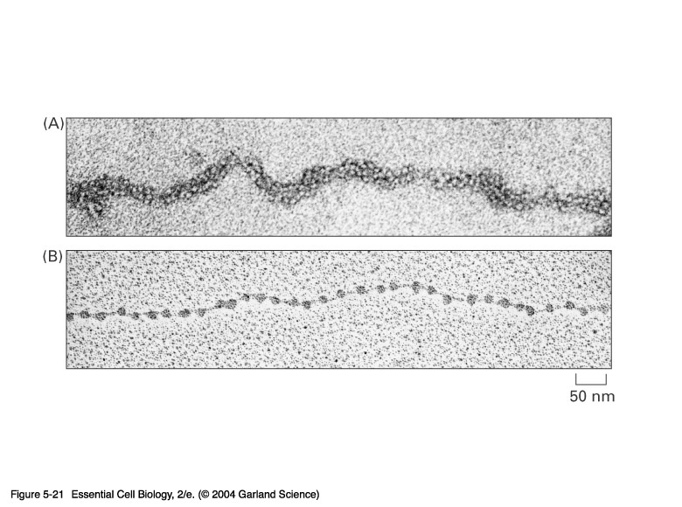
individual nucleosomes = “beads on a string”

Slide 38
Detailed analysis of these nucleosome core particles has shown that they contain 146 base pairs of DNA wrapped 1.75 times around a histone core consisting of two molecules each of H2A, H2B, H3, and H4 (the core histones).
One molecule of the fifth histone H1, is bound to the DNA as it enters and exists each nucleosome core particle.
This forms a chromatin subunit known as chromatosome, which consist of 166 base pairs of DNA wrapped around histone core and held in place by H1 (a linker histone)

Slide 39
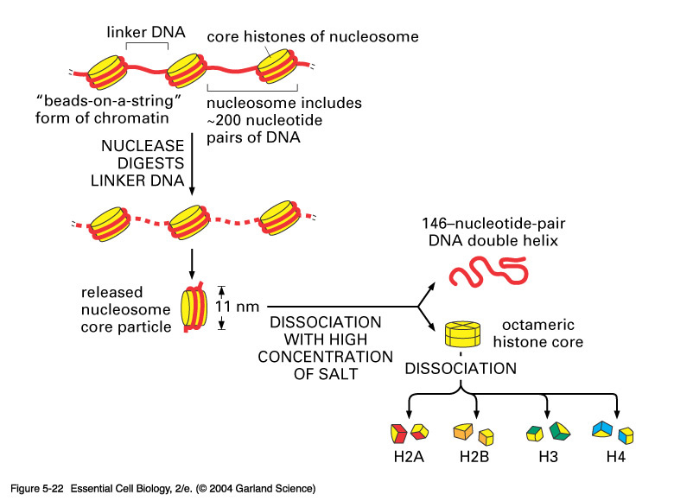

Slide 40
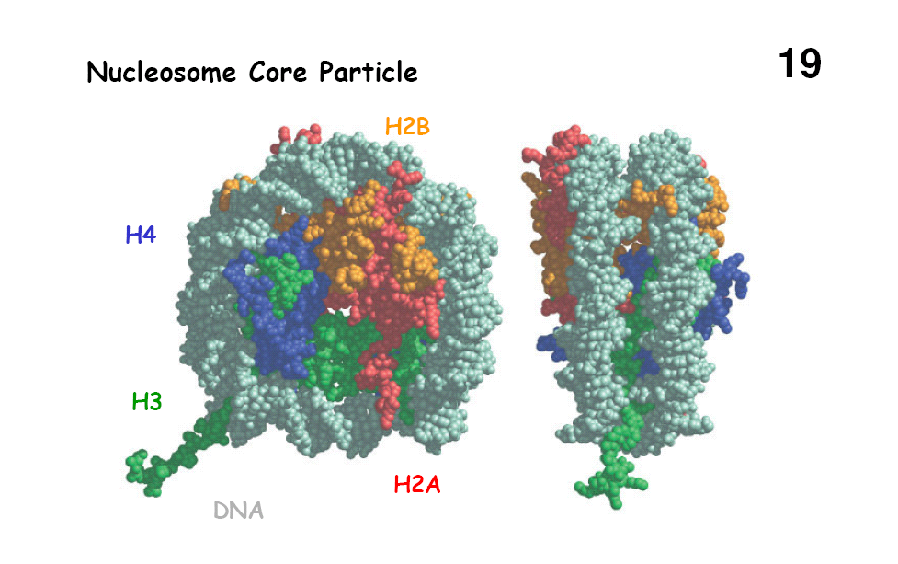

Slide 41
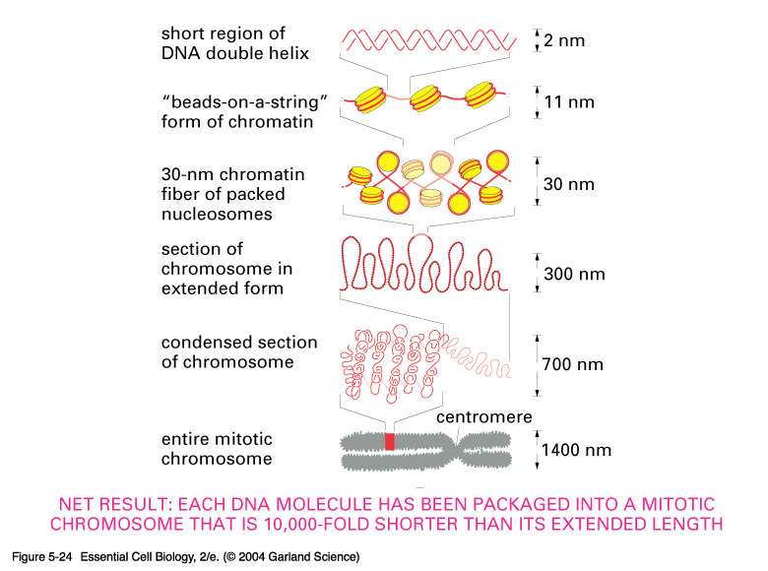

Slide 42
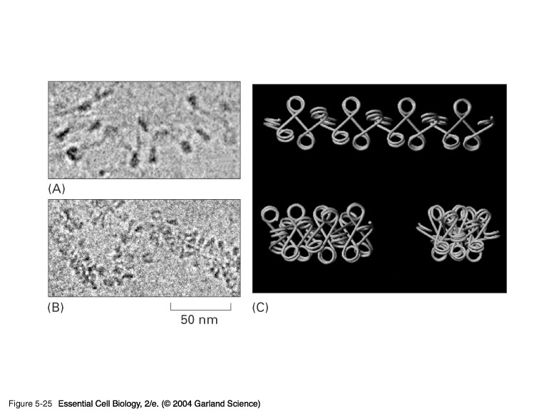

Slide 43
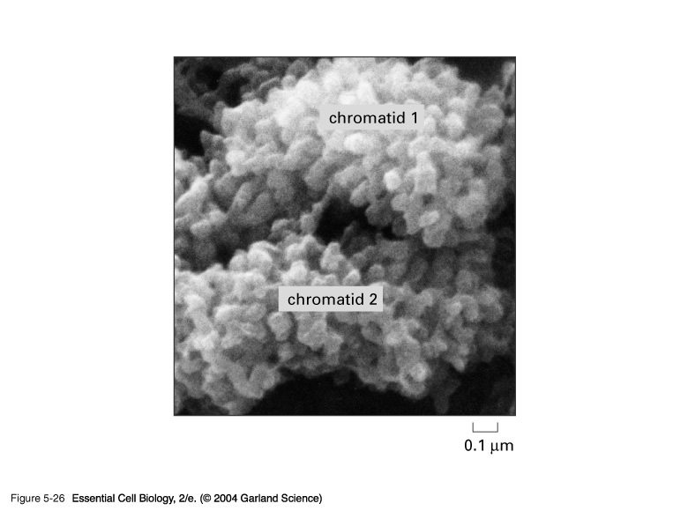

Slide 44
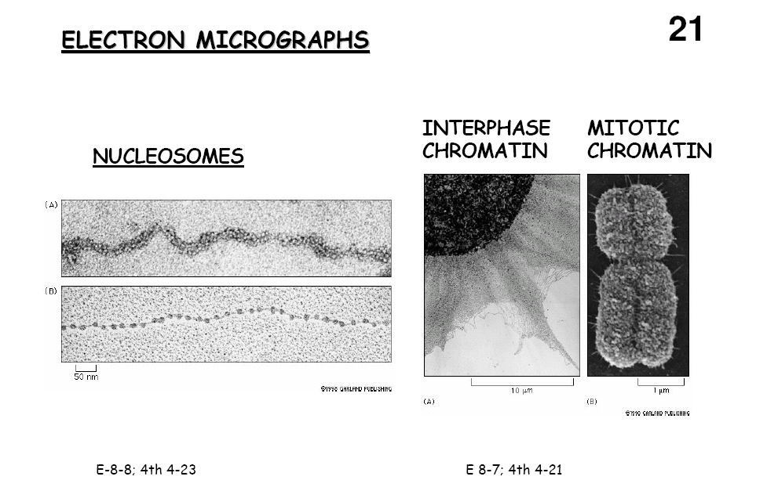

Slide 45
Centromeres and Telomeres
Centromeres and telomeres are two essential features of all eukaryotic chromosomes.
Each provide a unique function i.e., absolutely necessary for the stability of the chromosome.
Centromeres are required for the segregation of the centromere during meiosis and mitosis.
Teleomeres provide terminal stability to the chromosome and ensure its survival

Slide 46
Centromere
The region where two sister chromatids of a chromosome appear to be joined or “held together” during mitatic metaphase is called Centromere
When chromosomes are stained they typically show a dark-stained region that is the centromere.
Also termed as Primary constriction
During mitosis, the centromere that is shared by the sister chromatids must divide so that the chromatids can migrate to opposite poles of the cell.
On the other hand, during the first meiotic division the centromere of sister chromatids must remain intact
whereas during meiosis II they must act as they do during mitosis.
Therefore the centromere is an important component of chromosome structure and segregation.

Slide 47
As a result, centromeres are the first parts of chromosomes to be seen moving towards the opposite poles during anaphase.
The remaining regions of chromosomes lag behind and appear as if they were being pulled by the centromere.

Slide 48
Kinetochore
Within the centromere region, most species have several locations where spindle fibers attach, and these sites consist of DNA as well as protein.
The actual location where the attachment occurs is called the kinetochore and is composed of both DNA and protein.
The DNA sequence within these regions is called CEN DNA.

Slide 49
Typically CEN DNA is about 120 base pairs long and consists of several sub-domains, CDE-I, CDE-II and CDE-III.
Mutations in the first two sub-domains have no effect upon segregation,
but a point mutation in the CDE-III sub-domain completely eliminates the ability of the centromere to function during chromosome segregation.
Therefore CDE-III must be actively involved in the binding of the spindle fibers to the centromere.

Slide 50
The protein component of the kinetochore is only now being characterized.
A complex of three proteins called Cbf-III binds to normal CDE-III regions but can not bind to a CDE-III region with a point mutation that prevents mitotic segregation.

Slide 51
Telomere
The two ends of a chromosome are known as telomeres.
It required for the replication and stability of the chromosome.
When telomeres are damaged or removed due to chromosome breakage, the damaged chromosome ends can readily fuse or unite with broken ends of other chromosome.
Thus it is generally accepted that structural integrity and individuality of chromosomes is maintained due to telomeres.

Slide 52
McClintock noticed that if two chromosomes were broken in a cell, the end of one could attach to the other and vice versa.
What she never observed was the attachment of the broken end to the end of an unbroken chromosome.
Thus the ends of broken chromosomes are sticky, whereas the normal end is not sticky, suggesting the ends of chromosomes have unique features.

Slide 53
Telomere Repeat Sequences until recently, little was known about molecular structure of telomeres. However, during the last few years, telomeres have been isolated and characterized from several sp.
Species Repeat Sequence
Arabidopsis TTTAGGG
Human TTAGGG
Oxytricha TTTTGGGG
Slime Mold TAGGG
Tetrahymena TTGGGG
Trypanosome TAGGG

Slide 54
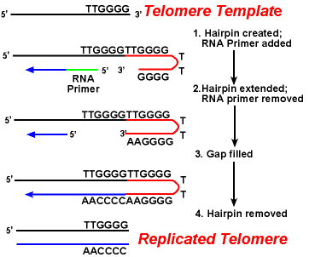
The telomeres of this organism end in the sequence 5'-TTGGGG-3'.
The telomerase adds a series of 5'-TTGGGG-3' repeats to the ends of the lagging strand.
A hairpin occurs when unusual base pairs between guanine residues in the repeat form.
Finally, the hairpin is removed at the 5'-TTGGGG-3' repeat.
Thus the end of the chromosome is faithfully replicated.
Tetrahymena - protozoa organism.
RNA Primer - Short stretches of ribonucleotides (RNA substrates) found on the lagging strand during DNA replication. Helps initiate lagging strand replication

Slide 55
Staining and Banding chromosome
Staining procedures have been developed in the past two decades and these techniques help to study the karyotype in plants and animals.
Feulgen Staining:
Cells are subjected to a mild hydrolysis in 1N HCl at 60⁰C for 10 minutes.
This treatment produces a free aldehyde group in deoxyribose molecules.
When Schiff’s reagent (basic fuschin bleached with sulfurous acid) to give a deep pink colour.
Ribose of RNA will not form an aldehyde under these conditions, and the reaction is thus specific for DNA

Slide 56
2. Q banding:
The Q bands are the fluorescent bands observed after quinacrine mustard staining and observation with UV light.
The distal ends of each chromatid are not stained by this technique.
The Y chromosome become brightly fluorescent both in the interphase and in metaphase.
3. R banding:
The R bands (from reverse) are those located in the zones that do not fluoresce with the quinacrine mustard, that is they are between the Q bands and can be visualized as green.

Slide 57
4. G banding:
The G bands (from Giemsa) have the same location as Q bands and do not require fluorescent microscopy.
Many techniques are available, each involving some pretreatment of the chromosomes.
In ASG (Acid-Saline-Giemsa) cells are incubated in citric acid and NaCl for one hour at 60⁰C and are then treated with the Giemsa stain.
5. C banding:
The C bands correspond to constitutive heterochromatin.
The heterochromatin regions in a chromosome distinctly differ in their stainability from euchromatic region.

Slide 58
VARIATION IN STRUTURE OF CHROMOSOME

Slide 59
Chromosomal Aberrations
The somatic (2n) and gametic (n) chromosome numbers of a species ordinarily remain constant.
This is due to the extremely precise mitotic and meiotic cell division.
Somatic cells of a diploid species contain two copies of each chromosome, which are called homologous chromosome.
Their gametes, therefore contain only one copy of each chromosome, that is they contain one chromosome complement or genome.
Each chromosome of a genome contains a definite numbers and kinds of genes, which are arranged in a definite sequence.

Slide 60
Chromosomal Aberrations
Sometime due to mutation or spontaneous (without any known causal factors), variation in chromosomal number or structure do arise in nature. - Chromosomal aberrations.
Chromosomal aberration may be grouped into two broad classes:
1. Structural and 2. Numerical

Slide 61
Structural Chromosomal Aberrations
Chromosome structure variations result from chromosome breakage.
Broken chromosomes tend to re-join; if there is more than one break, rejoining occurs at random and not necessarily with the correct ends.
The result is structural changes in the chromosomes.
Chromosome breakage is caused by X-rays, various chemicals, and can also occur spontaneously.

Slide 62
There are four common type of structural aberrations:
1. Deletion or Deficiency
2. Duplication or Repeat
3. Inversion, and
4. Translocation.

Slide 63
Consider a normal chromosome with genes in alphabetical order: a b c d e f g h i
1. Deletion: part of the chromosome has been removed: a b c g h i
2. Dupliction: part of the chromosome is duplicated:
a b c d e f d e f g h i
3. Inversion: part of the chromosome has been re-inserted in reverse order: a b c f e d g h i
ring: the ends of the chromosome are joined together to make a ring

Slide 64
4. translocation: parts of two non-homologous chromosomes are joined:
If one normal chromosome is a b c d e f g h i and the other chromosome is u v w x y z,
then a translocation between them would be
a b c d e f x y z and u v w g h i.

Slide 65
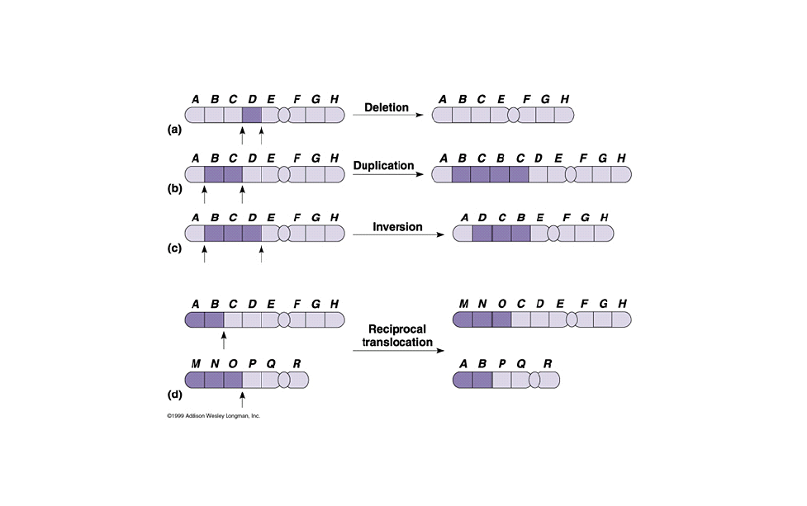

Slide 66
Deletion or deficiency
Loss of a chromosome segment is known as deletion or deficiency
It can be terminal deletion or interstitial or intercalary deletion.
A single break near the end of the chromosome would be expected to result in terminal deficiency.
If two breaks occur, a section may be deleted and an intercalary deficiency created.
Terminal deficiencies might seem less complicated.
But majority of deficiencies detected are intercalary type within the chromosome.
Deletion was the first structural aberration detected by Bridges in 1917 from his genetic studies on X chromosome of Drosophila.

Slide 67
Deletion generally produce striking genetic and physiological effects.
When homozygous, most deletions are lethal, because most genes are necessary for life and a homozygous deletion would have zero copies of some genes.
When heterozygous, the genes on the normal homologue are hemizygous: there is only 1 copy of those genes.
Crossing over is absent in deleted region of a chromosome since this region is present in only one copy in deletion heterozygotes.
In Drosophila, several deficiencies induced the mutants like Blond, Pale, Beaded, Carved, Notch, Minute etc.

Slide 68
Deletion in Prokaryotes:
Deletions are found in prokaryotes as well, e.g., E.coli, T4 phage and Lambda phage.
In E.coli, deletions of up to 1 % of the bacterial chromosome are known.
In lambda phage, however 20% of the genome may be missing in some of the deletions.
Deletion in Human:
Chromosome deletions are usually lethal even as heterozygotes, resulting in zygotic loss, stillbirths, or infant death.
Sometimes, infants with small chromosome deficiencies however, survive long enough to permit the abnormal phenotype they express.

Slide 69
Cri-du-chat (Cat cry syndrome):
The name of the syndrome came from a catlike mewing cry from small weak infants with the disorder.
Other characteristics are microcephaly (small head), broad face and saddle nose, physical and mental retardation.
Cri-du-chat patients die in infancy or early childhood.
The chromosome deficiency is in the short arm of chromosome 5 .
Myelocytic leukemia
Another human disorder that is associated with a chromosome abnormality is chronic myelocytic leukemia.
A deletion of chromosome 22 was described by P.C.Nowell and Hungerford and was called “Philadelphia” (Ph’) chromosome after the city in which the discovery was made.

Slide 70
Duplication
The presence of an additional chromosome segment, as compared to that normally present in a nucleus is known as Duplication.
In a diploid organism, presence of a chromosome segment in more than two copies per nucleus is called duplication.
Four types of duplication:
1. Tandem duplication
2. Reverse tandem duplication
3. Displaced duplication
4. Translocation duplication

Slide 71
The extra chromosome segment may be located immediately after the normal segment in precisely the same orientation forms the tandem
When the gene sequence in the extra segment of a tandem in the reverse order i.e, inverted , it is known as reverse tandem duplication
In some cases, the extra segment may be located in the same chromosome but away from the normal segment – termed as displaced duplication
The additional chromosome segment is located in a non-homologous chromosome is translocation duplication.

Slide 72
Origin
Origin of duplication involves chromosome breakage and reunion of chromosome segment with its homologous chromosome.
As a result, one of the two homologous involved in the production of a duplication ends up with a deficiency, while the other has a duplication for the concerned segment.
Another phenomenon, known as unequal crossing over, also leads to exactly the same consequences for small chromosome segments.
For e.g., duplication of the band 16A of X chromosome of Drosophila produces Bar eye.
This duplication is believed to originate due to unequal crossing over between the two normal X chromosomes of female.

Slide 73
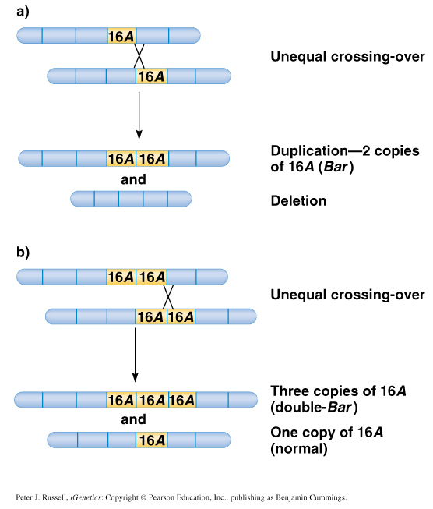

Slide 74
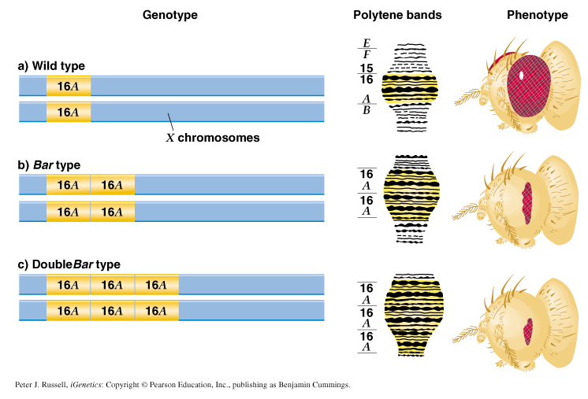

Slide 75
Inversion
When a segment of chromosome is oriented in the reverse direction, such segment said to be inverted and the phenomenon is termed as inversion.
The existence of inversion was first detected by Strutevant and Plunkett in 1926.
Inversion occur when parts of chromosomes become detached , turn through 180⁰ and are reinserted in such a way that the genes are in reversed order.
For example, a certain segment may be broken in two places, and the breaks may be in close proximity because of chance loop in the chromosome.
When they rejoin, the wrong ends may become connected.
The part on one side of the loop connects with broken end different from the one with which it was formerly connected.
This leaves the other two broken ends to become attached.
The part within the loop thus becomes turned around or inverted.

Slide 76
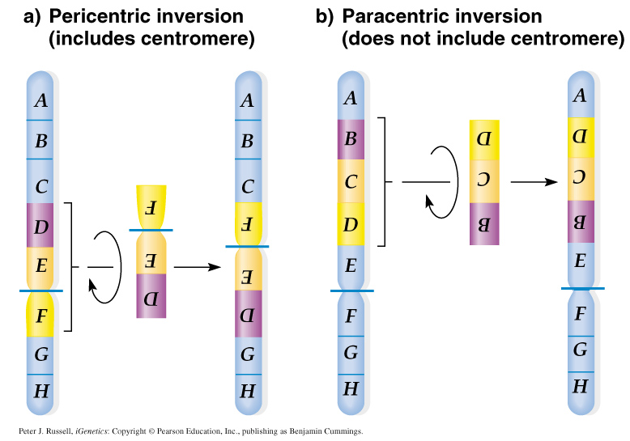
Inversion may be classified into two types:
  Pericentric - include the centromere
  Paracentric - do not include the centromere

Slide 77
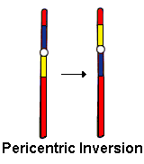
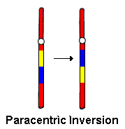
An inversion consists of two breaks in one chromosome.
The area between the breaks is inverted (turned around), and then reinserted and the breaks then unite to the rest of the chromosome.
If the inverted area includes the centromere it is called a pericentric inversion.
If it does not, it is called a paracentric inversion.

Slide 78
Inversions in natural populations
In natural populations, pericentric inversions are much less frequent than paracentric inversions.
In many sp, however, pericentric inversions are relatively common, e.g., in some grasshoppers.
Paracentric inversions appear to be very frequent in natural populations of Drosophila.

Slide 79
Translocation
Integration of a chromosome segment into a nonhomologous chromosome is known as translocation.
Three types:
1. simple translocation
2. shift
3. reciprocal translocation.

Slide 80
Simple translocation: In this case, terminal segment of a chromosome is integrated at one end of a non-homologous region. Simple translocations are rather rare.
Shift: In shift, an intercalary segment of a chromosome is integrated within a non-homologous chromosome. Such translocations are known in the populations of Drosophila, Neurospora etc.
Reciprocal translocation: It is produced when two non-homologous chromosomes exchange segments – i.e., segments reciprocally transferred.
Translocation of this type is most common

Slide 81
Non-Disjunction
Generally during gametogenesis the homologous chromosomes of each pair separate out (disjunction) and are equally distributed in the daughter cells.
But sometime there is an unequal distribution of chromosomes in the daughter cells.
The failure of separation of homologous chromosome is called non-disjunction.
This can occur either during mitosis or meiosis or embryogenesis.

Slide 82
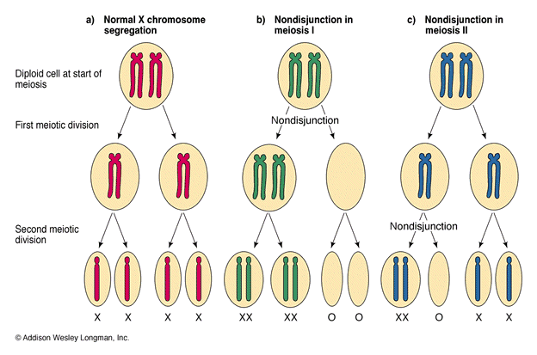

Slide 83
Mitotic non-disjunction: The failure of separation of homologous chromosomes during mitosis is called mitotic non-disjunction.
It occurs after fertilization.
May happen during first or second cleavage.
Here, one blastomere will receive 45 chromosomes, while other will receive 47.
Meiotic non-disjunction: The failure of separation of homologous chromosomes during meiosis is called mitotic non-disjunction
Occurs during gametogensis
Here, one type contain 22 chromosome, while other will be 24.

Slide 84
Variation in chromosome number
Organism with one complete set of chromosomes is said to be euploid (applies to haploid and diploid organisms).
Aneuploidy - variation in the number of individual chromosomes (but not the total number of sets of chromosomes).
The discovery of aneuploidy dates back to 1916 when Bridges discovered XO male and XXY female Drosophila, which had 7 and 9 chromosomes respectively, instead of normal 8.

Slide 85
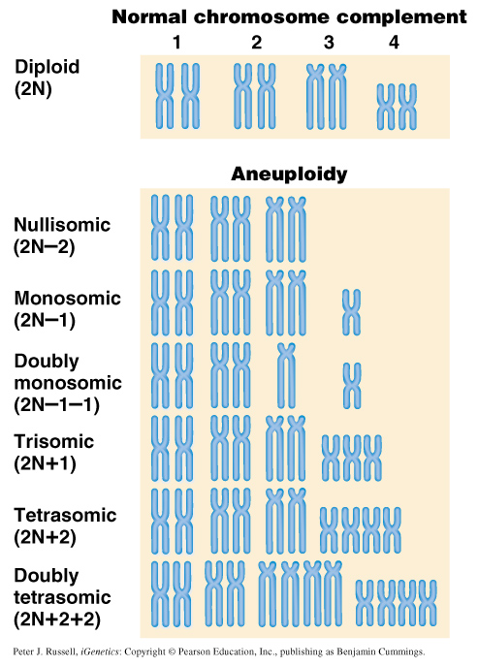
Nullisomy - loss of one homologous chromosome pair. (e.g., Oat )
Monosomy – loss of a single chromosome (Maize).
Trisomy - one extra chromosome. (Datura)
Tetrasomy - one extra chromosome pair.
More about Aneuploidy

Slide 86
Uses of Aneuploidy
They have been used to determine the phenotypic effect of loss or gain of different chromosome
Used to produce chromosome substitution lines. Such lines yield information on the effects of different chromosomes of a variety in the same genetic background.
They are also used to produce alien addition and alien substitution lines. These are useful in gene transfer from one species to another.
Aneuploidy permits the location of a gene as well as of a linkage group onto a specific chromosome.

Slide 87
Trisomy in Humans
Down Syndrome
The best known and most common chromosome related syndrome.
Formerly known as “Mongolism”
1866, when a physician named John Langdon Down published an essay in England in which he described a set of children with common features who were distinct from other children with mental retardation he referred to as “Mongoloids.”
One child in every 800-1000 births has Down syndrome
250,000 in US has Down syndrome.
The cost and maintaining Down syndrome case in US is estimated at $ 1 billion per year.

Slide 88
Patients having Down syndrome will Short in stature (four feet tall) and had an epicanthal fold, broad short skulls, wild nostrils, large tongue, stubby hands
Some babies may have short necks, small hands, and short fingers.
They are characterized as low in mentality.
Down syndrome results if the extra chromosome is number 21.

Slide 89
Amniocentesis for Detecting Aneuploidy
Chromosomal abnormalities are sufficiently well understood to permit genetic counseling.
A fetus may be checked in early stages of development by karyotyping the cultured cells obtained by a process called amniocentesis.
A sample of fluid will taken from mother and fetal cells are cultured and after a period of two to three weeks, chromosomes in dividing cells can be stained and observed.
If three No.21 chromosomes are present, Down syndrome confirmed.

Slide 90
The risk for mothers less than 25 years of age to have the trisomy is about 1 in 1500 births.
At 40 years of age, 1 in 100 births
At 45 years 1 in 40 births.

Slide 91
Other Syndromes
Chromosome Nomenclature: 47, +13
Chromosome formula: 2n+1
Clinical Syndrome: Trisomy-13
Estimated Frequency Birth: 1/20,000
Main Phenotypic Characteristics:
Mental deficiency and deafness, minor muscle seizures, cleft lip, cardiac anomalies

Slide 92
Other Syndromes
Chromosome Nomenclature: 47, +18
Chromosome formula: 2n+1
Clinical Syndrome: Trisomy-18
Estimated Frequency Birth: 1/8,000
Main Phenotypic Characteristics:
Multiple congenital malformation of many organs, malformed ears, small mouth and nose with general elfin appearance.
90% die in the first 6 months.

Slide 93
Other Syndromes
Chromosome Nomenclature: 45, X
Chromosome formula: 2n - 1
Clinical Syndrome: Turner
Estimated Frequency Birth: 1/2,500 female
Main Phenotypic Characteristics:
Female with retarded sexual development, usually sterile, short stature, webbing of skin in neck region, cardiovascular abnormalities, hearing impairment.

Slide 94
Other Syndromes
Chromosome Nomenclature: 47, XXY, 48, XXXY, 48,XXYY, 49, XXXXY, 50, XXXXXY
Chromosome formula: 2n+1; 2n+2; 2n+2; 2n+3; 2n+4
Clinical Syndrome: Klinefelter
Estimated Frequency Birth: 1/500 male borth
Main Phenotypic Characteristics:
Pitched voice, Male, subfertile with small testes, developed breasts, feminine, long limbs.

Slide 95
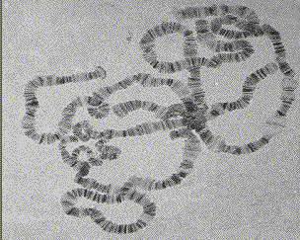
Giant chromosomes
Found in certain tissues e.g., salivary glands of larvae, gut epithelium, Malphigian tubules and some fat bodies, of some Diptera (Drosophila, Sciara, Rhyncosciara)
These chromosomes are very long and thick (upto 200 times their size during mitotic metaphase in the case of Drosophila)
Hence they are known as Giant chromosomes.

Slide 96
They are first discovered by Balbiani in 1881 in dipteran salivary glands and thus also known as salivary gland chromosomes.
But their significance was realized only after the extensive studies by Painter during 1930’s.
Giant chromosomes have also been discovered in suspensors of young embryos of many plants, but these do not show the bands so typical of salivary gland chromosomes.

Slide 97
He described the morphology in detail and discovered the relation between salivary gland chromosomes and germ cell chromosomes.
Slides of Drosophila giant chromosomes are prepared by squashing in acetocarmine the salivary glands dissected out from the larvae.
The total length of D.melanogater giant chromosomes is about 2,000µ.

Slide 98
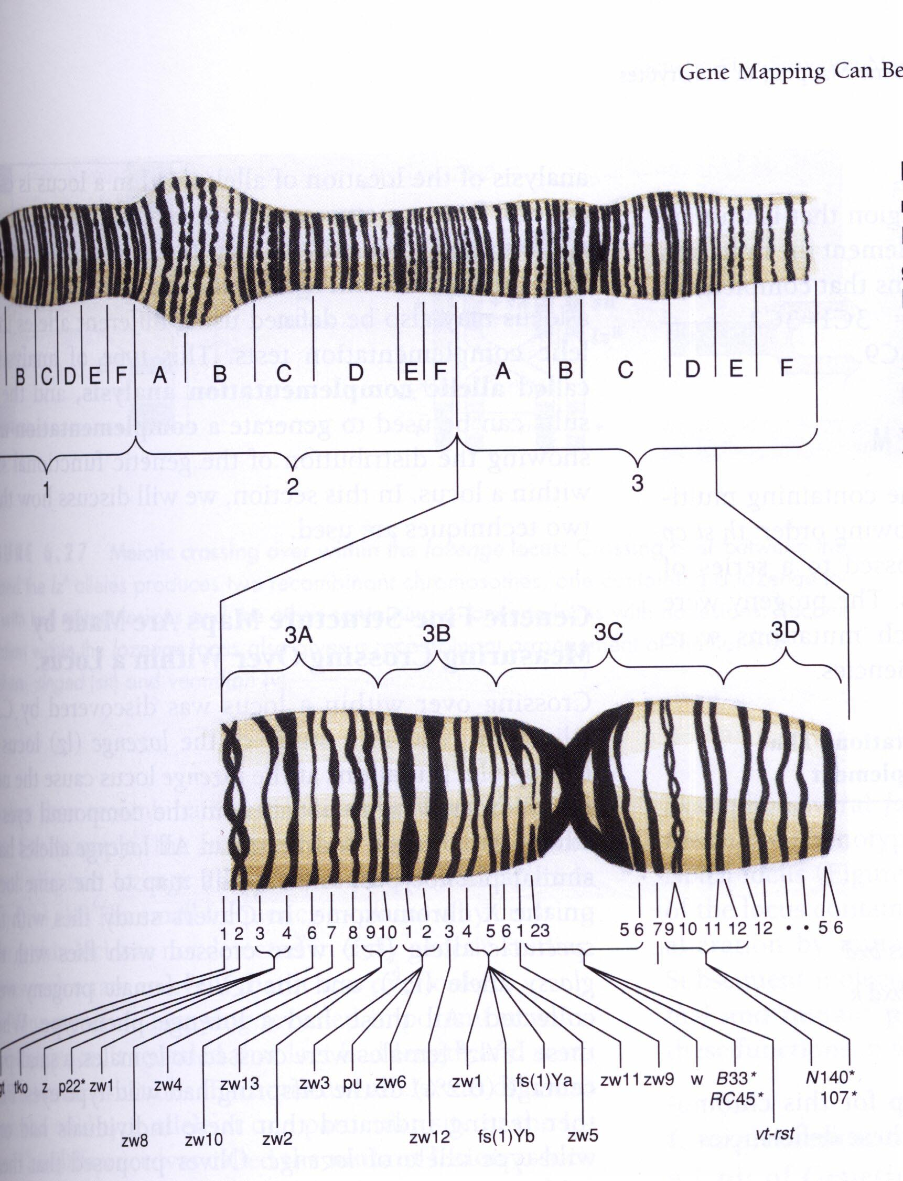
Giant chromosomes are made up of several dark staining regions called “bands”.
It can be separated by relatively light or non-staining “interband” regions.
The bands in Drosophila giant chromosome are visible even without staining, but after staining they become very sharp and clear.
In Drosophila about 5000 bands can be recognized.

Slide 99
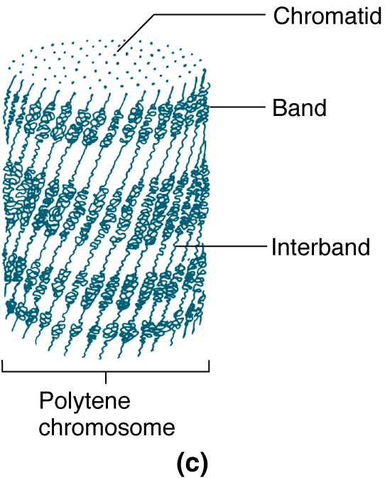
Some of these bands are as thick as 0.5µ, while some may be only 0.05µ thick.
About 25,000 base-pairs are now estimated for each band.
All the available evidence clearly shows that each giant chromosome is composed of numerous strands, each strand representing one chromatid.
Therefore, these chromosomes are also known as “Polytene chromosome”, and the condition is referred to as “Polytene”

Slide 100
The numerous strands of these chromosomes are produced due to repeated replication of the paired chromosomes without any nuclear or cell division.
So that the number of strands (chromatids) in a chromosome doubles after every round of DNA replication
It is estimated that giant chromosomes of Drosophila have about 1,024 strands
In the case of Chironomous may have about 4,096 strands.
The bands of giant chromosomes are formed as a result of stacking over one another of the chromomeres of all strands present in them.

Slide 101
Since chromatin fibers are highly coiled in chromosomes, they stain deeply.
On the other hand, the chromatin fibers in the interband regions are fully extended, as a result these regions take up very light stain.
In Drosophila the location of many genes is correlated with specific bands in the connected chromosomes.
In interband region do not have atleast functional genes

Slide 102
During certain stages of development, specific bands and inter band regions are associated with them greatly increase in diameter and produced a structure called Puffs or Balbiani rings.
Puffs are believed to be produced due to uncoiling of chromatin fibers present in the concerned chromomeres.
The puffs are sites of active RNA synthesis.

Slide 103
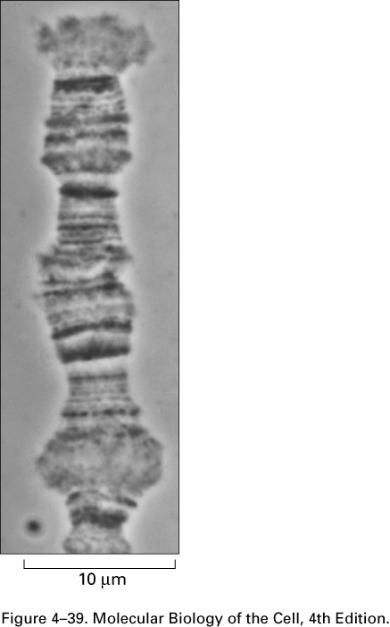
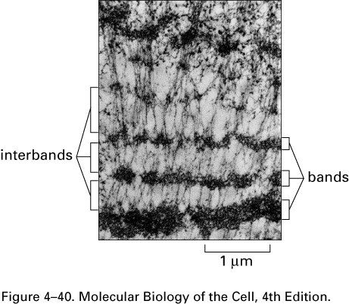

Slide 104
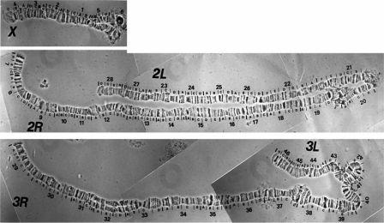
Figure 3. Polytene chromosome map of Anopheles gambiae

Slide 105
Lampbrush Chromosome
It was given this name because it is similar in appearance to the brushes used to clean lamp chimneys in centuries past.
First observed by Flemming in 1882.
The name lampbrush was given by Ruckert in 1892.
These are found in oocytic nuclei of vertebrates (sharks, amphibians, reptiles and birds)as well as in invertebrates (Sagitta, sepia, Ehinaster and several species of insects).
Also found in plants – but most experiments in oocytes.

Slide 106
Lampbrush chromosomes are up to 800 µm long; thus they provide very favorable material for cytological studies.
The homologous chromosomes are paired and each has duplicated to produce two chromatids at the lampbrush stage.
Each lampbrush chromosome contains a central axial region, where the two chromatids are highly condensed
Each chromosome has several chromomeres distributed over its length.
From each chromomere, a pair of loops emerges in the opposite directions vertical to the main chromosomal axis.

Slide 107
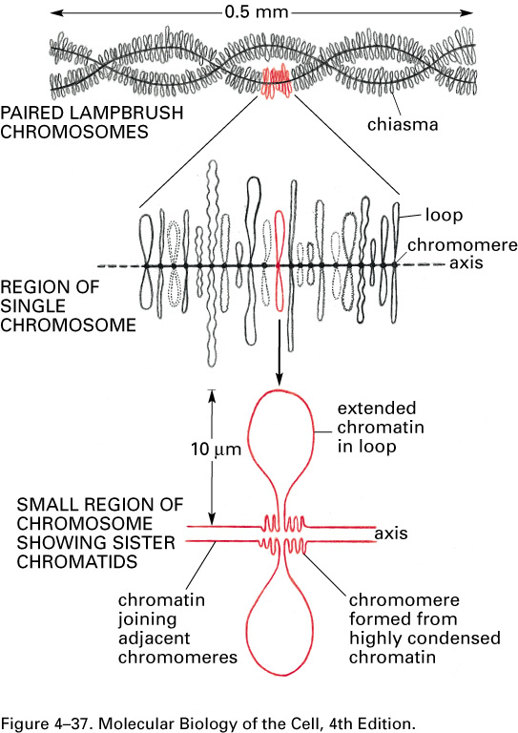
One loop represent one chromatid, i.e., one DNA molecule.
The size of the loop may be ranging the average of 9.5 µm to about 200 µm
The pairs of loops are produced due to uncoiling of the two chromatin fibers present in a highly coiled state in the chromomeres.

Slide 108
One end of each loop is thinner (thin end) than the other end (thick end).
There is extensive RNA synthesis at the thin end of the loops, while there is little or no RNA synthesis at the thick end.

Slide 109
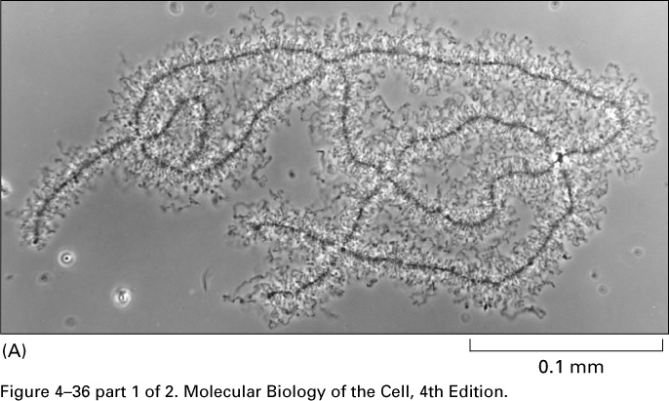
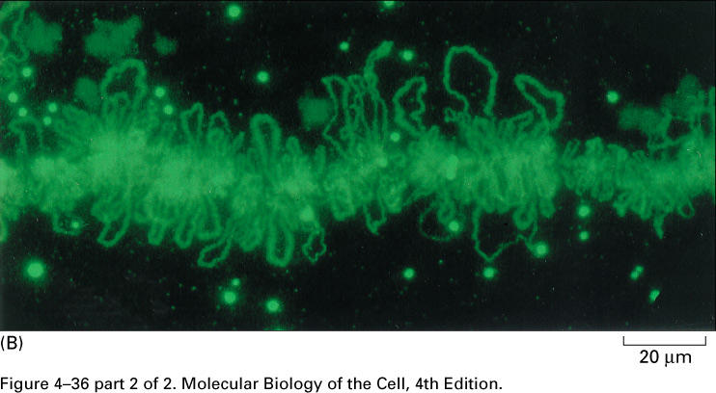
Phase-contrast and fluorescent micrographs of
lampbrush chromosomes

Slide 110
Dosage Compensation
Sex Chromosomes: females XX, males XY
Females have two copies of every X-linked gene; males have only one.
How is this difference in gene dosage compensated for? OR
How to create equal amount of X chromosome gene products in males and females?

Slide 111
Levels of enzymes or proteins encoded by genes on the X chromosome are the same in both males and females
Even though males have 1 X chromosome and females have 2.

Slide 112
G6PD, glucose 6 phosphate dehydrogenase, gene is carried on the X chromosome
This gene codes for an enzyme that breaks down sugar
Females produce the same amount of G6PD enzyme as males
XXY and XXX individuals produce the same about of G6PD as anyone else

Slide 113
In cells with more than two X chromosomes, only one X remains genetically active and all the others become inactivated.
In some cells the paternal allele is expressed
In other cells the maternal allele is expressed
In XXX and XXXX females and XXY males only 1 X is activated in any given cell the rest are inactivated

Slide 114
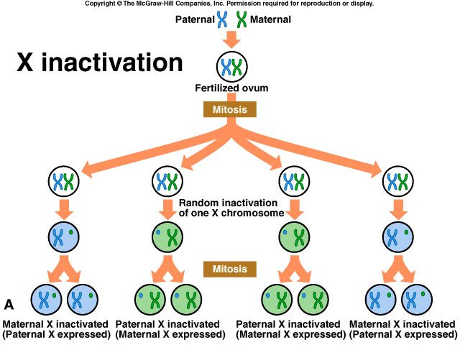

Slide 115
Barr Bodies
1940’s two Canadian scientists noticed a dark staining mass in the nuclei of cat brain cells
Found these dark staining spots in female but not males
This held for cats and humans
They thought the spot was a tightly condensed X chromosome

Slide 116
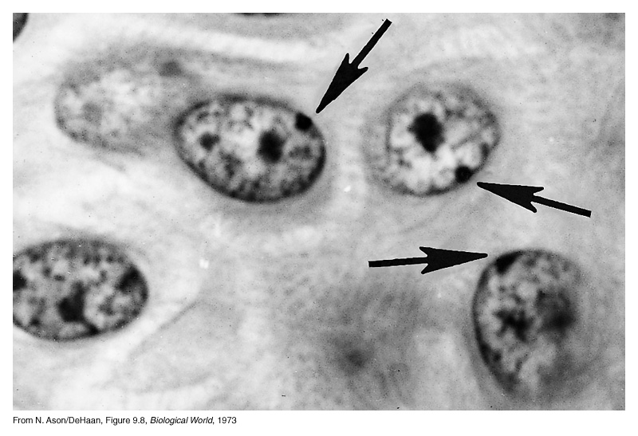
Barr Bodies
Barr bodies represent the inactive X chromosome and are normally found only in female somatic cells.

Slide 117
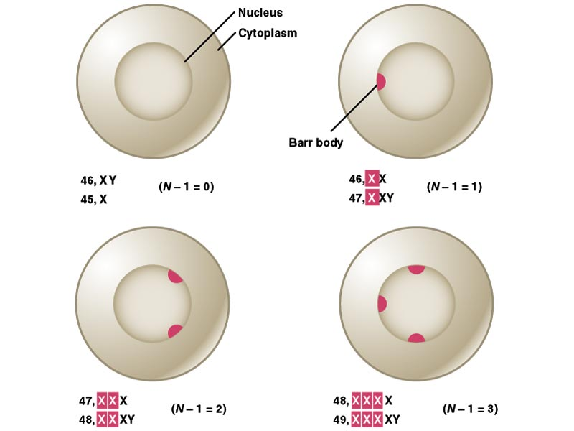
A woman with the chromosome constitution 47, XXX should have 2 Barr bodies in each cell.
XXY individuals are male, but have a Barr body.
XO individuals are female but have no Barr bodies.

Slide 118
Which chromosome is inactive is a matter of chance, but once an X has become inactivated , all cells arising from that cell will keep the same inactive X chromosome.
In the mouse, the inactivation apparently occurs in early in development
In human embryos, sex chromatin bodies have been observed by the 16th day of gestation.

Slide 119
Mechanism of X-chromosome Inactivation
A region of the p arm of the X chromosome near the centromere called the X-inactivation center (XIC) is the control unit.
This region contains the gene for X-inactive specific transcript (XIST). This RNA presumably coats the X chromosome that expresses it and then DNA methylation locks the chromosome in the inactive state.

Slide 120
This occurs about 16 days after fertilization in a female embryo.
The process is independent from cell to cell.
A maternal or paternal X is randomly chosen to be inactivated.

Slide 121
Rollin Hotchkiss first discovered methylated DNA in 1948.
He found that DNA from certain sources contained, in addition to the standard four bases, a fifth: 5-methyl cytosine.
It took almost three decades to find a role for it.
In the mid-1970s, Harold Weintraub and his colleagues noticed that active genes are low in methyl groups or under methylated.
Therefore, a relationship between under methylation and gene activity seemed likely, as if methylation helped repress genes.

Slide 122
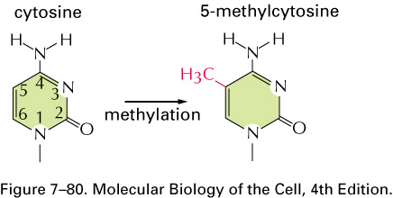
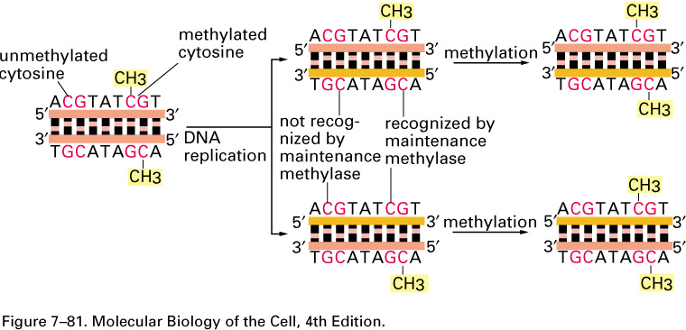

Slide 123
This would be a valuable means of keeping genes inactive if methylation passed on from parent to daughter cells during cell division.
Each parental strand retains its methyl groups, which serve as signals to the methylating apparatus to place methyl groups on the newly made progeny strand.
Thus methylation has two of the requirements for mechanism of determination:
1. It represses gene activity
2. It is permanent.

Slide 124
Strictly speaking, the DNA is altered, since methyl groups are attached, but because methyl cytosine behaves the same as ordinary cytosine, the genetic coding remain same.
A striking example of such a role of methylation is seen in the inactivation of the X chromosome in female mammal.
The inactive X chromosome become heterochromatic and appears as a dark fleck under the microscope – this chromosome said to be lyonized, in honor of Mary Lyon who first postulated the effect in mice.

Slide 125
An obvious explanation is that the DNA in the lyonized X chromosome is methylated, where as the DNA in the active, X chromosome is not.
To check this hypothesis Peter Jones and Lawrence Shapiro grew cells in the presence of drug 5-azacytosine, which prevents DNA methylation.
This reactivated the lyonized the X chromosome.
Furthermore, Shapiro showed these reactivated chromosomes could be transferred to other cells and still remain active.

Slide 126
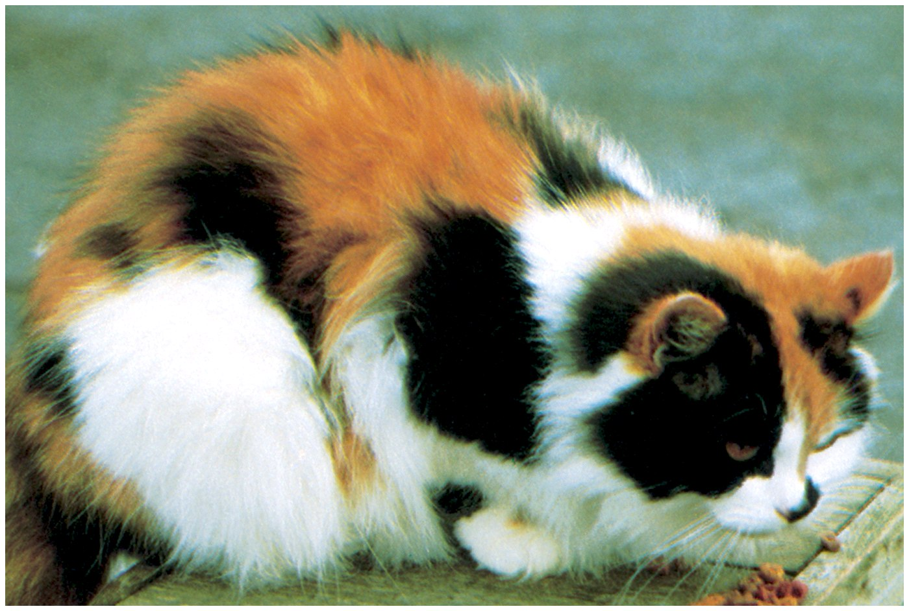

Slide 127
Reading assignment
Grewal and Moazed (2003) “Heterochromatin and epigenetic control of gene expression” Science 301:798
Goldmit and Bergman (2004) “Monoallelic gene expression: a repertoire of recurrent themes” Immunol Rev 200:197

Slide 128
This powerpoint was kindly donated to www.worldofteaching.com
http://www.worldofteaching.com is home to over a thousand powerpoints submitted by teachers. This is a completely free site and requires no registration. Please visit and I hope it will help in your teaching.

