Slide 1
Animal breeds
Agriculture – farming
Beef
Pig
Sheep
Poultry

Slide 2
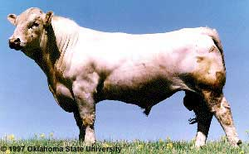
Beef Cattle - Charolais

Slide 3
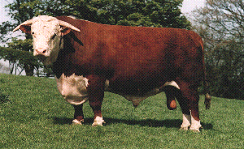
Hereford

Slide 4
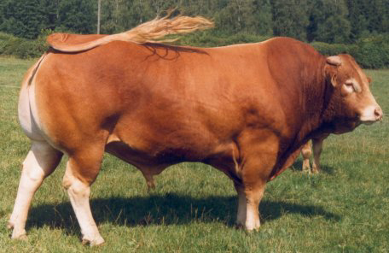
Limousin

Slide 5
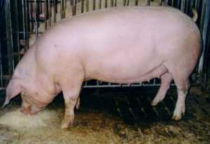
Pig - Landrace sow

Slide 6
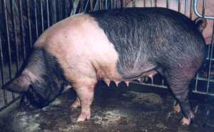
Saddleback - sow

Slide 7
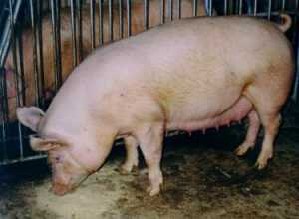
Yorkshire - sow

Slide 8
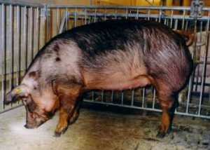
Durroc

Slide 9
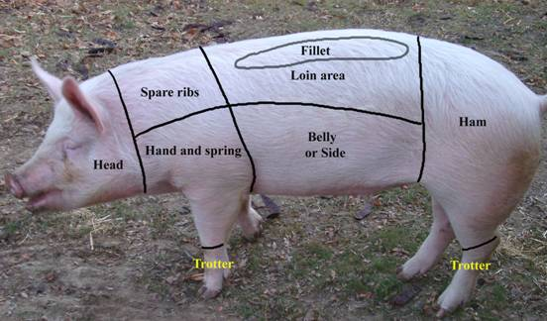
specifications

Slide 10
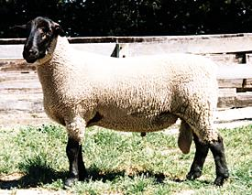
Sheep - suffolk ram

Slide 11
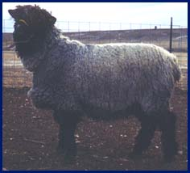
lincoln

Slide 12
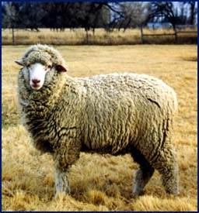
Merino wool sheep

Slide 13
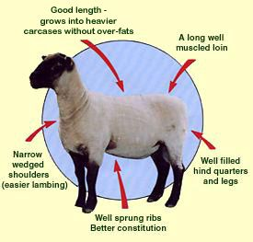
Specifications - suffolk

Slide 14
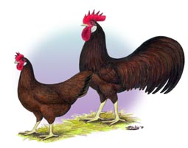
Chickens – longhorn red

Slide 15
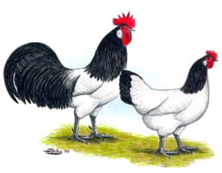
lakenvalder

Slide 16
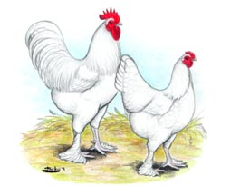
White shank white leg

Slide 17
This powerpoint was kindly donated to www.worldofteaching.com
http://www.worldofteaching.com is home to over a thousand powerpoints submitted by teachers. This is a completely free site and requires no registration. Please visit and I hope it will help in your teaching.

