Slide 1
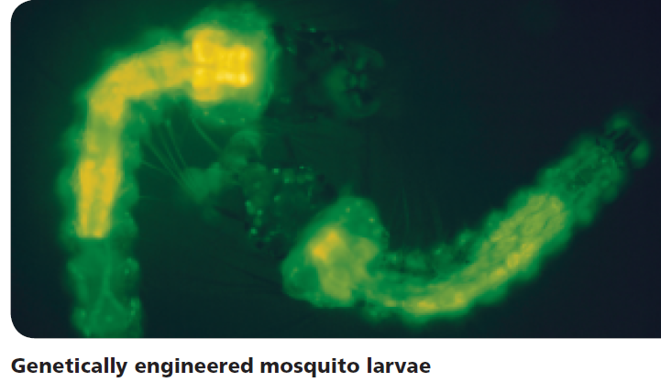
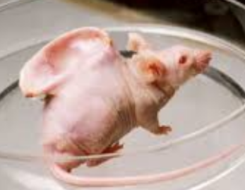
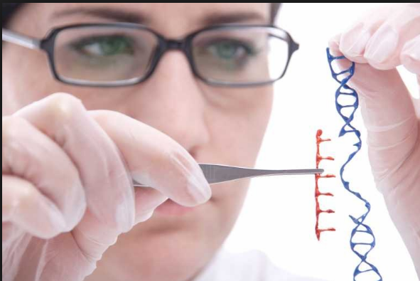
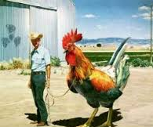
Advances in Genetics (p. 110)

Slide 2
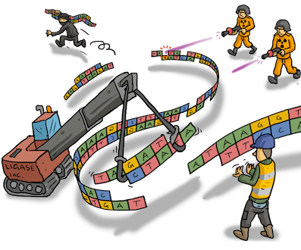
Genetic Engineering
Technology that involves modifying the DNA of one organism by inserting the DNA of another.
First used in the
1970s
Today is used in
a wide variety of
applications

Slide 3
Uses of Genetic Engineering
1. Pharmaceutical (production of medicines)
2. Gene Therapy (a way of treating some disorders and diseases that usually involves replacing bad copies of genes with other genes)
3. Food improvement (introducing genes from other species that gives food (plant/animal) a benefit to mankind.

Slide 4
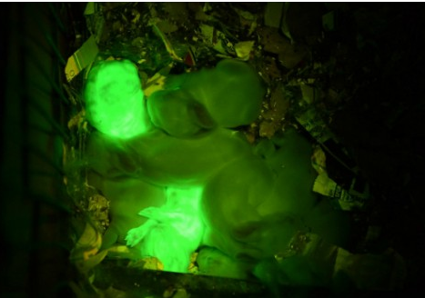
How do we put a new gene into an organism?
Recombinant DNA is DNA that is moved from one species into another.
Genetically Modified Organism(GMO): An organism that has recombinant DNA.
Glow in the dark rabbits

Slide 5
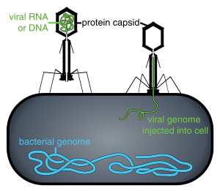
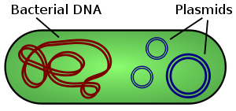
Moving Genes
A vector is used to move a gene from one species into another
Two common vectors are plasmids (small loops of DNA) and viruses (a some DNA in proteins that can use a cell to copy itself)
After the gene has been put in, it can be copied by the organism and used to make proteins

Slide 6
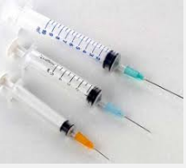
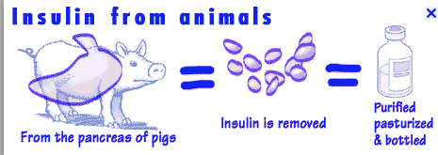
Humans need human insulin!!!
Ever heard of Diabetes당뇨병 ???
There are different types of diabetes, the most common type requires people to take injections of insulin인슐린 .
In the past, we got insulin from the pancreas췌장 of pigs.
Do you want pig insulin??? Oink oink

Slide 7
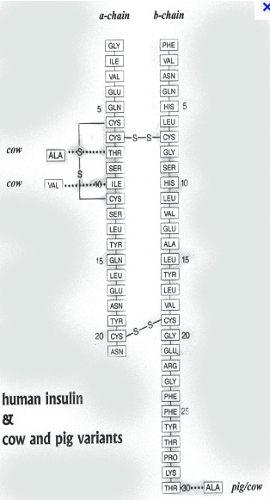
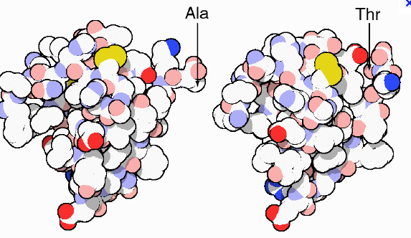
Why would we want a bacteria to make a human protein????
Pig insulin works, but it is not 100% identical.
Also, you need to take it out of a pig pancreas
Using insulin as our example, lets understand how companies can now make human insulin for humans, using our friends, BACTERIA

Slide 8
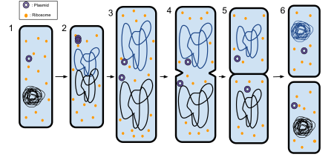
Cloning a gene
Insert a gene into a vector (e.g. plasmid), which is placed inside a bacterium
The recombinant gene is then copied and copied by the bacterium
When the bacterium reproduces asexually, it will copy the recombinant gene

Slide 9
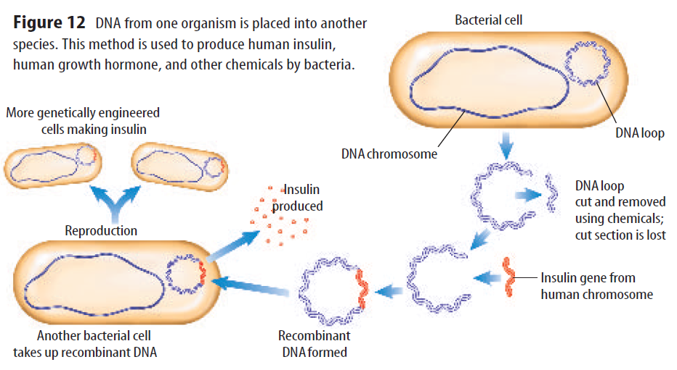
Step 4: bacteria makes human insulin
Step 3: put the recombinant plasmid in the bacteria
Step 2: paste in any gene (e.g. insulin) using the enzyme ligase
Step 1: cut piece of plasmid out with restriction enzymes

Slide 10
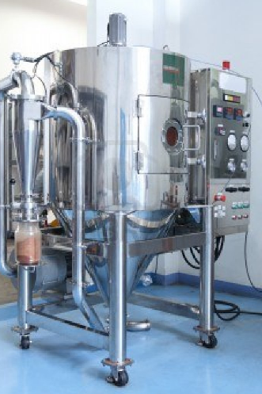
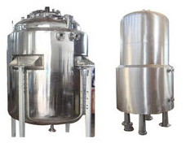
Pharmaceutical Benefits of Biotechnology
Human growth hormones, insulin and many other human products can be made large-scale using cloning. The advantages are the product is actually human, can be made in large amounts and can be made less expensively.

Slide 11
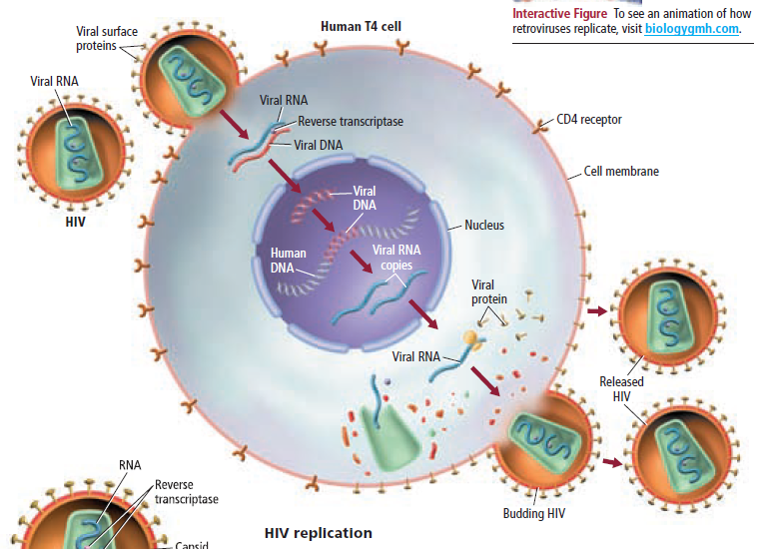
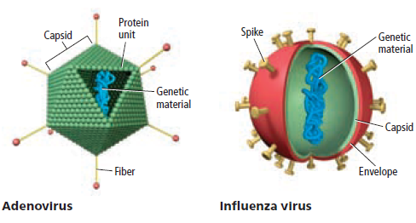
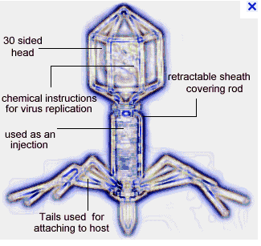
Viruses
Are “bad”
Cause illnesses
They shoot their genetic material into the nucleus of the human cell
The human cell makes more viruses (transcription and translation of virus proteins)
Viruses hijack납치the cell

Slide 12
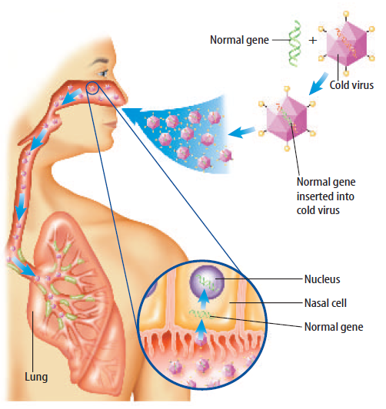
Gene Therapy
Put normal allele in a cold virus
Inhale the cold virus
The virus infects your nasal cells
The normal allele goes into the nucleus
The cell can make the normal protein

Slide 13
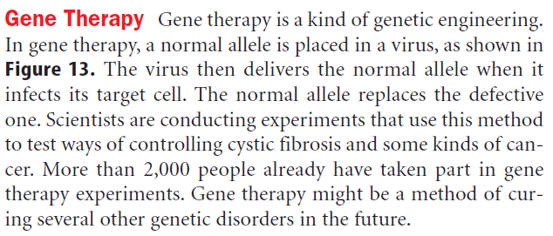
Gene Therapy

Slide 14
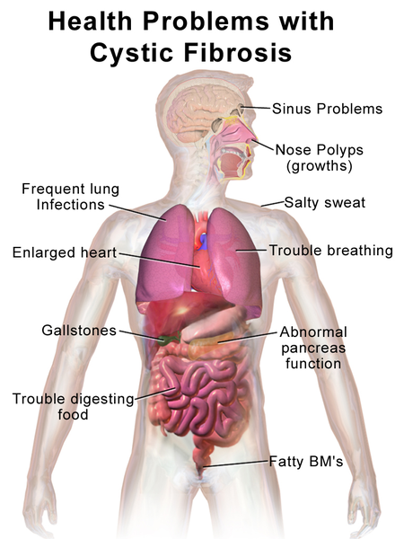
Cystic fibrosis
CF is caused by a mutation in the gene for the protein cystic fibrosic transmembrane conductance regulator (CFTR). This protein is required to regulate the components of sweat, digestive fluids, and mucus.

Slide 15
What if…………
Scientists removed the illness-causing genes from a virus
Well, the virus could infect your cell, but not cause damage.
Scientists inserted some “good” genes that a person is missing (e.g. cystic fibrosis gene)
Well, the virus could give the human cell this new gene like it used to give the old bad virus genes.

Slide 16
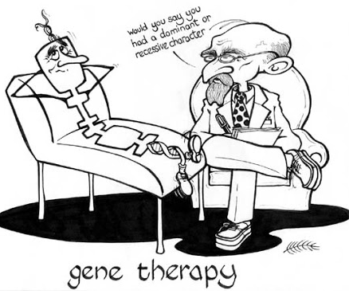
Types of Gene Therapy
Body cell: deliver gene to the body cell. Not passed on to the next generation. This type is has been used in human clinical trials.
Sex cell: deliver gene to the sex cells so it is passed on to the next generation. Many countries have not allowed this for human clinical trials.

Slide 17
Risks of Gene Therapy
Short-lived success: what if the “good” gene doesn’t go inside the genome (one of the chromosomes). The gene is “lost”
Possible Immune system response: the virus is still “foreign”, maybe your body will fight it.
May cause cancer: what if the “good” gene goes inside a cell cycle gene. Then your cell cycle is broken (cancer). Hope it jumps into junk DNA

Slide 18
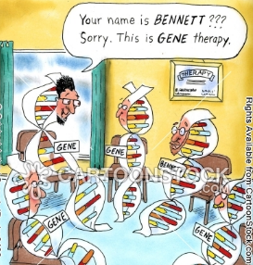
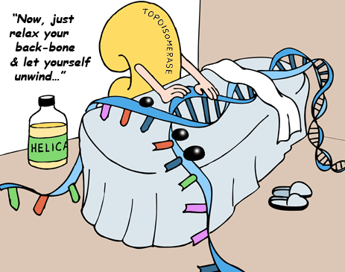
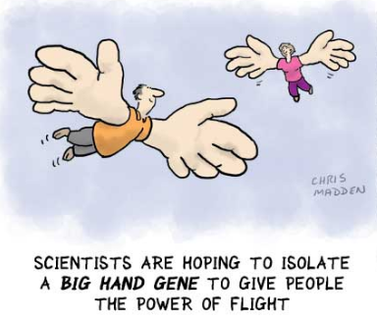
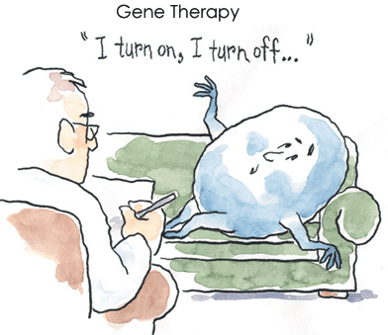

Slide 19
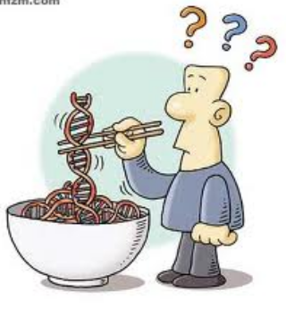
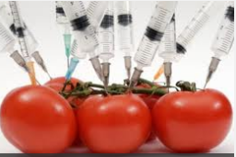
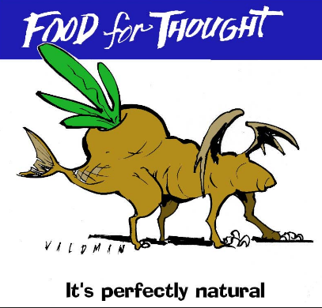
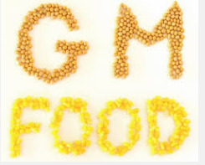
Genetically Modified Food
These foods have genes that do not belong to them. They are from other species. They have been designed to have “something” better

Slide 20
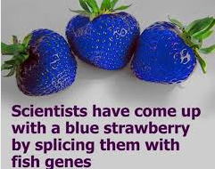
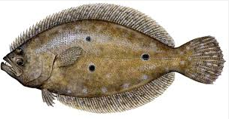
How to make crops better?
Arctic Flounder Fish: The Arctic Flounder Fish produces an anti-freeze that allows it to protect himself in freezing waters.

Slide 21
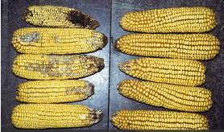
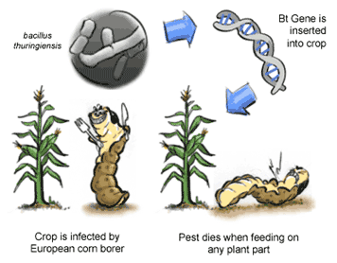
Bt corn
Insert a bacteria (Bacillus thuringiensis) gene that makes a toxin into corn.
Greater yield
No use of pesticides

Slide 22
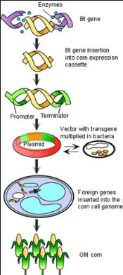
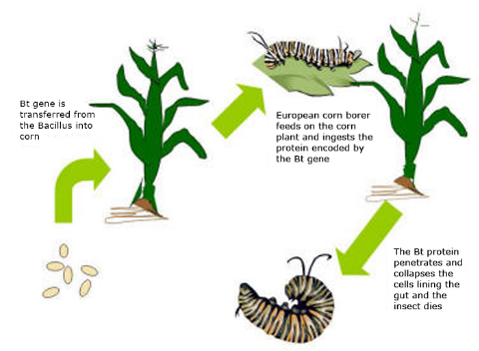
Bt Corn
Clone the Bt toxin gene then insert it into the corn genome

Slide 23
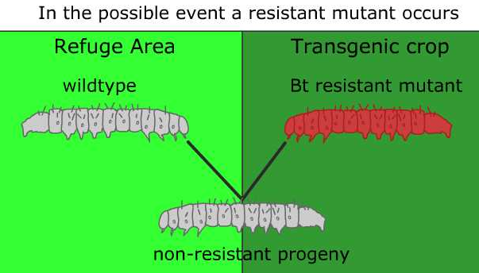
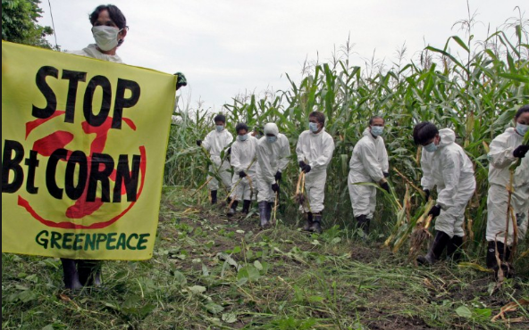
Why stop Bt corn?
Environmental concerns (poison to other insects?)
Allergies to the toxin in humans

Slide 24
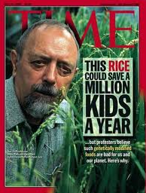
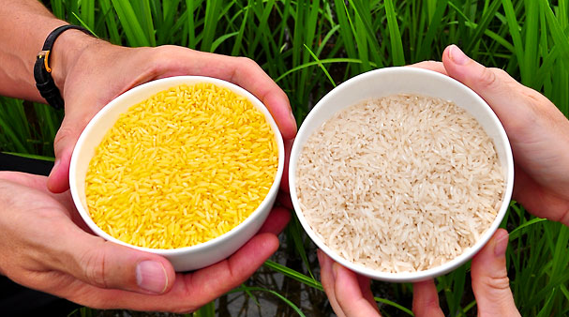
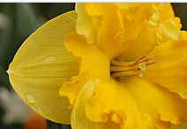
“Golden” rice
Scientists added bacteria and daffodil gene.
Adds Vitamin A
Lack of vitamin A kills 670,000 kids a year under age 5
수선화

Slide 25
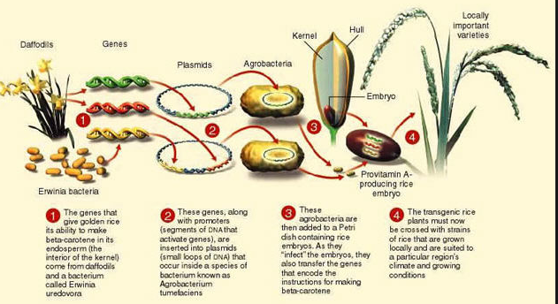
“Golden” rice

Slide 26
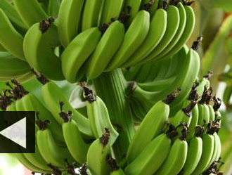
Banana vaccines?
Virus injected into a banana sapling.
Virus proteins are now part of the banana
Creates an immunity to the virus.

Slide 27
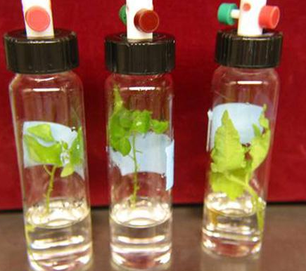
Pollution fighting plants
Plants engineered to have genes used for removing contamination from the ground water

Slide 28
Pros | Cons
Increased pest 해충, 유해 동물 and disease resistance병저항성 Drought tolerance내건성 Increased food supply (yield, nutrition, vaccine) | Introducing allergens and toxins to food Accidental contamination between genetically modified and non-genetically modified foods Antibiotic resistance Adversely changing the nutrient content of a crop Creation of "super" weeds and other environmental risks

