Slide 1
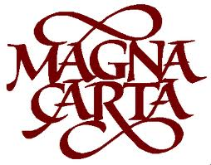
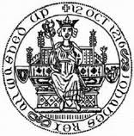

Slide 2
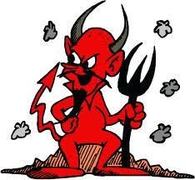
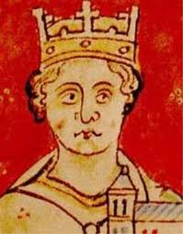
King John
“Bad”
King John was born in 1166
He was called John Lackland because he lost most of his lands in France while his brother Richard the Lionheart had been away on Crusade.

Slide 3
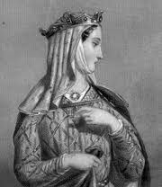
“Bad” King John
King John invented a tax called scutage to pay for his wars which made him very unpopular with his barons.
After his mother died, the French barons were no longer loyal to him either…
Eleanor of Aquitaine was John’s mother and very influential. She lived to the then astonishing age of 81!
Notes:
War with France broke out in 1202, so he needed war tax “Scutage”
Soon he didn’t have the support of his British barons because of Scutage and he was forced to sign a document called the Magna Carta
He lost the loyalty of his French barons when his mother Eleanor of Aquitaine died at the ripe old age of 81.

Slide 4
John had quarrelled with the church too.
The barons were unhappy with his foreign policy and thought him both a coward and a murderer.
When he lost the war in France it was the final straw…

Slide 5
Runnymede
Runnymede
Some barons drew up a charter of rights and forced King John to sign it at Runnymede in June 1215

Slide 6
The Magna Carta
This great charter or Magna Carta included 63 clauses.
Clause 61 came to be known as the security clause because it gave the barons power over the king.
It was not very generous to the peasants.
But the Pope said John was not bound to the Magna Carta.

Slide 7
What Magna Carta said
John wasn’t allowed to interfere with the Church.
He couldn’t raise taxes without his
barons agreeing .
Freemen couldn’t be punished without a fair trial.
Punishment should fit the crime.

Slide 8
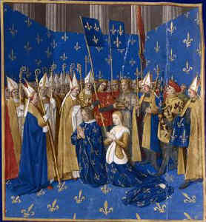
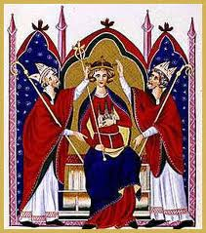
The Magna Carta
When he disobeyed, the barons started a rebellion and invited Prince Louis of France to take the crown.
After trying to escape by crossing the wash and losing his treasure he ate to many peaches died.
So his innocent son Henry III
reined for 50 years.
Prince Louis
Henry III

Slide 9
Thank You

