Slide 1
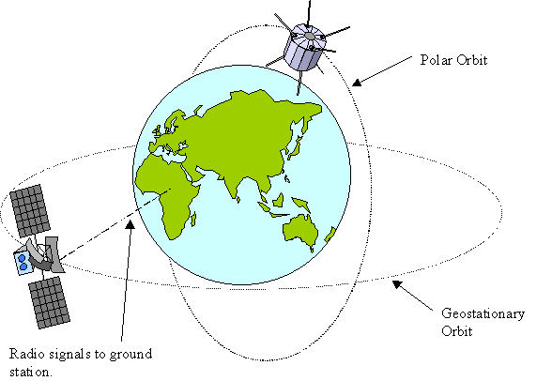
Class Opener: How are Satellites classified? What country launched the first satellite?

Slide 2
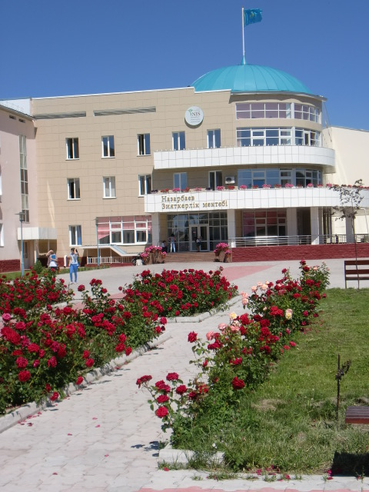
Satellite Orbits and Uses
Grade 11 Physics
NIS, Taldykorgan
Mr. Marty

Slide 3
Objectives:
describe motion of spacecraft
  Derive the expression for escape velocity.
  Calculate energy changes in the gravitational field for spacecraft leaving the Earth and the solar system
show an understanding of geostationary orbits and their application

Slide 4
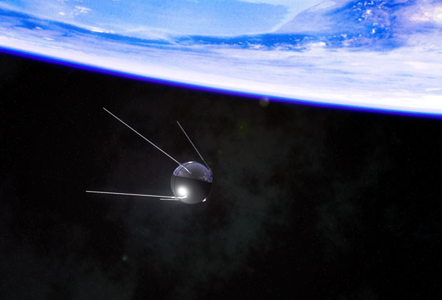
Why do you need to know about Satellites
Russia's Sputnik 1, the world's first man-made satellite was launched from Baykonur Cosmodrome!
Baykonur is used for many Satellite rocket launches!
International Launch Services is an unparalleled success in the space industry setting the standard for Russian-American space cooperation. http://www.ilslaunch.com/about-us/ils-legacy
Baykonur has many jobs for engineers and scientists!

Slide 5
PLACING SATELLITES IN ORBIT
TAURUS
TITAN IV
DELTA II
Notes:
5
5

Slide 6
TYPES OF ORBITS
LEO Low Earth Orbit, Polar
MEO Medium Earth Orbit, polar and elliptical
HEO High Earth Orbit, geostationary
GEO Geosynchronous Orbit
Notes:
6
6

Slide 7
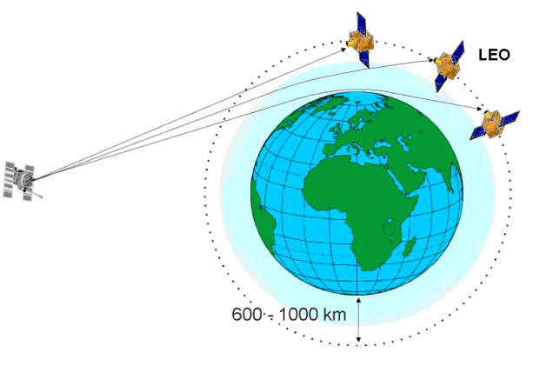
Low-Earth-Orbit (LEO = Polar)
Altitude (600 to 1600 km)
Revolution time: 90 min - 3 hours.
Advantages:
  Reduces transmission delay
  Eliminates need for bulky receiving equipment.
Disadvantages:
  Smaller coverage area.
  Shorter life span (5-8 yrs.) than GEOs (10 yrs).
Subdivisions: Little, Big, and Mega (Super) LEOs.

Slide 8
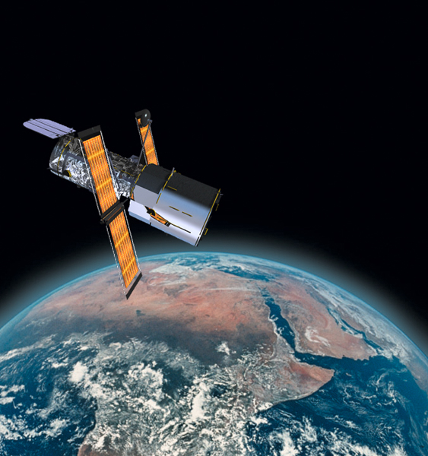
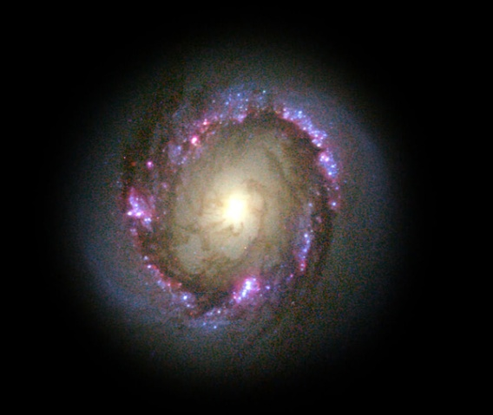
Hubble Telescope
Classification: LEO
Orbit: 375 miles, 600 km.
Revolution time: 100 min.
Speed: 7600 m/s
Concerns: Orbit decay from gravity and solar output. During “solar maximum”, the densities at all altitudes are enhanced, and the drag effects on satellites are much larger than during times of solar minimum.

Slide 9
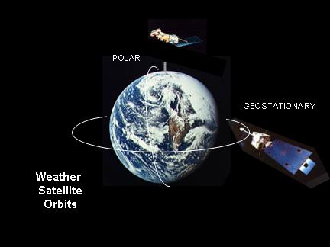
Geosynchronous-Earth-Orbit (GEO)
Orbit is synchronous with the earths rotation.
From the ground the satellite appears fixed.
Altitude is about 36,000 km.
Coverage to 40% of planet per satellite.

Slide 10
Basics of GEOs
Geostationary satellites are commonly used for communications and weather-observation.
The typical service life expectancy of a geostationary satellite is 10-15 years.
Because geostationary satellites circle the earth at the equator, they are not able to provide coverage at the Northernmost and Southernmost latitudes.

Slide 11
Information on Geostationary Satellites
For a satellite to be in a particular orbit, a particular velocity is required or a given height above Earth ‘r_{0+h}’.
Telecommunications satellites remain above one given point on the Earth’s surface, so are called geostationary
  broadcast television, forecast the weather.
Spy Satellites move in a polar orbit so that they can perform sweeps of the surface.
  spy on enemy forces

Slide 12
Summary of SATELLITE ORBITS
GEO = Geosynchronous
LEO = Polar
Located along the equatorial plane.
About 36000 km above the earth
Has Geo-synchronous orbit
Period of 1436 minutes
Good coverage from remote areas
Has wide field of view ~ 50 degrees
Has low resolution
Provides continuous data ~ 15-30 min.
Not very suitable for vertical soundings
Near polar orbiting
800 to 900 km above the earth
Has Sun-synchronous orbit
Period of 101 minutes
Excellent coverage at the poles
Has relatively narrow field of view
Has high resolution
Passes vary with latitude
Very suitable for vertical soundings

Slide 13
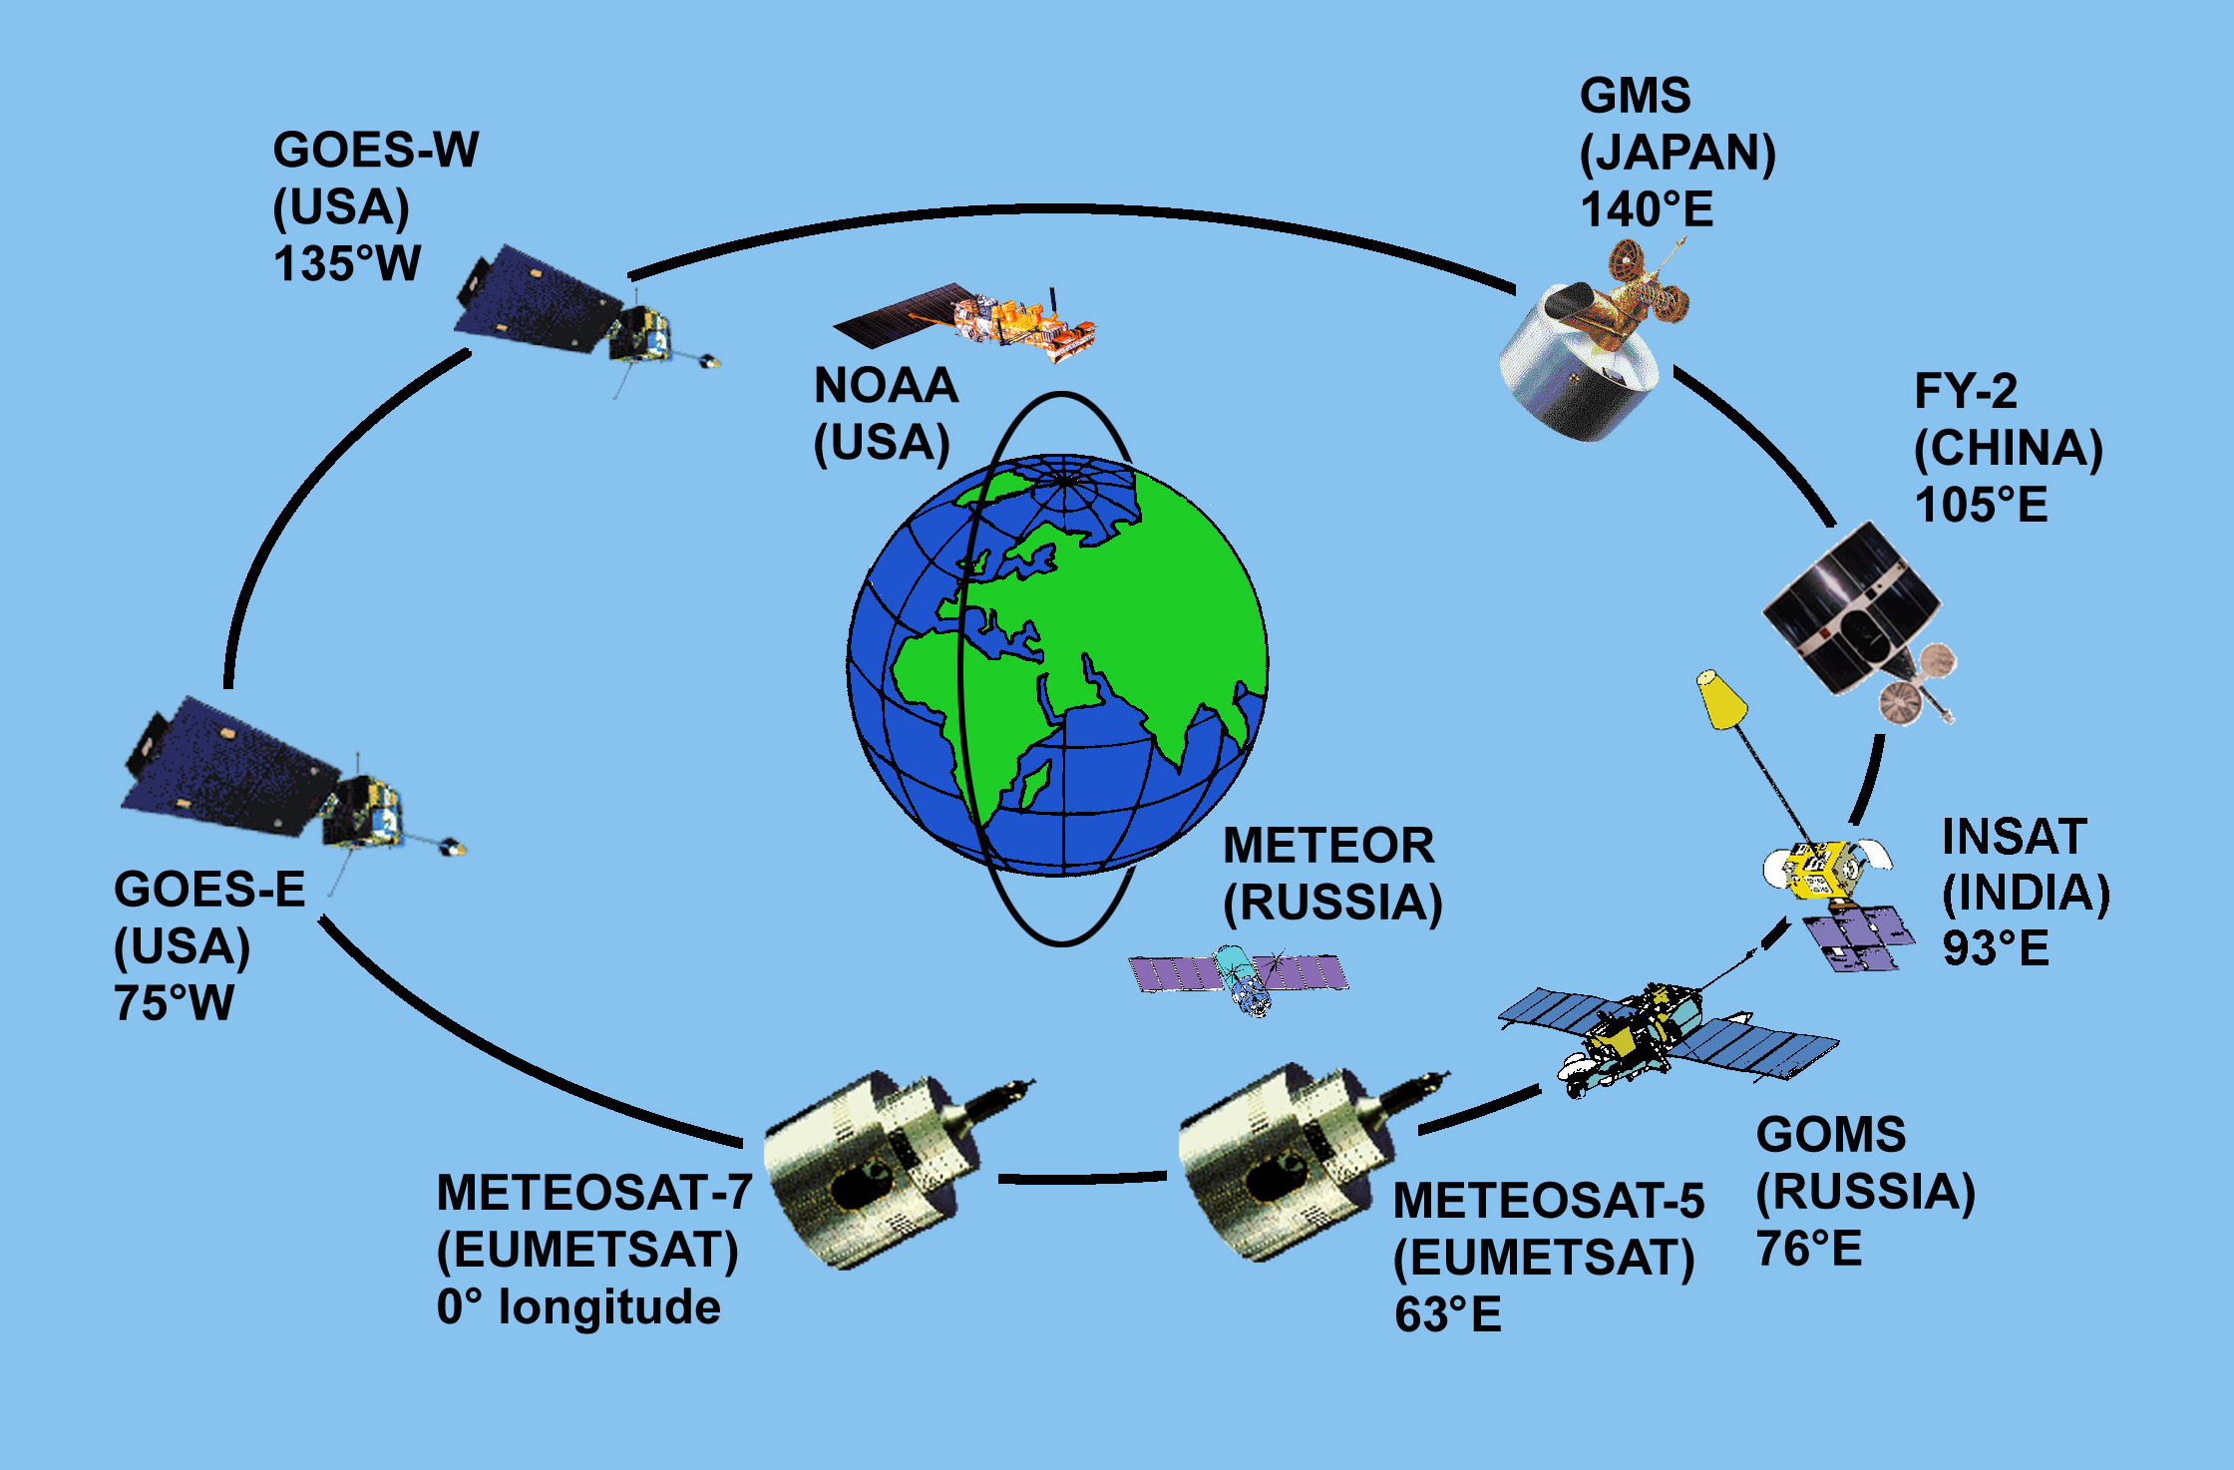
Some Satellites in Orbit

Slide 14
Geostationary Orbit Communications satellites orbit
These satellites are 36000 km above the surface and have R= 42,000km.
These satellites are positioned to orbit at rate of earths rotation and are always above the same part of the earth.
Used for TV broadcasts and mobile phones

Slide 15
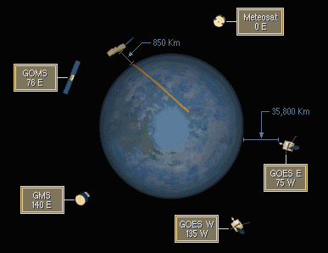
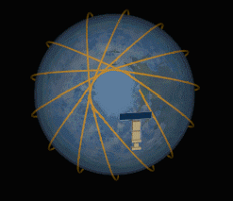
GOES and POES
Geostationary Operational Environmental Satellite geo-synchronous orbit 35,800 km above the earth
Polar-orbiting Operational Environmental Satellite sun-synchronous orbit 850 km above the earth
Notes:
NOAA series orbits: 833 +/- 19 km or 870 +/- 19 km

Slide 16
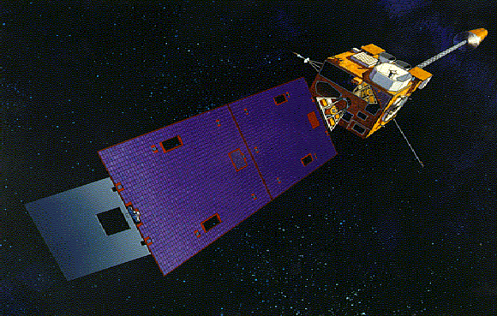
The GOES Spacecraft
GOES-8 Spacecraft
GOES I-M DataBook

Slide 17
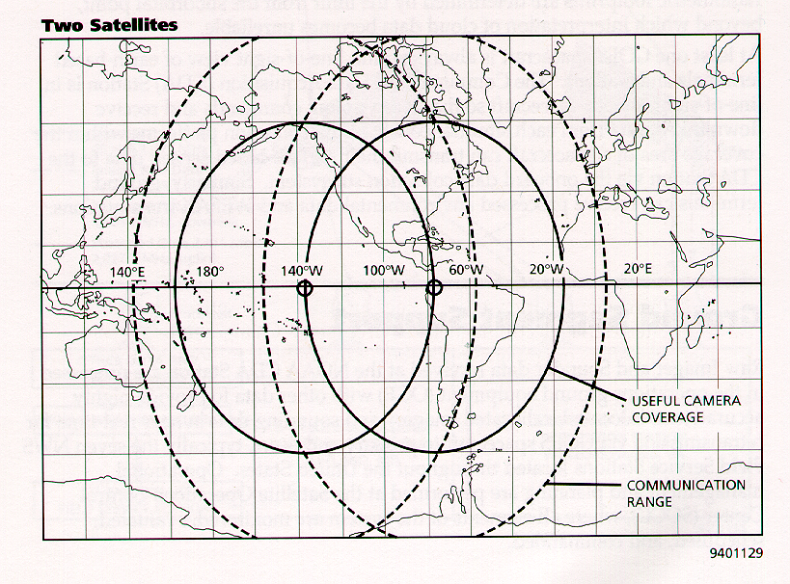
GOES
GOES I-M DataBook

Slide 18
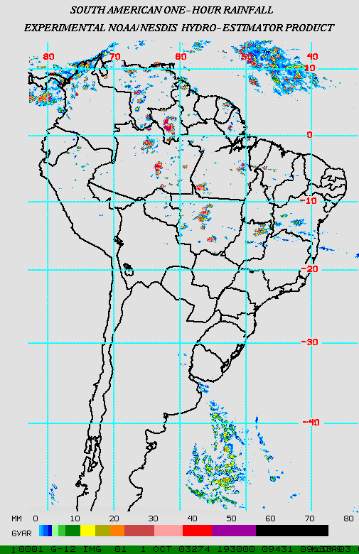
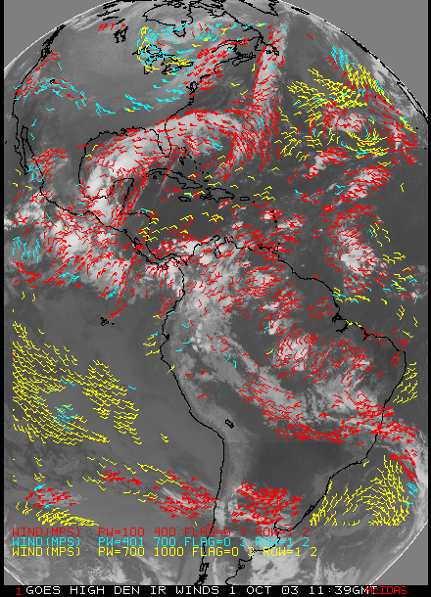
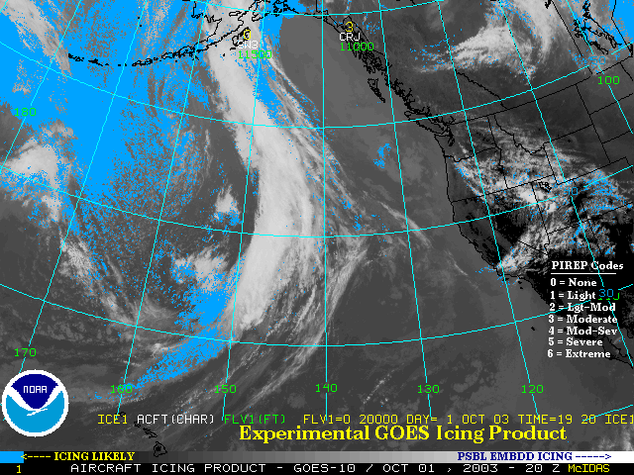
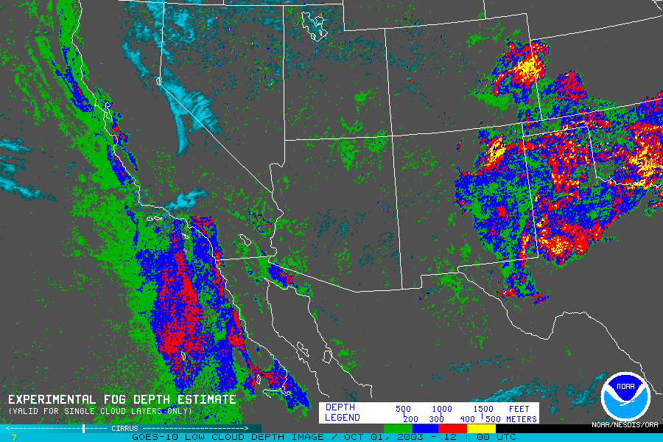
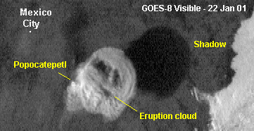
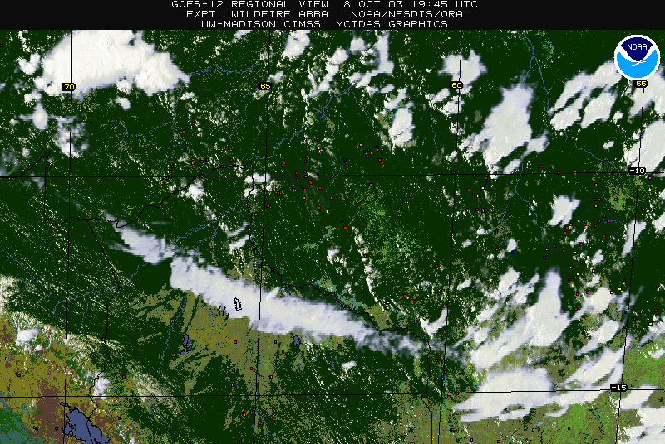
GOES Imager Products
Heavy Rainfall
High density winds
Fog/low cloud
In-flight Icing
Volcanic ash detection
Fire detection
Notes:
After this talk, Dr. Vilma Castro will talk about the GOES imager channels. Besides the individual channels, there are also products that are produced from either individual channels or combination of channels. We’ll be talking about many of these products throughout the course.

Slide 19
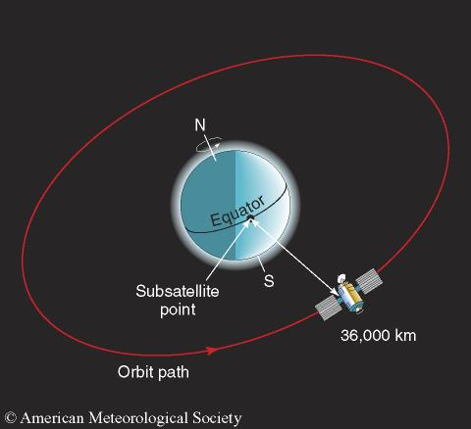
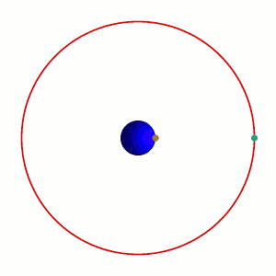
Geostationary Satellites for Weather
http://www.ssec.wisc.edu/data/geo/
http://www.rap.ucar.edu/weather/satellite/
http://www.ssec.wisc.edu/data/volcano.html

Slide 20
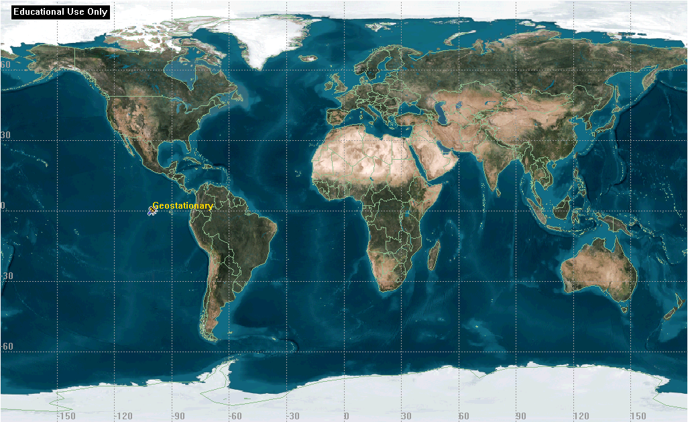
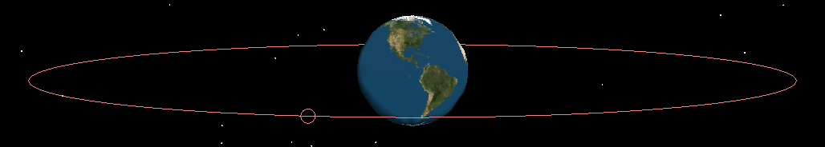
Geostationary

Slide 21
24/27 Satellites Used GPS
Global Positioning System
GPS Receiver Used in Search and Rescue Missions
GPS satellites orbit Earth in 12 hours
Notes:
5
5

Slide 22
Ground Tracks: Westward Regression
C
B
A
-120
-90
-60
-30
0
30
60
A - time zero B - after one orbit C - after two orbits
Notes:
6
6

Slide 23
Ground tracks: Inclination to equator
60
30
45N
0
30
60
45S
Inclination = 45 degrees Eccentricity ~ 0
Notes:
16
16

Slide 24
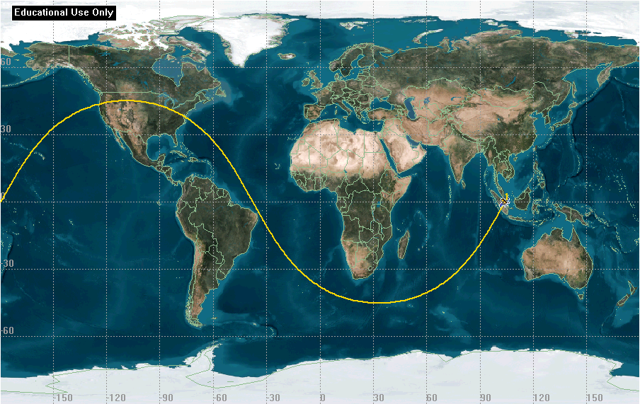
Ground Track of Geostationary orbit with 45⁰ angle to equator
Ground Track Slides Courtesy of Major David French

Slide 25
Ground Tracks: with eccentricity
Ground Track for Molnyia orbit eccentricity = .7252
Notes:
8
8

Slide 26
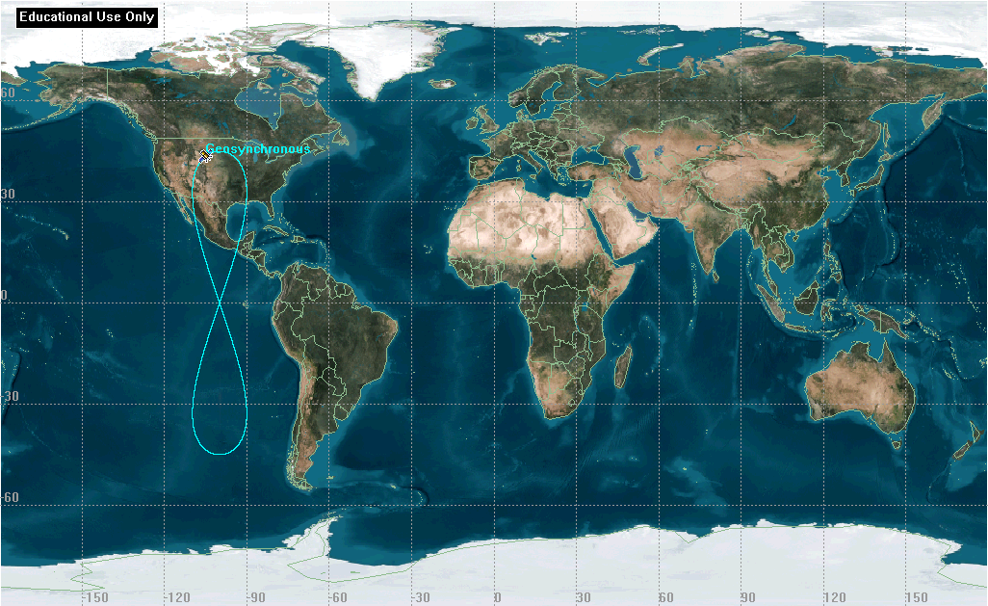
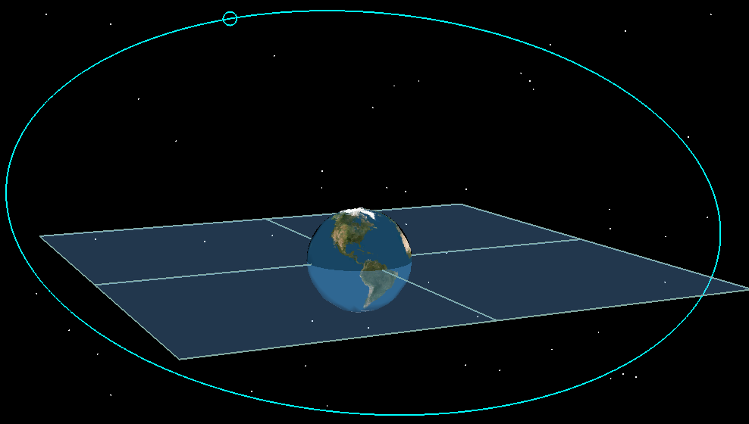
Geosynchronous

Slide 27
Geosynchronous
e = 0
e = 0.4
ω = 180°
e = 0
i = 0°
e = 0.6
ω = 90°

Slide 28
METEOROLOGICAL SATELLITES
For monitoring the environment, there are three types namely the:
  Weather satellites, GEO
  Meteorological climate research, Polar orbit
  Earth Resource satellites (ERS)
  Research and Development satellites (R&D).

Slide 29
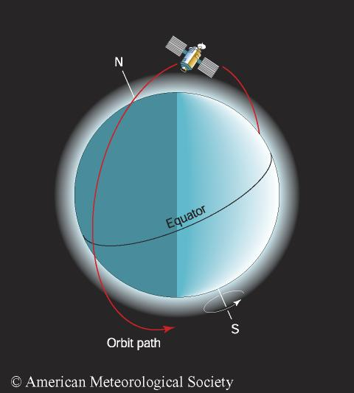
Orbit of a Polar-Orbiting Satellite
http://coastwatch.glerl.noaa.gov/modis/modis.cgi/modis?region=s&page=1

Slide 30
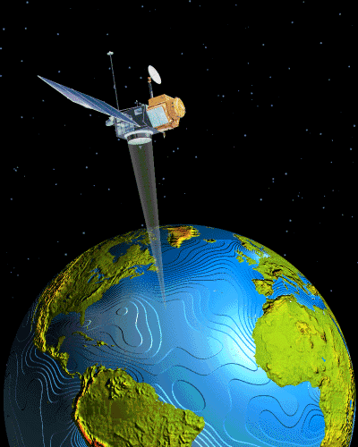
Polar Orbits are also called Monitoring satellites
LEO orbit at a height of about 500km (this is quite low!)
They take about 90 minutes to do one complete orbit.
These satellites are used to monitor things like climate research and enemy troop movements.

Slide 31
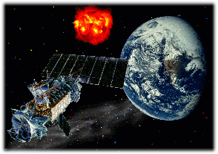
POES
Defense Meteorological Satellite Program (DMSP)
Sensors of interest
Special Sensor Microwave / Imager (SSM/I)
Special Sensor Microwave / Temperature (SSM/T) – Atmospheric Temperature Profiler
SSM/T2 – Atmospheric Water Vapor Profiler
http://dmsp.ngdc.noaa.gov/dmsp.html
Notes:
Microwave energy is referred to at various "frequencies" as opposed to "wavelengths." This terminology is commonly used by the remote sensing community.
Orbit – 860 km

Slide 32
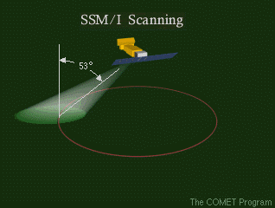
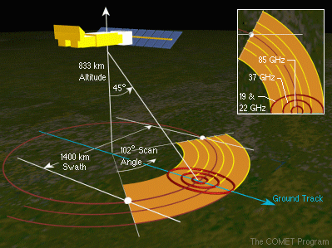
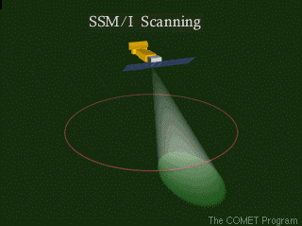
Conical Scanning –SSM/I
Polar Satellite Products for the Operational Forecaster – COMET CD
Notes:
The SSM/I is a conical scanning instrument, sweeping out consecutive 102-degree arcs perpendicular to the satellite's orbital track. The schematic shows that this results in an orbital swath approximately 1400 km wide, 64 percent of the swath of the AMSU.

Slide 33
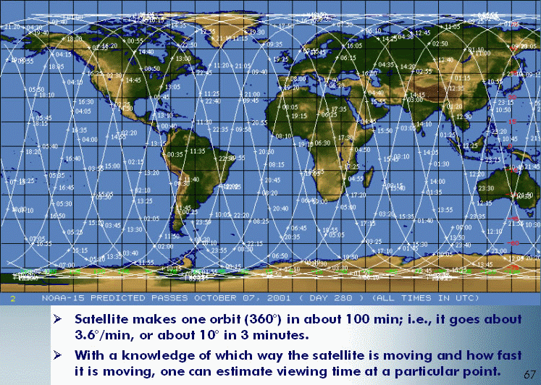
Orbital Coverage
Satellite makes one orbit (360°) in about 100 min; i.e., it goes about 3.6°/min, or about 10° in 3 minutes.
With a knowledge of which way the satellite is moving and how fast it is moving, one can estimate viewing time at a particular point.
Introduction to POES data and products – COMET/VISIT teletraining
Notes:
The AVHRR is a scanning radiometer – it makes calibrated measurements of upwelling radiation from small areas that are scanned across the sub-satellite track. Ground resolution at the end of scan is 2.3 x 6.4 km. The scan line angle from nadir is +/- 55.3 deg. And the distance is +/- 1500 km. Orbit of 850 km.

Slide 34
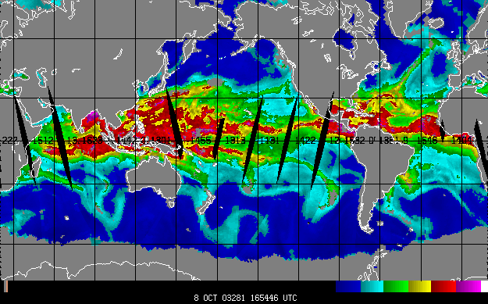
AMSU coverage (2200 km swath)
http://amsu.cira.colostate.edu/
Notes:
The AMSU orbital swath is approximately 2200 km wide. The composite of AMSU TPW swaths shows that this scanning leaves narrow gaps equator ward of 30 degrees north/south latitude.
Example image from Stan Kidder’s AMSU webpage at CIRA: http://amsu.cira.colostate.edu/

Slide 35
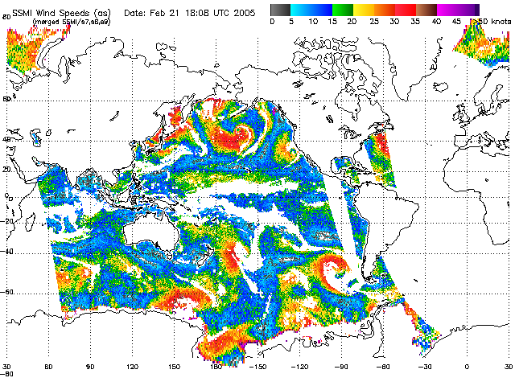
SSMI coverage (1400 km swath)
swath
Example from NOAA’s Marine Observing Systems Team Web Page
http://manati.orbit.nesdis.noaa.gov/doc/ssmiwinds.html

Slide 36
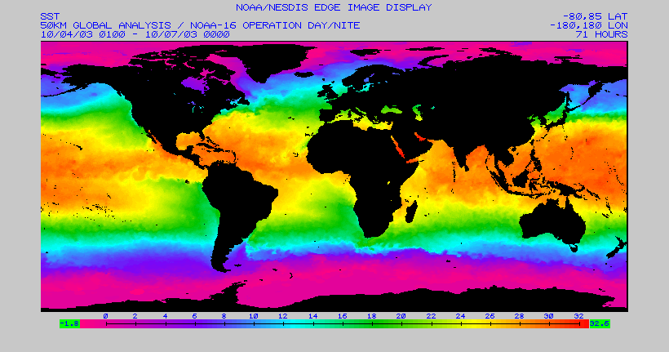
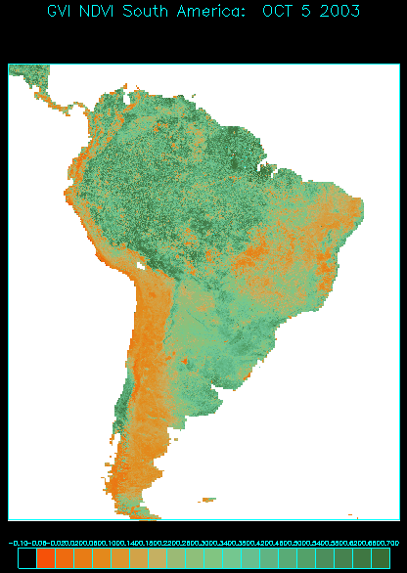
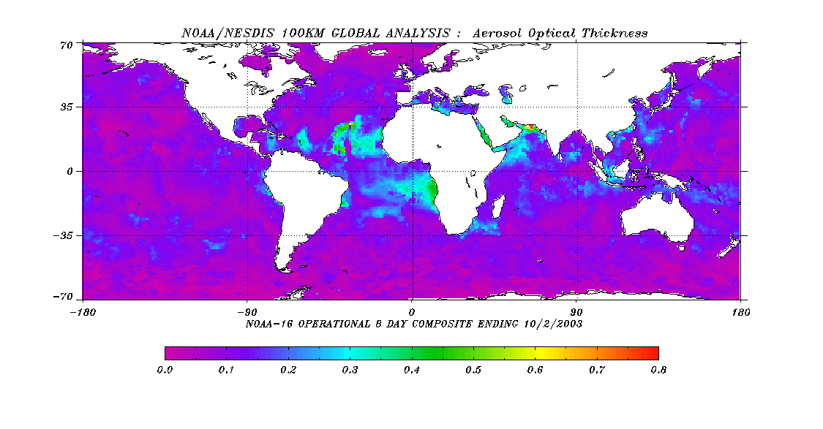
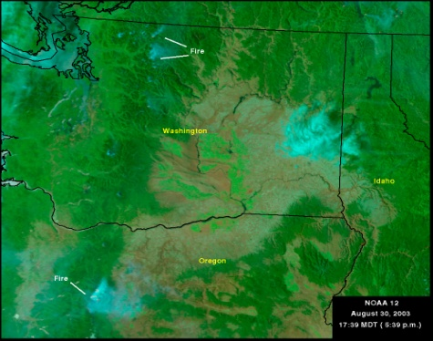
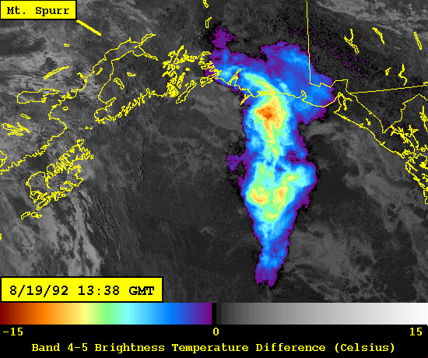
AVHRR Products
Sea Surface Temperature (SST)
Normalized Difference Vegetation Index (NDVI)
Atmospheric aerosols
Volcanic Ash detection
Fire detection
SST
NDVI
Aerosols
Fires
Volcanic Ash
Notes:
Sea Surface Temperature (SST) – gridded fields: daily 100-km (Global-Scale Analysis), bi-weekly 50 km (Regional Scale Analysis), biweekly 14 km (Local Scale)
NDVI is used to derive vegetation condition.
Good reference for products from the Office of Satellite Data Processing and Distribution: http://www.osdpd.noaa.gov/OSDPD/OSDPD_high_prod.html (That’s where I got pictures for the first 3 products.)
The fire image was obtained from the United States Department of Agriculture Forest Service Site that produces AVHRR Satellite Images: http://www.fs.fed.us/r4/rsgis_fire/index.html
The volcanic ash image was ‘borrowed’ from the tutorial: Polar Satellite Products for the Operational Forecaster

Slide 37

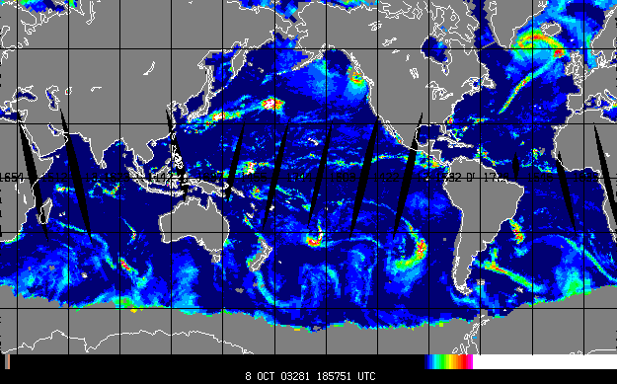
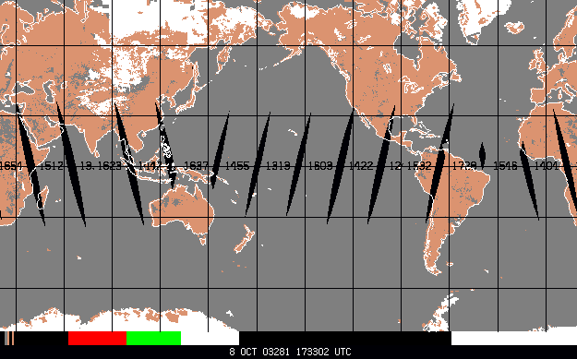
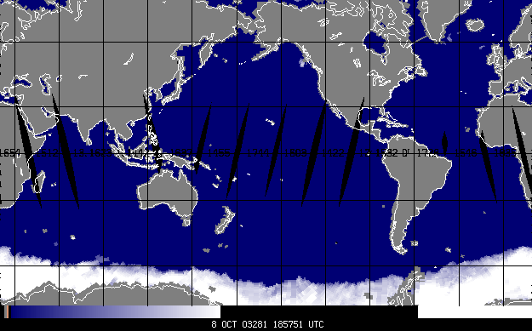
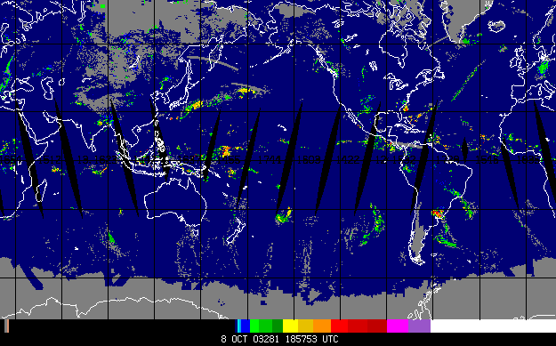
AMSU/SSMI Products
TPW
Total Precipitable Water (TPW)
Cloud Liquid Water (CLW)
Rain rate
Snow and Ice cover
CLW
Ice cover
Rain rate
Snow cover
http://amsu.cira.colostate.edu/
Notes:
Example images from Stan Kidder’s AMSU webpage at CIRA: http://amsu.cira.colostate.edu/

Slide 38
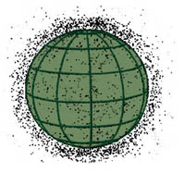
Space Debris
According to the U.S. Space Command (USSC), there are more than 8,000 objects larger than a softball now circling the globe.
Of these, over 2000 are satellites (working and not).

Slide 39
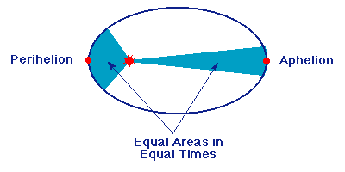
Diagram of Kepler’s Second Law
Equal Areas in Equal times: The line joining the planet to the Sun sweeps out equal areas in equal times as the planet travels around the ellipse.

Slide 40
ORBIT CLASSIFICATIONS
Eccentricity
e = 0.75
e = .45
e = 0
Eccentricity = c/a
Notes:
42
42

Slide 41
ORBITAL ELEMENTS
Keplerian Elements: Inclination
Equatorial Plane
Inclination ( i )
Orbital Plane
Notes:
62
62

Slide 42
PERTURBATIONS
Definition
  A disturbance in the regular motion of a satellite
Types
  Gravitational
  Atmospheric Drag
  Third Body Effects
  Solar Wind/Radiation Effects
  Electro-magnetic
Notes:
23
23

Slide 43
PERTURBATIONS
Gravitational: Libration
Ellipticity of the Earth causes gravity wells and hills
Stable points: 75E and 105W
-- Himalayas and Rocky Mountains
Unstable points: 165E and 5W
-- Marshall Islands and Portugal
Drives the requirement for station keeping
Notes:
29
29

Slide 44
PERTURBATIONS
Electro-Magnetic
Interaction between the Earth’s magnetic field and the satellite’s electro-magnetic field results in magnetic drag
Notes:
34
34

Slide 45
References:
http://coastwatch.glerl.noaa.gov/modis/modis.cgi/modis?region=s&page=1
http://www.ssec.wisc.edu/data/geo/
http://www.rap.ucar.edu/weather/satellite/
http://www.ssec.wisc.edu/data/volcano.html
Space Systems Loral, 1996 : GOES I-M DataBook
Can be found online at: http://rsd.gsfc.nasa.gov/goes/text/goes.databook.html
NOAA KLM User’s Guide http://www2.ncdc.noaa.gov/docs/klm/index.htm
NOAA/NESDIS Office of Satellite Operations: http://www.oso.noaa.gov/goes/index.htm
NOAA/NESDIS Office of Satellite Data Processing and Distribution http://www.osdpd.noaa.gov/

