Slide 1
Class Opener: What do these 3 Graphs show?
d
t
v
t
a
t

Slide 2
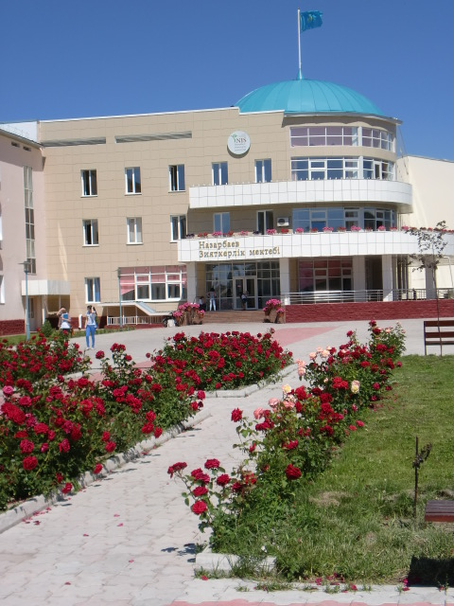
Kinematic Equations
Kinematics is the study of objects in Motion
Grade 11 Physics
NIS, Taldykorgan
Mr. Marty

Slide 3
Objectives:
Recall the definitions of position, distance, displacement, speed, velocity and acceleration and distinguish whether these are scalars or vectors.
Use the equations of motion involving distance/displacement, speed/velocity, acceleration and time in calculations and in interpreting experimental results.
Plot and interpret DTVA Graphs distance-time, velocity-time and acceleration-time graphs calculating the area under velocity-time graph to work out distance travelled for motion with constant velocity or constant acceleration.

Slide 4
Glossary- Kinematics
English | Definition | Russian | Kazakh
Position | The location of an object | Положение
Distance | A scalar of the total amount of motion | Расстояние
Displacement | A vector that connects initial and final position of a moving body | Перемещение
Speed | A scalar of how fast an object is moving | Скорость
Velocity | A vector of rate of change of displacement | Скорость
Acceleration | Rate of change of velocity | Ускорение
Gradient | The rate of change of an incline | Градиент, наклон

Slide 5
Scalars and Vectors
Scalar is a quantity that has only magnitude
Vector is a quantity that has magnitude and direction
Examples:
distance
time
mass
speed
area
work
energy
pressure
Examples:
displacement
velocity
acceleration
force
momentum
electric field strength

Slide 6
Learners should know the equations:
s = ½ (u+v)t
v = u +at
v² = u² +2as
s = ut + ½ at²
When 3 quantities are know the other 2 can be calculated
These equations only apply during constant acceleration (motion is one-dimensional motion with uniform acceleration).
When the acceleration is zero, s = ut.
Where:
s = final displacement (metres)
u = initial velocity (metres per second, ms⁻¹)
v = final velocity (ms⁻¹)
a = acceleration (metres per second per second, ms⁻²)
t = time taken (seconds, s)

Slide 7
Other symbols used in
General Kinematic Equations
Final velocity: v_{f} = v₀ + a(t)
Distance traveled: d = v₀ t + (½)at²
(Final velocity)²: v_{f}²= (v₀ t)² + 2ad
Distance traveled: d = [(v₀ + v_{f})/2]*t

Slide 8


Calculus formulas
Acceleration is the second derivative of displacement and velocity is the first derivative of displacement
Integration will
give the area under a curve

Slide 9
Slope of Distance-Time Graphs
Motion is described by the equation d = vt
The slope (gradient) of the DT graph = Velocity
The steeper the line of a DT graph, the greater the velocity of the body
1
d(m)
2
3
v₁ > v₂ > v₃
t(s)

Slide 10
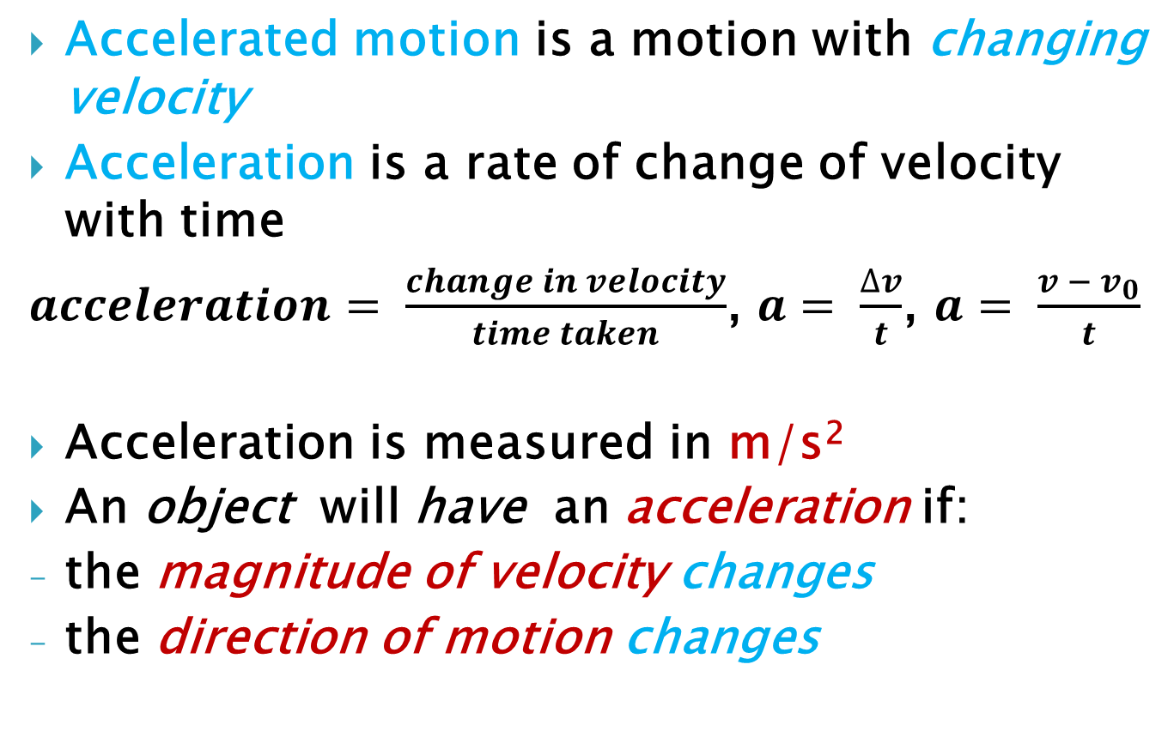
Accelerated Motion

Slide 11
Velocity-time Graphs
Uniform accelerated motion is a motion with the constant acceleration (a – const)
Slope (gradient) of the velocity –time graph
v(t) = acceleration
The steeper the line of the graph v(t) the greater the acceleration of the body
v(m/s)
1
2
3
t(s)
a₁ > a₂ > a₃

Slide 12
Graphing Negative Displacement
d
B
1 – D Motion
A
t
C
A … Starts at home (origin) and goes forward slowly
B … Not moving (position remains constant as time progresses)
C … Turns around and goes in the other direction
quickly, passing up home

Slide 13
Tangent Lines show velocity
d
t
On a position vs. time graph:
SLOPE | VELOCITY
Positive | Positive
Negative | Negative
Zero | Zero
SLOPE | SPEED
Steep | Fast
Gentle | Slow
Flat | Zero

Slide 14
Increasing & Decreasing Displacement
d
t
Increasing
Decreasing
On a position vs. time graph:
Increasing means moving forward (positive direction).
Decreasing means moving backwards (negative direction).

Slide 15
Concavity shows acceleration
d
t
On a position vs. time graph:
Concave up means positive acceleration.
Concave down means negative acceleration.

Slide 16
Special Points
d
Q
P
R
t
S
Inflection Pt. | P, R | Change of concavity
Peak or Valley | Q | Turning point
Time Axis Intercept | P, S | Times when you are at “home”

Slide 17
Curve Summary
d
B
C
t
A
D

Slide 18
All 3 Graphs
d
t
v
t
a
t

Slide 19
Graphing Tips
d
t
v
t
Line up the graphs vertically.
Draw vertical dashed lines at special points except intercepts.
Map the slopes of the position graph onto the velocity graph.
A red peak or valley means a blue time intercept.

Slide 20
Graphing Tips
The same rules apply in making an acceleration graph from a velocity graph. Just graph the slopes! Note: a positive constant slope in blue means a positive constant green segment. The steeper the blue slope, the farther the green segment is from the time axis.
v
t
a
t

Slide 21
Real life
Note how the v graph is pointy and the a graph skips. In real life, the blue points would be smooth curves and the green segments would be connected. In our class, however, we’ll mainly deal with constant acceleration.
v
t
a
t

Slide 22
Area under a velocity graph
v
“forward area”
t
“backward area”
Area above the time axis = forward (positive) displacement.
Area below the time axis = backward (negative) displacement.
Net area (above - below) = net displacement.
Total area (above + below) = total distance traveled.

Slide 23
Area
v
“forward area”
t
“backward area”
The areas above and below are about equal, so even though a significant distance may have been covered, the displacement is about zero, meaning the stopping point was near the starting point. The position graph shows this too.
d
t

Slide 24
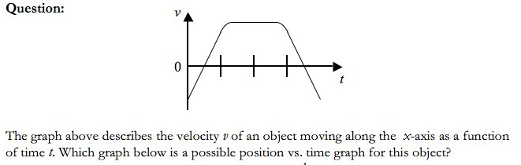
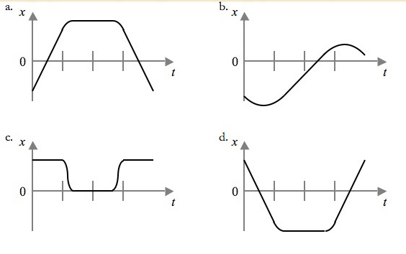
Example from AP Physics

Slide 25
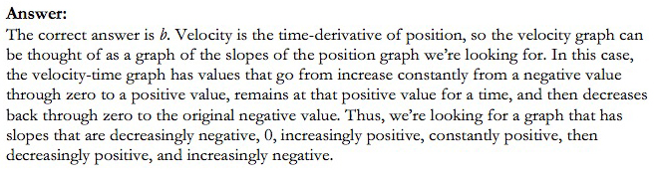
Answer B Explained:

Slide 26
References:
http://www.thestudentroom.co.uk/wiki/Revision:Kinematics_-_Equations_of_Motion_for_Constant_Acceleration
https://www.csun.edu/science/credential/cset/cset-physics/ppt/kinematics-graphing.ppt
http://www.learnapphysics.com/index.html

