Slide 1
Lesson Opener:
Make 4 small groups and discuss an answer to the question you are given
Have a spokesperson present a summary of your conclusion.

Slide 2
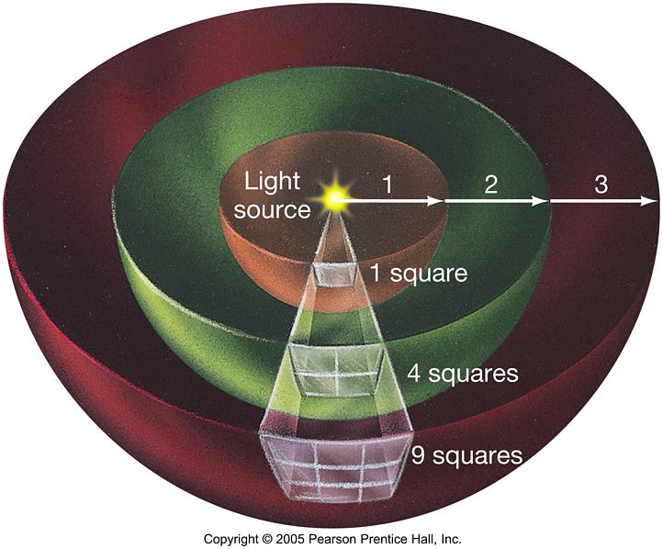
Gravity and Inverse Square Relationships
NIS, Taldykorgan
Grade 11 Physics

Slide 3
Lesson Objectives:
Define Gravitational Field and Gravitational Potential
define potential at a point as the work done in bringing unit mass from infinity to the point
2. Determine the potential of a point mass in a field
solve problems using the equation for ’V’ =‘ φ’ = ‘ϕ’ = phi , the potential in the field of a point mass is ϕ=-GM/r
3. Show an understanding of geostationary orbits and their application and derive the expression for escape velocity
analyze circular orbits in inverse square law fields by relating the gravitational force to the centripetal acceleration it causes
Contrast the graphs of φ ≈ 1 / r, and g ≈ 1/r²

Slide 4
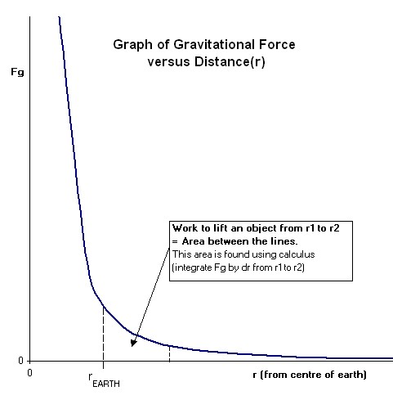
Newton’s Law of Universal Gravitation
Is an Inverse Square Relationship (ISR) where Force is inversely proportional to the square of the radius (or distance) between the center of mass of two objects.

Slide 5
What Does Inverse “R” Squared Mean?
Light will spread out across an area as the distance grows linearly!
As the distance goes up the amount of light down.
The energy, light, or gravitational strength decreases as the distance “Radius” gets bigger by a power of 2, “R squared”.

Slide 6
Effect of Mass and Distance on Gravitational Force

Slide 7
Nonuniform Gravitational Fields
Near Earth’s surface the gravitational field is approximately uniform. Far from the surface it looks more like a sea urchin.
The field lines
are radial, rather than parallel, and point toward center of Earth.
get farther apart farther from the surface, meaning the field is weaker there.
get closer together closer to the surface, meaning the field is stronger there.
Earth

Slide 8
Equipotential Lines Around Earth

Slide 9
Diagram showing field lines and equipotential surfaces

Slide 10
Gravitational Potential
Defined as ‘φ’ or work done measure in Joules
mass kg
Work done on a unit of mass in a gravitation field by bringing that mass from infinity
Allows for easier accounting of work and energy in a field where force varies with distance
Has the units of Joules per kilogram
Is a scalar quantity
At infinity Potential is zero, therefore Potential is always negative

Slide 11
V=ϕ=-GM/r Potential becomes Zero at Infinity
How do we get this expression?

Slide 12
Advanced Students: Integration will give the are under the curve which is work done on the mass

Slide 13
Work done by the mass= -mΔV
And work done by the mass is
force times distance moved so
mgΔr = -mΔV

Slide 14
Combining equations and calculus for ‘g’ gives the general formula of ‘V’
Two equations for ‘g’ and
Combining
Integrating and solving for V
Notes:
Potential is always represented as a difference, there is nothing like an absolute potential, only the difference between the potential at one location and the potential at another.

Slide 15
Notes:
The higher you try to get above the earth's surface, the more energy it is going to take. Thus, without a lot of energy (read: spaceship fuel) you will never get very far off the earth. Worse yet, just getting to a particular height without gaining the necessary tangential velocity for orbiting you will just fall back down to the surface again. That is, unless you go so fast that you "escape" earth's gravity well altogether — represented on the graph by the dotted line at the top. Source: http://psas.pdx.edu/orbit_intro/

Slide 16
Escape Velocity

Slide 17
Deriving Escape Velocity:
We can calculate the energy necessary to escape earth's gravity well completely.
Gravitational Potential (Φ):
There G is the universal gravitational constant; M is the mass of the earth and r is the distance from the center of the earth.
We want to find the difference in potential of an object at infinity (i.e., it has escaped earth forever) and at the surface of the earth. Using r₀ as the radius of the earth can write this difference as
Since the 1/∞ term will go to 0 we find the potential needed to escape earth is
Notes:
Reference: http://psas.pdx.edu/orbit_intro/

Slide 18
Deriving Escape Velocity:
Gravitational potential energy is the same as gravitational potential per unit mass. The speed you would need to have enough energy to escape earth's gravity well is called escape velocity To find this number we set the potential energy equal to kinetic energy.
The mass of the object m cancels out as expected because the escape velocity should be the same for all objects. Solving for v we get
Substituting our escape potential we get
Plugging in numbers we find the escape velocity to be 11,181 m/s or about 25,011 mph.
Notes:
Reference: http://psas.pdx.edu/orbit_intro/

Slide 19
Geostationary Satellites

Slide 20
Information on Geostationary Satellites
For a satellite to be in a particular orbit, a particular velocity is required or a given height above Earth ‘r_{0+h}’.
Telecommunications satellites remain above one given point on the Earth’s surface, so are called geostationary.
Spy Satellites move in a polar orbit so that they can perform sweeps of the surface.

Slide 21
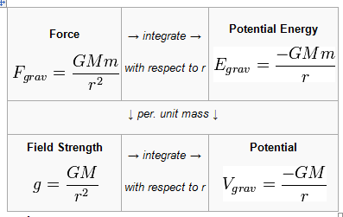
Formulae for calculating satellite orbits
ω = 2πf;
v = ωr;
a = ω²r
a=v²/r → v²=ar
v=2πr/T
g=GM/r²
V=-GM/r

Slide 22
References:
Giancoli , Physics: Principles with Applications, 6th edition
http://kilby.sac.on.ca/physics/sph4u/3-Fields/GravEnergy.htm
http://www.antonine-education.co.uk/Pages/Physics_4/Fields/FLD_02/Fields_page_2.htm
http://www.physicsclassroom.com/class/circles/u6l3c.cfm
http://hyperphysics.phy-astr.gsu.edu/hbase/gpot.html
http://blog.superprincipia.com/2012/01/16/a-theory-of-gravity-for-the-21st-century-the-gravitational-force-and-potential-energy-in-consideration-with-special-relativity-general-relativity/

