Slide 1
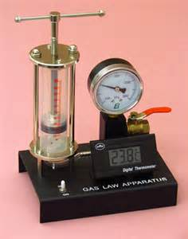
Gas Temperature, Volume, and Pressure
This tool can measure the temperature, volume, and pressure of a gas

Slide 2
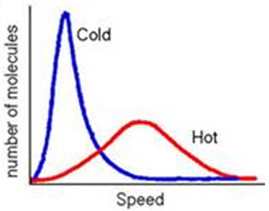
What is temperature?
All particles in all things are moving at all times, but some faster than others
Temperature measures the average speed of the particles in something
Some of the particles move faster or slower than the average, as shown in this diagram

Slide 3
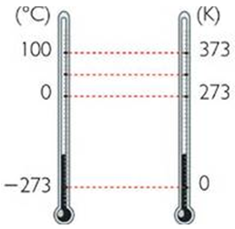
Kelvin Temperature Scale
The Kelvin scale of temperature (K) is just like the Celsius scale (⁰C), 0 K is absolute zero.
0 K=-273 ⁰C
The Kelvin scale, not the Celsius scale, is used when doing math problems
This picture shows how the Celsius scale is related to the Kelvin scale

Slide 4
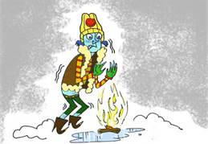
Absolute Zero Temperature
Absolute zero (0 K) is the coldest possible temperature. It is the temperature at which all movement stops
Scientists have made temperatures very close to absolute zero, but it is thought that absolute zero can never be reached
Absolute Zero is much colder than this

Slide 5
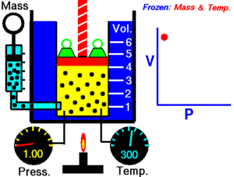
Review Boyle’s Law
Boyle’s Law shows how the pressure of a gas changes with volume (or volume with pressure)
P₁V₁=P₂V₂

Slide 6
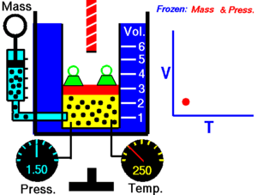
Charles’s Law
Charles’s Law shows how the volume of a gas changes with temperature (or temperature with volume)
V₁ V₂
T₁ T₂
=

Slide 7
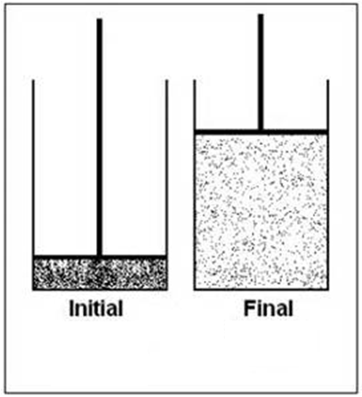
Question:
The pressure does not change.
2 L
200 K
10 L
1000 K
What is the final temperature?

Slide 8
The Ideal Gas Law
The Ideal Gas Law combines Boyle’s Law, Charles’s Law, and the number of particles (atoms or molecules) into one equation
(Ideal means “perfect”)
P₁V₁ P₂V₂ (n is the number of particles)
n₁T₁ n₂T₂
=

Slide 9
Ideal Gas Law Assumptions
An assumption is something taken as true in a certain situation
The Ideal Gas Law assumes a few things about the particles in a gas
These assumptions are usually very close to being true, but are never completely true
That’s why it’s called the “Ideal” Gas Law instead of the “Real” Gas Law

Slide 10
Question:
You are at the top of a mountain where the pressure is 0.5 atm and the temp. is 200 K. You put 2 L of air into a balloon and then take it down the mountain. Along the way, half of the air leaks out of the balloon. At the bottom of the mountain the pressure is 1 atm and the temp. is 300 K. What is the new volume?
Answer: 0.75 L

