Slide 1
Acceleration
Graphs and Problems

Slide 2
a. A car is moving eastward along Lake Avenue and increasing its speed from 25 mph to 45 mph.
b. A northbound car skids to a stop to avoid a reckless driver.
c. An Olympic diver slows down after splashing into the water.
d. A southward-bound free kick delivered by the opposing team is slowed down and stopped by the goalie.
e. A downward falling parachutist pulls the chord and rapidly slows down.
f. A rightward-moving Hot Wheels car slows to a stop.
g. A falling bungee-jumper slows down as she nears the concrete sidewalk below
For each sentence determine the direction of acceleration.
As a general rule
if object is increasing speed acceleration is in the same direction as motion
if object is slowing down acceleration is in the opposite direction

Slide 3
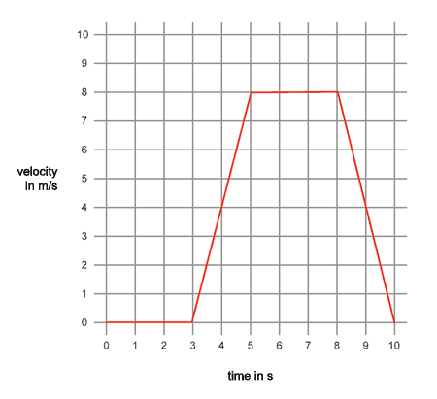
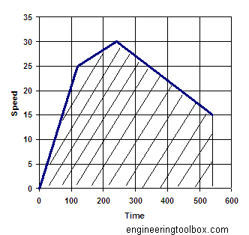
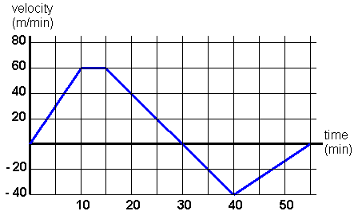
Representing acceleration graphically
Describe the motion indicated by the graphs.

Slide 4
Examples - calculating Acceleration
The velocity of the aircraft is reduced from 100 m/s[S] to 40 m/s[S] in 8 s. Find it’s average acceleration.

Slide 5
example 2
A truck is moving east at a speed of 20 m/s. The driver presses on the gas pedal and truck accelerates at the rate of 1.5 m/s² [E] for 7 seconds. What is the final velocity of the truck?

Slide 6
example 3
A truck is moving east at a speed of 30 m/s. The driver presses on the brake pedal and truck accelerates at the rate of 4.5 m/s² [W] for 5 seconds. What is the final velocity of the truck?

Slide 7
Kinematic Equations - found in Motion text section 2.5
, always true
, always true
, constant acceleration only
, constant acceleration only
, constant acceleration only
, constant acceleration only
d
d

Slide 8
example 4- finding average velocity
A motorcycle accelerates uniformly from +40 ft/s to +120 ft/s in 7 seconds. Find the average velocity
use v_{avg} - ½(v_{i} + v_{f}). this only works if acceleration is constant and uniform.

Slide 9
example 5
A car is moving at +25 m/s. It then accelerates at a rate of 1.5 m/s² for 10 s. Find it’s final velocity.

Slide 10
example 6
A sports car accelerates from +20 m/s to +50 m/s while covering a distance of + 2km. Find it’s acceleration.

Slide 11
example 7
A jet accelerates from a velocity of +50 m/s to a velocity of +120 m/s while having a displacement of +1200 meters. How long did it take to reach this velocity?

