Slide 1
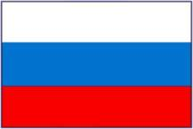
Pictures of
R U S S I A
Russia’s National Anthem

Slide 2
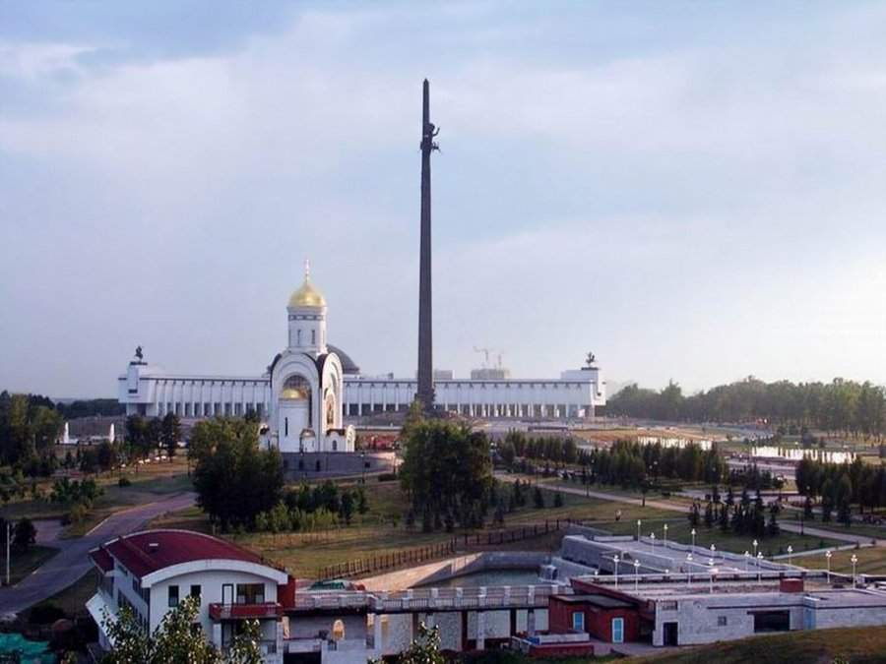
Moscow – Russia

Slide 3
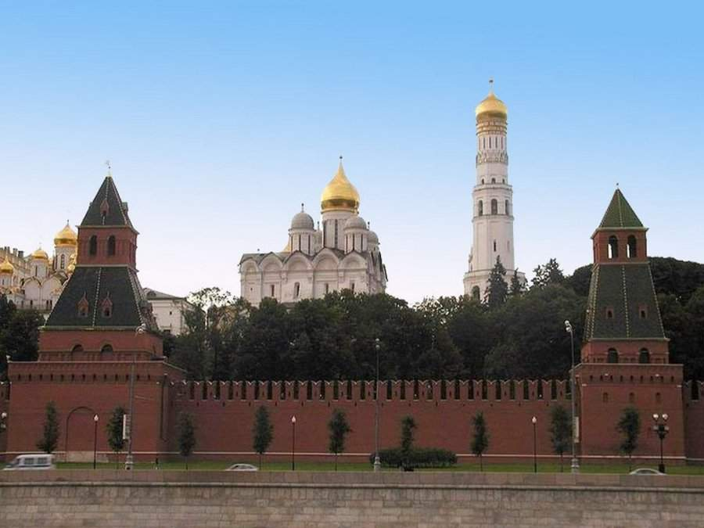
Moscow – Russia

Slide 4
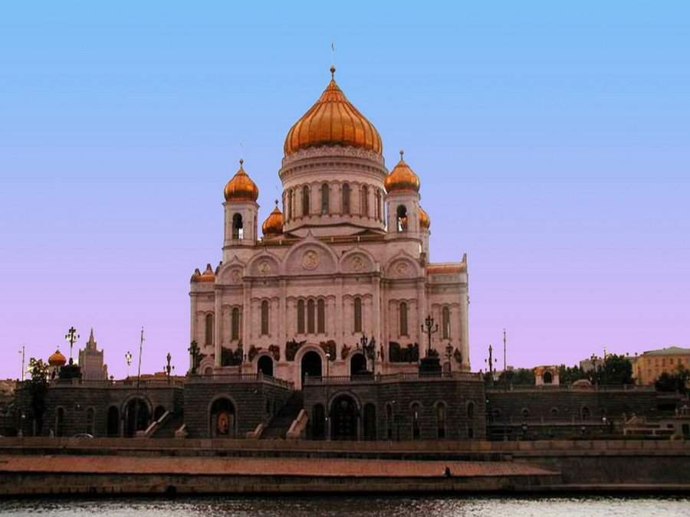
Moscow – Russia

Slide 5
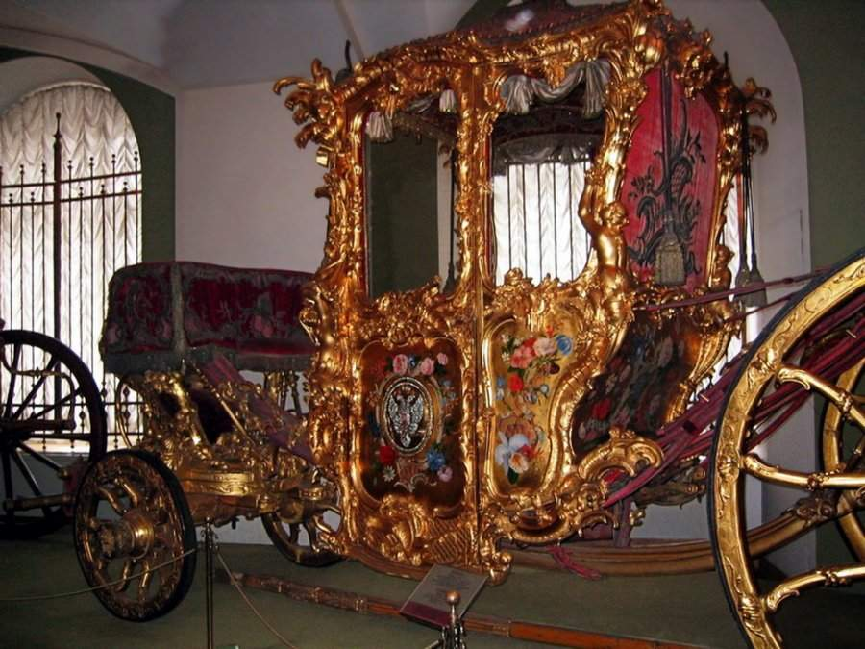
Imperial Chariot. Moscow Museum

Slide 6
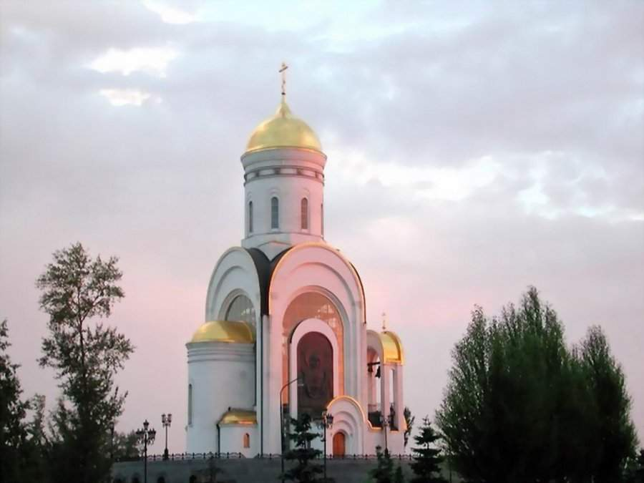
Moscow – Russia

Slide 7
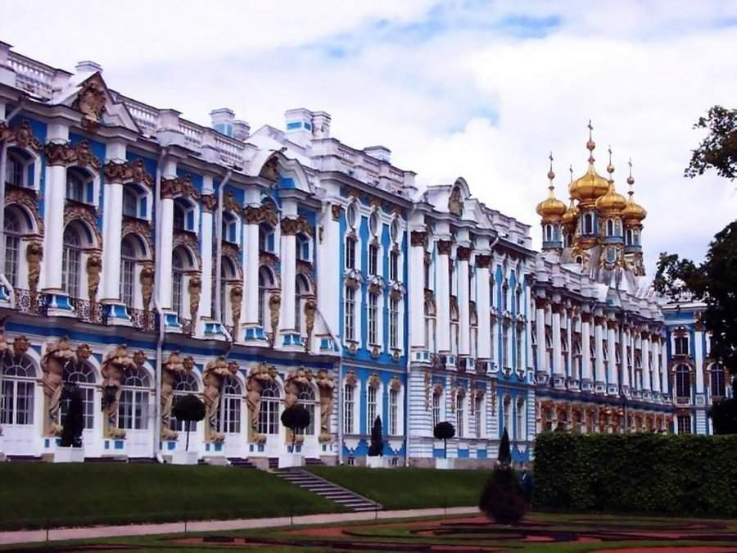
Royal Palace of Catherine the Great - Saint Petersburg - Russia

Slide 8
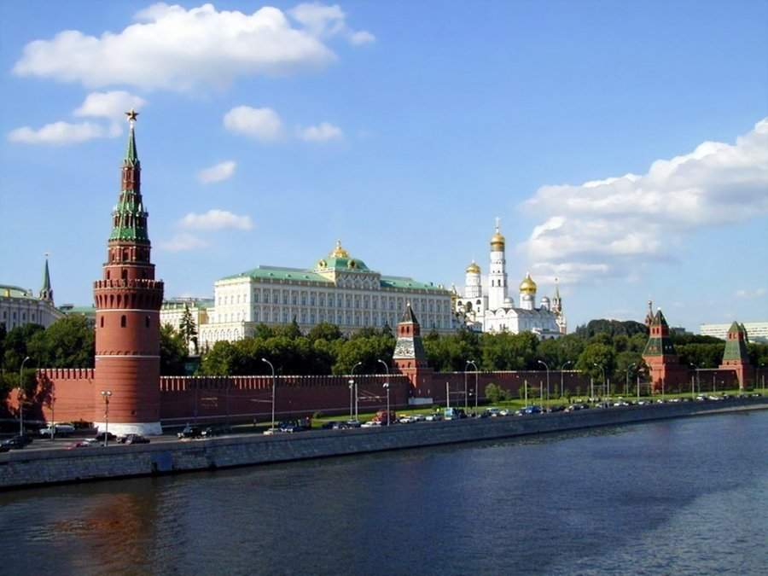
Czar's Palace in the Kremlin

Slide 9
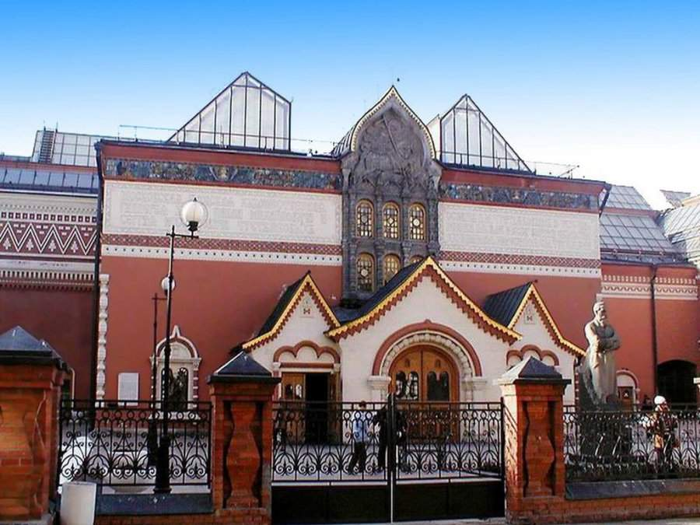
Moscow – Russia

Slide 10
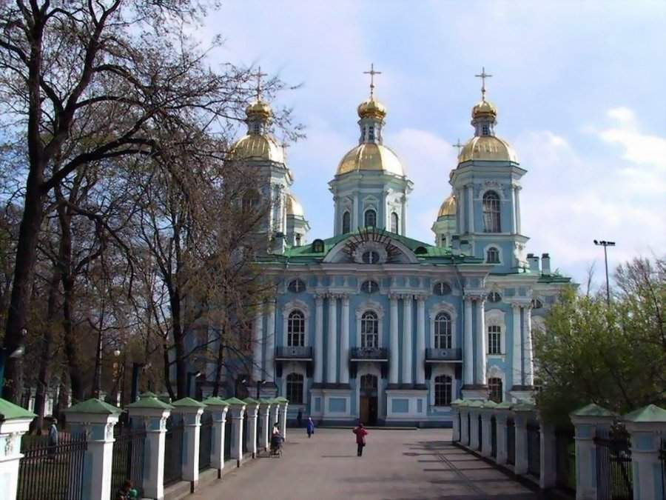
St. Nicholas Cathedral - St. Petersburg - Russia

Slide 11
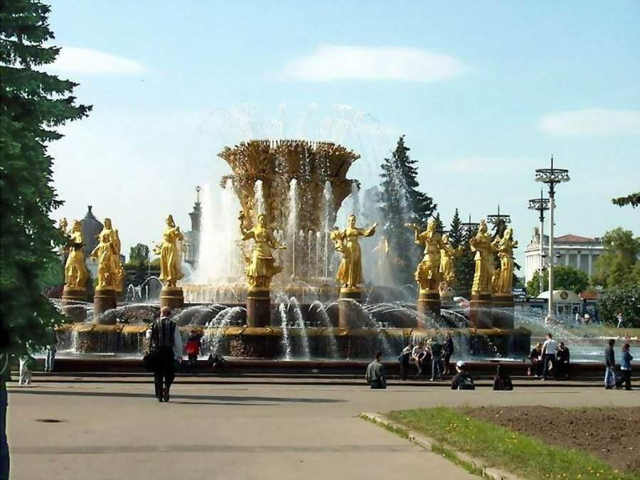
The Dorada Fountain- Moscow

Slide 12
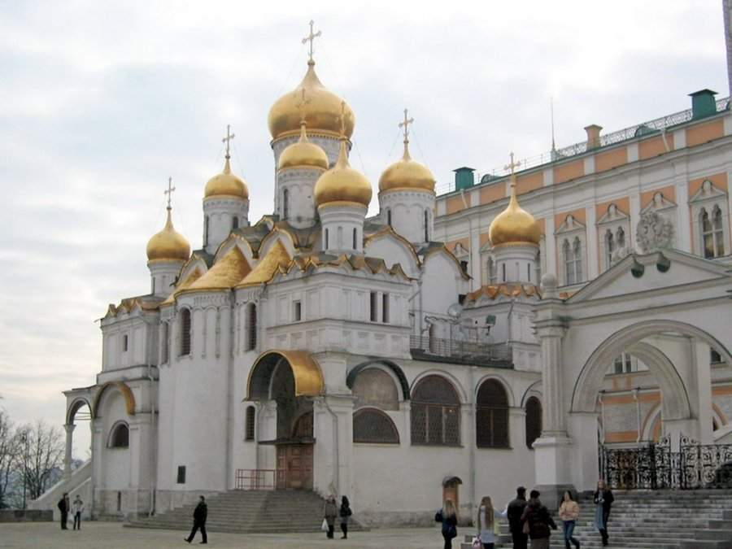
Cathedral of the Annunciation. Moscow

Slide 13
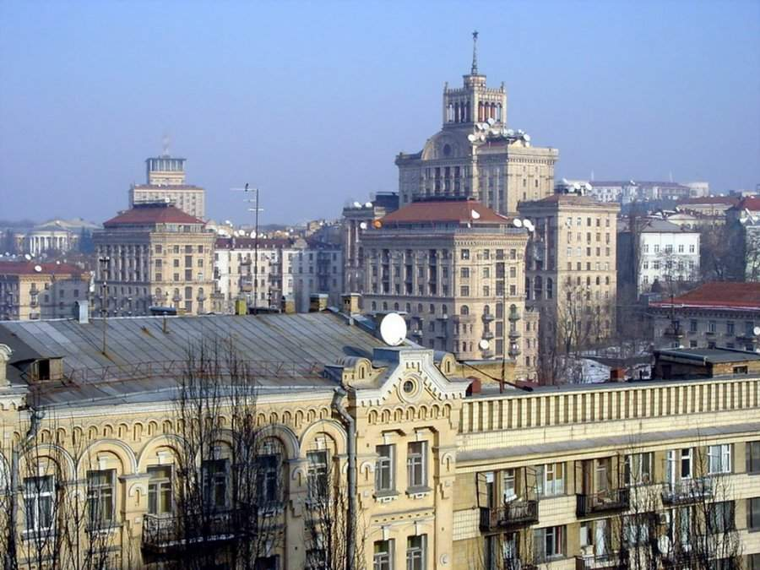
View of Kiev. Ukraine

Slide 14
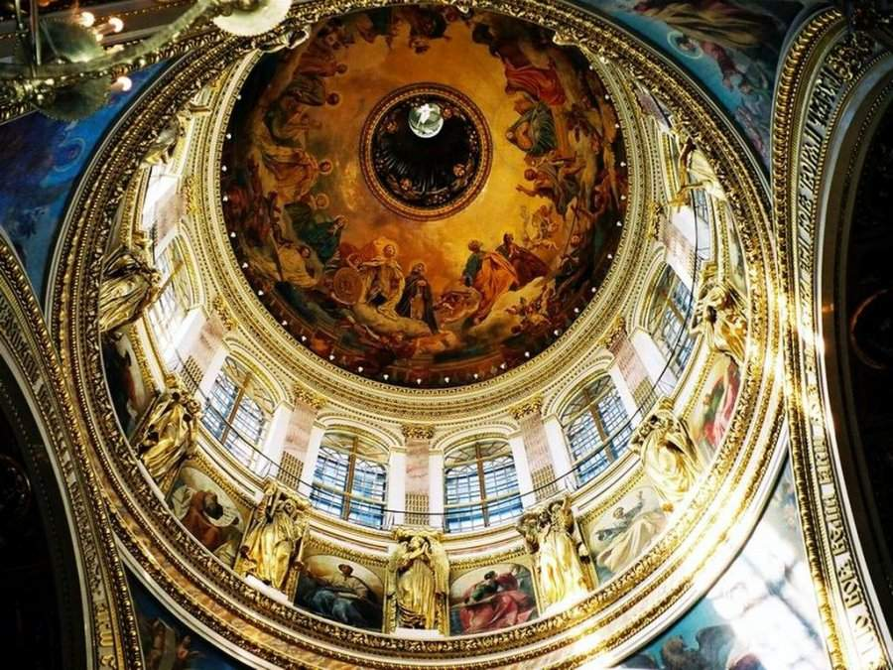
Ceiling of the Cathedral of St. Isaac. St. Petersburg

Slide 15
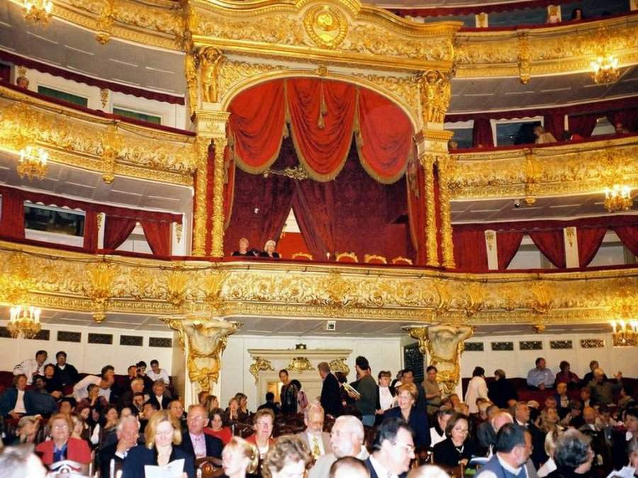
Interior of the Bolshoi Theater. Moscow

Slide 16
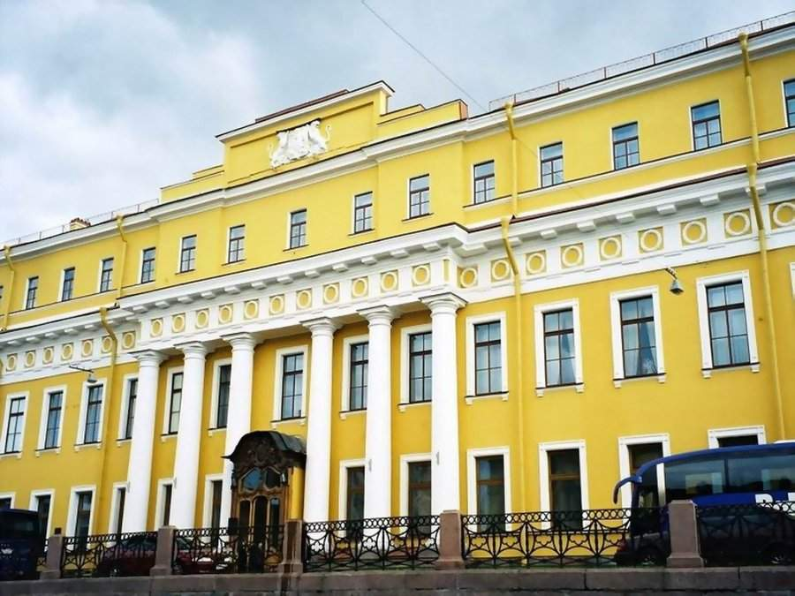
Yusupov Palace. St. Petersburg

Slide 17
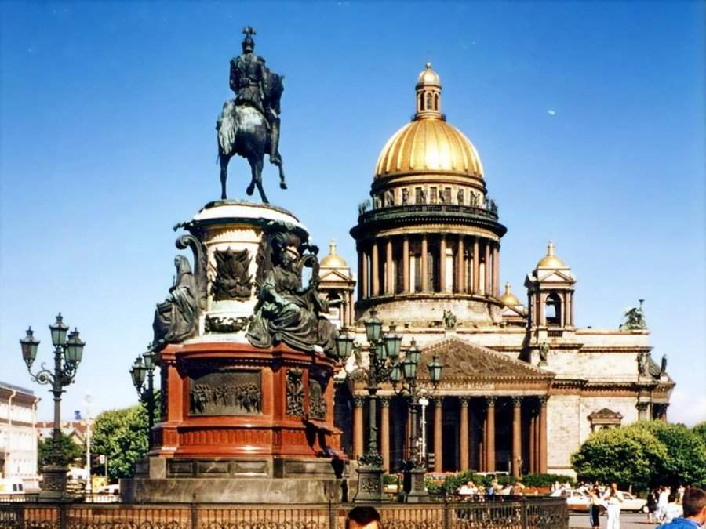
St. Isaac's Cathedral. St. Petersburg

Slide 18
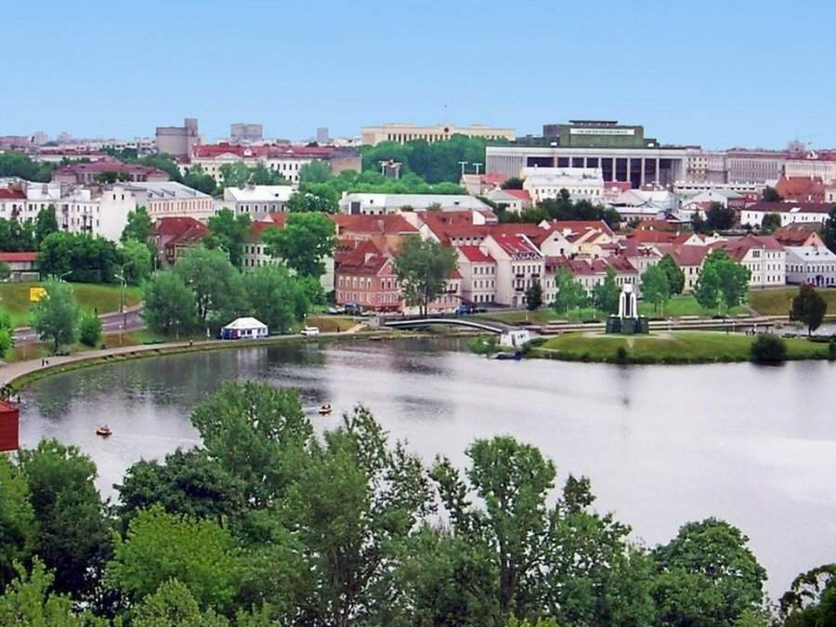
Russian city

Slide 19
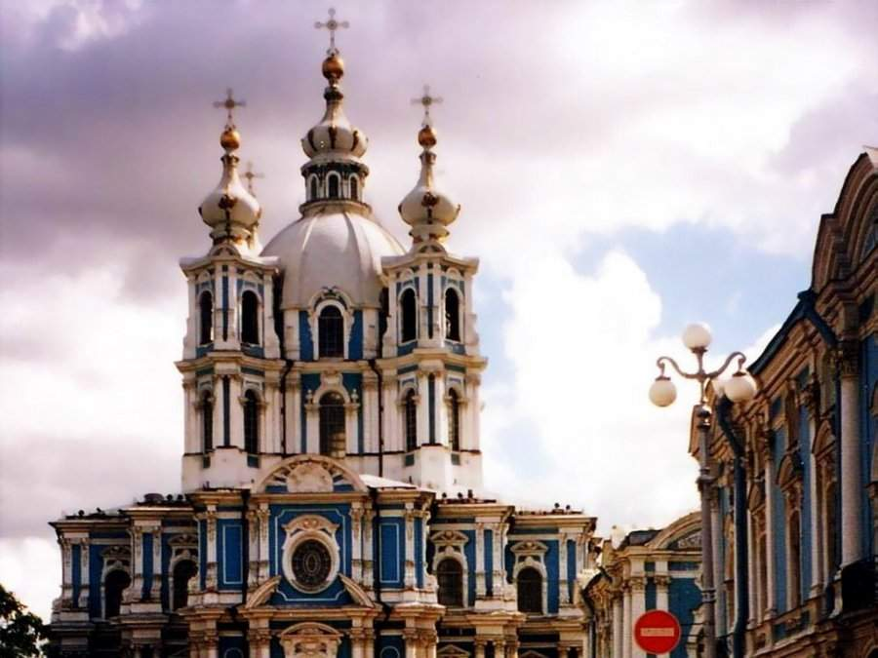
The Smolny Cathedral, St. Petersburg

Slide 20
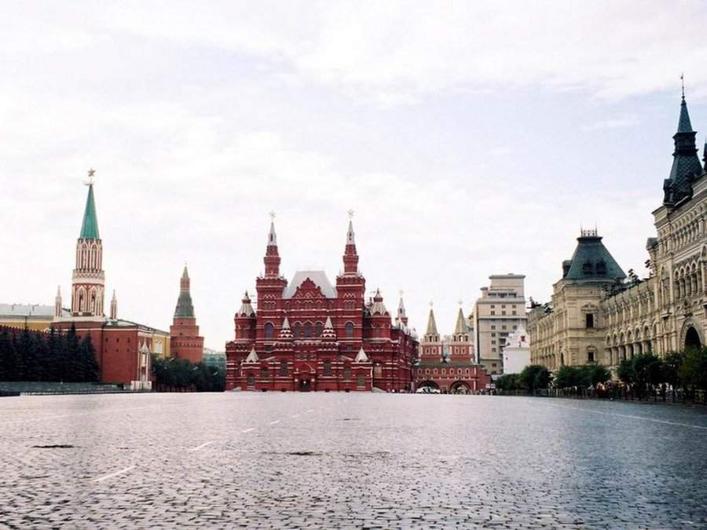
Red Square. Moscow

Slide 21
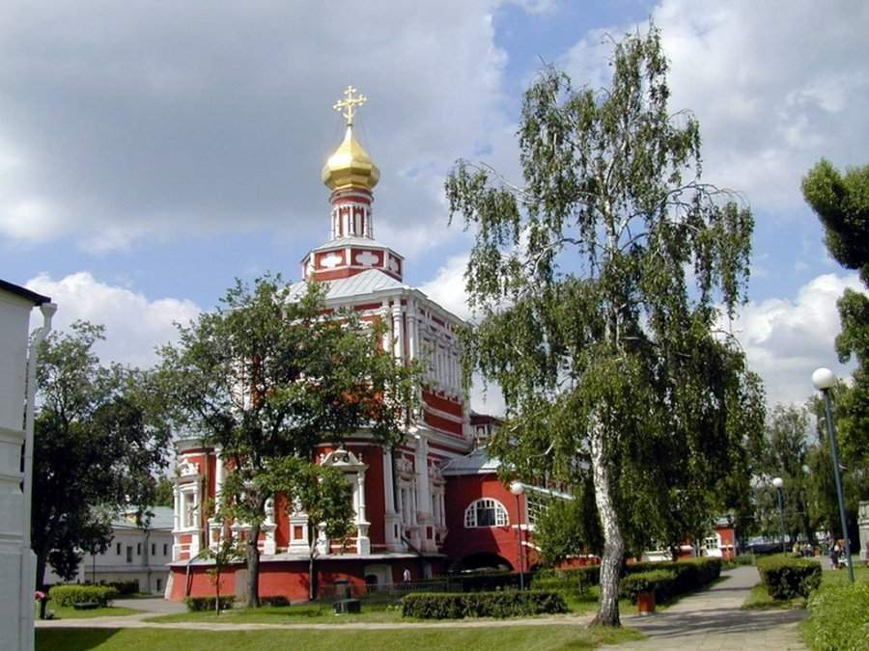
Novodevichy Convent, Moscow

Slide 22
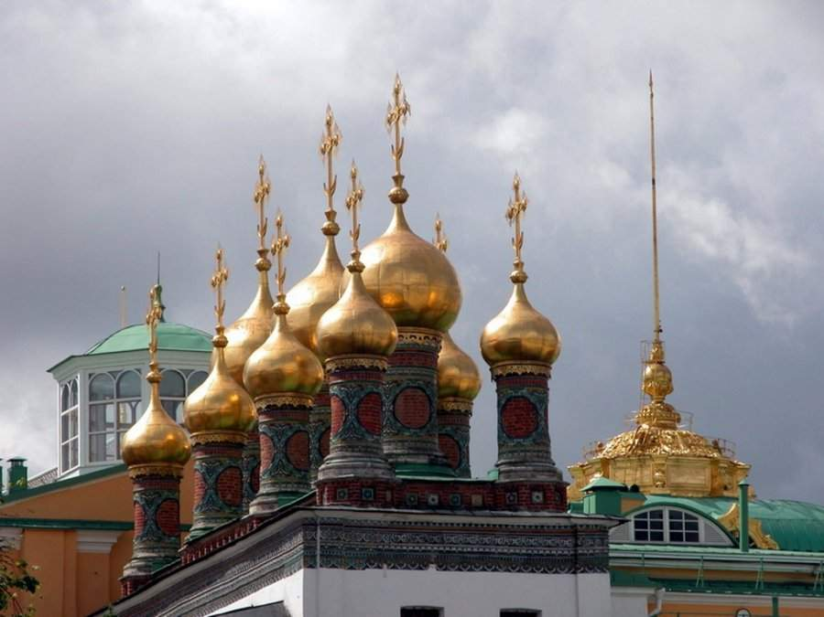
Domes. Moscow

Slide 23
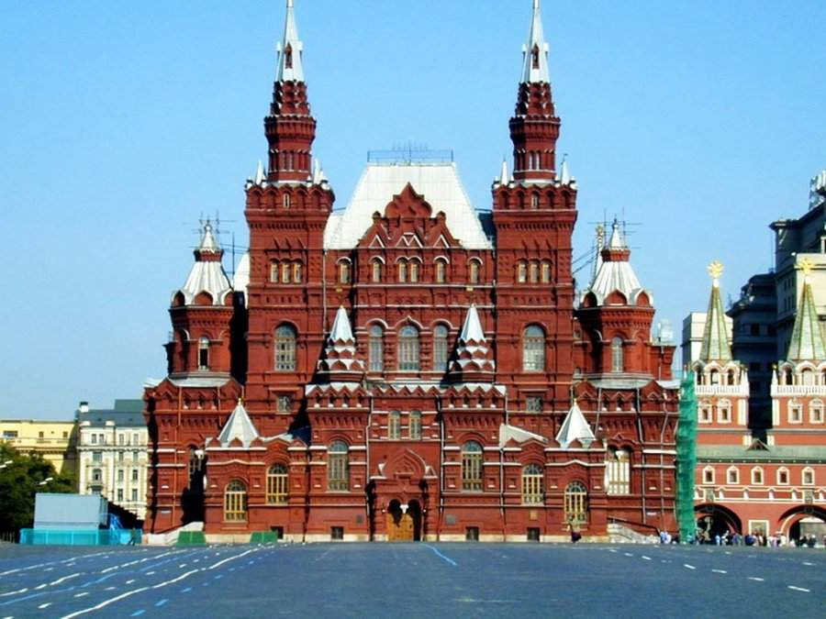
Basilica in Red Square. Moscow

Slide 24
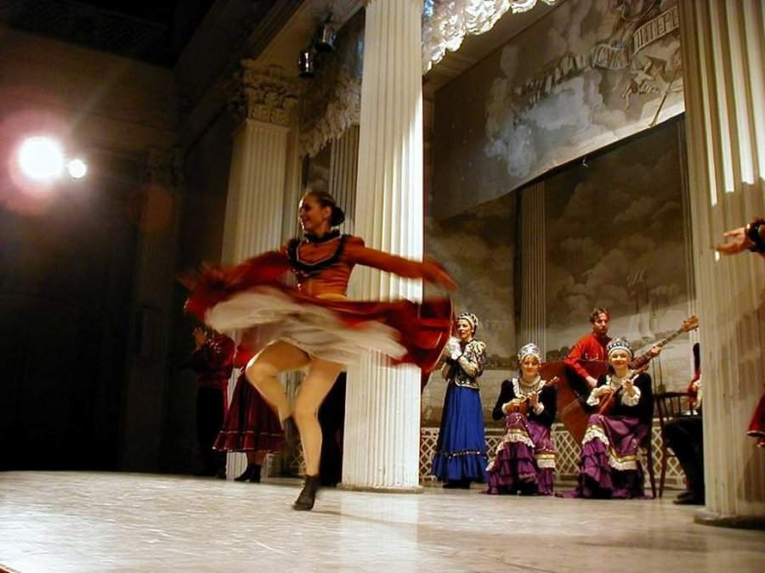
Russian Folklore

Slide 25
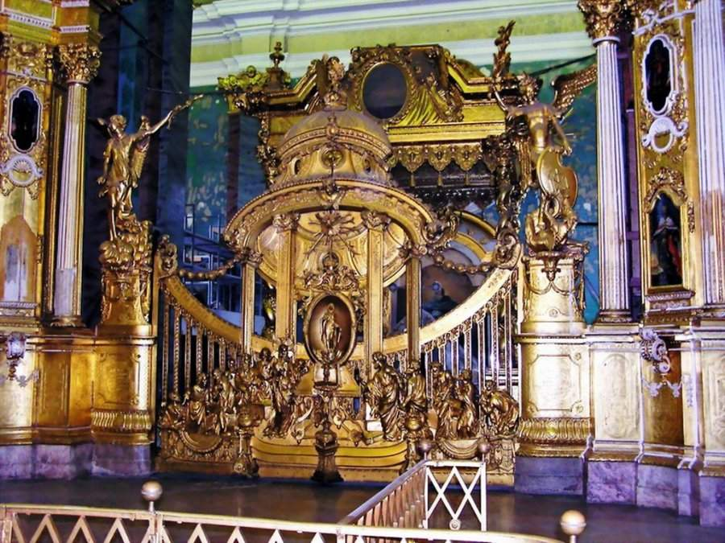
Interior of the Basílica

Slide 26
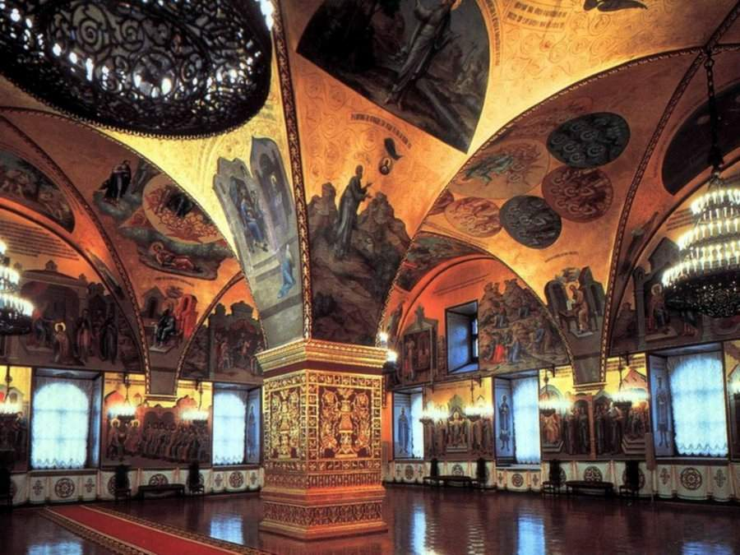
Interior of the Kremlin

Slide 27
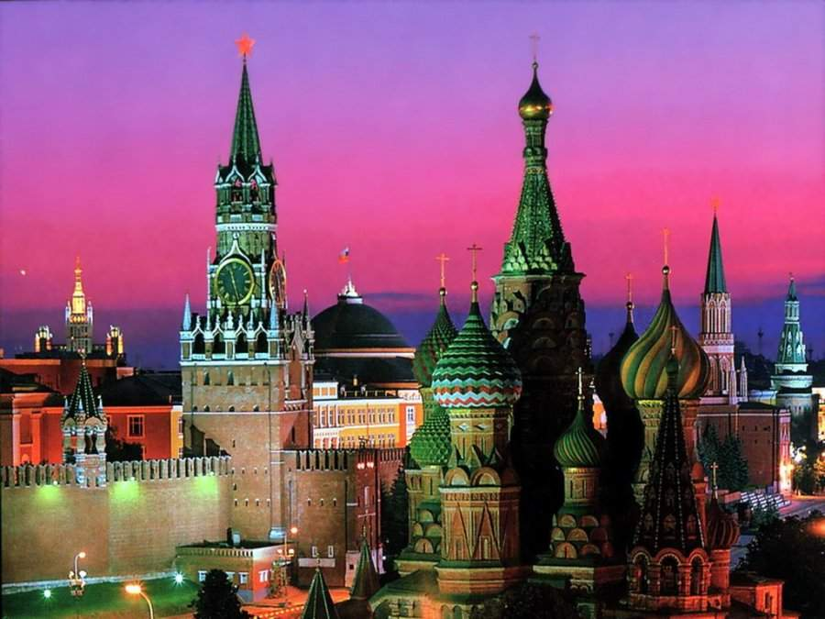
The Kremlin at night

Slide 28
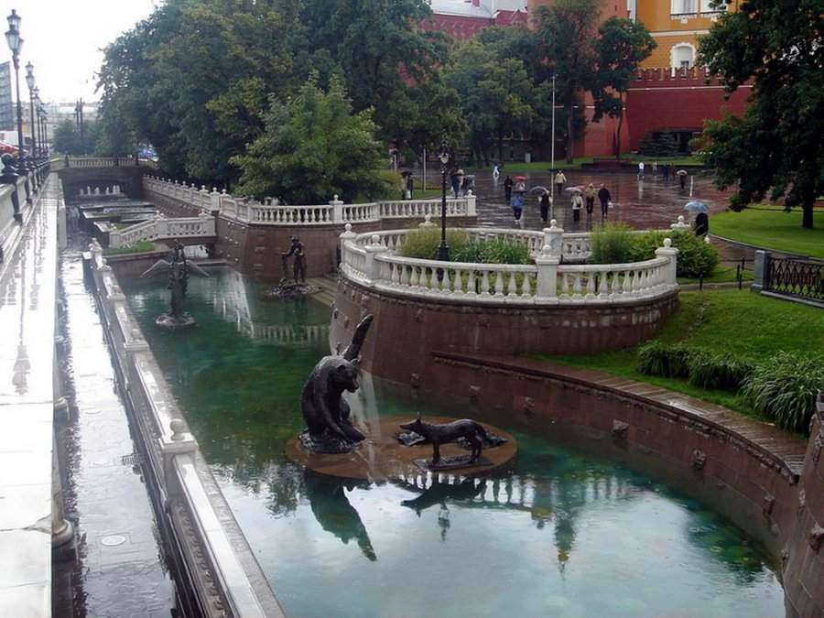
Moscow in summer

Slide 29
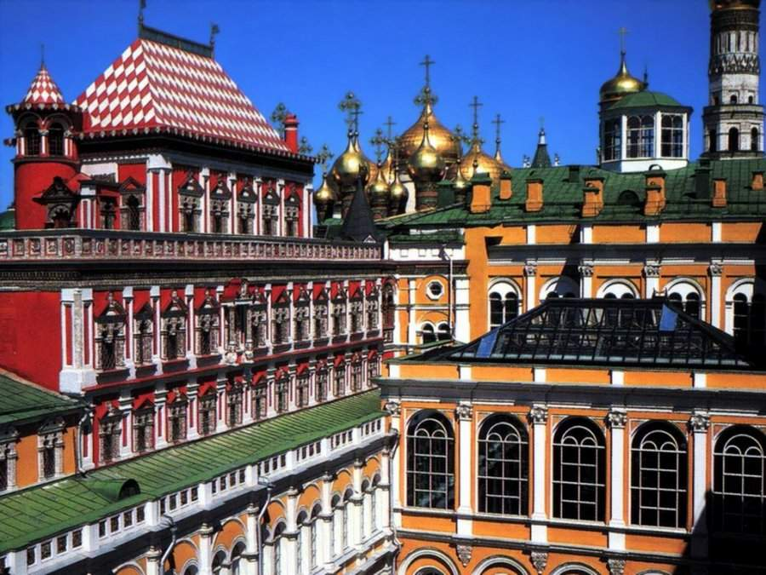
Terems Place. Moscow

Slide 30
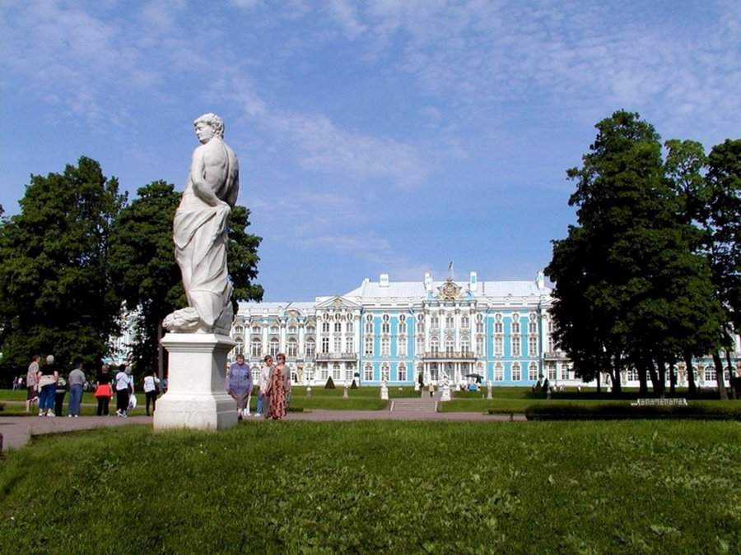
Park of the Palace of Catherine the Great. St. Petersburg

Slide 31
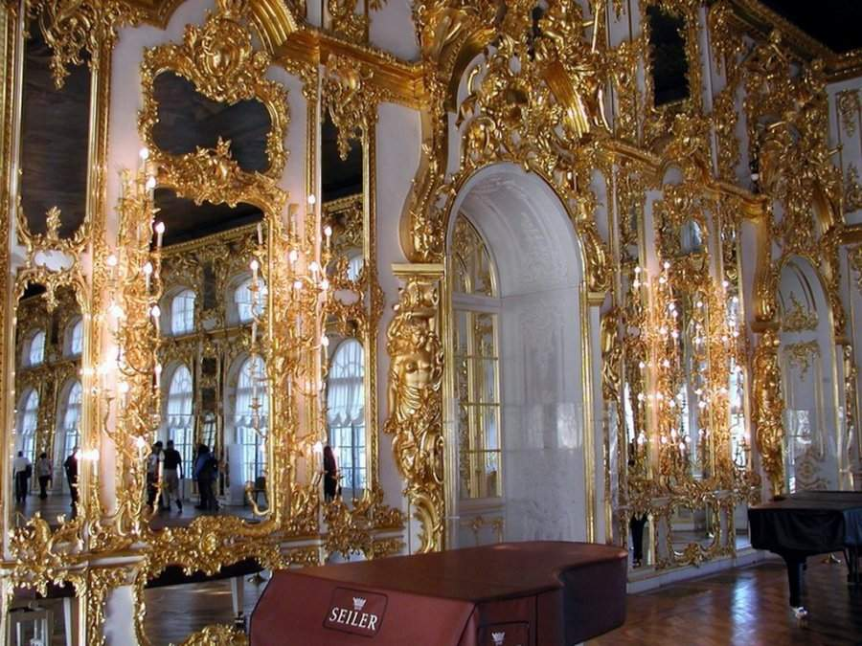
Hall of the Palace of Catherine the Great. St. Petersburg

Slide 32
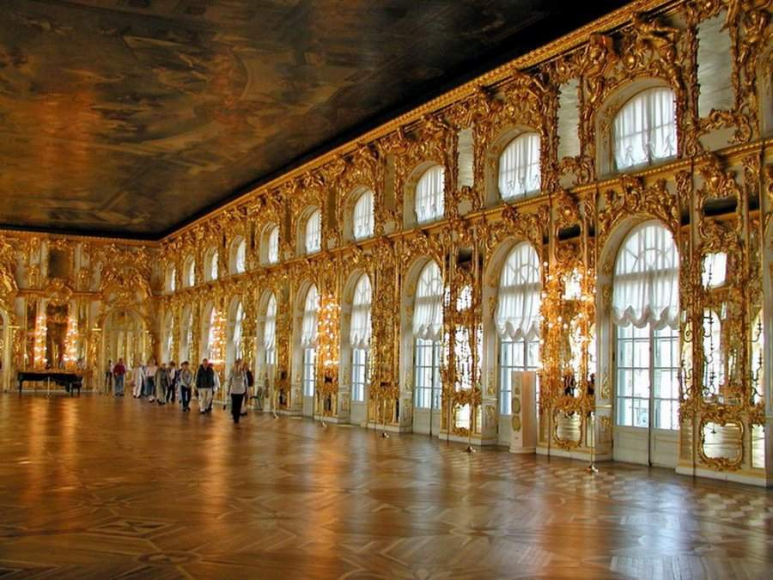
Hall of the Palace of Catherine the Great. St. Petersburg

Slide 33
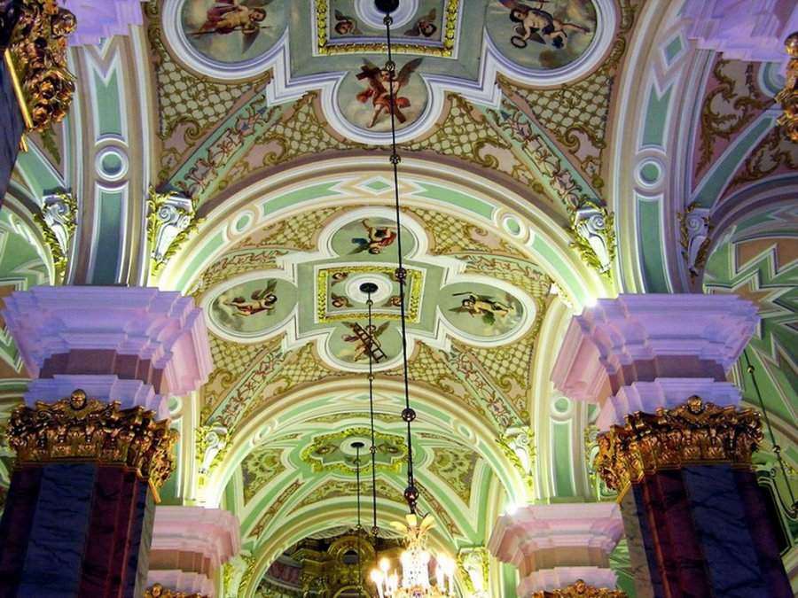
Ceiling of the Basílica

Slide 34
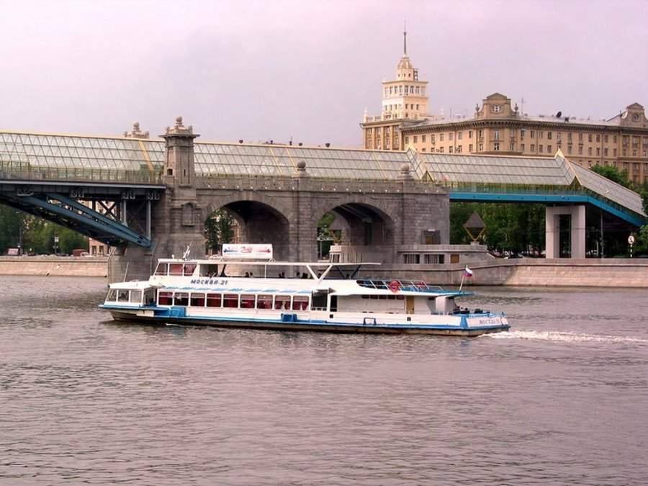
The Moskow river

Slide 35
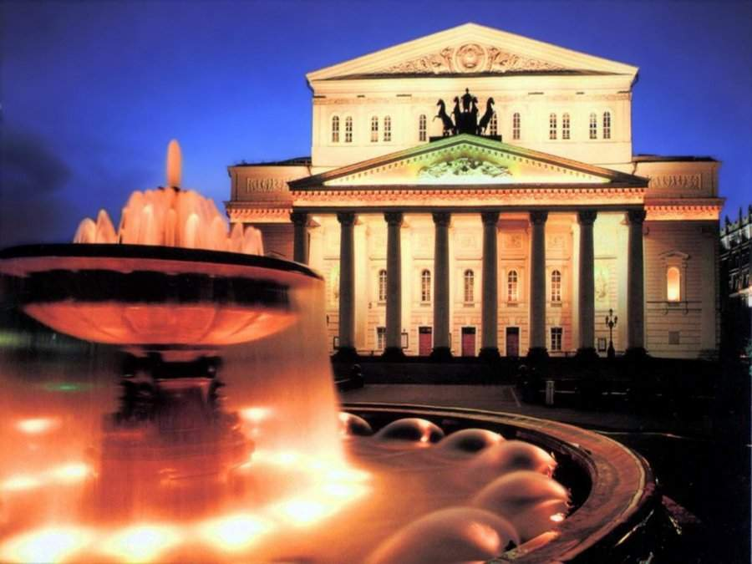
Bolshoi Theater. Moscow

Slide 36
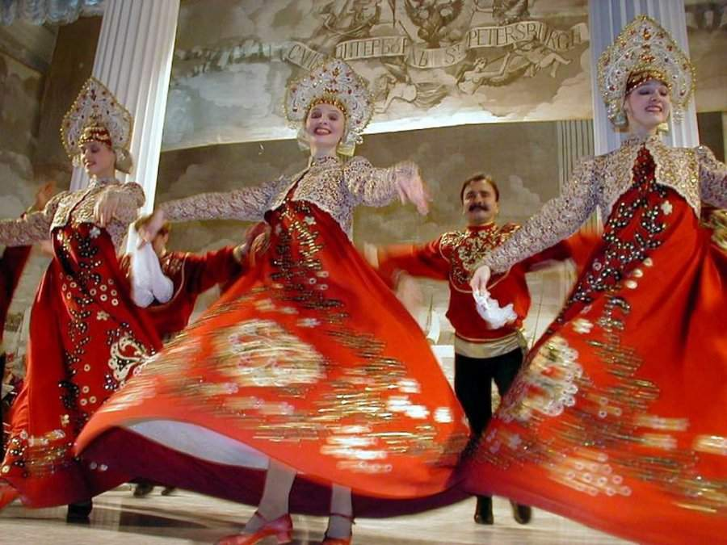
Russian Folklore

Slide 37
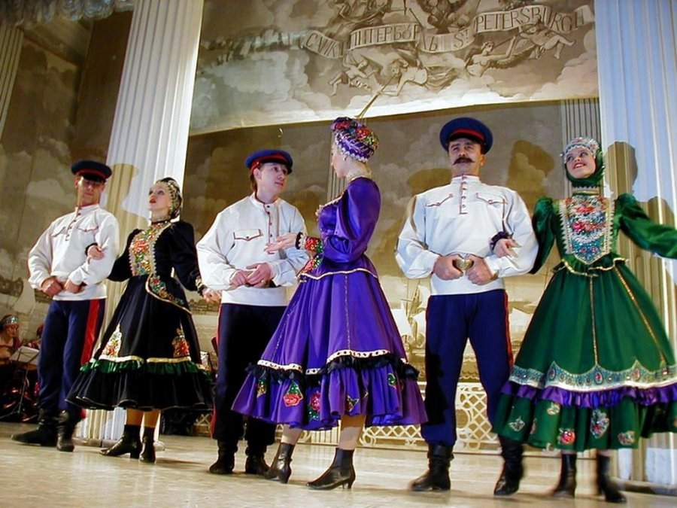
Russian Folklore

Slide 38
Hoy jueves, 26 de marzo de 2015,
Time 10:05:00 p.m.,
Have a beautiful day!

