Slide 1
Louisiana’s Congressional Delegation
Current as of:
2/4/2015
Created by:
Wade Price
Meisler Middle School
Metairie, LA

Slide 2
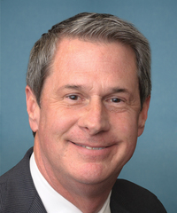
Senators
Each state elects two senators for staggered 6-year terms. Senators represent the entire state.
Senior Senator
David Vitter
Took Office: Jan 4, 2005
Next Election: 2016
Party: Republican
Junior Senator
Bill Cassidy
Took Office: Jan 6, 2015
Next Election: 2020
Party: Republican

Slide 3
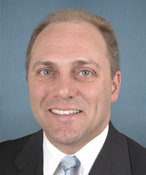
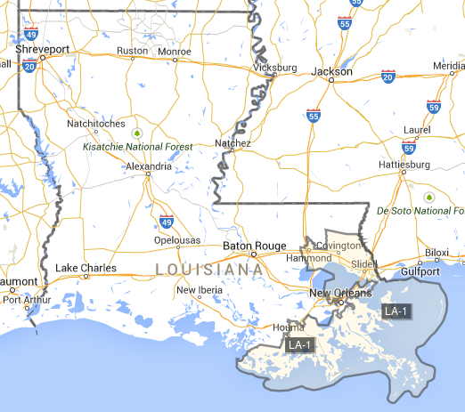
Representatives
The United States is divided into 435 congressional districts — 6 in Louisiana — each with a population of about 710,000 individuals. Each district elects a representative to the House for a two-year term. Representatives are also called congressmen/congresswomen.
1st District
Steve Scalise
Took Office: May 7, 2008
Party: Republican
Leadership Position:
Majority Whip

Slide 4
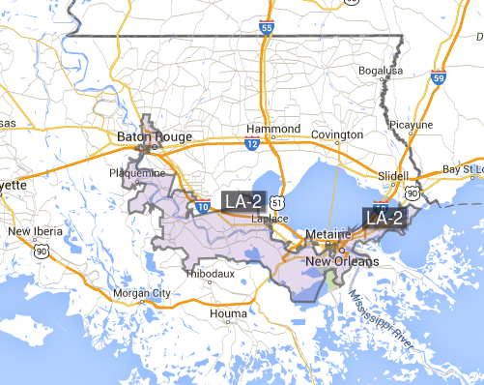
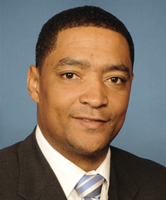
2nd District
Cedric Richmond
Took Office: Jan 5, 2011
Party: Democrat
This is a great example of a gerrymandered, or packed, district. See it? Also,
look at how small the land area is here. What’s that suggest about population? Speculate about why this district is drawn as shown.

Slide 5
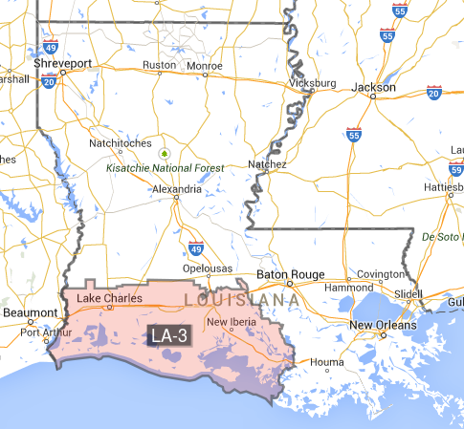
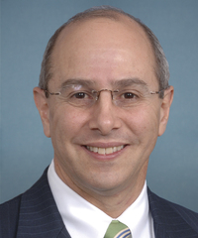
3rd District
Charles Boustany Jr.
Took Office: Jan 3, 2013
Party: Republican

Slide 6
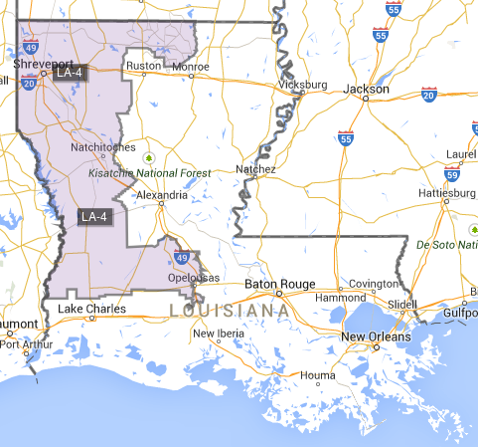
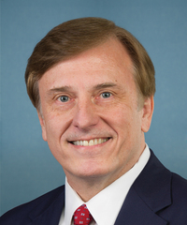
4th District
John Fleming
Took Office: Jan 6, 2009
Party: Republican
This district covers A LOT of land area from N to S. What does this suggest?

Slide 7
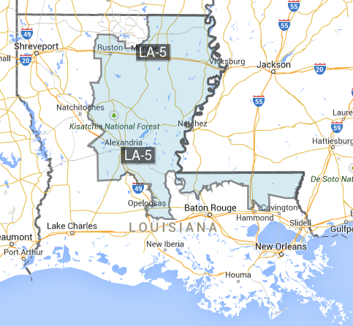
5th District
Ralph Abraham
Took Office: Jan 6, 2015
Party: Republican
We talked about the importance of Congressmen to get to work quickly, as they only have two years. In his first 28 days in office, Rep. Abraham has:
3 sponsored bills!!!
Not wasting time!
Based on what you’ve learned from previous slides, what two conclusions can you reach about this district, when you consider size and shape?
Each bill has about a 2% chance of enactment, but he’s working!

Slide 8
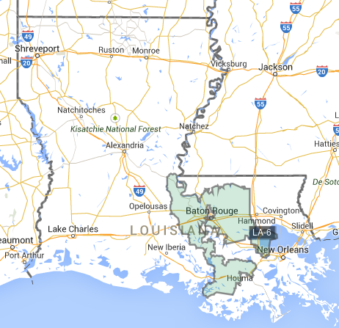
6th District
Garret Graves
Took Office: Jan 6, 2015
Party: Republican
What are two conclusions we can make about this district, when we consider shape and size?

