Slide 1
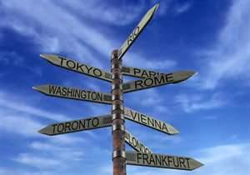
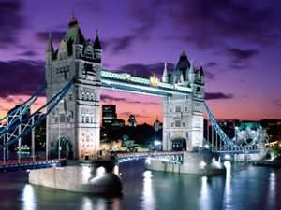
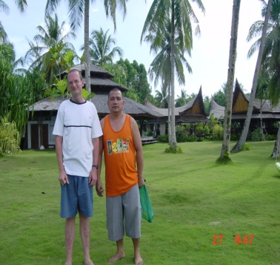
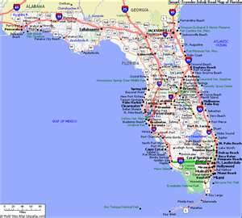

Because I am a global explorer its very convenient to give information which I believe will be beneficial and fact finding to everyone concerned especially my students.
I have already prepared a travelogue about:
1)The history and culture of London and the UK.
2) Florida, America in November 2008.

Slide 2
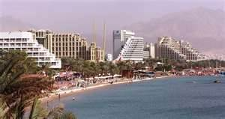
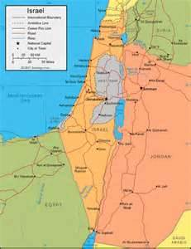
3) Geographical, cultural and military status of Israel and the people because I lived there for a great number of years
4)Now it’s time to focus on a groups of islands near China known as The Philippines.

Slide 3
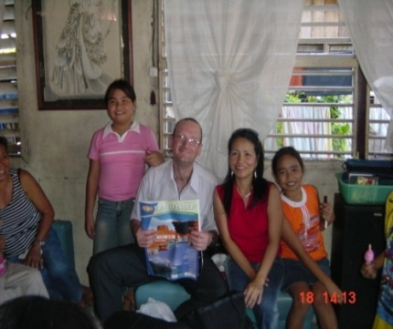
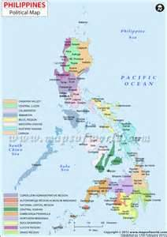
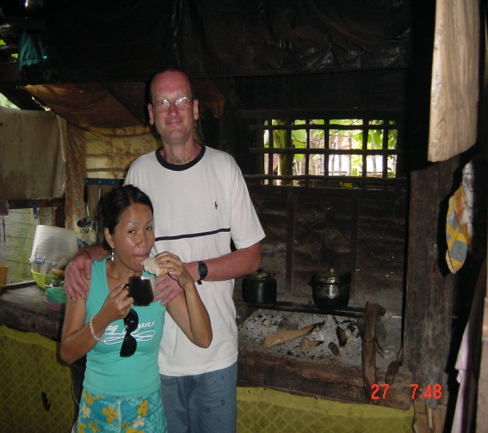
I was lucky enough to travel to this part of the world on no less than 3 occasions.
1) Spring 2007.
2) Spring 2008.
3) Winter 2012.
The first two occasions I met up with some experienced Filipino tour guides plus their families while the last time was with my Chinese girlfriend.

Slide 4
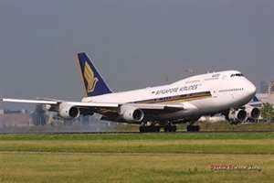
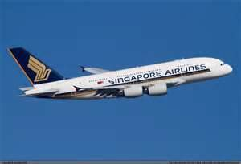
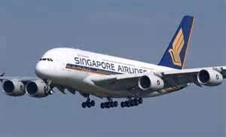
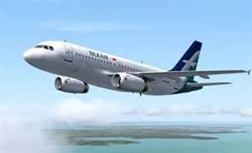
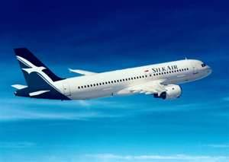
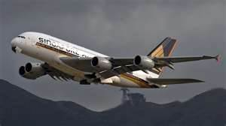
In 2007 and 2008 I travelled alone from London with Singapore airlines and Silkair to a place called Davao city达沃市

Slide 5
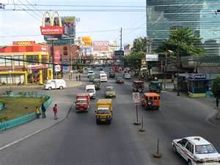
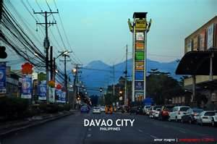
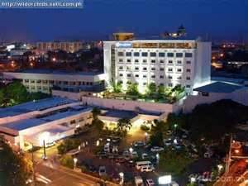
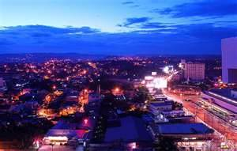
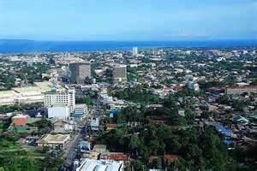
Davao city is a large place in the southern part of The Philippines

Slide 6
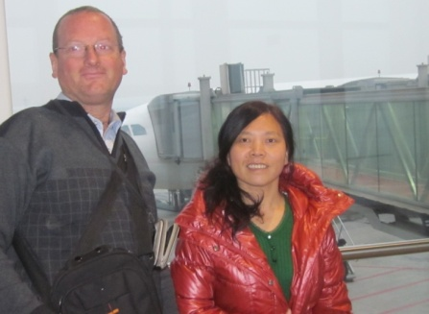
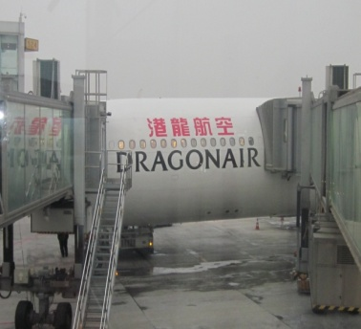
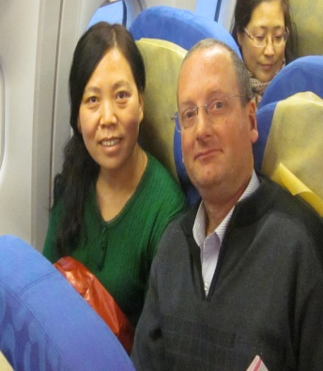
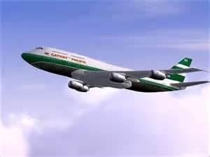
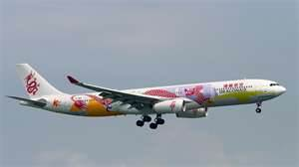
In 2012 I flew with Yvonne with two airline companies known as Dragon air
and Cathay Pacific国泰 to a place called Manila

Slide 7
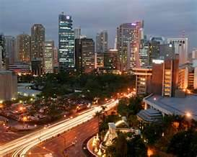
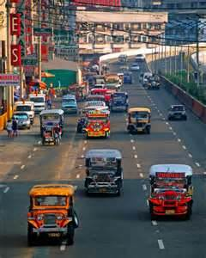
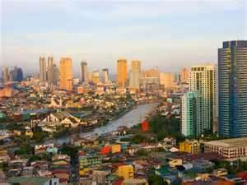
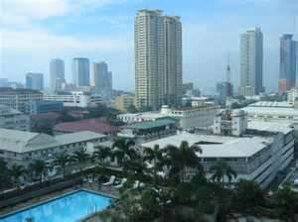
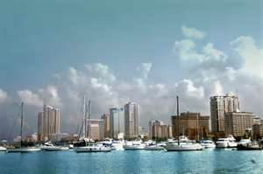
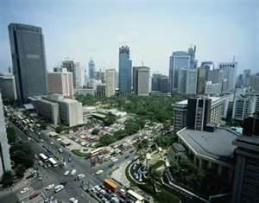
Manila is the largest city in the northern part of The Philippines.

Slide 8
Question one
Where are The Philippines located?

Slide 9
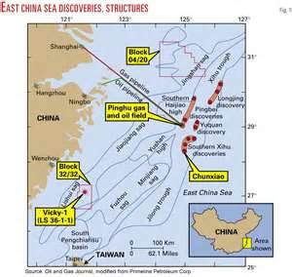
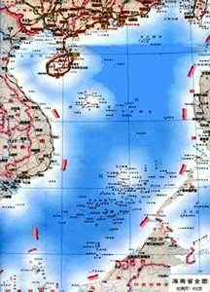
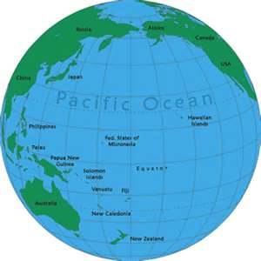
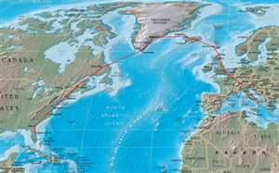
East china sea
South china sea
Pacific ocean
Atlantic ocean

Slide 10
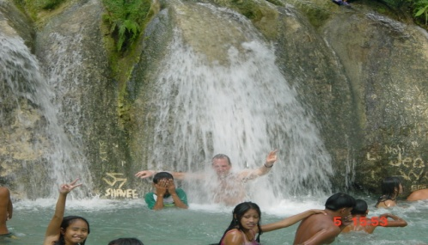
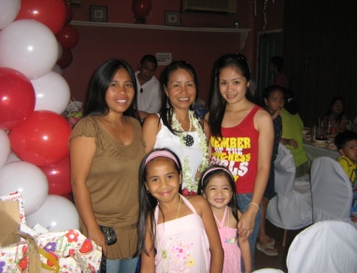
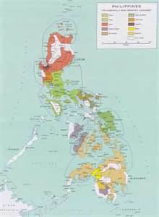
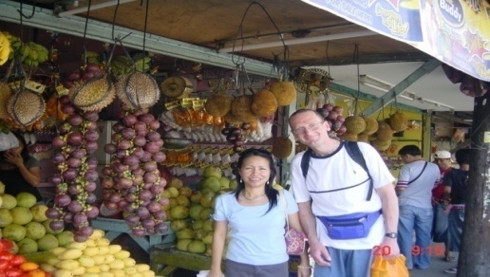
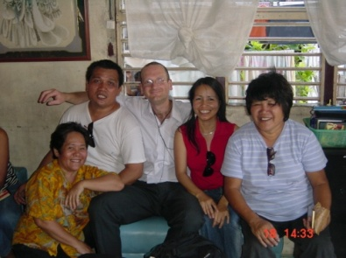
Another reason why I have decided to focus on The Philippines because it’s one of the more intriguing places in the world.
There is a vast variety of tropical food together with culture, climate, people, history, language and of course geographical location.

Slide 11
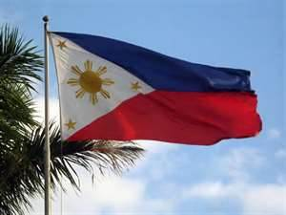
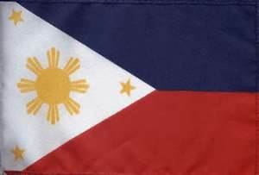
This is the national flag

Slide 12
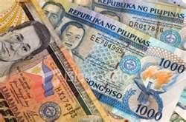
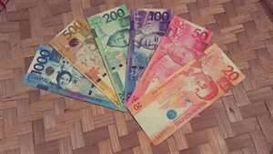
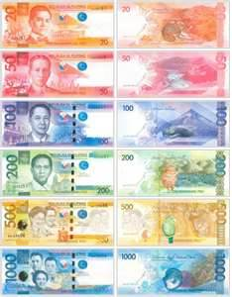
The national currency currently in use is the peso 比索

Slide 13
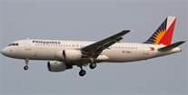
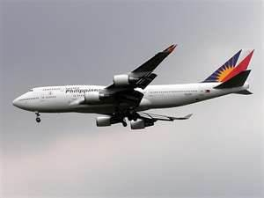
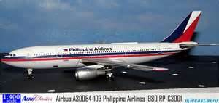
The national airline is called
The Royal Philippines airlines

Slide 14
Question two:
How many islands are there in total?

Slide 15
7107

Slide 16
What is the current population?

Slide 17
About Ninety two million
92,000,000

Slide 18
Did you know:
That it rains nearly every day in this part of the world but can you tell me the main reason why?

Slide 19
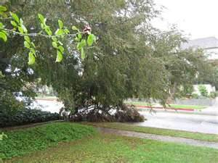
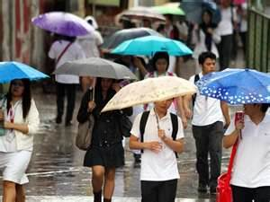

Because it’s tropical and humid 潮湿的.
Its near to the equator.
The rain is always warm.

Slide 20



Information:
Did you know that the 3 largest islands are called:
1) Mindanao棉兰老岛
2) Luzon 吕宋
3) Visayas 米沙鄢群岛

Slide 21




The 3 or 4 largest cities for population and geographical location are:
Davao city达沃市
Manila
Quezon city奎松市
Cebu 宿务

Slide 22




Another popular place to visit is Boracay 长滩岛 but I have never been there.

Slide 23
Of course there are many other tropical islands in this part of the world some of which i will mention a little later in the lesson but first a question?
What types of tropical fruits are available?

Slide 24

What types of tropical fruits are available.

Slide 25






菠萝蜜Jackfruit

Slide 26









Dorian多利安人
Bananas
Mangoes
Coconuts
Papaya
Large green coconut

Slide 27




Ramputan
Watermelon
Guava番石榴
Pineapple

Slide 28
How many languages are spoken there?

Slide 29
There are 120 to 170 dialects方言 or small languages but the two main official ones spoken are
Tagalog 他加禄语
Filipino

Slide 30




In 2007 I travelled to a place called Davao city which is the largest urban or cosmopolitan 世界主义者 place on Mindanao island.
Its actually located on the south coast.

Slide 31
When I arrived my tour guide met me at the airport with their family. Then we spent a few days visiting just some of the many places of interest in this area
The next exercise:
Give me a list of things we did or places of interest we went to.

Slide 32





1) We ate tropical fruits and vegetables.
2) We went to a national park called ‘Eden’ which was located about 1000 meters above sea level.
3) We went to a underground cave where I learned all about gold which was buried there quite long time ago.
4) We saw people climbing up palm trees to bring down coconuts.
5) There was a nature resort for eagles and other birds of prey plus crocodiles.

Slide 33




I also learned that the Japanese had invaded The Philippines as many as 500 years ago this probably explains why the Tagalog language sounds a little bit like Japanese.

Slide 34
Useful information:
Did you know that if you are over the age of 30/35 in the Philippines there is something known as
Age discrimination年龄歧视.
What does this mean?

Slide 35
You are too old for certain types of job even badly paid ones.

Slide 36
Another interesting fact
Did you know that the percentage of failed marriages in this part of the world is getting larger. Am not sure of the exact number during the last 10 years but if a married couple wishes to separate they need to pay a lawyer about 5000 dollars ($5000) for a mutual 共同的 agreement.
This is also known as an:
“Annulment” 宣告婚姻无效

Slide 37
Interesting Information:
Did you know that The Philippines is rapidly developing into an industrialized nation which means there are normally no power cuts unless there are strong storms.
Did you know that they are located near The equators.
What are they called?

Slide 38


The tropic of Cancer 北回归线
Tropic of Capricorn南回归线

Slide 39



Did you know that:
‘The Philippines’ suffer from about 20 major storms every year.
These storms are known as typhoons 台风 which normally cause a lot of damage to building, trees and agriculture and the power supply.

Slide 40
From Davao city we took a long bus journey inland of more than 600 km to the very north of the island to a small sea port called
Surigao city 苏里高城

Slide 41





during the journey I noticed that the whole area was one of the most beautiful I had ever seen. It was so green with palm trees, green grass, lakes and sunsets etc.

Slide 42







From Surigao city we took a 3 hour boat ride to a tropical island called Surigao del Norde.
It was just one of a number of paradise islands in this area.

Slide 43



Just as the boat arrived I saw something which really amazed me.
There were many small children who lived, slept and ate in small boats. They were aged from between 7 and 14 and totally illiterate 文盲的 (not able to read and write). I am not sure if they were classified as orphans or simply had decided to abandon their families for morale or economic reasons.

Slide 44
They made a living by begging travellers to throw them money into the water.
Every time a coin was thrown in they would dive into the water and pick it up before it sank to the bottom.
These children were also excellent swimmers because this was all they could do in life but they were always hungry.

Slide 45



Did you know that ‘Surigao Del Norde’ was one of the most amazing places I had been to in my life.
It was nothing less than travelling through a emotional and physical tropical paradise 热带天堂 for nearly 4 days.

Slide 46

Fortunately we didn’t have to pay for a guest house because one of the tour guides knew someone who had been living here for nearly 10 years.
Once we had settled in his home can you guess what we did?

Slide 48
1) We swam in the pacific ocean and did some sunbathing on the beach.
2) We went for some motorbike rides to see the island.
3) We saw some waterfalls and swam in some fresh pools of water.
4) We went for some boat rides to see and swim in the lagoons 泻湖.
5) We visited some exotic 奇异的 holiday villages.
7) We travelled through fields of wheat and rice

Slide 49

9) We got sun burnt.
10) We ate the cheapest and best quality fish, salads and fruits which were available.
12) We went to a place called Cloud 9 where people go surfing 冲浪运动 normally in the month of September every year.

Slide 50




13) We saw lovely sunrises and sunsets
14) We saw Mangroves 红树林
(special trees) growing in salt water.
15) We ate the best, cheapest and sweetest bread which was baked at a local bakery every morning.

Slide 51







Slide 52







Slide 53








Slide 54




From the Surigao del Norde we travelled back to the mainland and took another boat to an island called Cebu宿务.
When we arrived there were even more children on boats that were begging for food and money.

Slide 55
What is so special about this island?

Slide 56






There was a famous Portuguese warrior or explorer called Ferdinand Magellan 麦哲伦who came
here in the 16th century.

Slide 57









Slide 58



We visited some famous places which were dedicated专注的 to this explorer.
We also had a lovely fish dinner at one of the many restaurants.
The food was so good it was like a banquet 宴会.
Did you know that there was a famous battled in this area in 1521 when Ferdinand Magellan was killed it was called the
‘Battle of Mactan’

Slide 59



We also met some friends but we didn’t stay over night.
In the evening it was time to take yet another boat trip to an island called Bohol 保和岛.
This is located in the central part of The Philippines. We stayed for just two nights in someone’s home for free instead of paying for a hotel.

Slide 60
Bohol was very similar to Surigao Del Norde:
Very tropical many hills and valleys
So can you guess:
1) What we did?
2) What we ate?
3) What we saw?
4) What we learnt?

Slide 61






1) Visited some paradise beaches with white sands.
2) Holiday centers.
3) We went Swimming (but it was also possible to go deep sea diving and snorkeling浮潜
4) We saw the ‘Chocolate hills’.
5) There was Tropical fish and coral 珊瑚

Slide 62


6) We visited some beautiful waterfalls and swam in the pools.
7) we saw people go fishing.
8) We saw a small animal called ‘Tarsier’眼镜猴. This is known as the smallest monkey in the world.
5) It was possible to go on a ‘Loboc’ boat trip where they also provided a meal.
11) We visited an underground cave with a spring inside. (‘spring泉’ is a source of water or reservoir水库)

Slide 63



12) We went to ‘Disney land
迪斯尼乐园
13) We ate fresh fish, fruit and vegetables.
14) It was possible to see dolphins.
15)We saw some lovely sunsets and sunrises
16) We visited a cave full of Stalactites 石钟乳 and stalagmites 石笋.
17) We visited a ‘Man made forest’
18) We visited a statue called The blood brothers pact 亲兄弟协议.

Slide 64




19) We visited towns, villages and did some shopping.
The main town on the island was called Tagbilaran 塔比拉兰City.

Slide 65







Slide 66









Slide 67










Slide 68






From Bohol we travelled with another boat to a sea port called
Cagayan del Oro 德尔奥罗的 which was on the mainland (Mindanao)

Slide 69







From the sea port we took a bus and boat to yet another tropical island called ‘Carmiguan’. This time we stayed for just two nights in a guest house which we had to pay but it was rather cheap.

Slide 70



Can you guess some of what we did or saw?

Slide 71


There were beaches.
We saw a lot of fishing.
We were able swim in hot and cold water springs
We saw at least one waterfall.
There were some inactive 不活动的 volcanoes
There was a light house 光房子

Slide 72



We visited a cemetery墓地 which was completely under water.
We travelled in a jeep吉普车 through the jungle and had picnics.

Slide 73






Slide 74







Slide 75







Then we travelled back to the mainland and visited a place known as
Illigan 城市 city.

Slide 76
Can you guess what was so special about this place?

Slide 77
There were two magnificent waterfalls?

Slide 78







One of them was called the
Maria Christina 玛丽亚·克里斯蒂娜waterfalls.
This is the highest waterfalls in The Philippines and provides the power for the whole of the island with a hydroelectric 水力发电的 power plant.

Slide 79









The other was called Tinago
As you can see this was one of the most wonderful waterfalls
I have seen in my life

Slide 80


Slide 81
From Illigan city we took the night bus all the way back to Davao city where we spent the remainder of our holiday.
Can you guess what we did?

Slide 82



We travelled by ferry to yet another island called Samal 萨马尔 island which is also tropical.
We went with all the family and had a picnic.

Slide 83






We began by visiting a large cave which was swarming with bats 蝙蝠.

Slide 84







Then we went to a lovely waterfall where it possible to go swimming, diving and had a nice picnic.

Slide 85
I would sum up this holiday as being nothing less.
1) One is a million:
2) Living, and physical paradise
3) Dream holiday which had come true or materialized 物化.
3) A fairy tale story which one had to see to actually believe it happened.
4) It taught me a great deal about this part of the world and the quality of life that could be found.

Slide 86
5) I accomplished a great deal in such a short period of time and what was even more incredible it had been done a cost of next to nothing with excellent tour guides.

Slide 87



Did you know that I was also able to learn about 100 to 150 words in Tagalog which as you know is the national language.
I am well aware that there was a great deal more to learn but you can imagine that one of the hardest things I had to do was fly back to the UK.
Just before I did that I was able to have one more celebration.
My 43rd birthday party.

